Slide 1
MAPLE-HCM
Abhishek Kumar, MD
PGY-5 FAU Cardiology

Slide 2
Disclosures
Neither the planners nor the speakers disclosed relevant financial relationships with ineligible companies.

Slide 3
Background
Hypertrophic cardiomyopathy (HCM) is the most common inherited heart disease worldwide and is associated with considerable disease-related morbidity.
Cohen and Braunwald first observed that beta-adrenergic receptor blockade could reduce left ventricular outflow tract (LVOT) obstruction and has been the cornerstone of therapy over the last 60 years.
Data for beta blockers is largely based on expert opinion.
Notes:
only a few small, single-center, placebo-controlled studies supporting guideline recommendations.

Slide 4
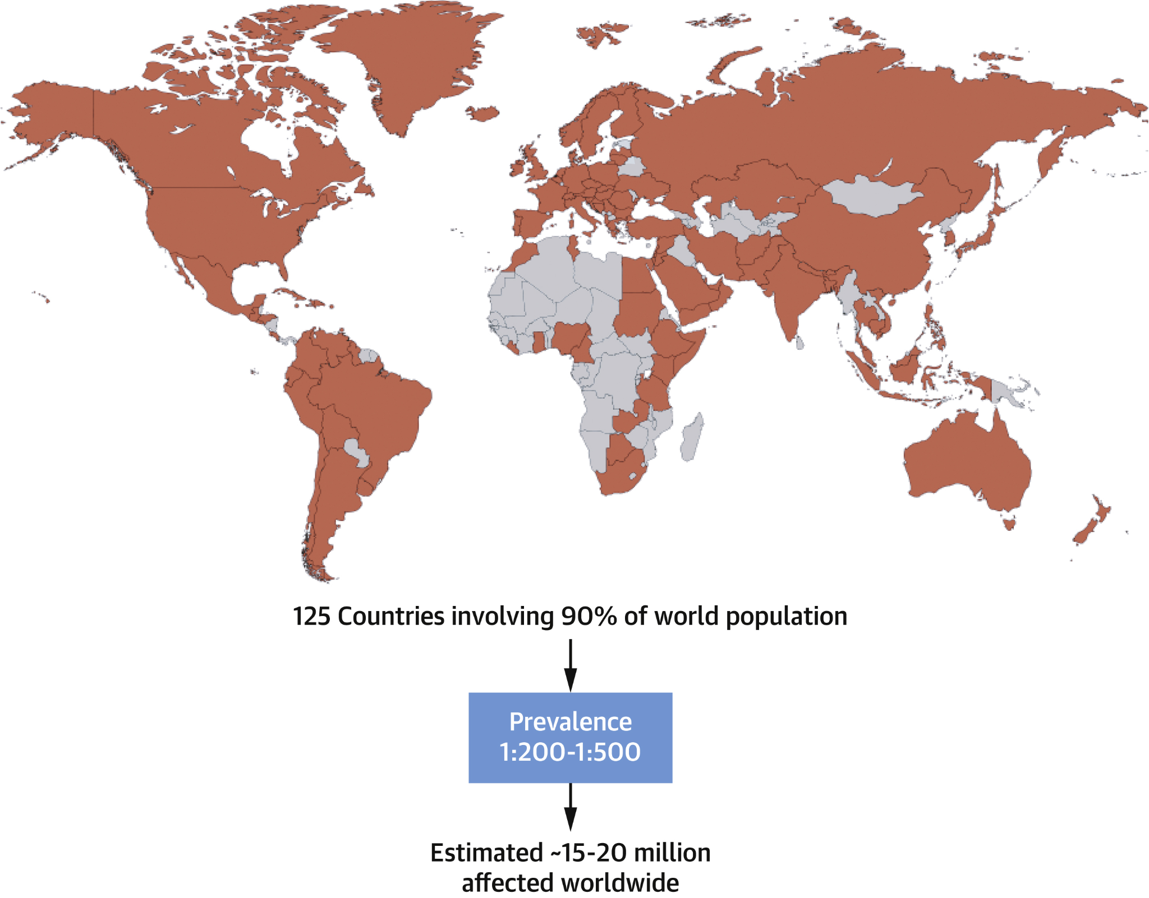

Slide 5
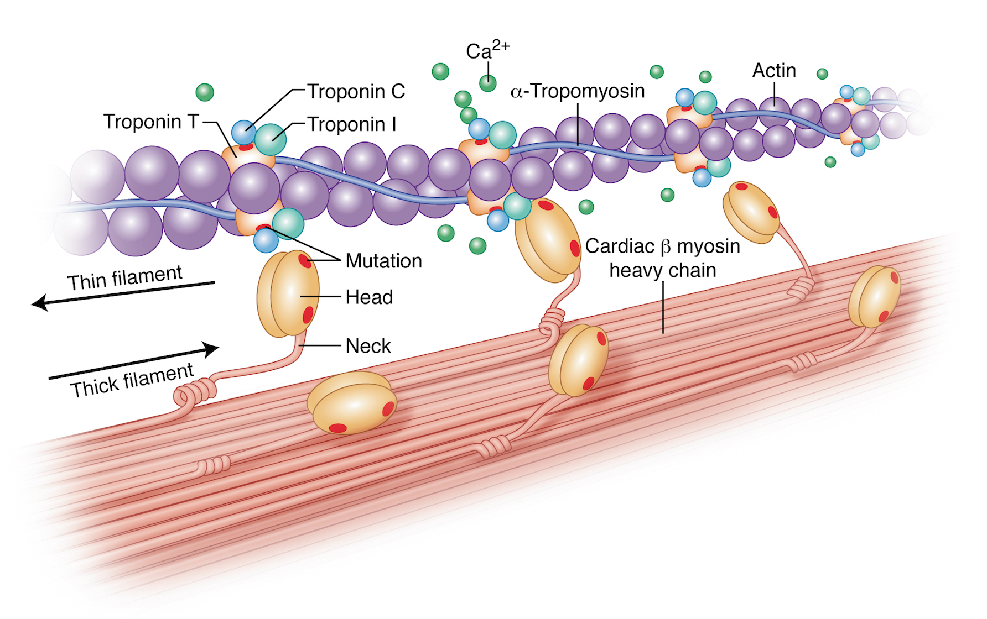
Pathophysiology
Notes:
Mutations in sarcomeric proteins (e.g., β-myosin heavy chain, myosin-binding protein C) lead to abnormal contractile function
These mutations cause hypercontractility and inefficient energy use, increasing mechanical stress
The result is myocyte hypertrophy, disarray, and fibrosis, contributing to diastolic dysfunction and arrhythmogenic risk

Slide 6
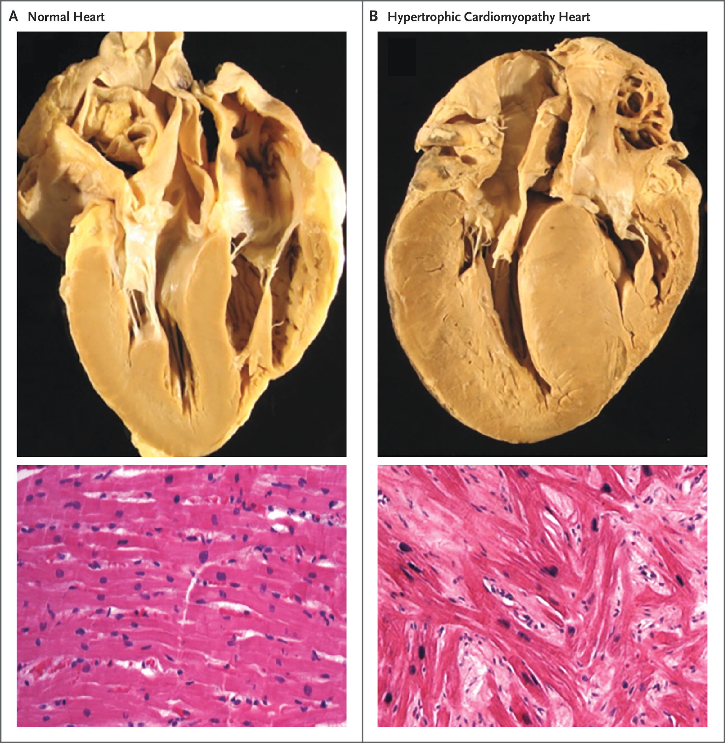

Slide 7


Slide 8
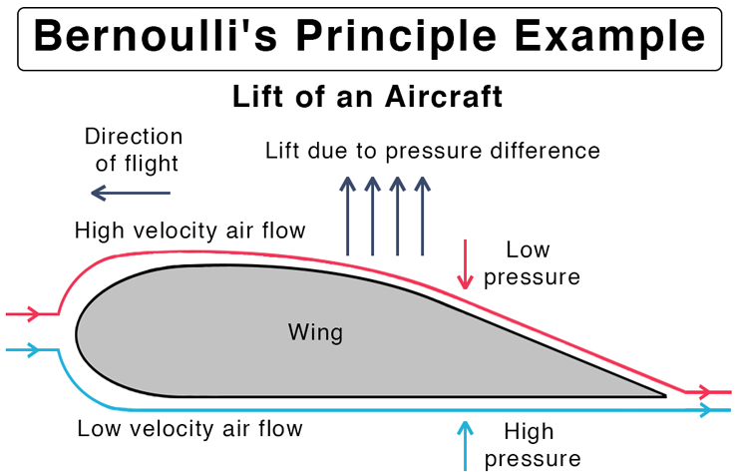

Slide 9
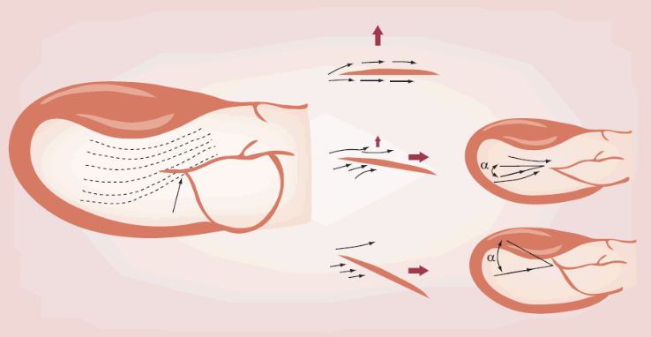
Notes:
Initially, SAM was thought to be because of a Venturi effect from the septal hypertrophy sucking the mitral valve leaflets into the left ventricular outflow tract. It is now recognized that hypercontractile ejection occurs against an abnormally positioned and elongated mitral valve apparatus, which results in a drag force on a portion of the mitral valve leaflets and pushes the leaflets into the outflow tract, thereby causing obstruction

Slide 10
Mavacamtem
Binds to cardiac myosin heads and stabilizes them in a super-relaxed state, reducing the number of myosin heads available to interact with actin
Reduces excessive actin-myosin cross-bridge formation, thereby decreasing hypercontractility which improves myocardial relaxation and reduced left ventricular outflow tract obstruction.

Slide 11


Slide 12
EXPLORER-HCM (2020)
Phase 3, randomized, double-blind, placebo-controlled trial in 68 clinical cardiovascular centers in 13 countries, patients with hypertrophic cardiomyopathy with an LVOT gradient of 50 mm Hg or greater and New York Heart Association (NYHA) class II-III symptoms were assigned (1:1) to receive mavacamten (starting at 5 mg) or placebo for 30 weeks.

Slide 13
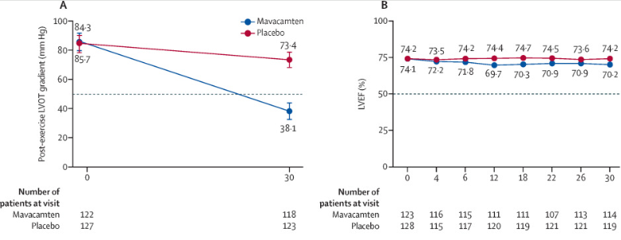

Slide 14
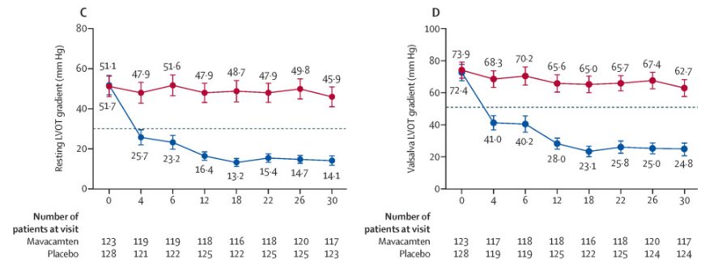

Slide 15
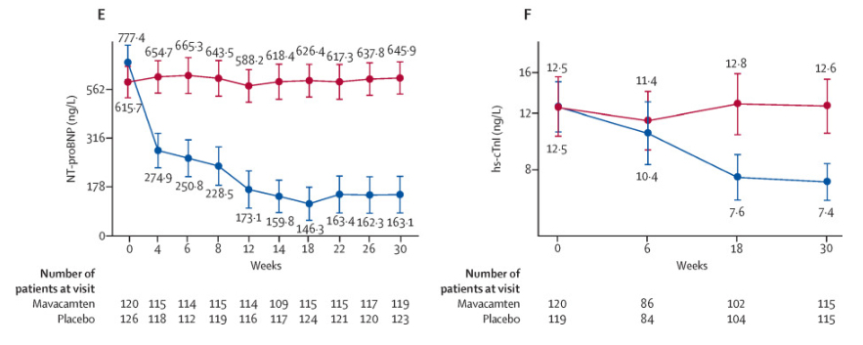

Slide 16
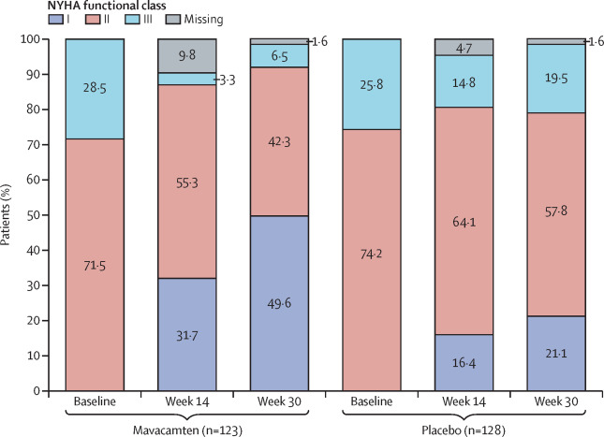

Slide 17
EXPLORER-HCM Findings
Patients on mavacamten had greater reductions than those on placebo in post-exercise LVOT gradient (−36 mm Hg, 95% CI −43·2 to −28·1; p<0·0001), greater increase in pVO2 (+1·4 mL/kg per min, 0·6 to 2·1; p=0·0006), and improved symptom scores (KCCQ-CSS +9·1, 5·5 to 12·7; HCMSQ-SoB −1·8, −2·4 to −1·2; p<0·0001). 34% more patients in the mavacamten group improved by at least one NYHA class (80 of 123 patients in the mavacamten group vs 40 of 128 patients in the placebo group; 95% CI 22·2 to 45·4; p<0·0001).

Slide 18
VALOR-HCM (2023)
EXPLORER-HCM was great at demonstrating short-term efficacy with mavecampten use, but what about long-term efficacy?
VALOR-HCM was designed to examine the cumulative longer-term effect of mavacamten specifically on the need for septal reduction therapy (SRT) through week 56

Slide 19
VALOR-HCM Design
Double-blind, placebo-controlled, multicenter, randomized clinical trial with placebo crossover at 16 weeks, conducted from July 2020 to November 2022.
Patients initially assigned to mavacamten at baseline continued the drug for 56 weeks, and patients taking placebo crossed over to mavacamten from week 16 to week 56 (40-week exposure).
Dose titrations were performed using echocardiographic LVOT gradient and LV ejection fraction (LVEF) measurements.
Proportion of patients undergoing SRT, remaining guideline eligible or unevaluable SRT status at week 56.

Slide 20
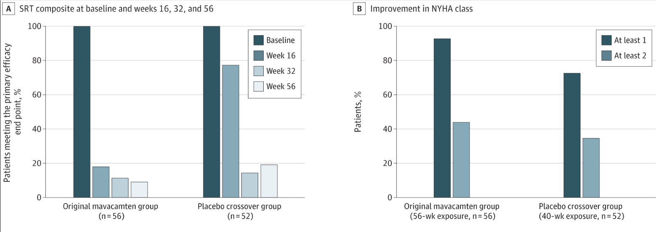

Slide 21
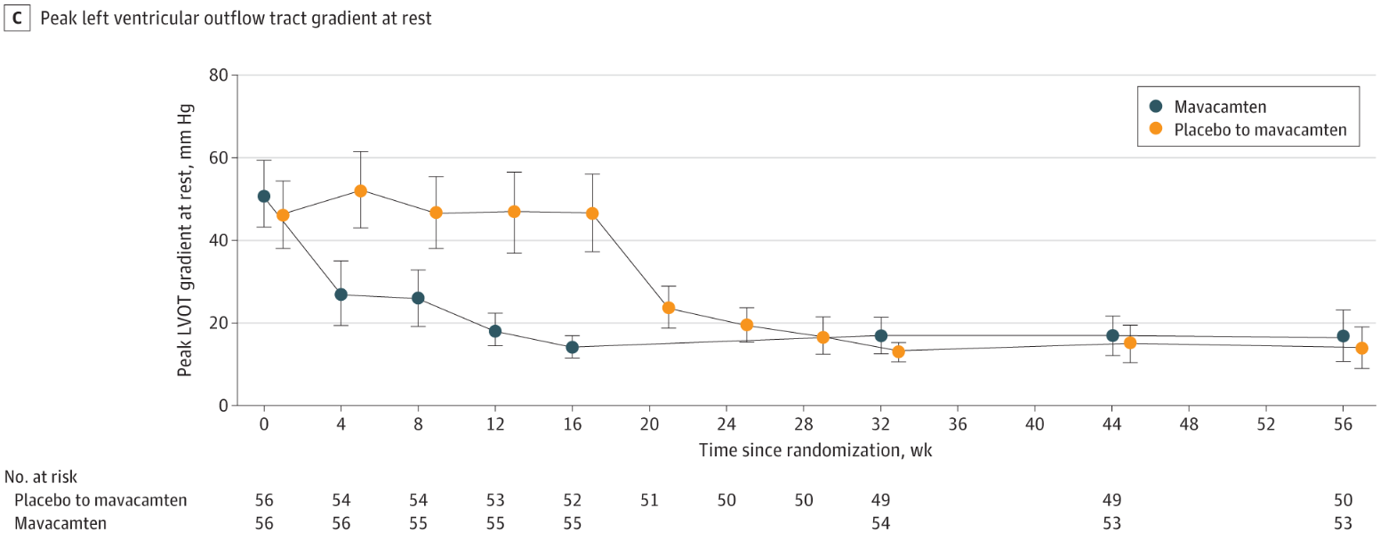

Slide 22
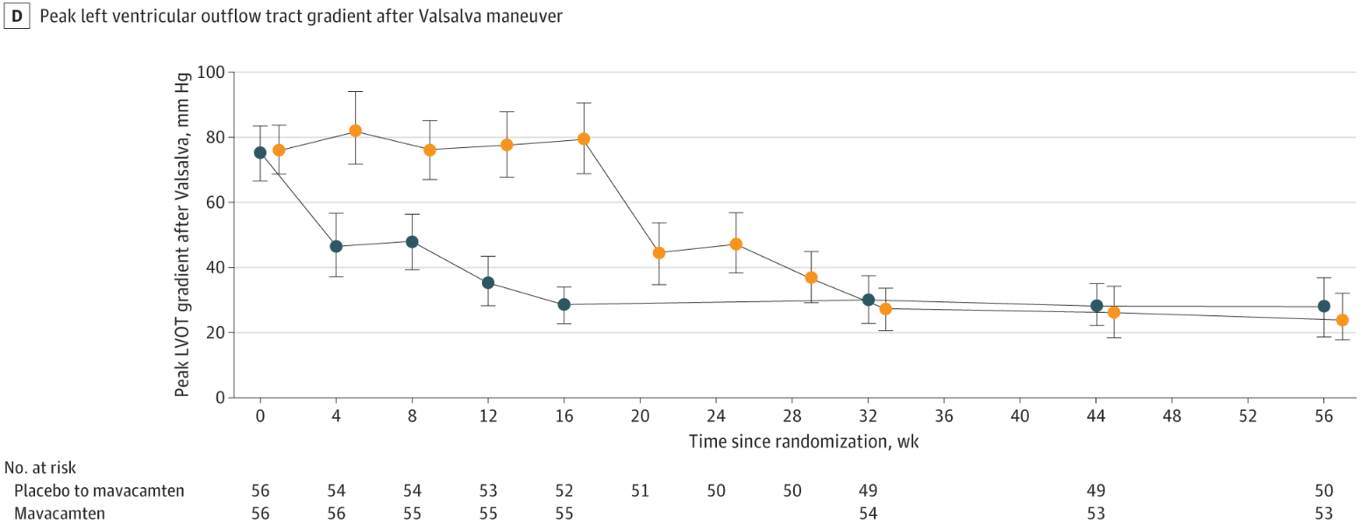

Slide 23
Background
Aficamten is a small molecule allosteric inhibitor of cardiac myosin designed to reduce the hypercontractility that underlies the pathophysiology of HCM in the cardiac sarcomere
The intended effect is reduction in force produced by the cardiac sarcomere resulting in less LVOT obstruction and improved diastolic function in patients with obstructive HCM

Slide 24
Why aficamten?
Mavacamten is already approved by numerous regulatory agencies for the treatment of symptomatic obstructive HCM, but due to its associated reduction in LVEF*, heart failure risk, drug–drug interactions (DDIs), and inconsistent pharmacokinetic to pharmacodynamic relationship, rigorous safety monitoring programs have been recommended or enforced
Aficamten has a shorter half‐life than mavacamten, a more consistent pharmacokinetic/pharmacodynamic profile, and is metabolized through multiple cytochrome P450 enzymes leading to infrequent DDIs
Notes:
*Initial echo (make sure EF > 55%) -> week 4 echo -> week 8 echo -> week 12 echo -> every 12 weeks for the first 6 months -> every 6 months thereafter = 7 echos in the first year alone

Slide 25
Background
Aficamten demonstrated substantial decrease in LVOT obstruction, decrease in symptoms, and improvements in functional capacity, cardiac structure,and cardiac biomarkers when compared with placebo in patients with symptomatic, obstructive HCM
However, whether aficamten administered as a monotherapy is superior to beta-blockers is unknown

Slide 26
Trial Design
Head-to-head, phase 3, international, double-blind, double-dummy, randomized trial in which patients with symptomatic, obstructive HCM received aficamten + placebo (in place of metoprolol) or metoprolol + placebo (in place of aficamten).
281 patients screened from June 20, 2023 to August 9, 2024
170 participants across 60 investigational sites worldwide randomized in a 1:1 ratio to aficamten + placebo or metoprolol + placebo
Participants were randomized within 6 weeks after the start of screening

Slide 27
Trial Design
Group 1 included patients who had recently (≤12 months) received a diagnosis of HCM or had not received standard medications in the past 12 months, regardless of the date of diagnosis
Group 2 included patients with a long-standing (>12 months) HCM diagnosis who had received standard medications within the past 12 months
Enrollment of patients who had previously received mavacamten and those who had undergone septal reduction therapy was capped at approximately 10% each, and enrollment of patients who used a cycle ergometer for exercise testing was capped at approximately 50%.
Notes:
To understand whether current or recent use of standard medications or time since HCM diagnosis influenced the effect of treatment, patients were divided into two groups:

Slide 28
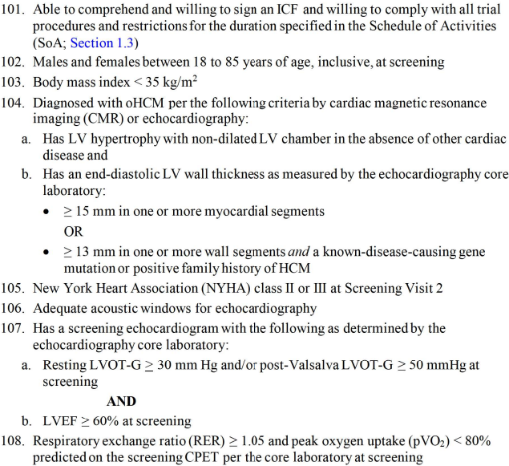
Notes:
Inclusion Criteria

Slide 29
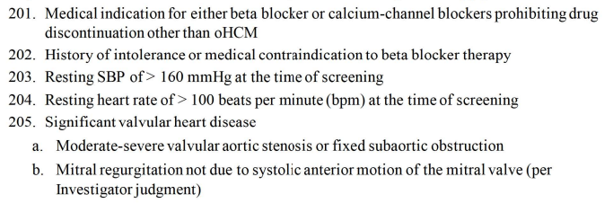
Exclusion Criteria

Slide 30
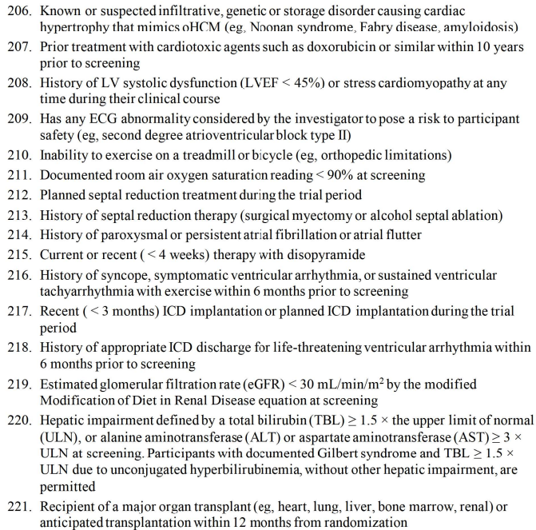

Slide 31
Statistical Analysis
The statistical power for the primary endpoint was calculated under the assumption that the difference between groups in the change in peak oxygen uptake at week 24 would be 2 ml per kilogram of body weight per minute, with a standard deviation of 3 ml per kilogram per minute
With the assumption that 10% of the data would be missing, the authors estimated that a sample size of 170 patients would provide the trial with more than 90% power to detect a difference in peak oxygen uptake at a two-sided type I error level of 0.05.

Slide 32
Statistical Analysis
The primary analysis tested the null hypothesis that there would be no between-group difference in peak oxygen uptake in the full analysis population.
The primary endpoint was analyzed with the use of an analysis of covariance model, with treatment group, randomization stratification factors, baseline peak oxygen uptake, and baseline weight as covariates.
The percentage of patients with an improvement in NYHA class was analyzed with the use of the Cochran–Mantel–Haenszel test, with stratification according to method of cardiopulmonary exercise testing (cycle ergometer or treadmill), time since HCM diagnosis, and previous treatment.
Other secondary endpoints were analyzed with the use of a mixed model for repeated measures.

Slide 33
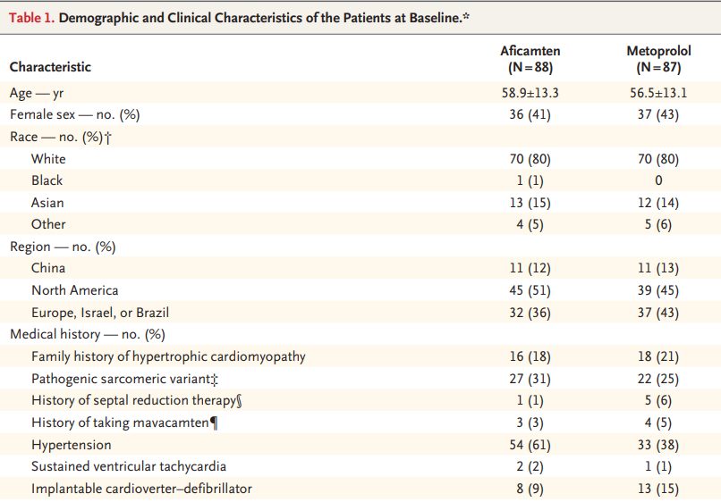

Slide 34

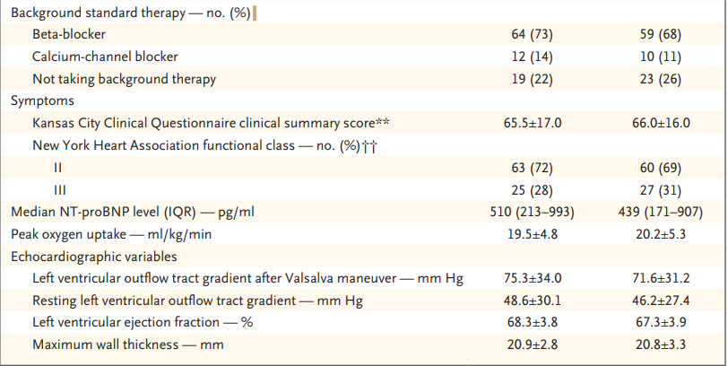

Slide 35
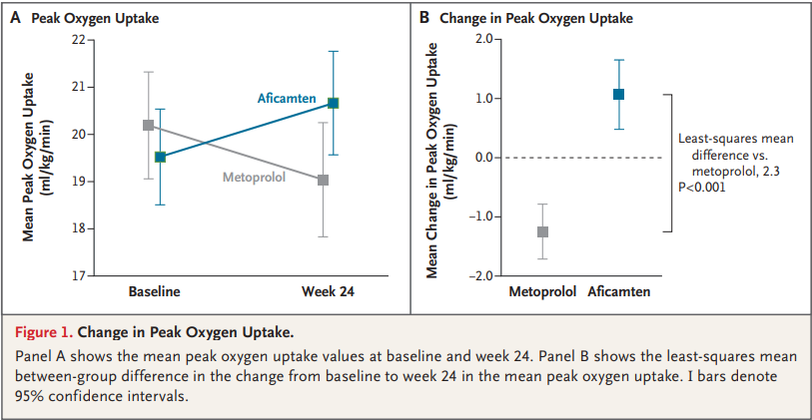

Slide 36
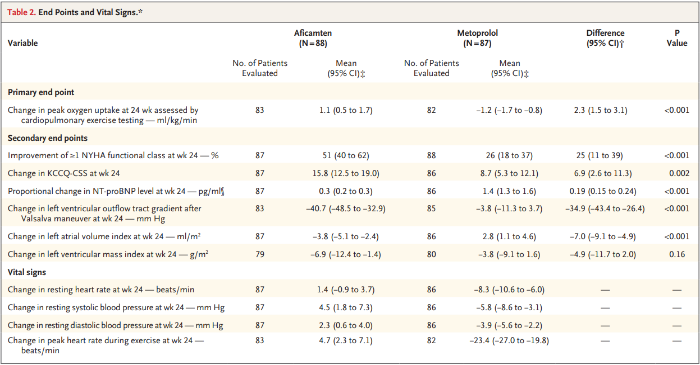

Slide 37
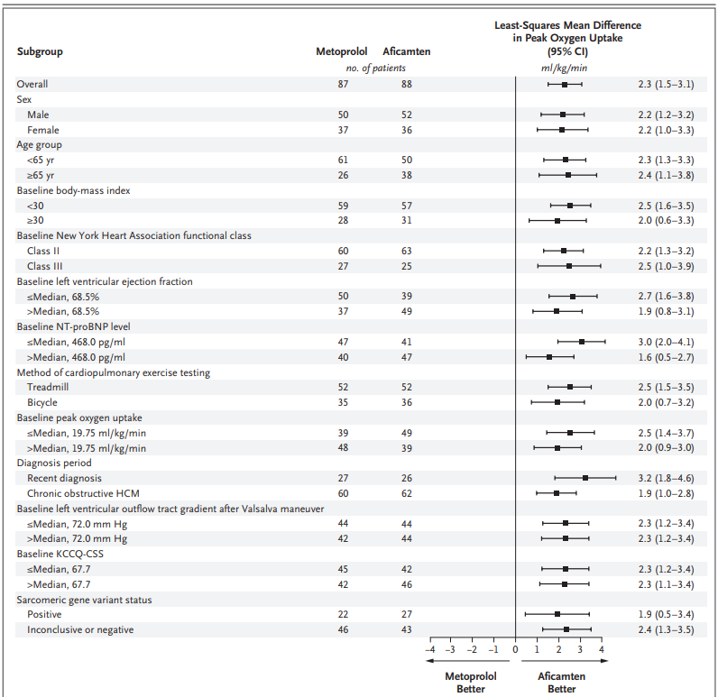

Slide 38
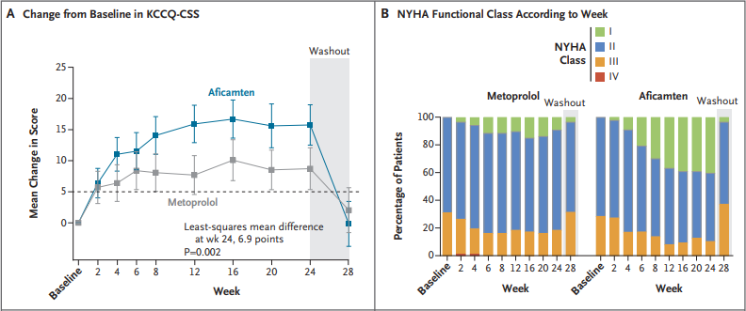

Slide 39
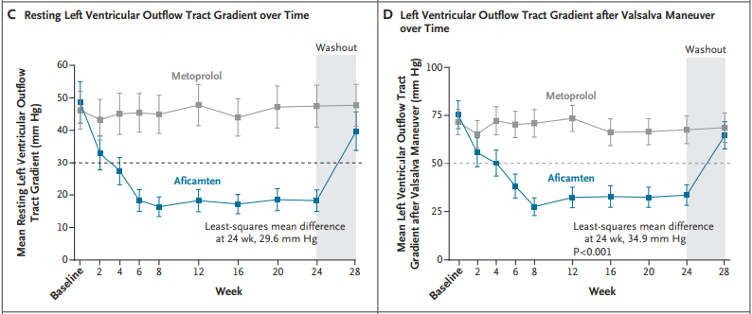

Slide 40
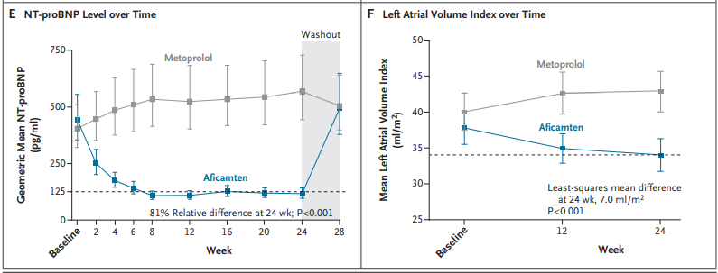

Slide 41
Discussion - Strengths
Aficamten reduced NT-proBNP levels
Effect on exercise capacity was seen across all specified subgroups (newly diagnosed HCM or without treatment, long-standing HCM, and known pathogenic sarcomere variant)
Most patients (63% metoprolol, 76% aficamten) were receiving the highest dose of metoprolol (150-200 mg daily) and aficamten (15-20 mg daily).
Baseline profile of patients enrolled is similar to that encountered in routine practice, including 42% women and 20% non-White participants

Slide 42
Discussion - Observations
Metoprolol did not improve objective measures of LVOT gradients, NT-proBNP levels, or left atrial volume index despite subjective improvement in quality of life by KCCQ-CSS and NYHA Class scores.
Despite observational studies suggesting that beta-blockers may mitigate exercise-induced LVOT obstruction, this did not translate into improved peak oxygen uptake

Slide 43
Discussion - Limitations
Short treatment period precludes assessment of relative effect of aficamten and metoprolol on longer-term clinical outcomes
The authors could not exclude the possibility that other non-vasodilating beta-blockers have effects different from those of metoprolol
Metoprolol dose-adjustment protocol used in the trial may differ from strategies used in local practice

Slide 44
Conclusion
Among patients with symptomatic obstructive HCM, monotherapy with aficamten resulted in a significantly greater decrease in symptoms and improvement in peak oxygen uptake, left ventricular outflow tract gradient, NT-proBNP level, and left atrial volume index than monotherapy with metoprolol.

Slide 45
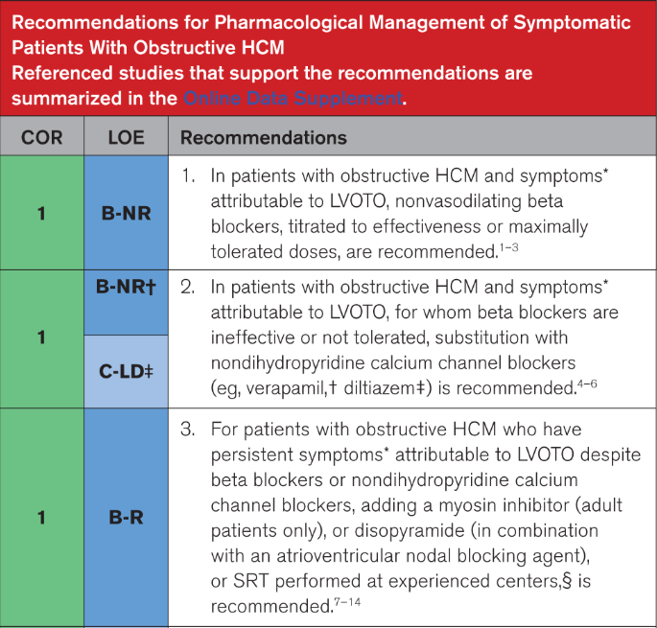

Slide 46


Slide 47
Resources
https://www.jacc.org/doi/10.1016/j.jacc.2021.12.002
https://www.ahajournals.org/doi/10.1161/circresaha.116.309348
https://www.ahajournals.org/doi/10.1161/JAHA.124.038758

