Slide 1
Complete Trial
Mohamed Hamed
PGY-6
FAU CVD Fellowship
August 22, 2025

Slide 2
Disclosure
Neither the planners nor the speakers disclosed relevant financial relationships with ineligible companies.

Slide 3
Question?
Patients with STEMI often have multivessel coronary artery disease, with additional angiographically significant lesions in locations separate from that of the culprit lesion that caused the acute event.
Whether to routinely revascularize these nonculprit lesions or to manage them conservatively with guideline-based medical therapy alone

Slide 4
Nonculprit lesions, which are usually discovered incidentally at the time of primary PCI, may represent stable coronary artery plaques or unstable plaques, which confer an increased risk of future cardiovascular events, there may be a benefit of routine nonculprit-lesion PCI.

Slide 5
PRAMI (NEJM 2013)
From 2008 through 2013, at five centers in the United Kingdom
465 patients with acute STEMI
Immediate Preventive PCI (234 patients) or no preventive PCI (231 patients).
The primary outcome was a composite of death from cardiac causes, nonfatal myocardial infarction, or refractory angina.
Notes:
Patients were ineligible if they were in cardiogenic shock, were unable to provide consent for any other reason, had undergone previous coronary-artery bypass grafting (CABG)

Slide 6
During a mean follow-up of 23 months, the primary outcome occurred in 21 patients assigned to preventive PCI and in 53 patients assigned to no preventive PCI, (hazard ratio in the preventive-PCI group, 0.35; 95% confidence interval [CI], 0.21 to 0.58; P<0.001).
Hazard ratios for the three components of the primary outcome were
0.34 (95% CI, 0.11 to 1.08) for death from cardiac causes
0.32 (95% CI, 0.13 to 0.75) for nonfatal myocardial infarction
0.35 (95% CI, 0.18 to 0.69) for refractory angina.

Slide 7
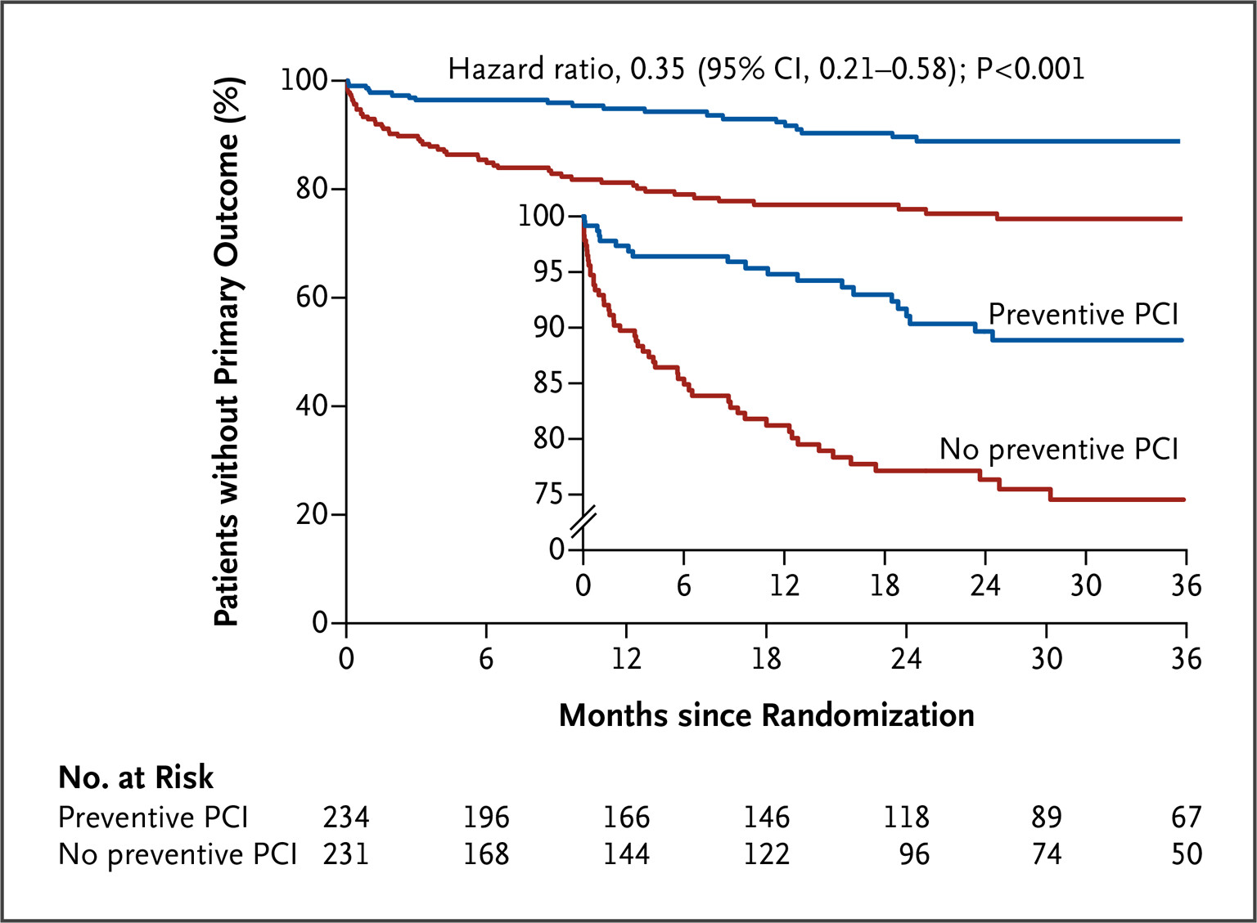

Slide 8
CvLPRIT trial (JACC 2015)
CvLPRIT (Complete versus Lesion-only Primary PCI trial) is a U.K. open-label randomized study comparing complete revascularization at index admission ( at time of PCI or before DC)
The primary endpoint was a composite of all-cause death, recurrent myocardial infarction (MI), heart failure, and ischemia-driven revascularization within 12 months.
The primary endpoint occurred in 10.0% of the complete revascularization group versus 21.2% in the IRA-only revascularization group (hazard ratio: 0.45; 95% confidence interval: 0.24 to 0.84; p = 0.009).
Notes:
index admission ( at time of PCI or before DC)

Slide 9
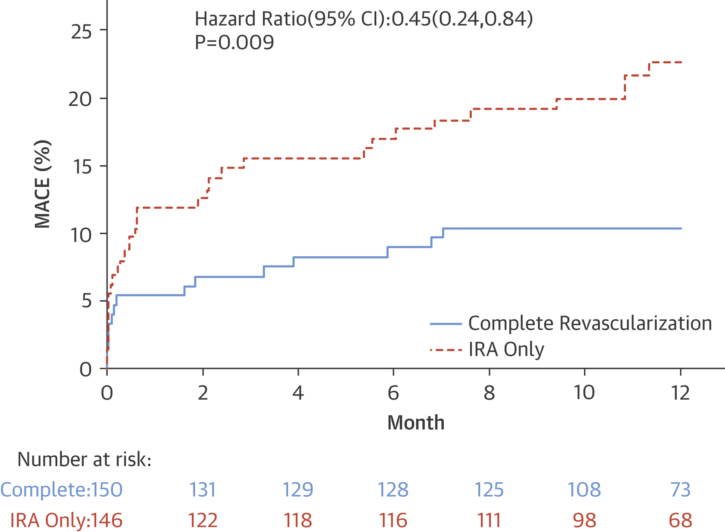

Slide 10
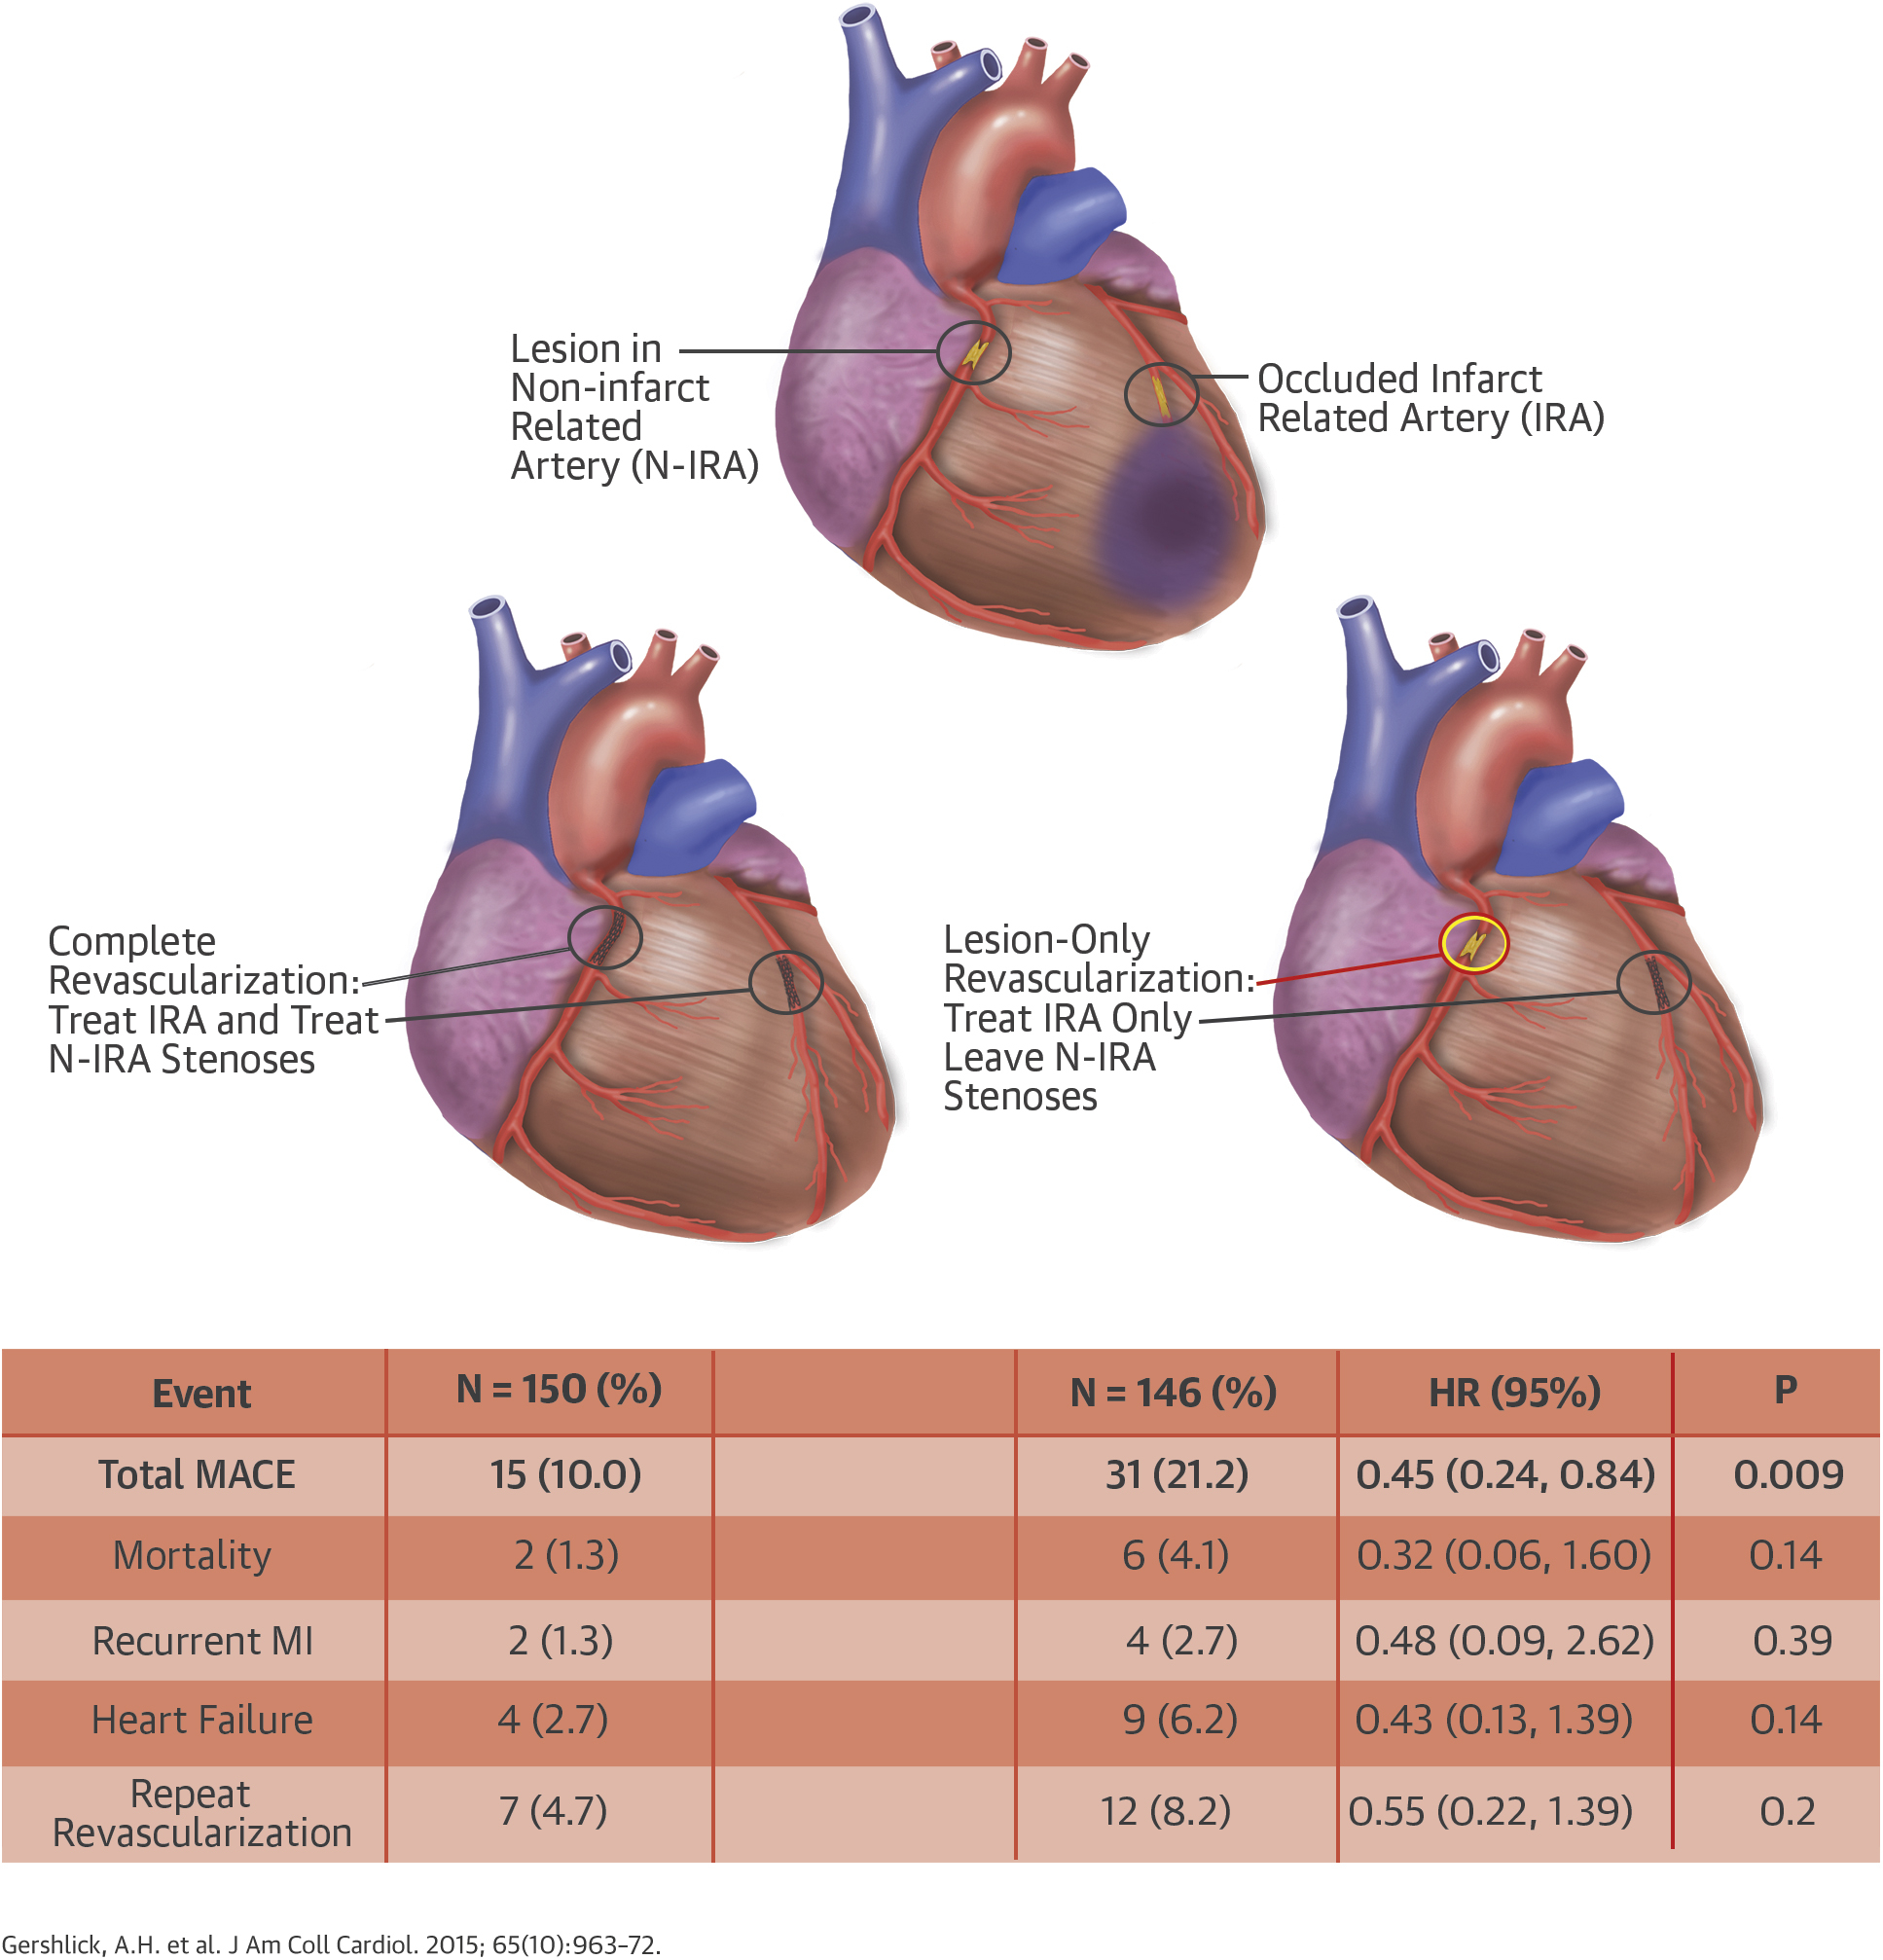

Slide 11
DANAMI-3—PRIMULTI (Lancet 2015)
From March 2011, to February, 2014 enrolling 627 patients (2 hospitals in Denmark), revascularization before Discharge
The primary endpoint was a composite of all-cause mortality, non-fatal reinfarction, and ischaemia-driven revascularization of lesions in non-infarct-related arteries
Primary endpoint was reported in 68 (22%) patients who had PCI of the infarct-related artery only and in 40 (13%) patients who had complete revascularization (hazard ratio 0∙56, 95% CI 0∙38–0∙83; p=0∙004).

Slide 12
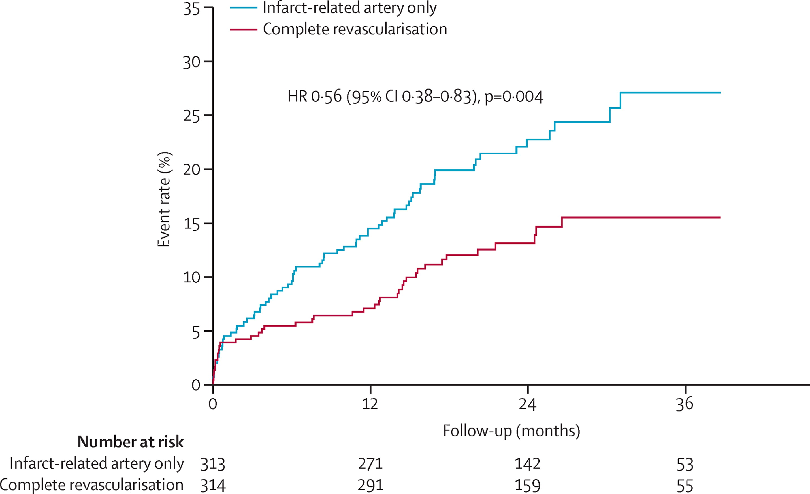

Slide 13
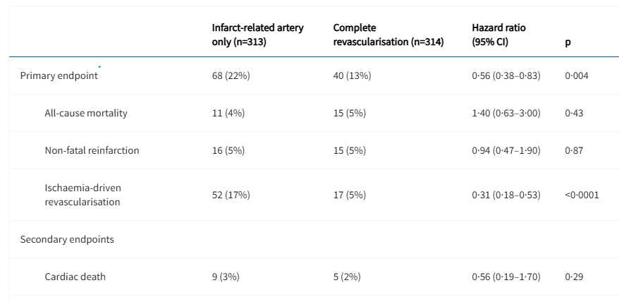

Slide 14
Compare-Acute (NEJM 2017)
Assigned 885 patients with STEMI and multivessel disease to 1:2 ratio to undergo complete revascularization of non–infarct-related coronary arteries guided by fractional flow reserve (FFR) (295 patients) or to undergo no revascularization of non–infarct arteries (590 patients).
Revascularization preferably same procedure or during the index hospitalization and preferably within 72 hours.
The primary end point was a composite of death from any cause, nonfatal myocardial infarction, revascularization, and cerebrovascular events at 12 months.
The primary outcome occurred in 23 patients in the complete-revascularization group and in 121 patients in the infarct-artery-only group that did not receive complete revascularization

Slide 15
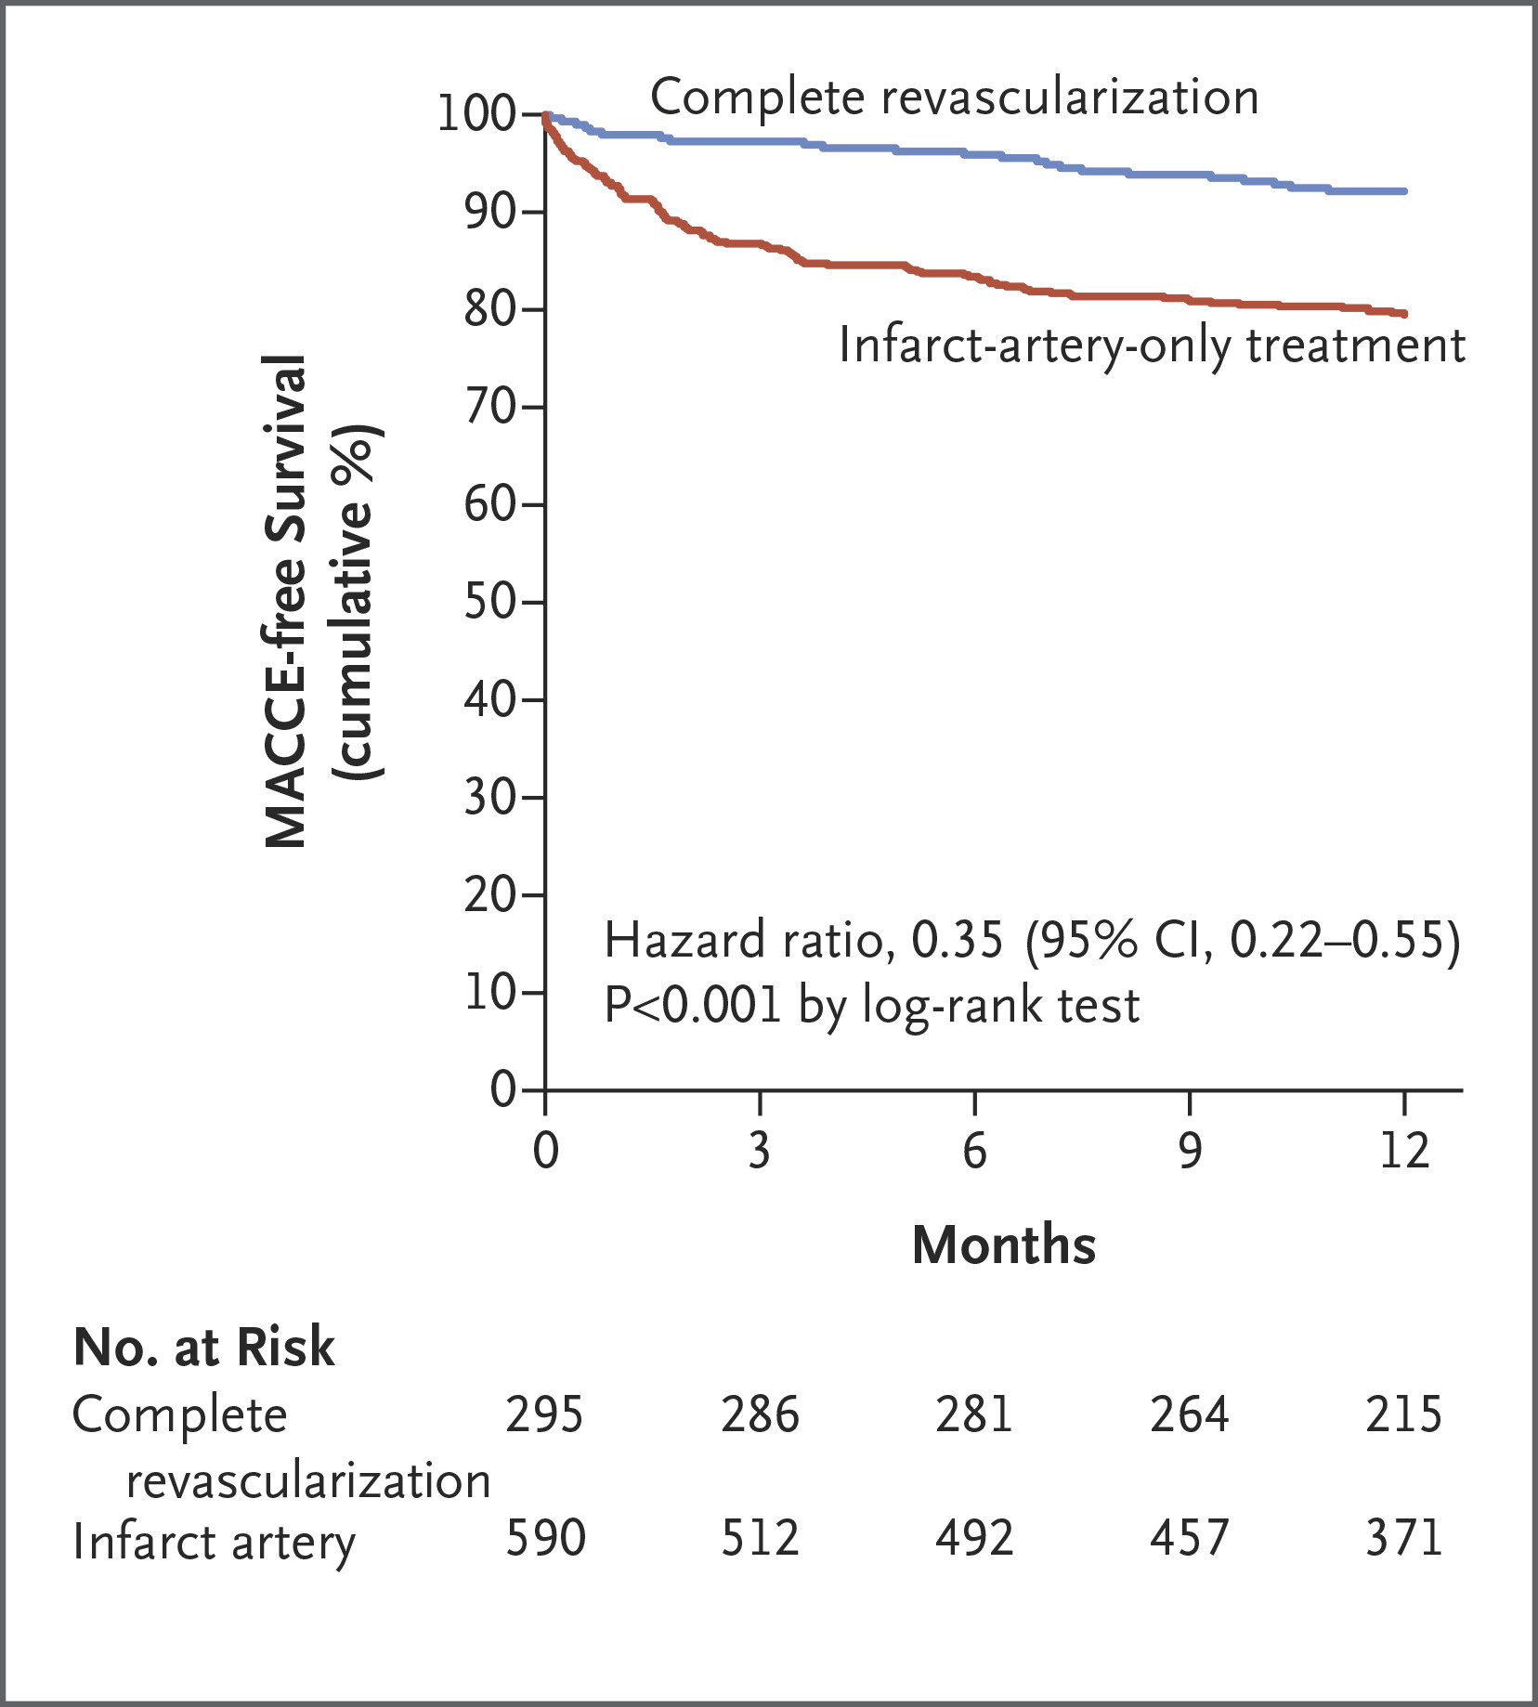

Slide 16
Death occurred in 4 patients in the complete-revascularization group and in 10 patients in the infarct-artery-only group (1.4% vs. 1.7%) (hazard ratio, 0.80; 95% CI, 0.25 to 2.56)
Myocardial infarction in 7 and 28 patients, respectively (2.4% vs. 4.7%) (hazard ratio, 0.50; 95% CI, 0.22 to 1.13)
Revascularization in 18 and 103 patients (6.1% vs. 17.5%) (hazard ratio, 0.32; 95% CI, 0.20 to 0.54)
Cerebrovascular events in 0 and 4 patients (0 vs. 0.7%).

Slide 17
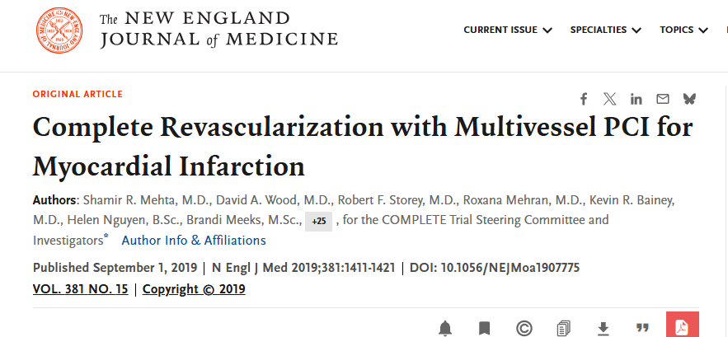

Slide 18
Rationale
Randomized trials have shown reductions in the risk of composite outcomes with nonculprit-lesion PCI, with results driven predominantly by the decreased risk of subsequent revascularization with that strategy.
Meta-analyses suggest a reduction in the risk of death from cardiovascular causes or myocardial infarction with nonculprit-lesion PCI, but previous individual trials was not powered to examine this clinically important outcome.
The Complete versus Culprit-Only Revascularization Strategies to Treat Multivessel Disease after Early PCI for STEMI (COMPLETE) trial was designed to address this evidence gap.

Slide 19
Methods
Multinational
Randomized trial
Complete revascularization (consisting of PCI of all suitable nonculprit lesions) as compared with a strategy of no further revascularization in patients with STEMI and multivessel coronary artery disease
The trial was coordinated and sponsored by the Population Health Research Institute of Hamilton Health Sciences and McMaster University.
Funded by the Canadian Institutes of Health Research. AstraZeneca and Boston Scientific provided additional funding

Slide 20
Eligibility
Adults who presented to the hospital with STEMI were considered for inclusion in the trial if they could undergo randomization within 72 hours after successful culprit-lesion PCI.
Multivessel coronary artery disease, defined as the presence of at least one angiographically significant non–infarct-related (nonculprit) lesion that was amenable to successful treatment with PCI with following criteria
In a vessel with a diameter of at least 2.5 mm that was not stented as part of the index culprit-lesion PCI.
Nonculprit lesions were deemed angiographically significant if they were associated with at least 70% stenosis of the vessel diameter on visual estimation OR
50 to 69% stenosis accompanied by a fractional flow reserve (FFR) measurement of 0.80 or less.

Slide 21
Exclusion criteria
An intention before randomization to revascularize a nonculprit lesion
Planned surgical revascularization
Previous coronary-artery bypass grafting surgery.
Life expectancy less than 5 years

Slide 22
Randomization
Computer-generated randomization list with the use of randomly permuted blocks and with blinding to trial center.
Randomization was stratified according to center and the intended timing of nonculprit-lesion PCI
Routine staged PCI (PCI during a procedure separate from the index PCI procedure for STEMI) of all suitable nonculprit lesions:
- Nonculprit-lesion PCI during the index hospitalization or after hospital discharge (no later than 45 days after randomization).
Everolimus-eluting stents were strongly recommended for all PCI procedures.
PCI of CTO was recommended to be attempted only by operators who had experience in treating CTO and only when there was a high likelihood of successful PCI.
Notes:
Patients who were randomly assigned to the complete-revascularization strategy were to have routine staged PCI (PCI during a procedure separate from the index PCI procedure for STEMI) of all suitable nonculprit lesions

Slide 23
Both groups received Guideline-based medical therapy
After initial hospital discharge, routine follow-up occurred at:
6 weeks,
6 months
1 year
yearly thereafter up to the final follow-up visit.

Slide 24
Guideline-based medical therapy
Dual antiplatelet therapy with aspirin and ticagrelor for at least 1 year was recommended.
Beyond 1 year, aspirin was recommended for all patients, and ticagrelor (60 mg twice daily) was recommended for patients who were not at high risk for bleeding.
High-dose statin therapy, angiotensin-converting–enzyme inhibitors or angiotensin-receptor blockers, mineralocorticoid-receptor antagonists, and beta-blockers were recommended.

Slide 25
Outcomes
The first co-primary outcome: composite of death from cardiovascular causes or new myocardial infarction
The second co-primary outcome: composite of death from cardiovascular causes, new myocardial infarction, or ischemia-driven revascularization.
Safety outcomes: major bleeding and contrast-associated acute kidney injury.
Myocardial infarction was defined according to the third universal definition and was subclassified according to type.

Slide 26
Statistical Analysis
Intention-to-treat principle
An estimated sample of 4000 patients would give the trial 80% power to detect a 22% lower risk of the composite of cardiovascular death or myocardial infarction in the complete-revascularization group than in the culprit-lesion-only PCI group, assuming an event rate of 5% per year in the culprit-lesion-only PCI group.
To preserve the overall type I error rate of 5% for the testing of both coprimary outcomes, the first coprimary outcome was tested at a P value of 0.045 and the second at a P value of 0.0119.

Slide 27
Time-to-first-event approach was used to analyze the coprimary outcomes
Estimates of the hazard ratios and 95% confidence intervals were calculated with the use of Cox proportional-hazards models
The two treatment groups were compared with the use of the stratified log-rank test.
Cumulative incidence was estimated with the Kaplan–Meier method.
A sensitivity analysis was performed with a Fine–Gray model to account for the competing risk of death from noncardiovascular causes.

Slide 28
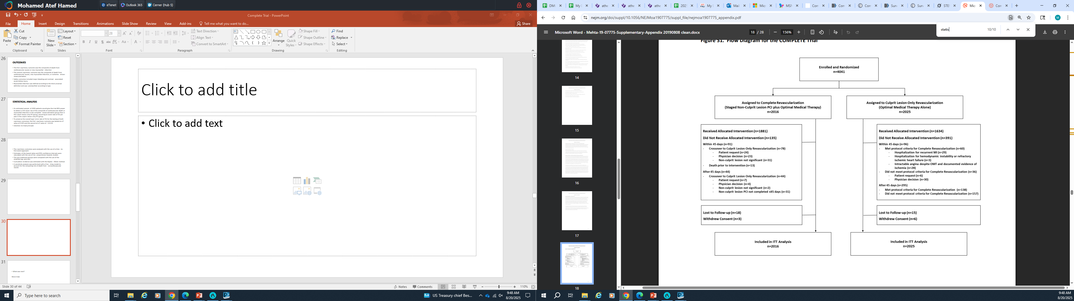
From February 1, 2013, through March 6, 2017, a total of 4041 patients from 140 centers in 31 countries underwent randomization

Slide 30
Complete revascularization
The median time from randomization to nonculprit-lesion PCI was 1 day (interquartile range, 1 to 3) among the 1285 patients (during the index hospitalization)
23 days (interquartile range, 12.5 to 33.5) among the 596 patients for (after hospital discharge)
Within the first 45 days:
crossover to the complete-revascularization group occurred in 96 patients (4.7%)
crossover to the culprit-lesion-only PCI group occurred in 78 patients (3.9%).

Slide 31
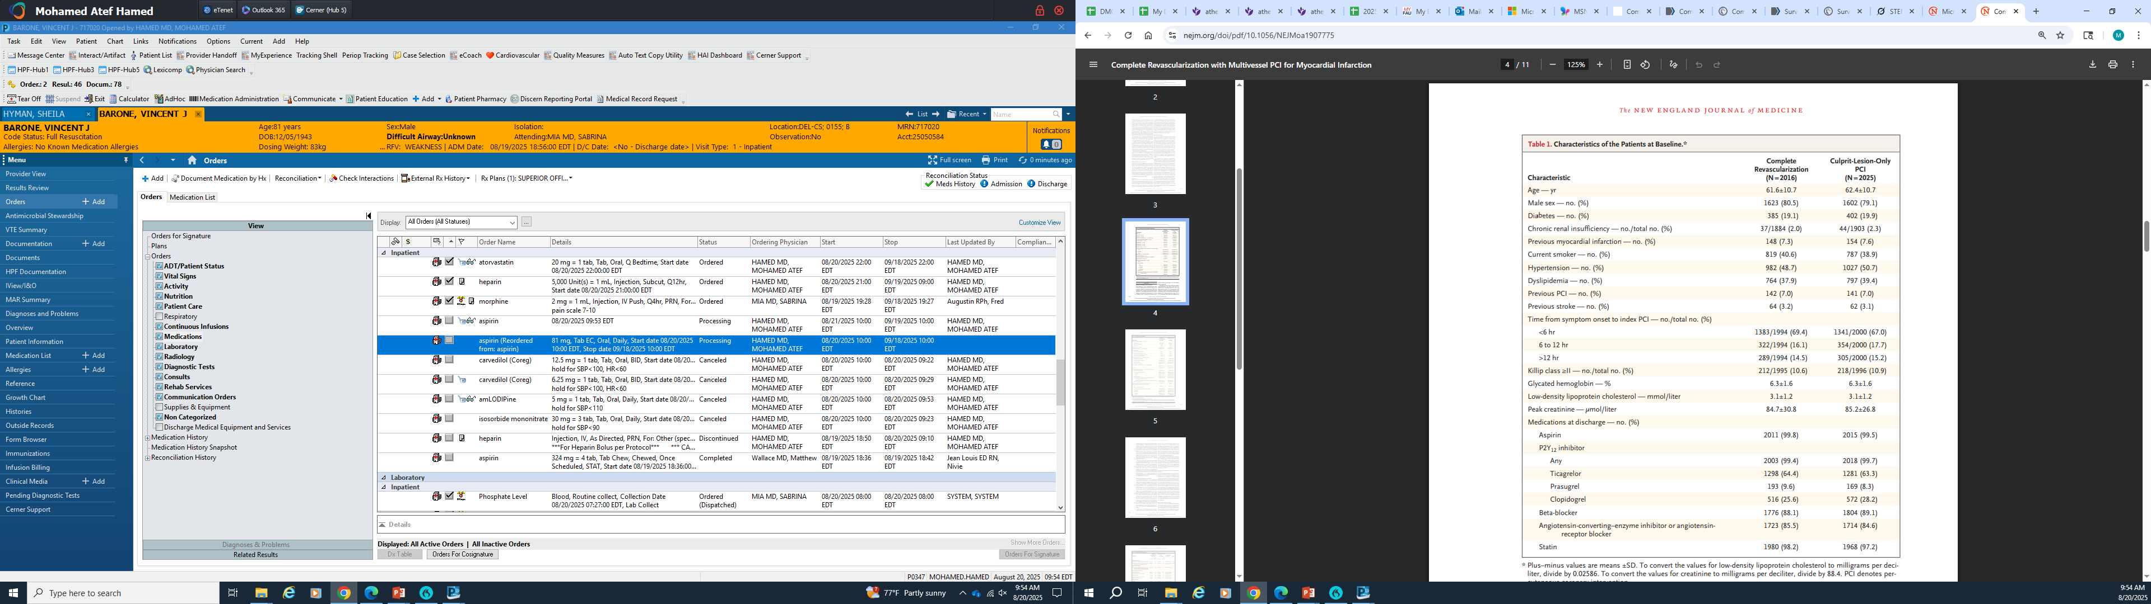

Slide 32
119.8 mg/dl

Slide 33
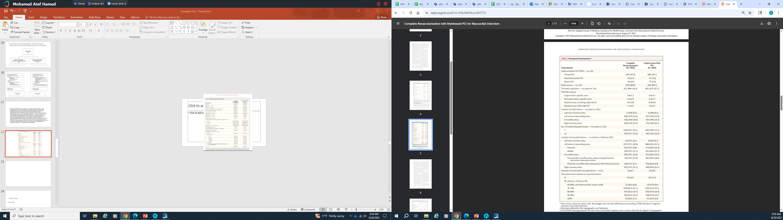

Slide 35


Slide 36
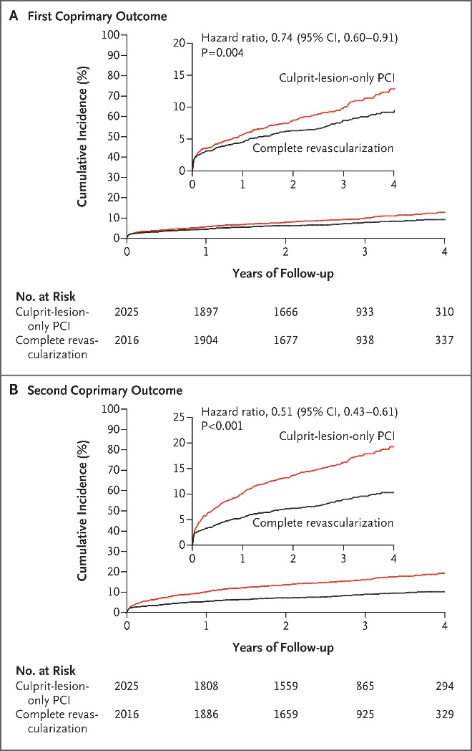
Notes:
This result was driven by the lower incidence of new myocardial infarction in the complete-revascularization group than in the culprit-lesion-only PCI group

Slide 39
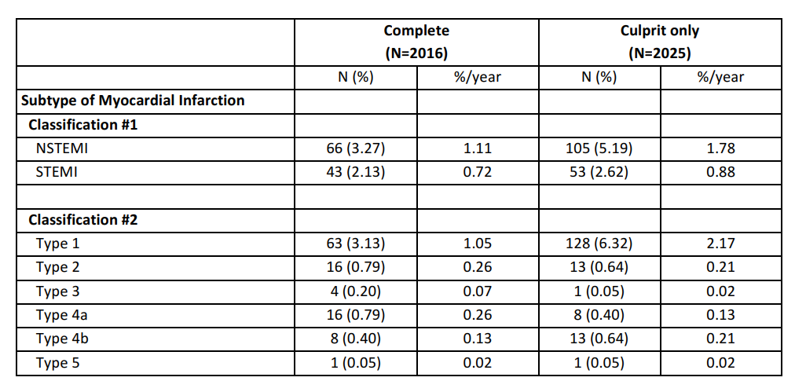

Slide 40
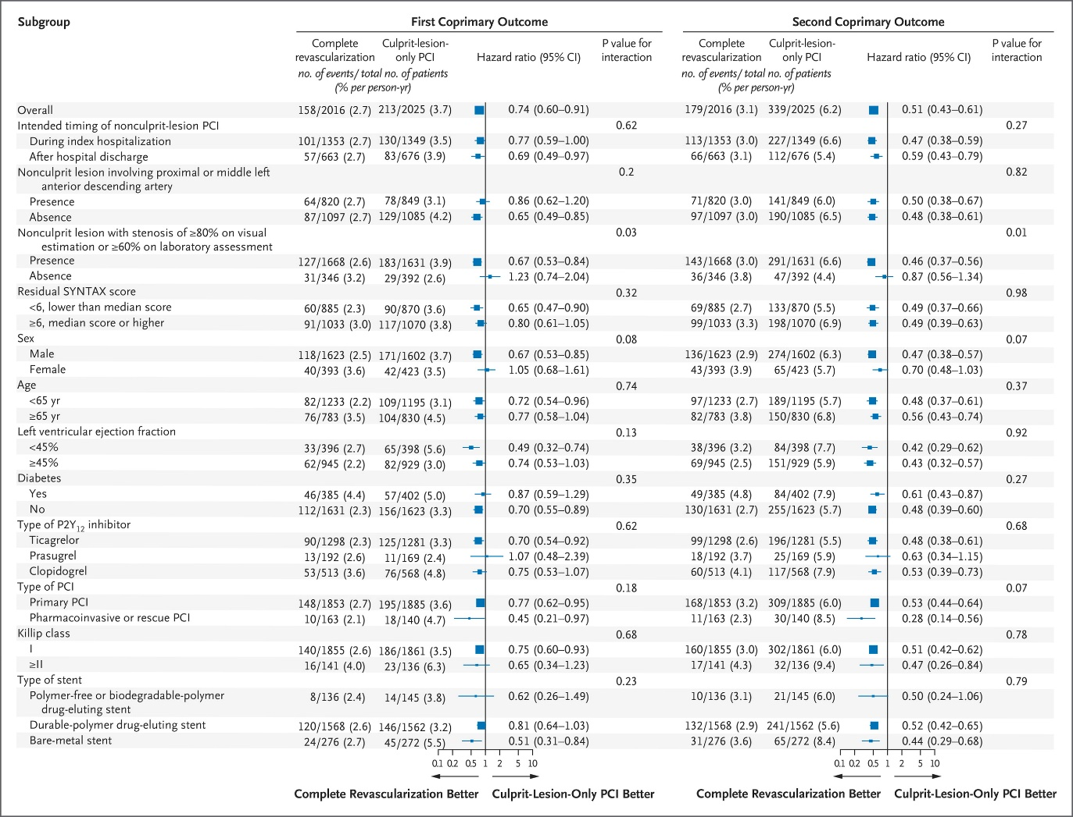

Slide 42
Discussion
The COMPLETE trial showed that, among patients with STEMI and multivessel coronary artery disease, a strategy of staged nonculprit-lesion PCI with the goal of complete revascularization resulted in a 26% lower risk of a composite of death from cardiovascular causes or new myocardial infarction at a median follow-up of 3 years
This benefit was driven by the 32% lower risk of new, nonfatal myocardial infarction in the complete-revascularization group than in the culprit-lesion-only PCI group
The incidence of death from cardiovascular causes was similar in the two groups.

Slide 43
For the second coprimary outcome, which included ischemia-driven revascularization in addition to the other two events, the risk with a complete-revascularization strategy was approximately half the risk with a culprit-lesion-only PCI strategy.
There was no significant difference between the two groups in the risk of major bleeding or stroke.
The benefit of complete revascularization was consistently observed regardless of whether nonculprit-lesion PCI was to be performed during the index hospitalization or several weeks after discharge from the hospital.

Slide 44
Previous trials that evaluated a complete-revascularization strategy in patients with STEMI were smaller and included revascularization as part of the composite primary outcome.
Over a period of 3 years:
NNT to prevent cardiovascular death or myocardial infarction from occurring in 1 patient is 37 patients
NNT to prevent cardiovascular death, myocardial infarction, or ischemia-driven revascularization from occurring in 1 patient is 13 patients.

Slide 45
Limitations
Complete revascularization during the same procedure (index culprit-lesion PCI) for STEMI was not evaluated.
Although cardiogenic shock was not an exclusion criterion, no patients with cardiogenic shock were enrolled in the trial and the results should not be extrapolated to such patients.
Complete revascularization was attained in more than 90% of the patients in the complete-revascularization group, and crossover to the nonculprit-lesion PCI strategy occurred in only 4.7% of the patients in the culprit-lesion-only PCI group. It is unclear whether the trial results would have been similar if complete revascularization had been observed in fewer patients or if the crossover criteria in the culprit-lesion-only PCI group had been more liberal.
Notes:
Open-label study

Slide 46
Conclusion
The COMPLETE trial showed that, among patients with STEMI and multivessel coronary artery disease, a strategy of routine nonculprit-lesion PCI with the goal of complete revascularization, performed either during the index hospitalization or soon after discharge, was superior to a strategy of culprit-lesion-only PCI in reducing the risk of death from cardiovascular causes or new myocardial infarction, as well as the risk of death from cardiovascular causes, new myocardial infarction, or ischemia-driven revascularization, at a median follow-up of 3 years.

Slide 47

What was next?
More trials

Slide 48
MULTISTARS AMI Trial (NEJM 2023)
International, open-label, randomized, non-inferiority trial at 37 sites in Europe.
Hemodynamically stable condition who had STEMI and multivessel coronary artery disease were randomly assigned to undergo immediate multivessel percutaneous coronary intervention (PCI; immediate group) or PCI of the culprit lesion followed by staged multivessel PCI of nonculprit lesions within 19 to 45 days after the index procedure (staged group).

Slide 49
The primary end point was a composite of death from any cause, nonfatal myocardial infarction, stroke, unplanned ischemia-driven revascularization, or hospitalization for heart failure at 1 year after randomization.
A primary end-point event occurred in 35 patients (8.5%) in the immediate group as compared with 68 patients (16.3%) in the staged group (risk ratio, 0.52; 95% confidence interval, 0.38 to 0.72; P<0.001 for noninferiority and P<0.001 for superiority).

Slide 50
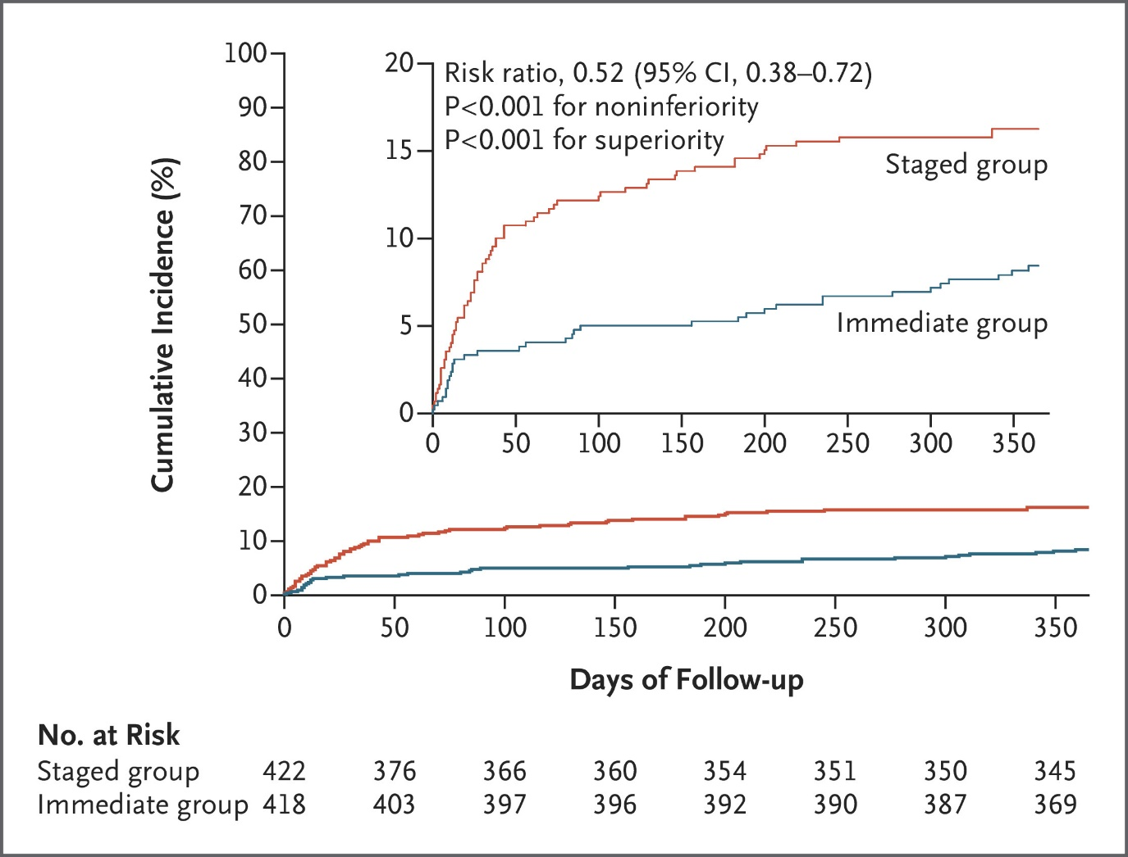

Slide 51
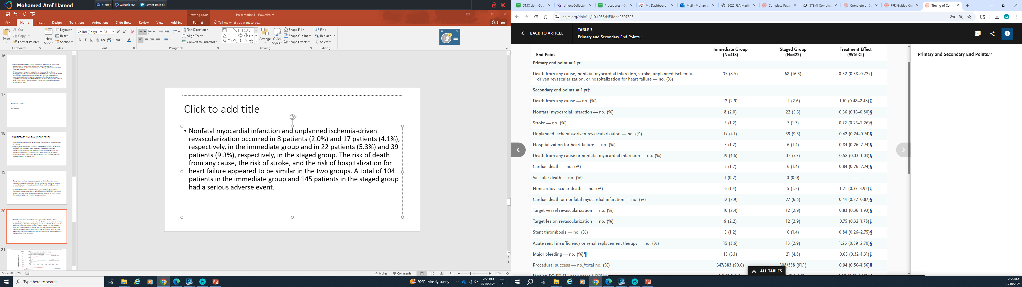

Slide 52


Slide 53

ESC Guidelines (2023 ESC Guidelines for the Management of Acute Coronary Syndromes)
Class I, Level of Evidence A: CR should be considered in patients with STEMI and MVD
(non-culprit lesions with ≥70% stenosis or fractional flow reserve [FFR] ≤0.8)
To reduce major adverse cardiovascular events (MACE), including cardiovascular death, myocardial infarction (MI), and ischemia-driven revascularization.

Slide 54
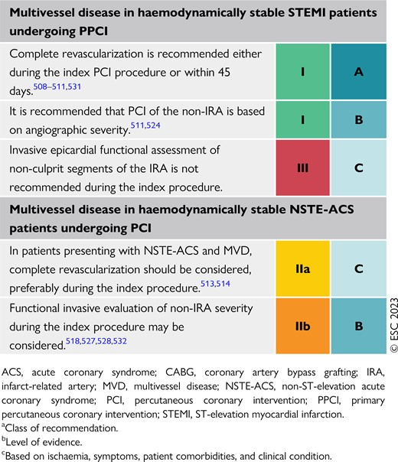

Slide 55


ACC/AHA Guidelines (2020 ACC/AHA Guideline for the Management of Patients With Non–ST-Elevation Acute Coronary Syndromes, with STEMI Updates)
Recommendation: Complete revascularization is reasonable in STEMI patients with MVD who are hemodynamically stable, either during the index procedure or as a staged procedure.
Class I, Level of Evidence A: CR is reasonable to reduce cardiovascular events in patients with STEMI and MVD with significant non-culprit lesions (≥70% stenosis or FFR ≤0.8).

Slide 56
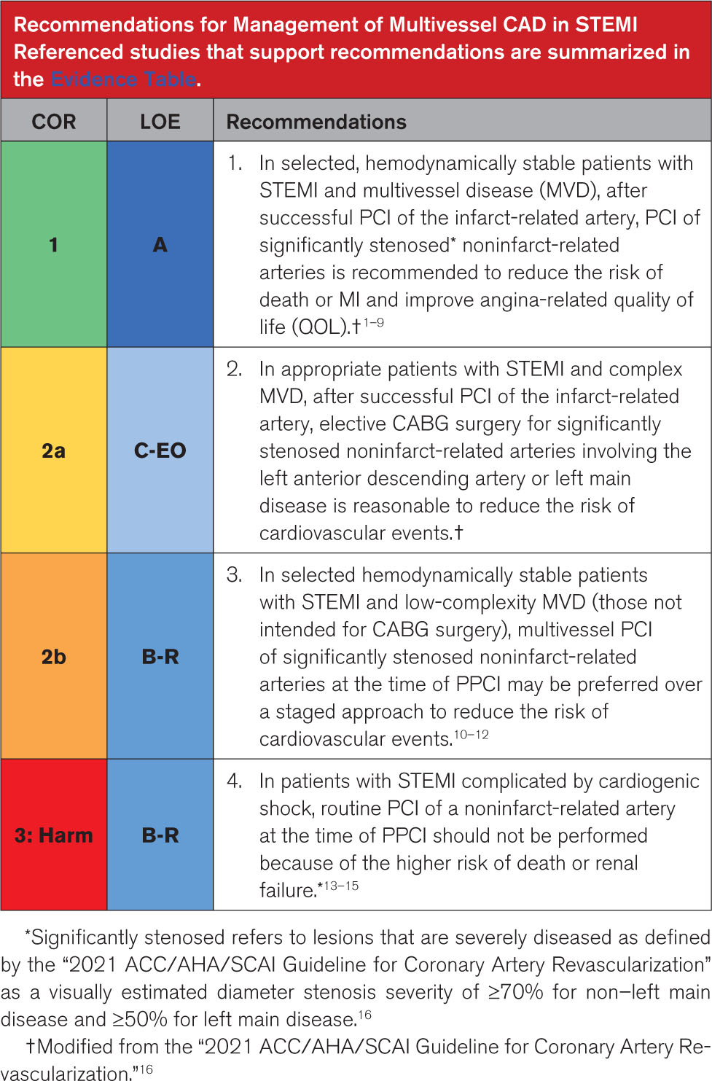

Slide 57
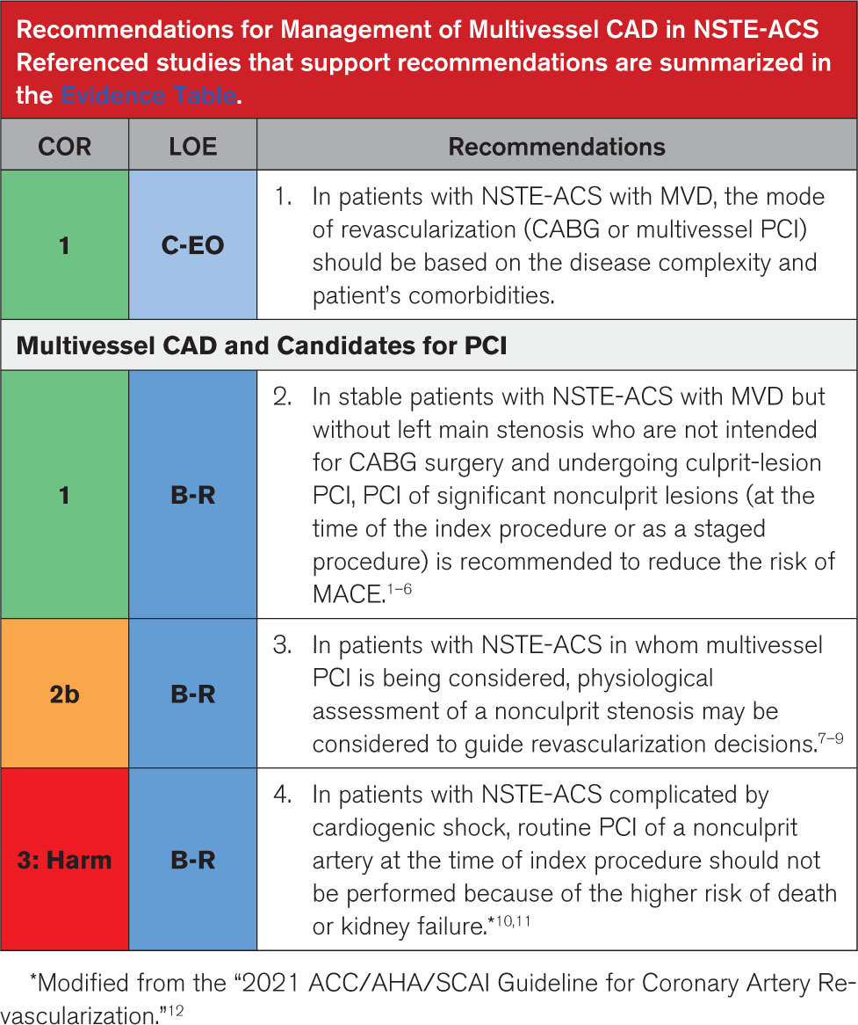

Slide 58


