Slide 1


ALONE-AF Trial
Raffael Mishaev, MD
PGY-4
FAU Cardiology Grand Rounds

Slide 2
Disclosures
Neither the planners nor the speakers disclosed relevant financial relationships with ineligible companies

Slide 3
Learning Objectives
Understand the rationale behind ALONE-AF
  Review trial design, methods, and results
  Critically evaluate strengths and limitations
  Discuss implications for practice and guidelines

Slide 4
Clinical Vignette
66 year old male with a past medical history of HTN, DM2, paroxysmal atrial fibrillation (currently on apixaban) s/p first PVI ablation 16 months ago without documented recurrent episodes - should we stop his anticoagulation?

Slide 5
Why was the trial done?
Current guidelines recommend continuing long-term OAC based on stroke risk (CHA₂DS₂-VASc) irrespective of perceived ablation success, because randomized trial data were lacking.
Clinicians and patients often ask whether OAC can be stopped after a successful ablation when there are no recurrences.
ALONE-AF was the first randomized trial to test that question.

Slide 6
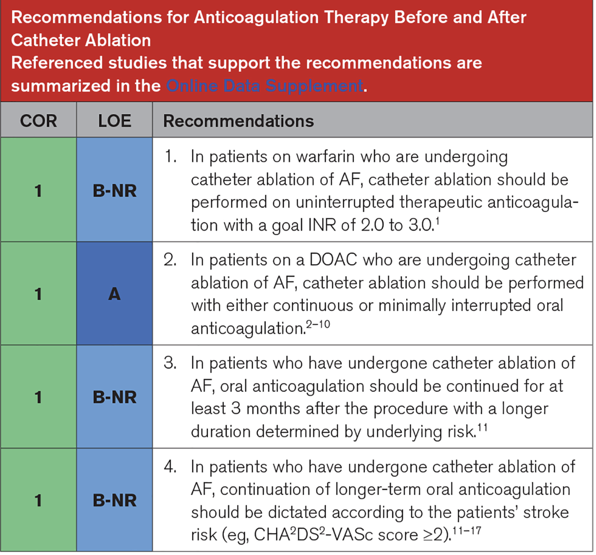
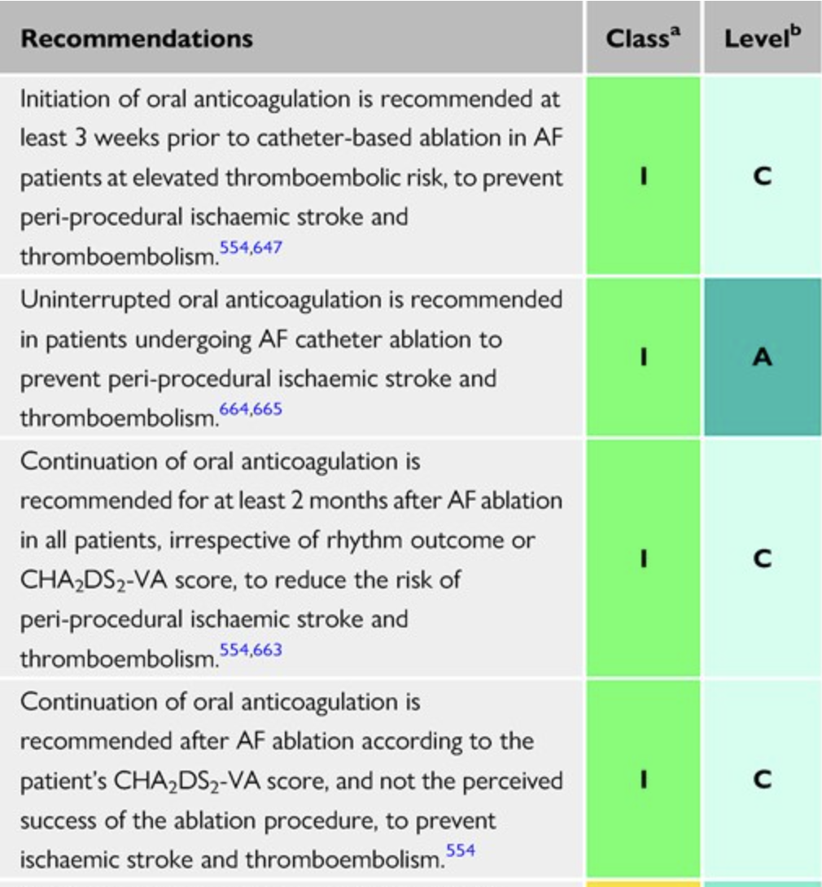

Slide 7
Question
In patients without documented atrial fibrillation (AF) recurrence after catheter ablation and at least 1 non-sex-related stroke risk factor, does discontinuing oral anticoagulant therapy result in superior clinical outcomes?

Slide 8
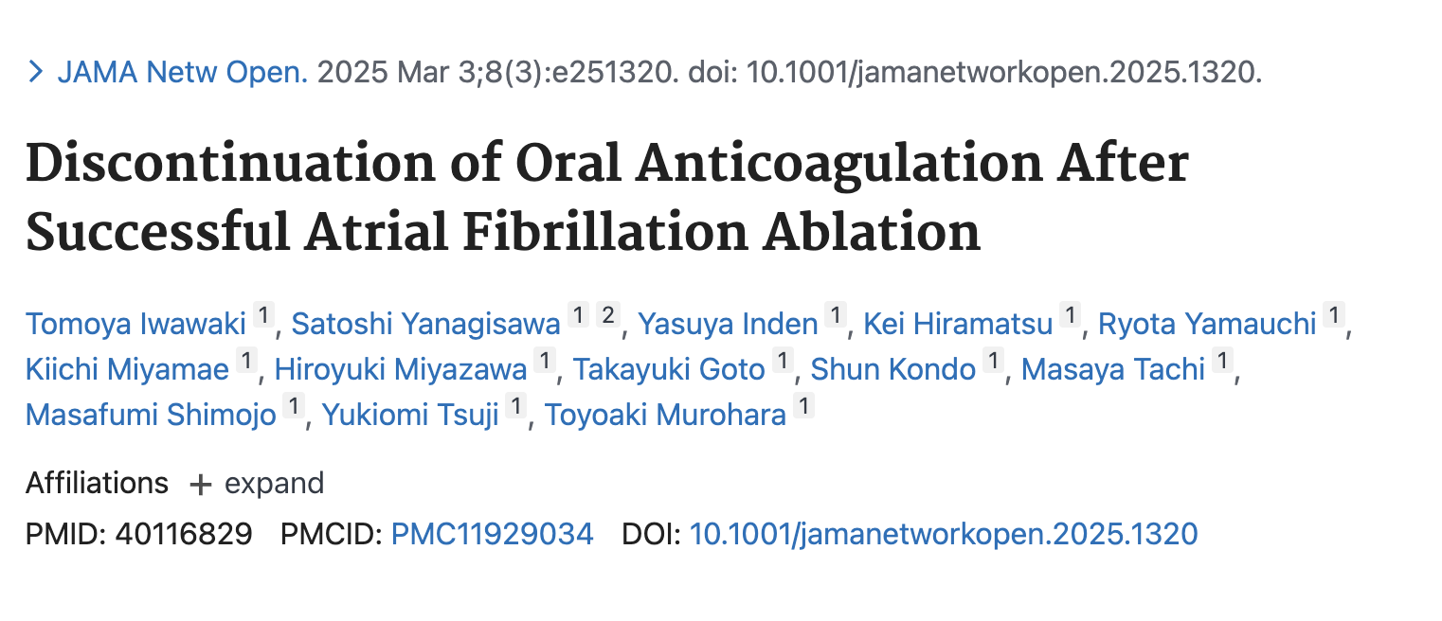
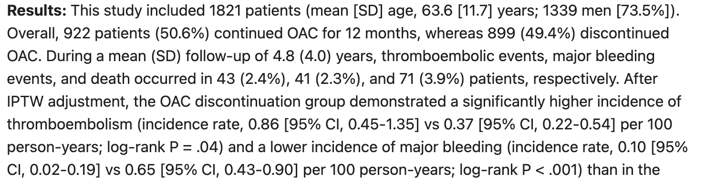
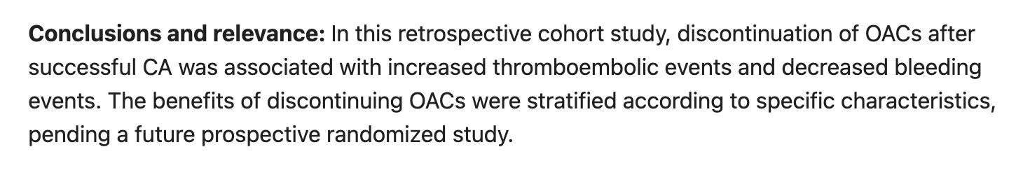
Prior Evidence

Slide 9
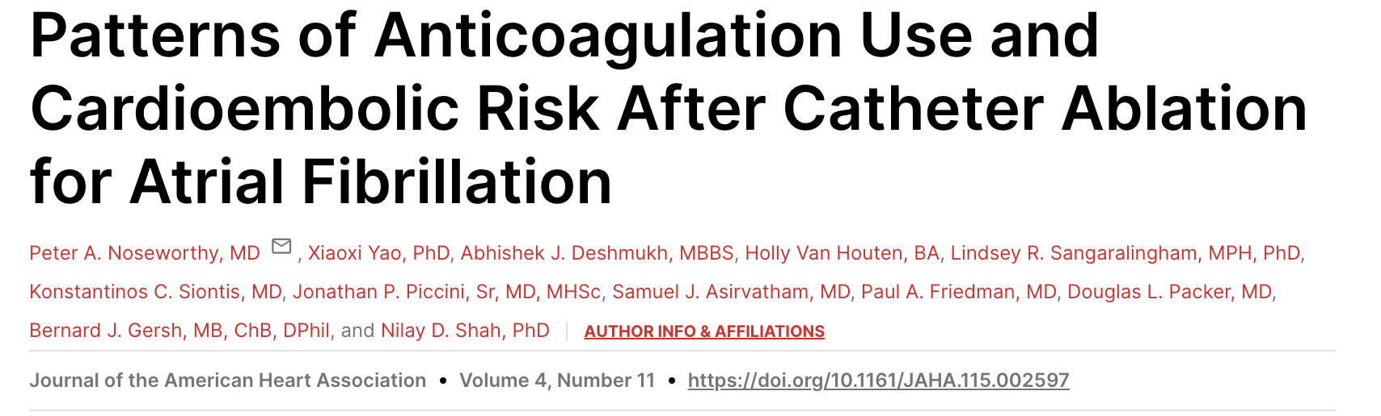
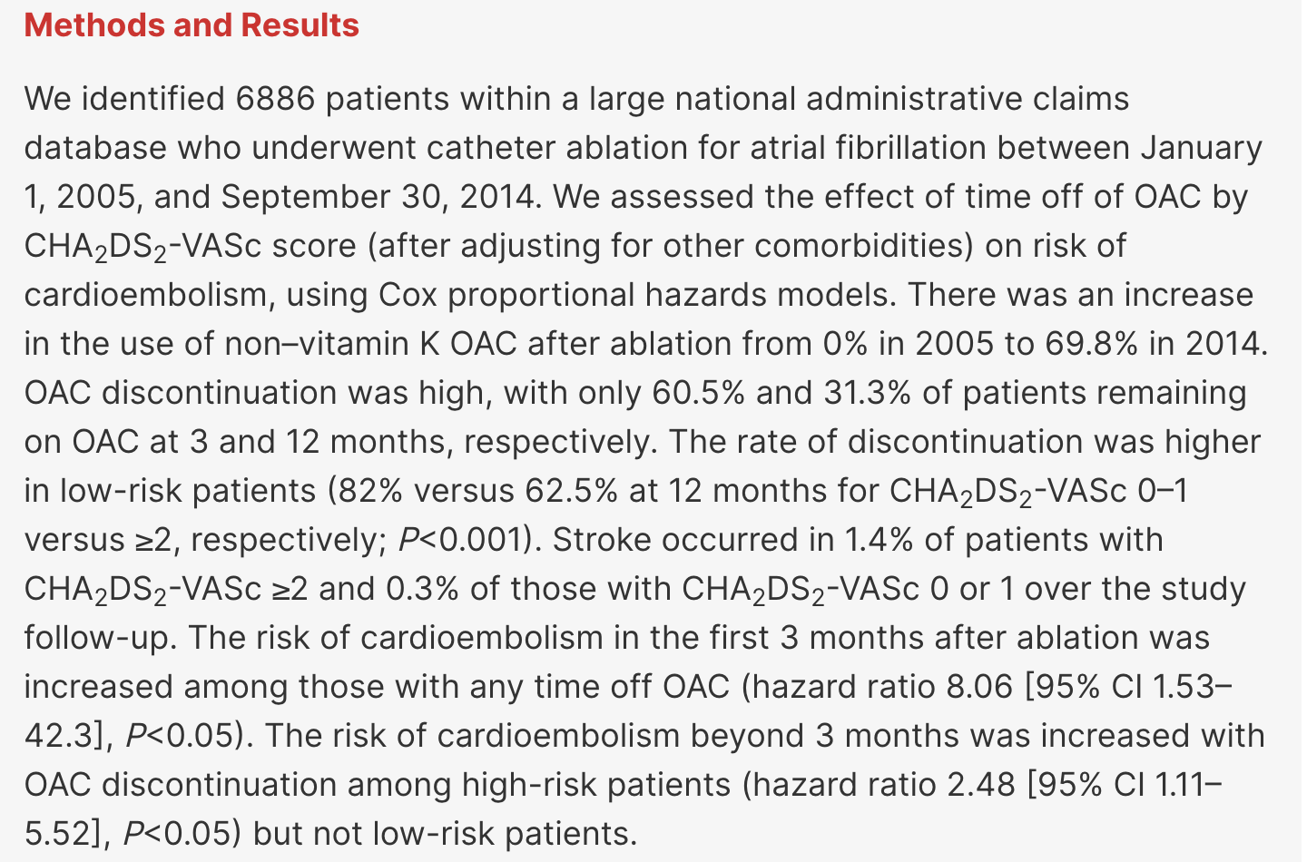
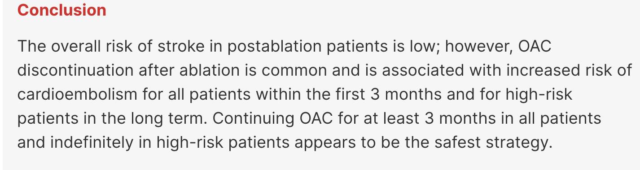

Slide 10
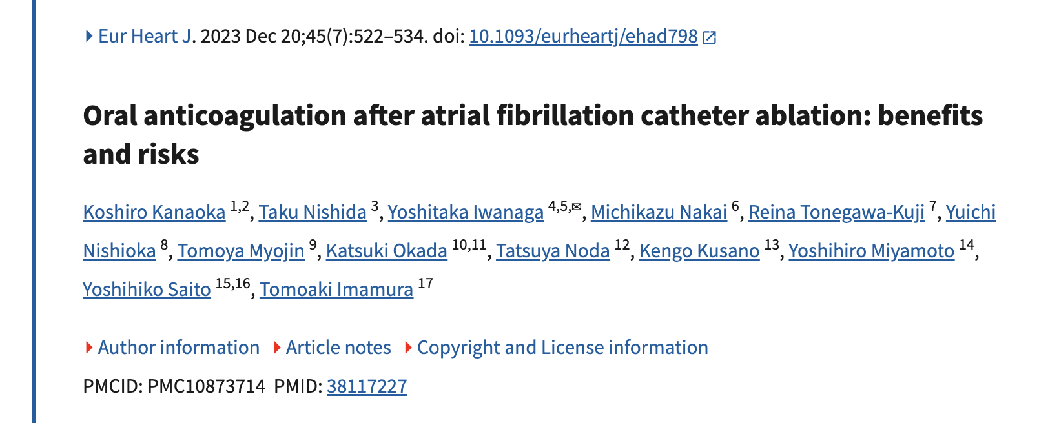
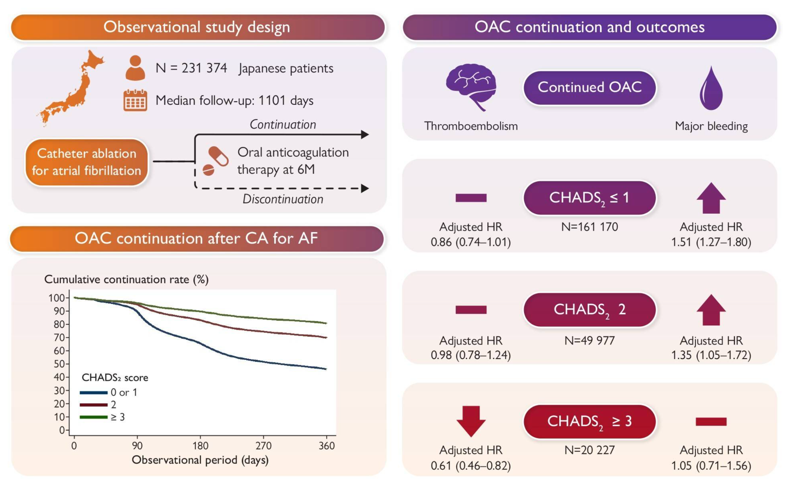
Prior Evidence

Slide 11
Prior Evidence
Observational studies and meta-analyses showing conflicting results
Some studies suggested discontinuing OAC after successful ablation did not increase thromboembolic risk and lowered bleeding risk
Others found discontinuation of OAC (especially in higher CHA₂DS₂-VASc patients), was associated with increased stroke risk
ACC and HRS guidelines reflect this uncertainty
No randomized controlled trial data before ALONE-AF

Slide 12
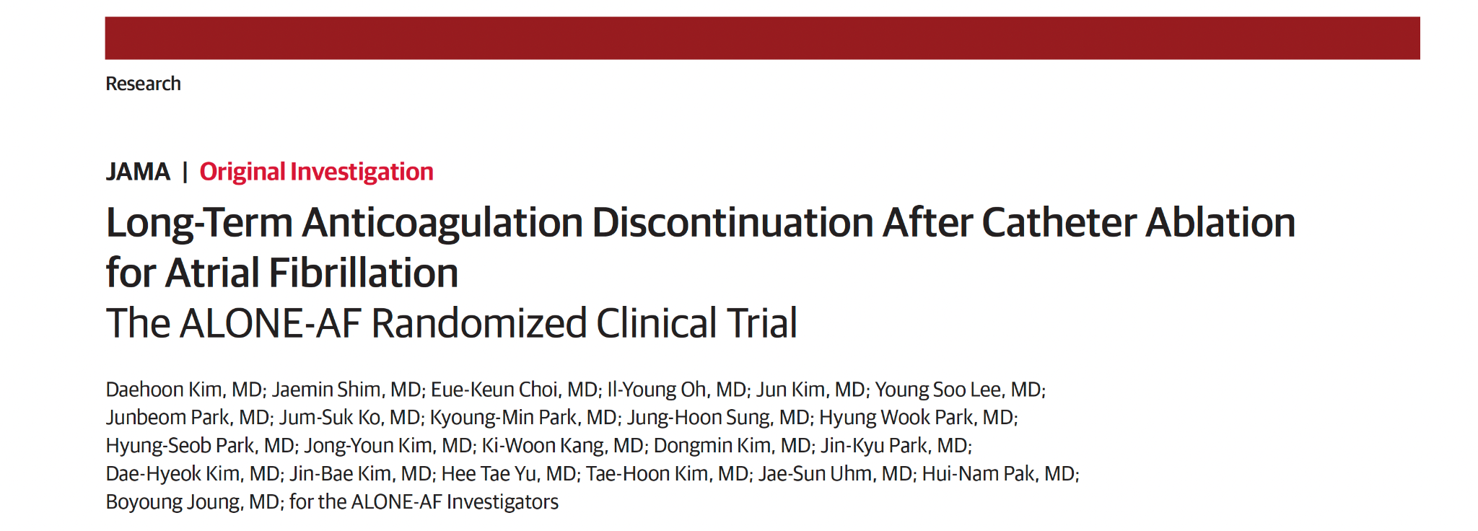

ALONE-AF Trial

Slide 13
Introduction
Data from randomized clinical trials on a long-term anticoagulation strategy for patients after catheter-based ablation for atrial fibrillation (AF) are lacking
The ALONE-AF trial (Anticoagulation One year after Ablation of Atrial Fibrillation in Patients with Atrial Fibrillation) was designed to evaluate whether discontinuing oral anticoagulant therapy could lead to fewer adverse events (including stroke, systemic embolism, and major bleeding) compared with continuing direct oral anticoagulant therapy in patients without documented AF recurrence for at least 1 year after ablation

Slide 14
ALONE-AF Trial Design
Multicenter, open-label, randomized superiority trial, non-blinded
  840 patients, 18 centers in South Korea
  Randomized July 2020 – March 2023
  Follow-up: 24 months

Slide 15
Population & Eligibility
Age 19–80, mean 64 ± 8 years; ~25% women
Intermediate-high risk of thromboembolism (CHA₂DS₂-VASc ≥1 (men), ≥2 (women))
First AF ablation procedure
Remain free of atrial arrhythmia recurrence at least 12 months
Documented by at least 2 sessions of 24-72 hour Holter and ECG monitoring (at least 1 session within 2 months prior to enrollment)

Slide 16
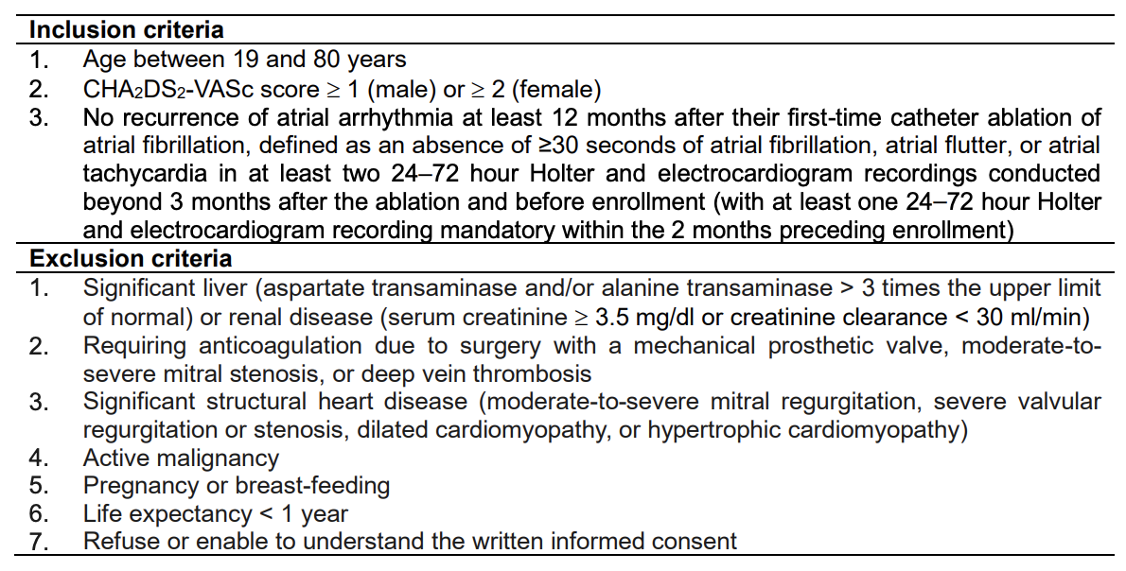
Inclusion and Exclusion Criteria

Slide 17
Interventions
Randomized 1:1 ratio
  Discontinue OAC (stop DOAC)
  Continue OAC (standard-dose DOAC: apixaban, rivaroxaban)
  Crossover allowed if recurrence or physician judgement
Intention to treat protocol

Slide 18
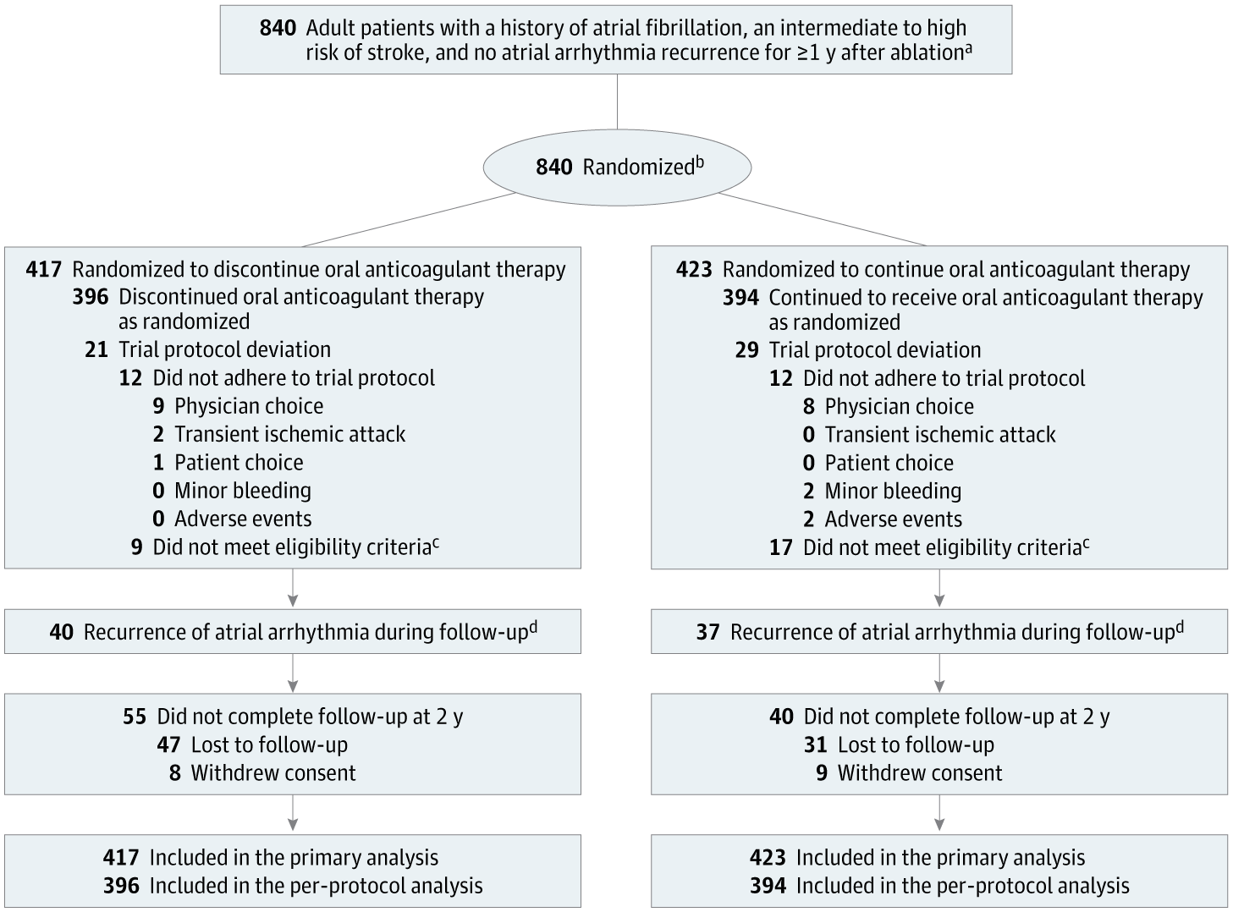
Notes:
aAn intermediate to high risk of stroke was defined as a CHA2DS2-VASc score of 1 for men and 2 for women. There were no data collected regarding screening.
bRandomization was performed without any adjustments or stratification.
cIn the discontinue therapy group, 5 never underwent catheter ablation for atrial fibrillation, 2 were aged >80 years, and 2 had a CHA2DS2-VASc score of 0. In the continue therapy group, 10 never underwent catheter ablation for atrial fibrillation and 7
were aged >80 years.
dThese patients were censored at the time of recurrence. Based on thromboembolic risk, anticoagulation was restarted in the discontinue therapy group or continued in the continue therapy group.

Slide 19
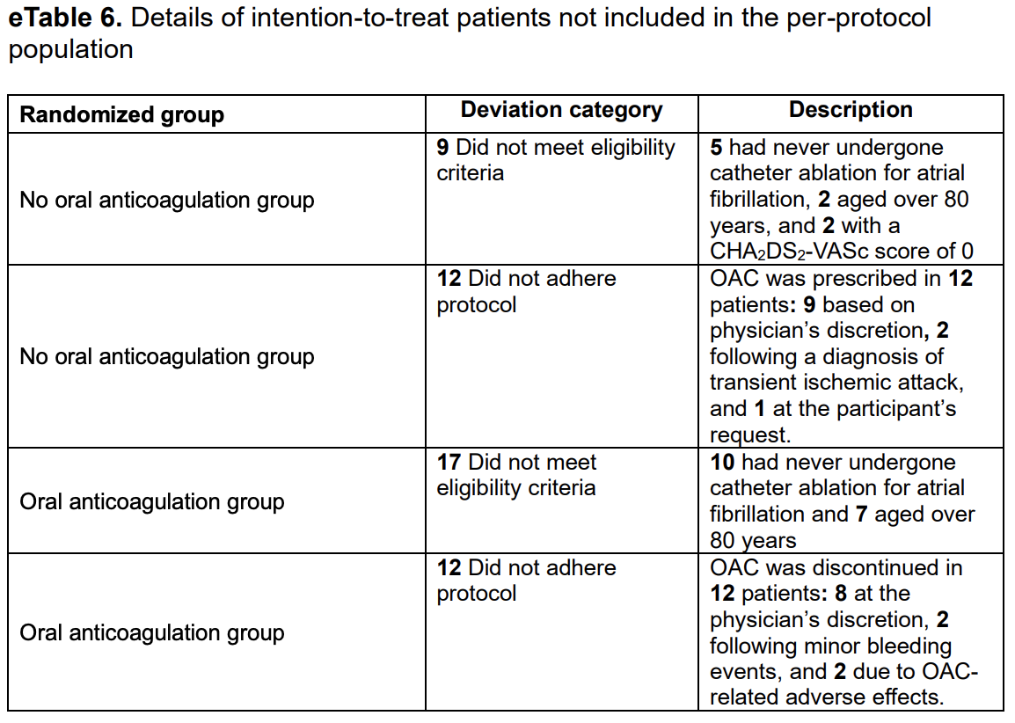

Slide 20
Endpoints
Primary: composite of stroke, systemic embolism, major bleeding at 24 months
  Major bleeding defined by International Society of Thrombosis and Haemostasis (ISTH): fatal bleeding, symptomatic bleeding in critical area/organ (brain, spine, retroperitoneal), or significant reduction in Hgb by at least 2 g/dL or transfusion of 2 or more units of blood/red cells
Secondary: individual components of primary outcome, clinically relevant non-major bleeding, all-cause mortality, myocardial infarction, TIA, and hospitalization due to any cause
Notes:
Major Bleeding - fatal bleed, symptomatic bleed in critical organ (head, retroperitoneal, etc), Hgb drop by 2 or 2 units of pRBCs given

Slide 21
Population Characterizations
Mean age was 64 years (SD, 8 years)
209 (24.9%) women
568 (67.6%) had paroxysmal atrial fibrillation
Mean duration between catheter ablation and randomization was 3.6 years (SD 3 years)
Mean CHA₂DS₂-VASc score was 2.1 (SD, 1.0) and HAS-BLED was 1.8 (SD, 1.1)
247 (29.4%) had CHA₂DS₂-VASc < 2, 336 (40.1%) had score of 2, 166 (19.8%) had score of 3, and 90 (10.7%) had a score of 4 or greater

Slide 22
Population Characterizations
Radiofrequency ablation most common method of ablation, 360 of 412 (87.4%), in no OAC group vs 352 of 412 (85.2%) in OAC group
Pulmonary vein isolation performed in all cases
Apixaban (5mg BID) most commonly prescribed (78.0%)
  Also included renal adjusted
Atrial arrhythmia recurred in 40 (9.6%) in no OAC group vs 37 (8.7%) patients in OAC group

Slide 23
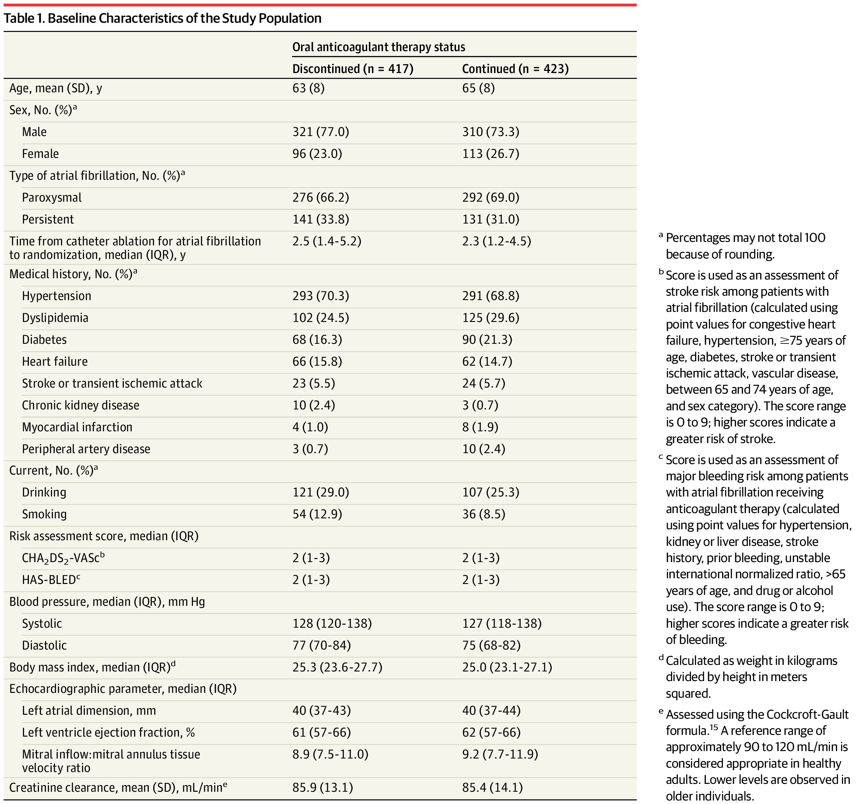
Population Characterizations

Slide 24
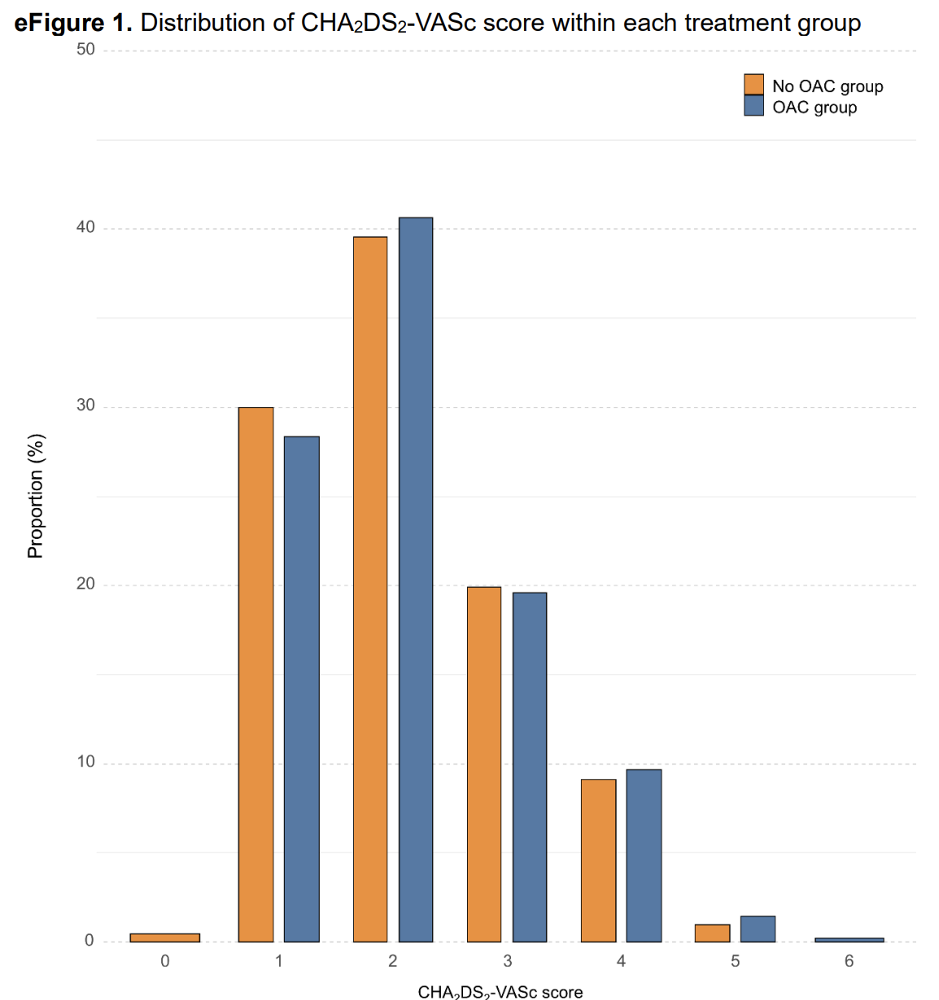

Slide 25
Primary Outcome
At 2 years - primary composite outcome occurred in 1 of 417 patients (0.3%) in no OAC vs 8 of 423 (2.2%) in OAC group
  Absolute difference: -1.9% (95% CI -3.5 to -0.3), P = 0.02

Slide 26
Secondary Outcomes
Ischemic stroke: 0.3% vs 0.8%
  Absolute difference: -0.5% (95% CI -1.6 to 0.6)
Major bleeding: 0 vs 1.4%
  Absolute difference: -1.4% (95% CI -2.6 to -0.2)
Systemic embolism: none
TIA 2 (0.6%) vs 0 (0%)
  Absolute difference: 0.6% (95% CI -0.2 to 1.3)
Non-Major bleed: 1.4% vs 1.9%, no clinical significance
MI, All-cause mortality: none

Slide 27
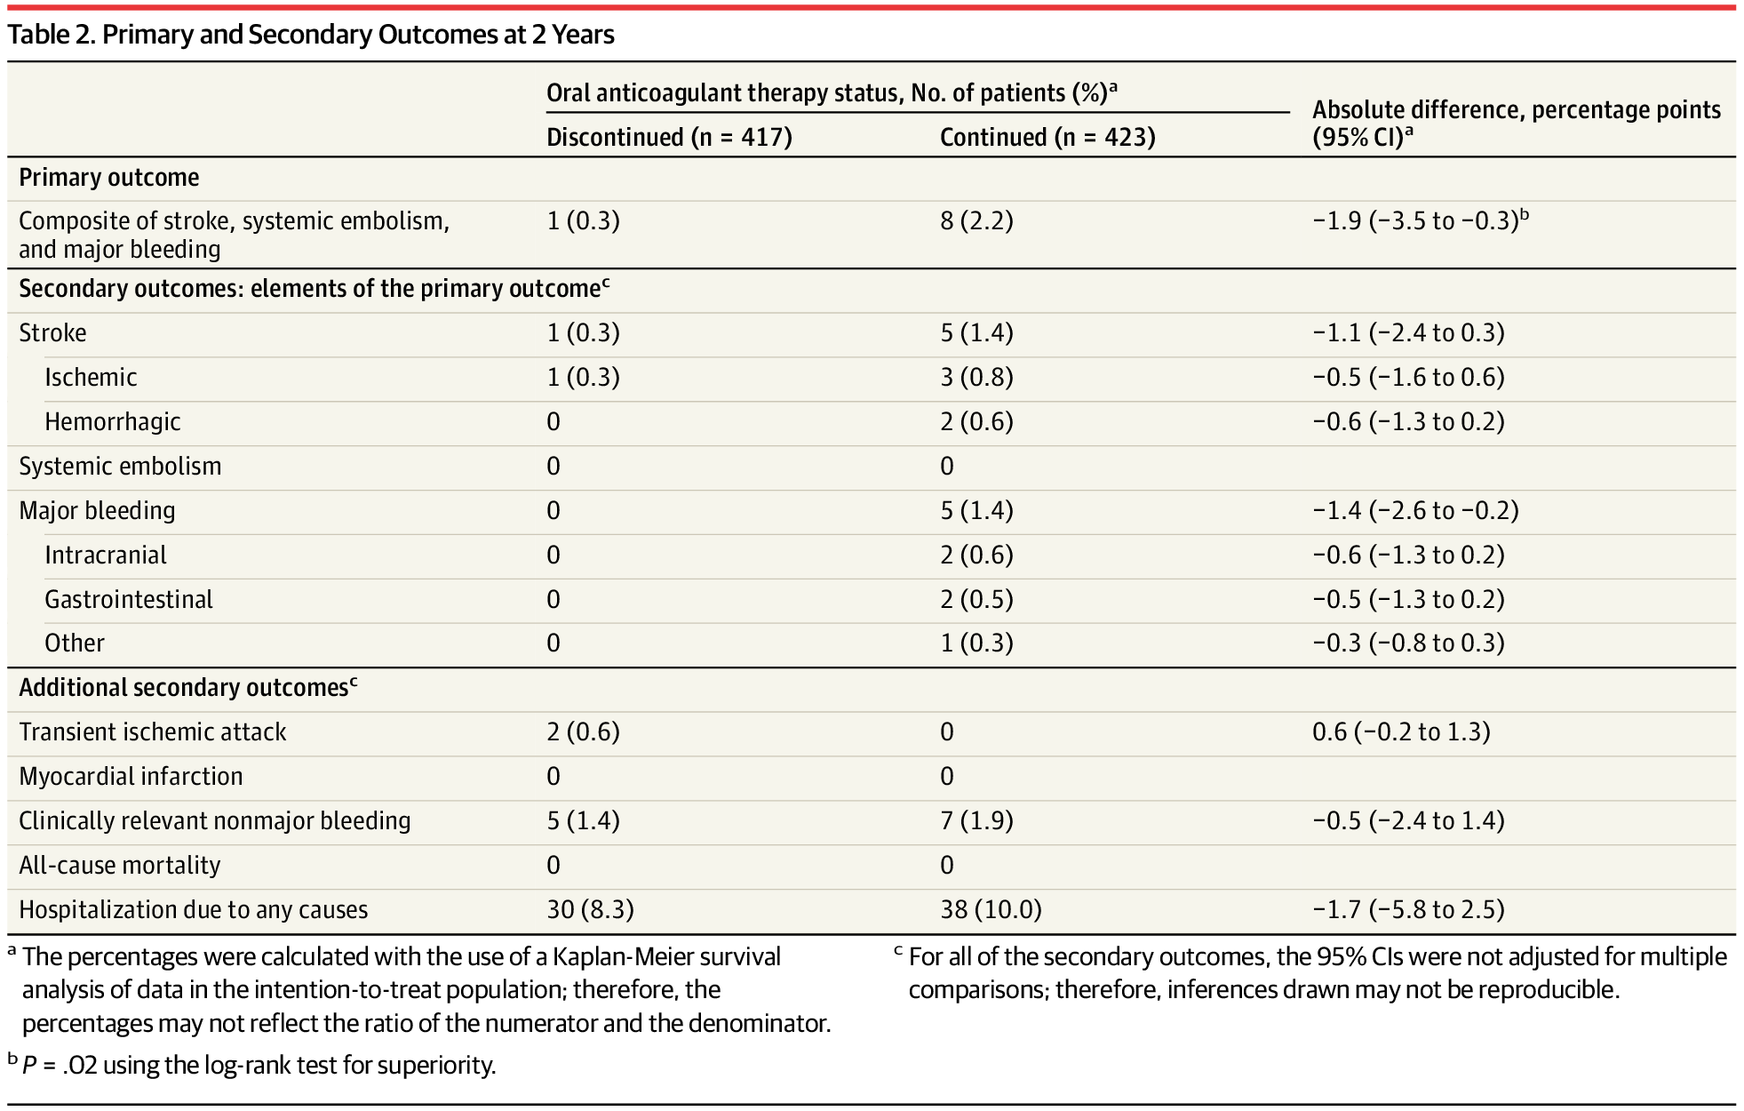

Slide 28
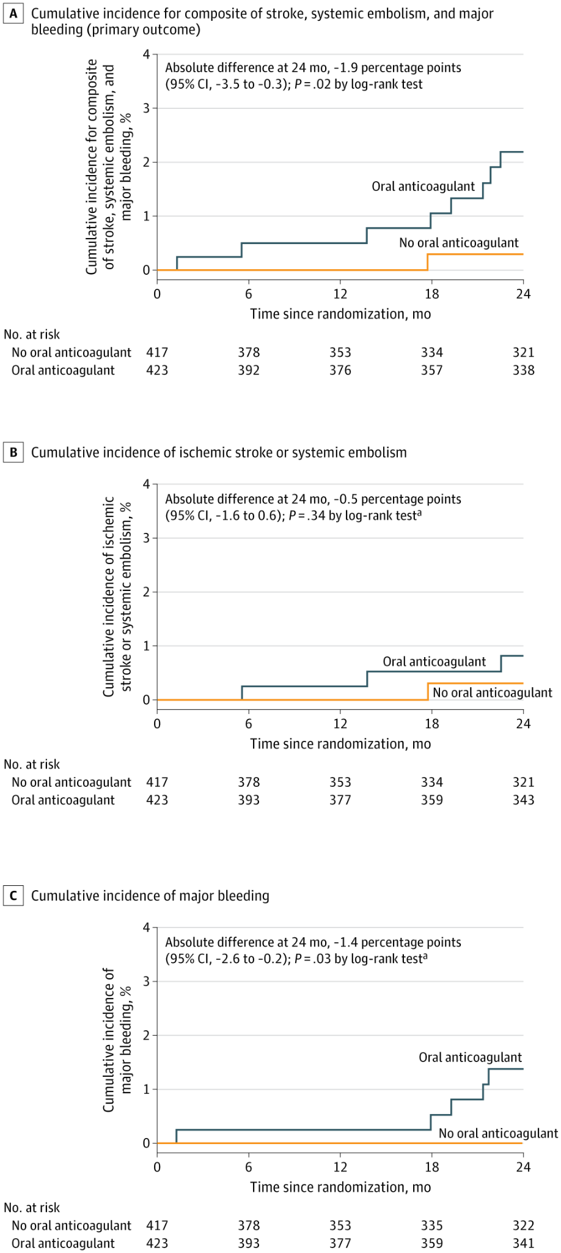

Slide 29
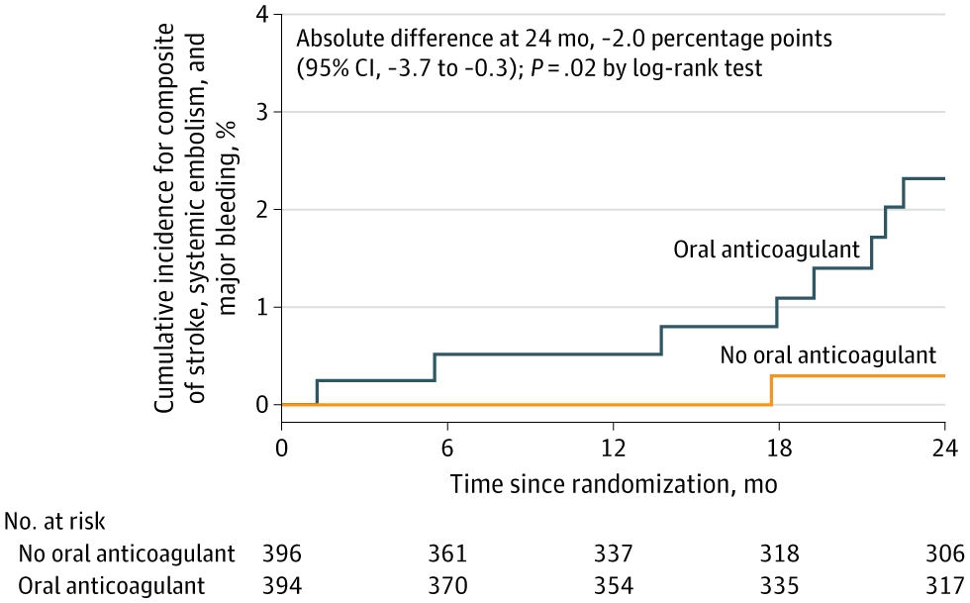

Slide 30
Discussion
First multicenter, randomized, clinical trial evaluation long term anticoagulation strategies in patients without documented AF recurrence after catheter ablation
Primary composite outcome of stroke, systemic embolism, and major bleed was lower after discontinuing oral anticoagulant therapy
Largely driven by reduction in major bleeding events (ischemic events remained comparable)
These results largely supports safety of anticoagulation discontinuation

Slide 31
Strengths
First randomized trial addressing this question
Contemporary DOAC use and ablation practice
Practical real-life rhythm monitoring
Clinically meaningful composite endpoint

Slide 32
Limitations
Open-label design
Low stroke/embolic event rate - underpowered to detect differences in stroke/embolic events - a potential disadvantage of stopping AC
Primary outcome composite of stroke, systemic embolism, and major bleeding - given higher bleeding events, this biases results in favor of discontinuing OACs
Caution applying to higher-risk patients, patients with prior stroke/TEE-documented thrombus history, or those with incomplete rhythm surveillance
Relatively low CHA₂DS₂-VASc of 2.1
Single-country (Korea), generalizability concerns
  Relatively healthier population
Follow-up limited to 2 years
Notes:
Bleeding reduction is obvious — stopping OAC stops bleeding
“Does intensive monitoring in the trial (Holters, clinic follow-up) mean we would miss recurrences in routine practice?” — Yes, monitoring intensity matters; stopping OAC safely likely depends on robust rhythm surveillance and mechanisms to re-start OAC promptly.

Slide 33
Comparison to Prior Evidence
Consistent with observational data (lower bleeding, no clear ↑ stroke)
Provides randomized support for stopping OAC in low/mod risk, well-monitored patients
Differs from guideline recommendations that mandate lifelong OAC by CHA₂DS₂-VASc

Slide 34
Guideline Implications
Current ESC/ACC/AHA guidelines: lifelong OAC if CHA₂DS₂-VASc ≥2 (men), ≥3 (women)
ALONE-AF suggests that in selected patient who have documented no AF recurrence ≥12 months after ablation, stopping DOAC may be reasonable
Shared decision-making critical
Future guidelines may emphasize individualized OAC strategy

Slide 35
Future Research
Longer follow-up beyond 2 years
Higher-risk patients (CHA₂DS₂-VASc ≥4)
Role of continuous wearable/implantable monitoring
Validation in non-Asian populations
Larger female population involvement

Slide 36
Take-Home Message
In selected, monitored patients free of AF ≥12 months post-ablation, stopping OAC was safe at 2 years
  Benefit driven by fewer major bleeds
  Not generalizable to all patients — requires careful selection
  Represents a paradigm shift towards individualized anticoagulation strategy

Slide 37
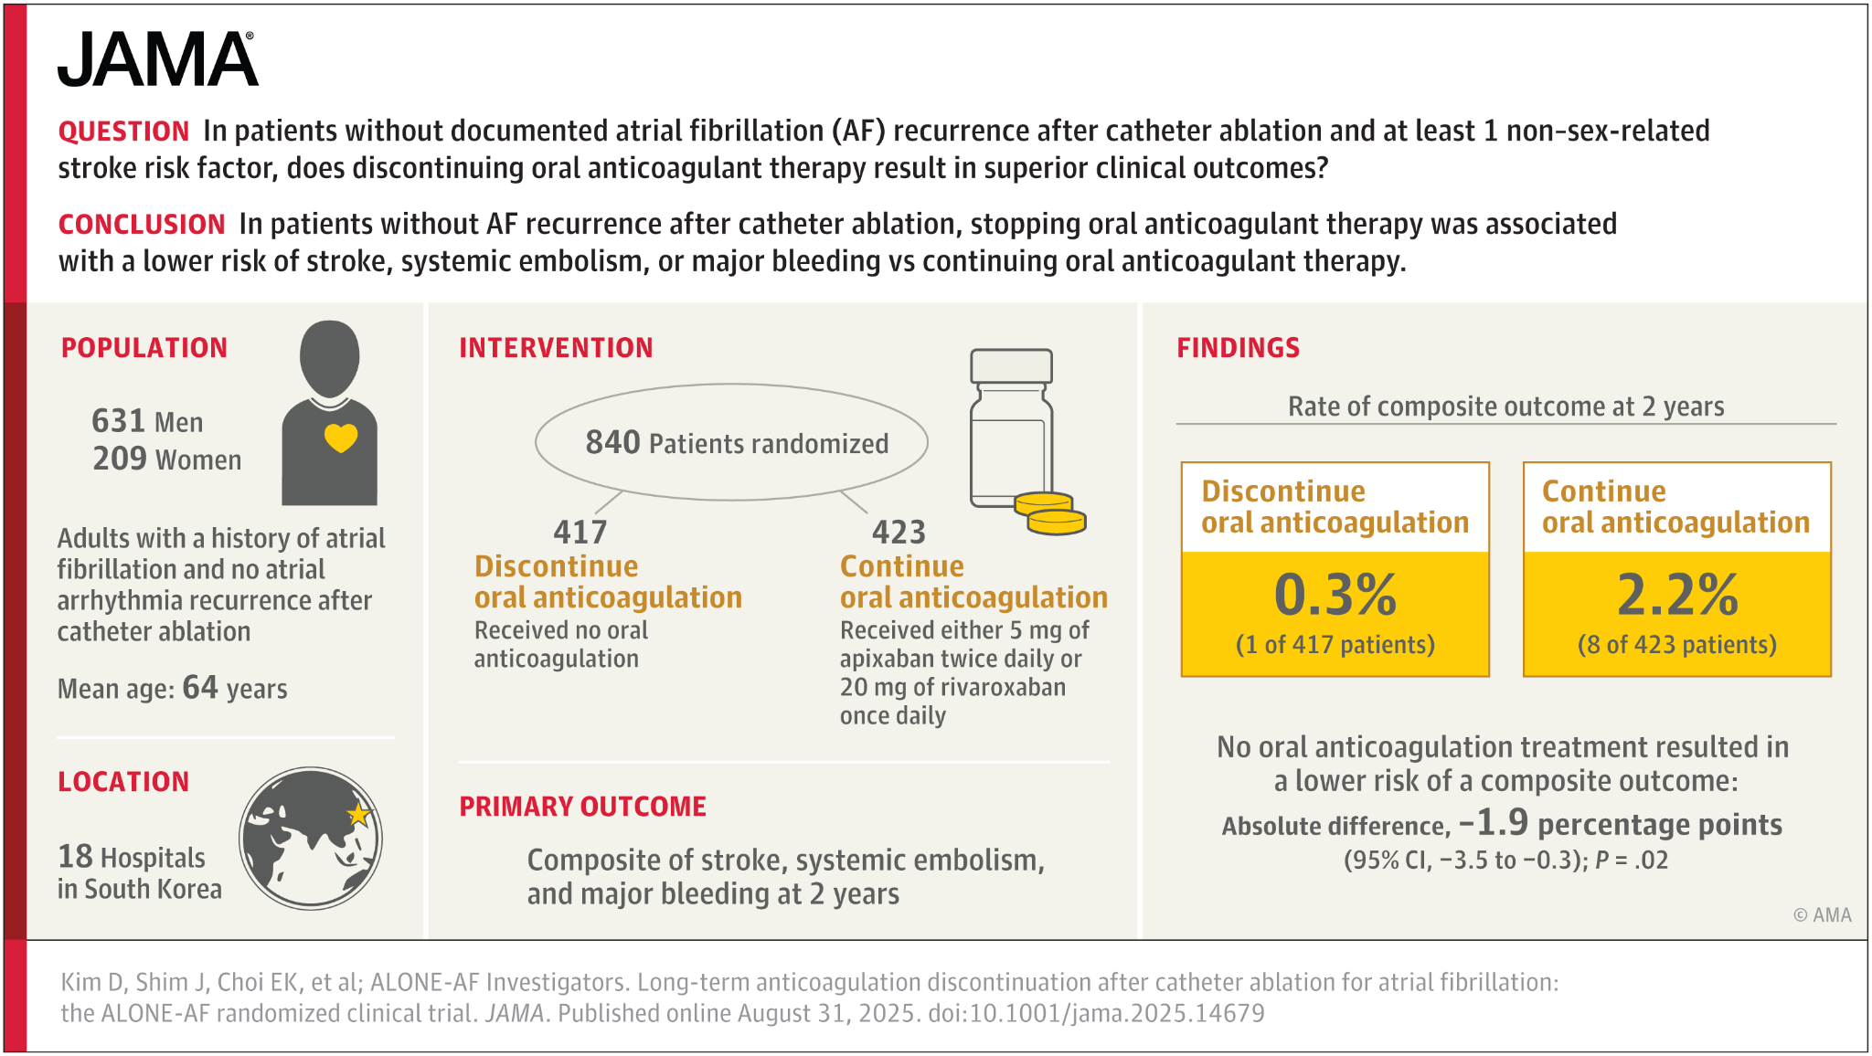

Slide 38
Key References
Kim D, Shim J, Choi E, et al. Long-Term Anticoagulation Discontinuation After Catheter Ablation for Atrial Fibrillation: The ALONE-AF Randomized Clinical Trial. JAMA. Published online August 31, 2025. doi:10.1001/jama.2025.14679
Kanaoka K, Nishida T, Iwanaga Y, Nakai M, Tonegawa-Kuji R, Nishioka Y, Myojin T, Okada K, Noda T, Kusano K, Miyamoto Y, Saito Y, Imamura T. Oral anticoagulation after atrial fibrillation catheter ablation: benefits and risks. Eur Heart J. 2024 Feb 16;45(7):522-534. doi: 10.1093/eurheartj/ehad798. PMID: 38117227; PMCID: PMC10873714.
Iwawaki T, Yanagisawa S, Inden Y, Hiramatsu K, Yamauchi R, Miyamae K, Miyazawa H, Goto T, Kondo S, Tachi M, Shimojo M, Tsuji Y, Murohara T. Discontinuation of Oral Anticoagulation After Successful Atrial Fibrillation Ablation. JAMA Netw Open. 2025 Mar 3;8(3):e251320. doi: 10.1001/jamanetworkopen.2025.1320. PMID: 40116829; PMCID: PMC11929034
Isabelle C Van Gelder, Michiel Rienstra, Karina V Bunting, et al. ESC Scientific Document Group , 2024 ESC Guidelines for the management of atrial fibrillation developed in collaboration with the European Association for Cardio-Thoracic Surgery (EACTS): Developed by the task force for the management of atrial fibrillation of the European Society of Cardiology (ESC), with the special contribution of the European Heart Rhythm Association (EHRA) of the ESC. Endorsed by the European Stroke Organisation (ESO), European Heart Journal, Volume 45, Issue 36, 21 September 2024, Pages 3314–3414, https://doi.org/10.1093/eurheartj/ehae176
Joglar JA, Chung MK, Armbruster AL, et al., Peer Review Committee Members. 2023 ACC/AHA/ACCP/HRS Guideline for the Diagnosis and Management of Atrial Fibrillation: A Report of the American College of Cardiology/American Heart Association Joint Committee on Clinical Practice Guidelines. Circulation. 2024 Jan 2;149(1):e1-e156. doi: 10.1161/CIR.0000000000001193. Epub 2023 Nov 30. Erratum in: Circulation. 2024 Jan 2;149(1):e167. doi: 10.1161/CIR.0000000000001207. Erratum in: Circulation. 2024 Feb 27;149(9):e936. doi: 10.1161/CIR.0000000000001218. Erratum in: Circulation. 2024 Jun 11;149(24):e1413. doi: 10.1161/CIR.0000000000001263. PMID: 38033089; PMCID: PMC11095842.

Slide 39

Thank you!

