Slide 1

SENIOR-RITA trial and a recent Meta-analysis of RCTs
Presented by:
Mohamed Hamed
PGY-6
FAU CVD Fellowship

Slide 2
Disclosures
Neither the planners nor the speakers have financial disclosure or conflict of interests with the presented material in this presentation

Slide 3
Question?
Lack of Pharmacologic and invasive treatment guidelines for older patients with acute coronary syndromes

Slide 4
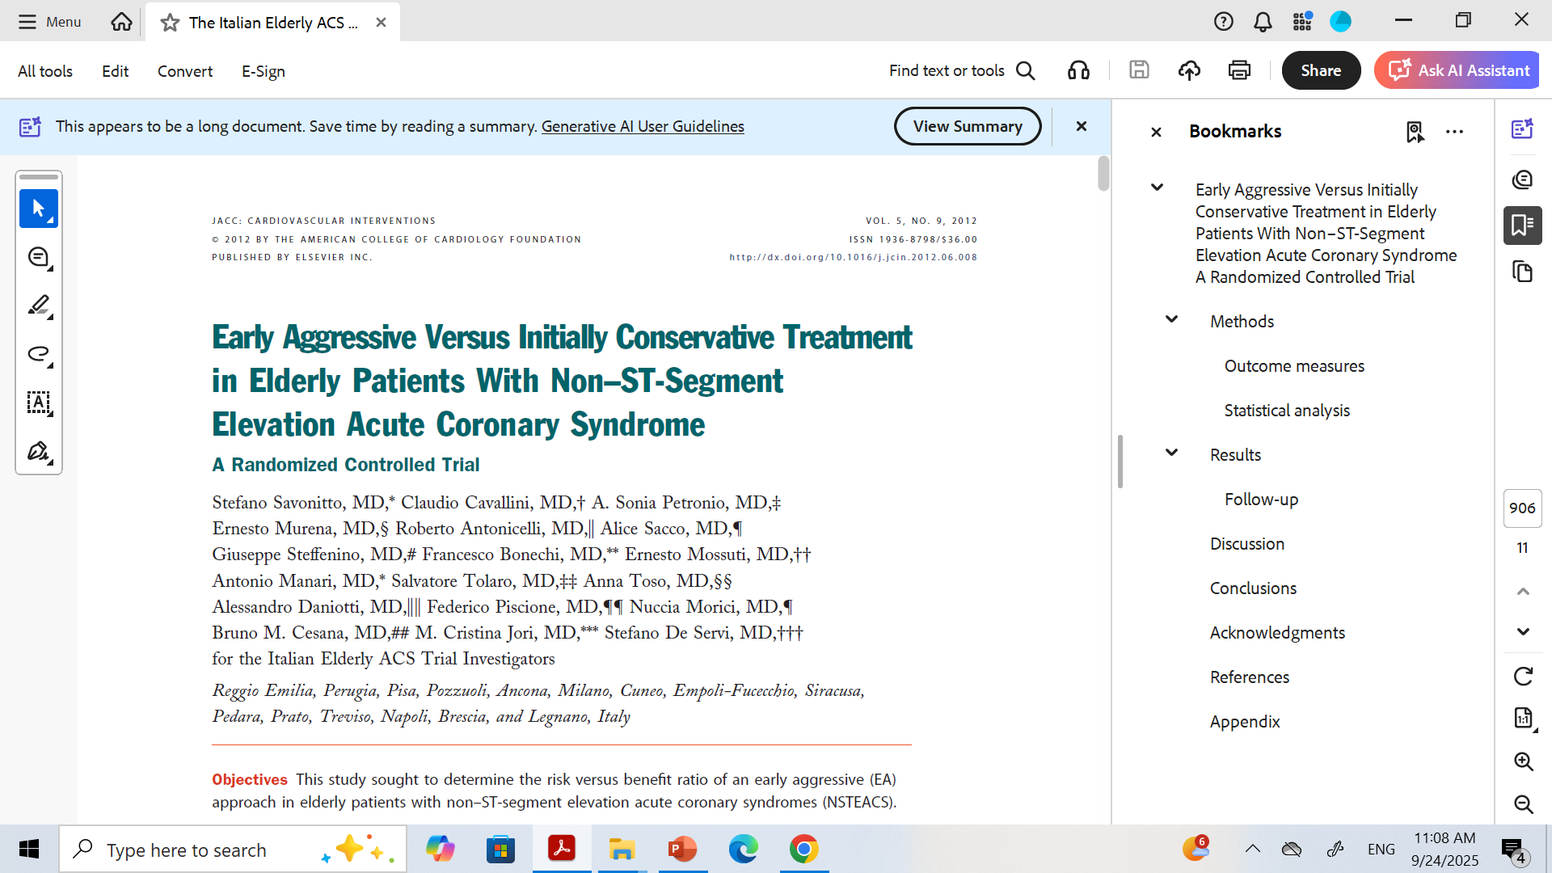
Italian Elderly ACS Trial (2012, JACC Intv)

Slide 5

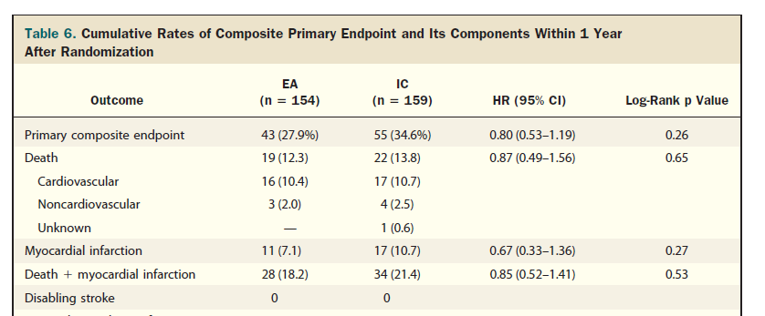
Population: 313 patients ≥75 yrs with NSTEMI.
Design: Early aggressive vs initially conservative strategy within 72 hrs
Primary outcome: Composite of death, MI, stroke, or rehospitalization at 1 yr.
Results: No overall significant difference.

Slide 6
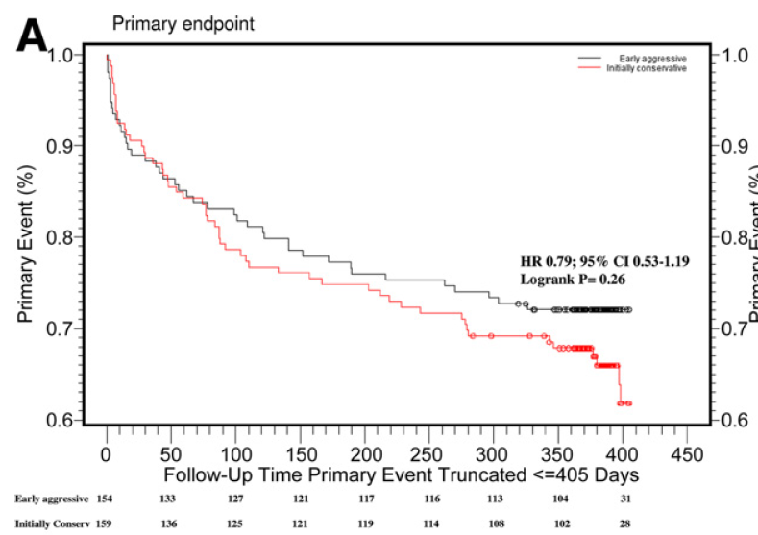

Slide 7
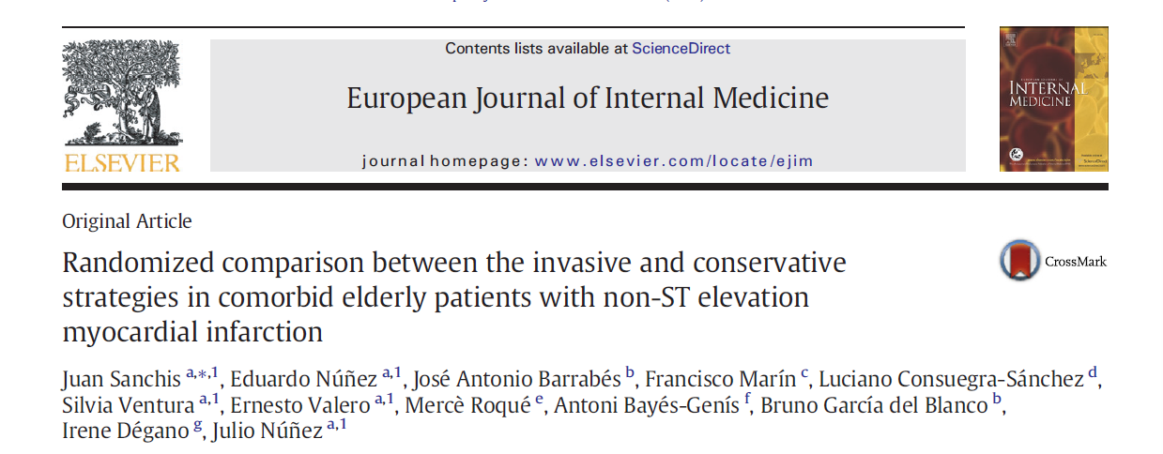
MOSCA trial 2016

Slide 8
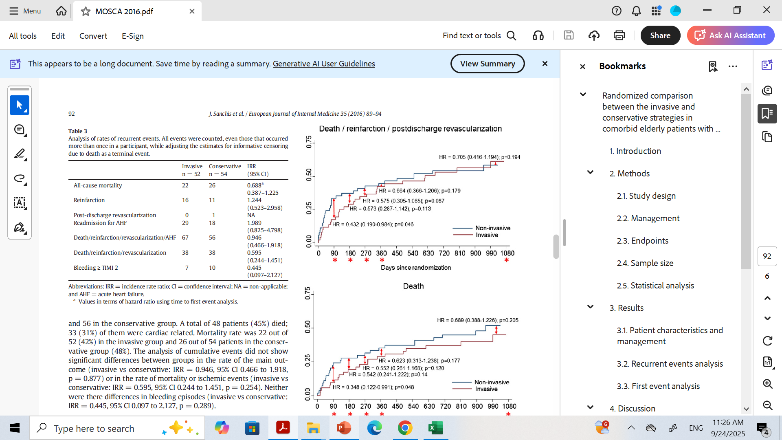
Population: 106 patients ≥70 yrs with NSTEMI and ≥2 significant comorbidities (peripheral artery disease, cerebral vascular disease, dementia, chronic pulmonary disease, chronic renal failure or anemia.
Design: Invasive vs conservative strategy.
Primary outcome: All-cause mortality at 2.5 yrs.
Results: No difference in mortality

Slide 9
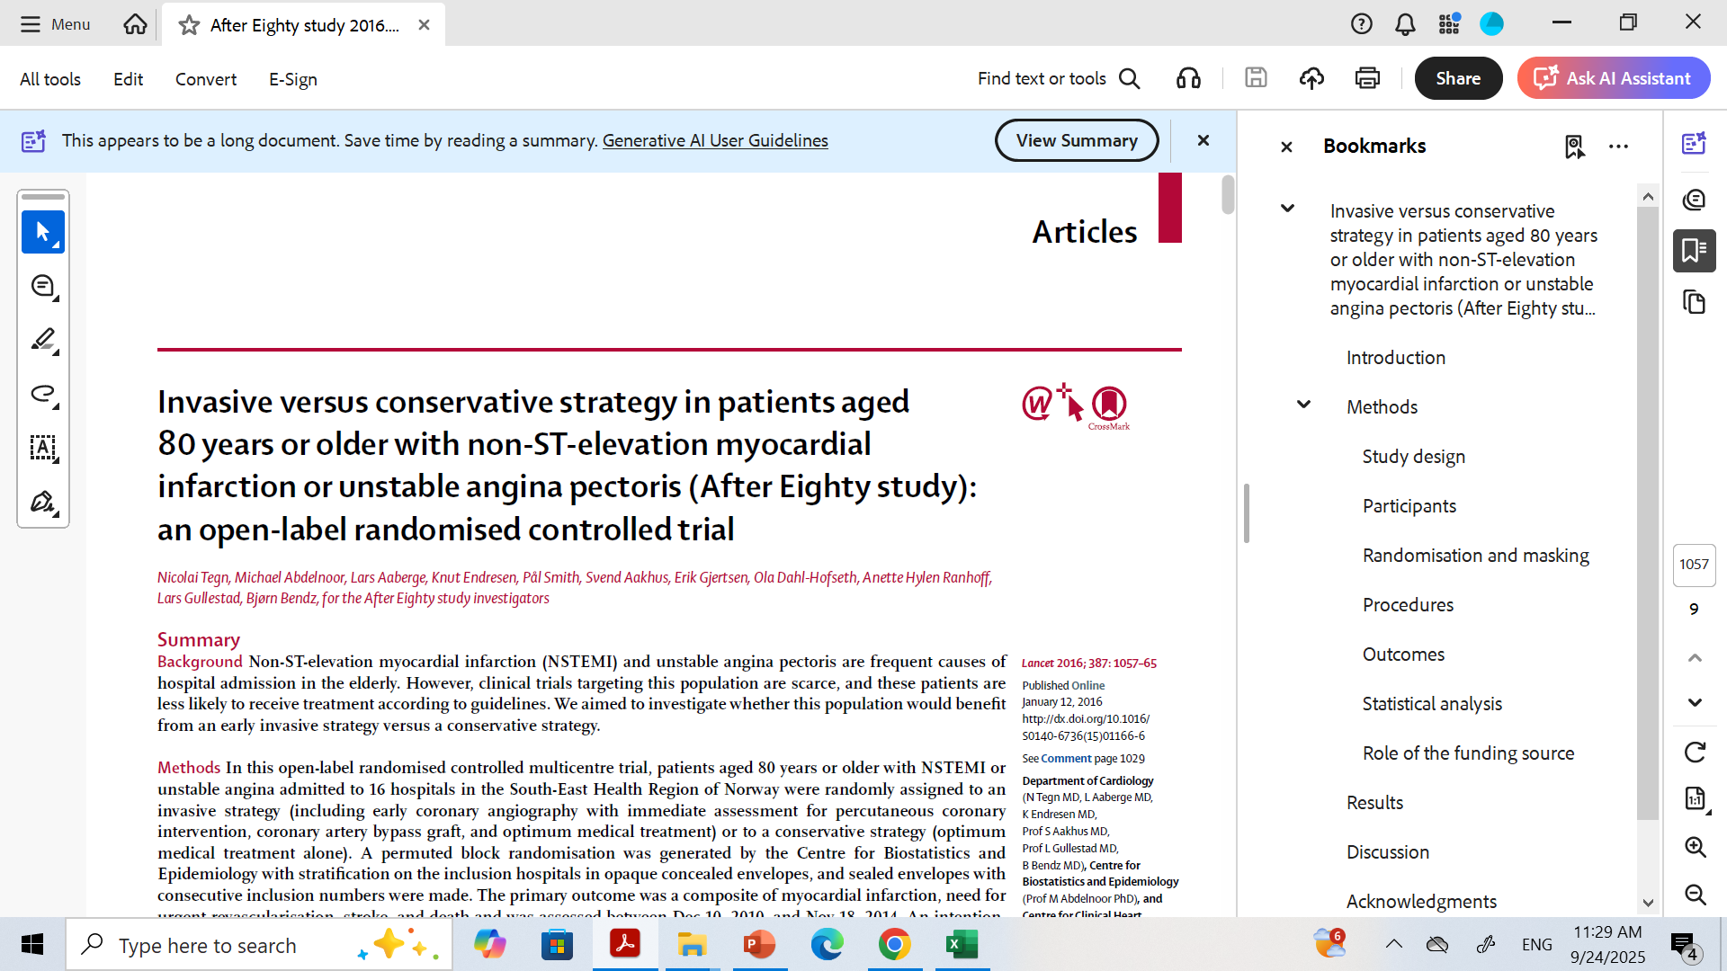
After Eighty Trial (2016, Tegn et al., Lancet)

Slide 10
Population: 457 patients ≥80 years with NSTEMI or unstable angina.
Design: Invasive (early angiography ± PCI/CABG) vs conservative (optimal medical therapy, cath only if refractory).
Primary outcome: Composite of MI, urgent revascularization, stroke, or death.
Results:
Primary outcome reduced (40.6% invasive vs 61.4% conservative; HR ~0.53).
Benefit mainly driven by fewer MIs and urgent revascularizations.
Mortality alone not significantly reduced.
Takeaway: Routine invasive strategy reduced ischemic events in patients ≥80 yrs.

Slide 11
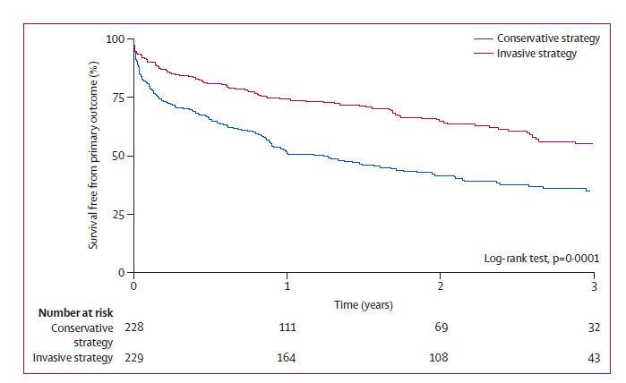
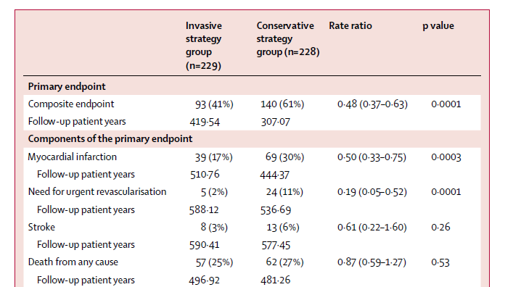

Slide 12
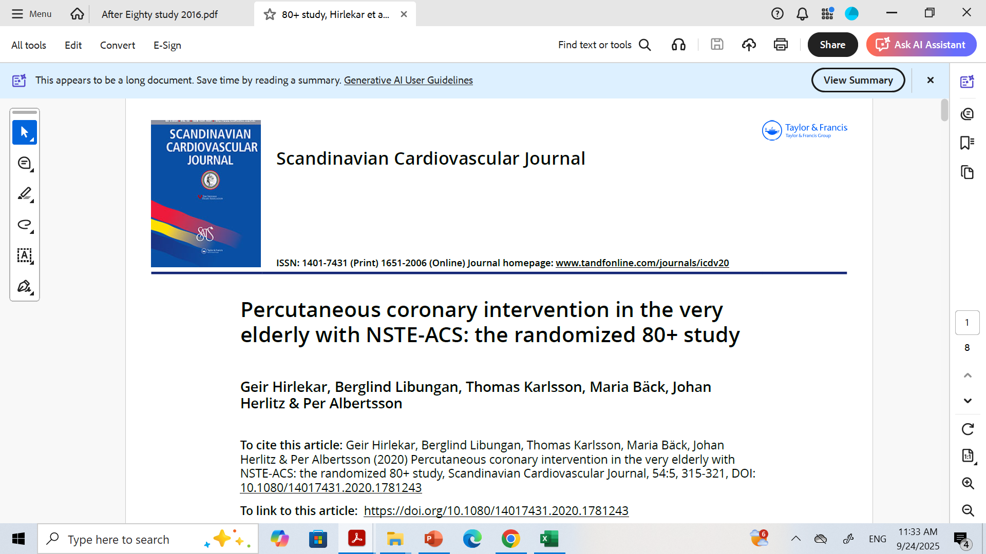
80+ study

Slide 13
Population: 186 patients ≥80 years with NSTEMI or unstable angina.
Design: Patients with NSTE-ACS to an invasive strategy with coronary angiography and optimal medical treatment or a conservative strategy with only optimal medical treatment.
Primary outcome: Combined endpoint of major adverse cardiac and cerebrovascular events (MACCE).
Results:
No difference in primary outcome

Slide 14
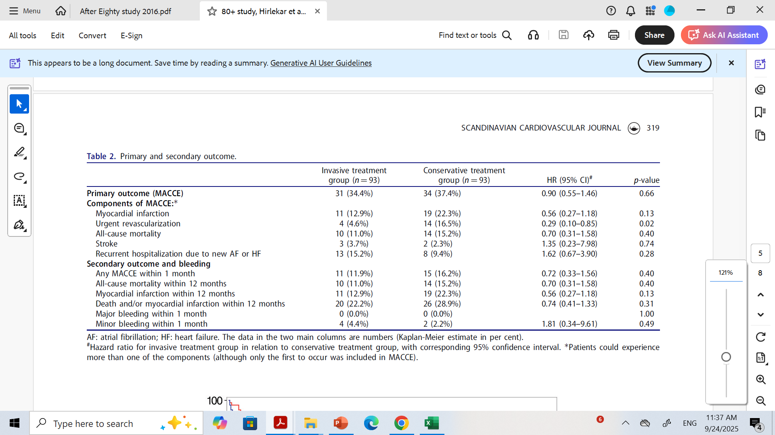
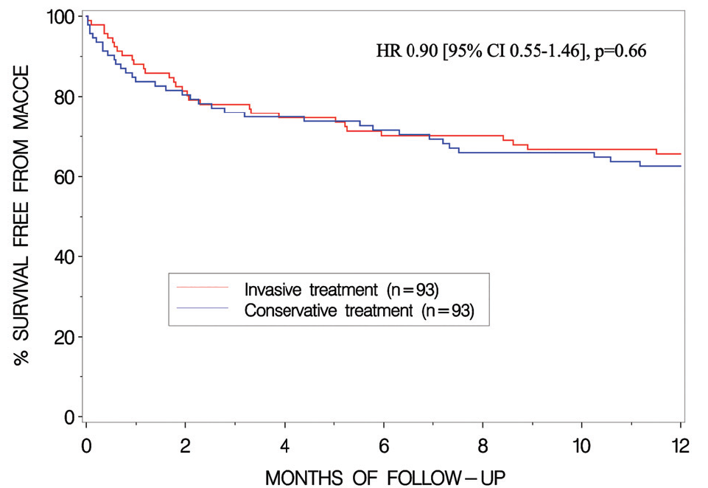

Slide 15
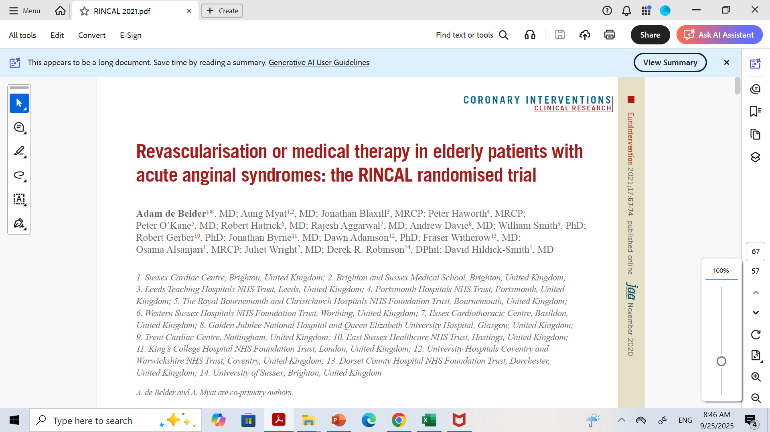
RINCAL Trial (2021, EuroIntervention)
Population: ~251 patients ≥80 yrs with NSTEMI.
Design: Invasive-guided therapy + OMT vs OMT alone.
Primary outcome: Composite of CV death, nonfatal MI, or readmission with ischemia.
Results:
Event rates lower in invasive arm 18.5% vs 22.2%, but study underpowered (did not reach statistical significance).
Early revascularization reduced unplanned MI/revascularization but not mortality.

Slide 16
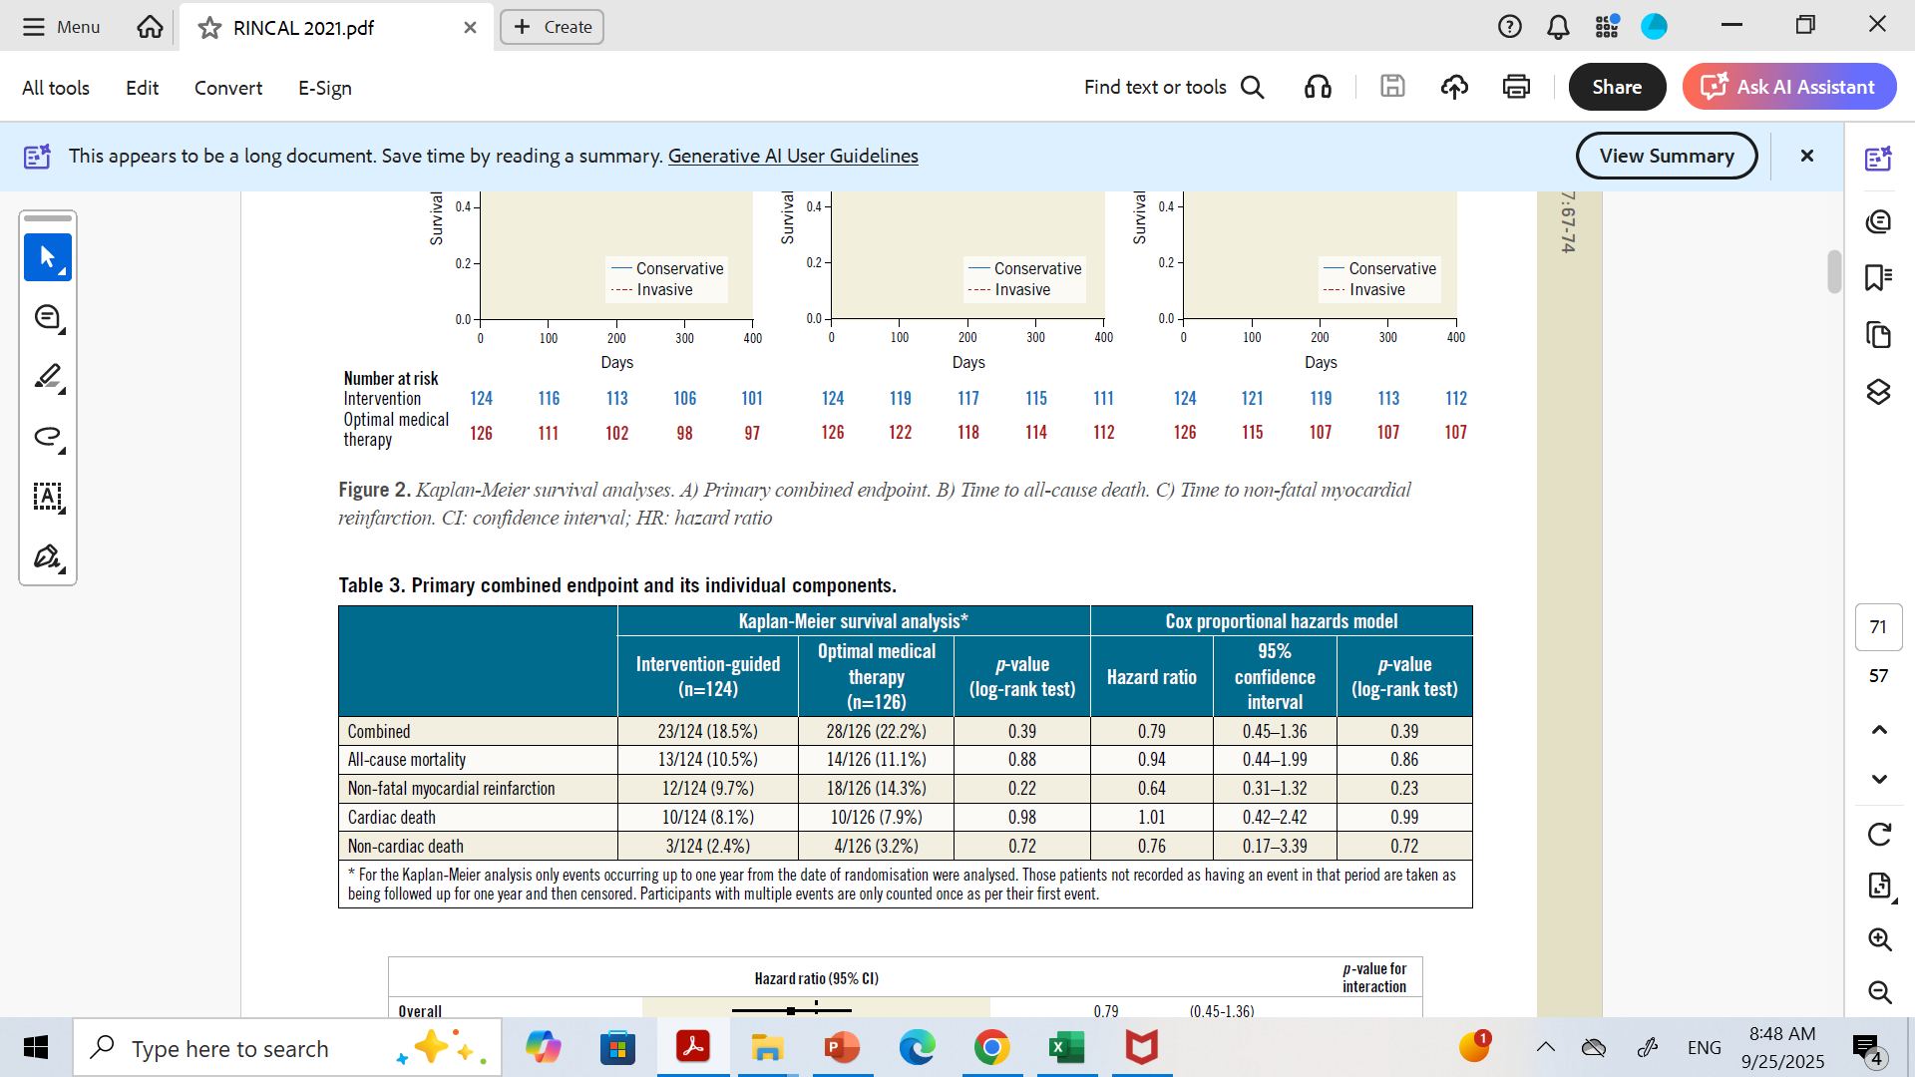

Slide 17
MOSCA-FRAIL Trial (2023, JAMA)
Population: 167 frail patients ≥70 yrs with NSTEMI (frailty defined by Clinical Frailty Scale ≥4).
Design: Invasive vs conservative.
Primary outcome: Days alive and out of hospital at 1 year.
Results:
No significant difference between groups.
Early invasive strategy linked to higher early complications.
Takeaway: In frail elderly, invasive approach offers no clear benefit and may add harm.

Slide 18
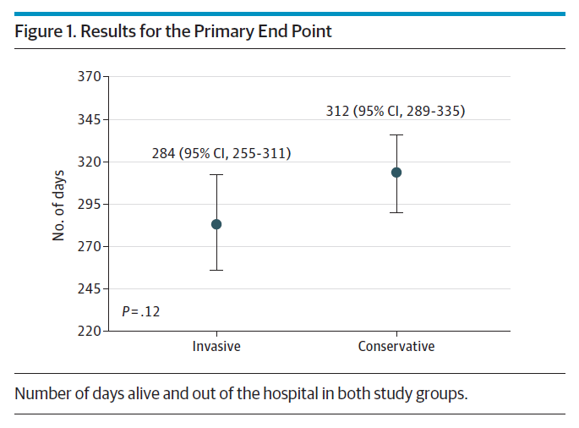
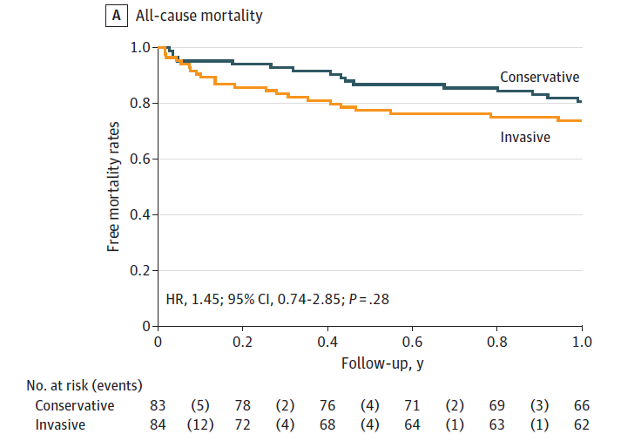

Slide 19
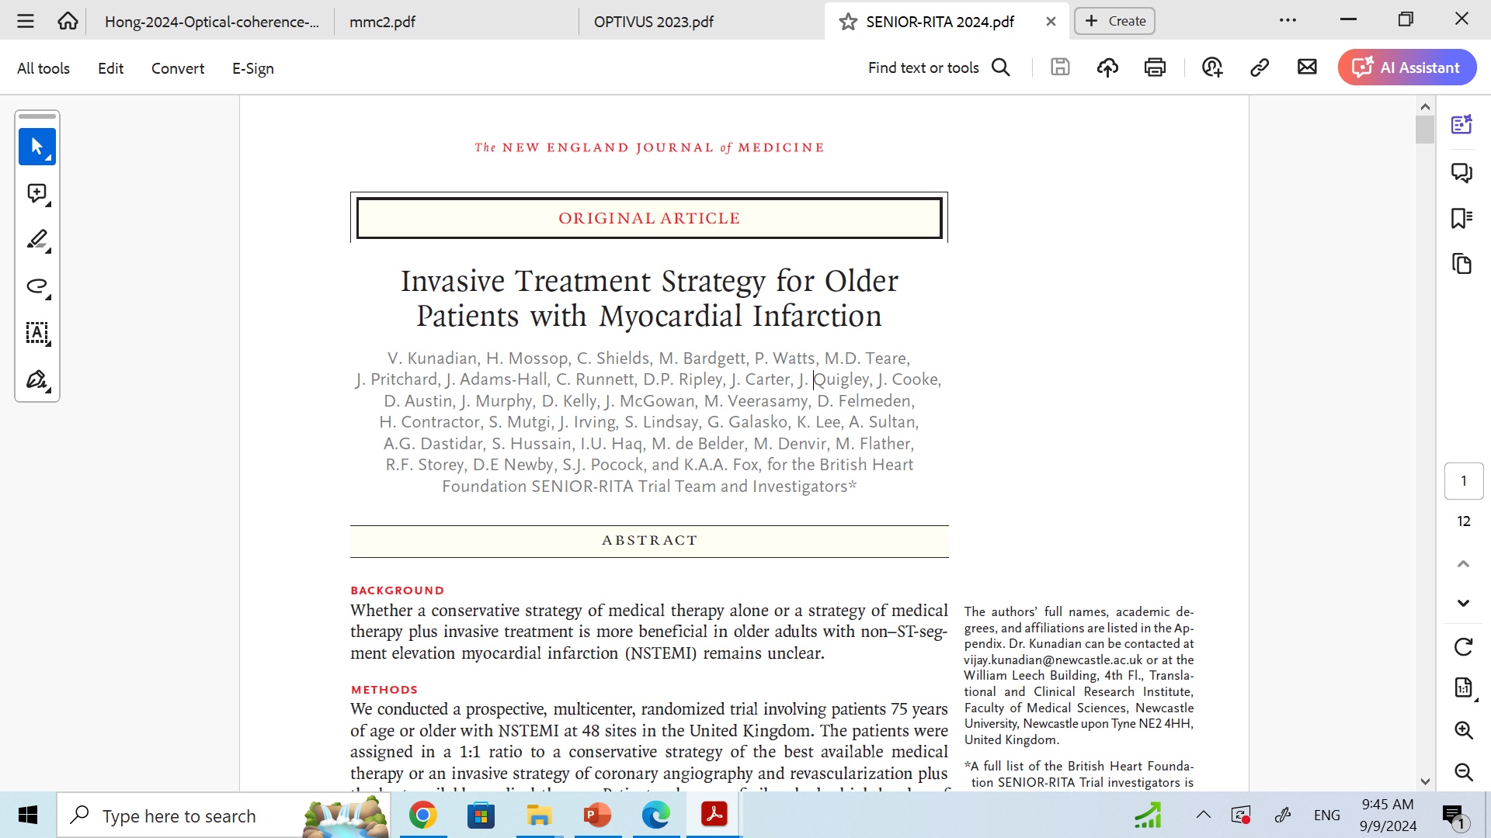

Slide 20
Introduction
Specific pharmacologic and invasive treatment guidelines for older patients with acute coronary syndromes are lacking owing to the underrepresentation of older patients in clinical trials.
SENIOR-RITA (Older Patients with Non–ST-Segment Elevation Myocardial Infarction Randomized Interventional Treatment) trial evaluated the potential beneficial effects of a routine invasive approach compared with a conservative approach of the best available medical treatment in a broadly representative population of older patients, including frail patients, presenting with NSTEMI and coexisting conditions.

Slide 21
Methods
Prospective
Multicenter
open-label
randomized controlled trial
patients who were least 75 years of age with NSTEMI
invasive strategy vs. conservative treatment strategy

Slide 22
Inclusion criteria
At least 75 years of age
Patients with a type 1 NSTEMI during the index hospitalization
Myocardial infarction (MI) is defined by the fourth universal definition.

Slide 23
Exclusion criteria
1. Patients presenting with STEMI or unstable angina
2. Patients with cardiogenic shock
3. Patients with a known life expectancy of <1 year
4. Unable to provide written informed consent
5. Previous randomization in the SENIOR RITA trial
6. Inability to undergo invasive coronary angiography, such as no vascular access site, or absolute contraindication to coronary revascularization

Slide 24
Frailty, Coexisting Conditions, and Cognitive Impairment
Frailty by Fried Frailty Index
modified Rockwood Clinical Frailty Scale
Charlson Comorbidity Index
Montreal Cognitive Assessment

Slide 25
Frailty was assessed with the use of the Fried Frailty Index
(three categories of patient frailty graded on five criteria):
Criteria: Shrinking, Physical endurance/energy, Low physical activity, Weakness and Slow walking speed
Frail: ≥3 criteria present
Intermediate or Pre-Frail:1 or 2 criteria present
Robust: 0 criteria Present

Slide 26
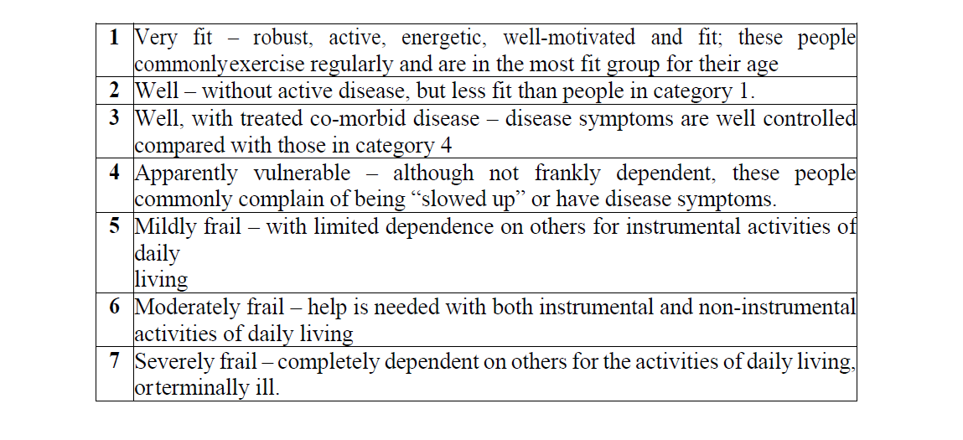
Modified Rockwood Clinical Frailty Scale
ranging from 1 [very fit] to 7 [severely frail], with a score of 5 or greater indicating frailty

Slide 27
Charlson Comorbidity Index
Assess degree of coexisting conditions that was graded according to age-adjusted scores
Range, 0 to 37, with higher scores indicating a greater burden of coexisting conditions

Slide 28
Cognitive impairment
It was evaluated with the use of the Montreal Cognitive Assessment (MoCA; range, 0 to 30, with a score of 26 or higher indicating normal cognitive function)

Slide 29
Randomization
Randomly assigned in a 1:1 ratio
- invasive-treatment strategy of coronary angiography (and if appropriate, coronary revascularization) plus the best available medical therapy (the invasive-strategy group)
OR
- only the best available medical therapy (the conservative-strategy group).

Slide 30
Best available medical therapy
aspirin (at a dose of 75 mg daily)
a P2Y₁₂ receptor antagonist
statin therapy
a beta-blocker (to reach a target heart rate of 60 to 70 beats per minute)
Angiotensin-converting enzyme inhibitor or angiotensin II receptor blocker.
Management of hypertension, diabetes, and hypercholesterolemia was in accordance with the relevant clinical practice guidelines.

Slide 31
Coronary angiography
On the basis of angiographic findings, coronary revascularization was performed within 3 to 7 days, when feasible, by either percutaneous coronary intervention (PCI) or coronary-artery bypass grafting (CABG) at the discretion of the attending cardiologist and the multidisciplinary team.
In the conservative-therapy group, coronary angiography was allowed if the patient had clinical deterioration and the procedure was clinically indicated in the judgment of the treating physicians.

Slide 32
Outcomes
The primary outcome, assessed in a time-to-event analysis
- Composite of cardiovascular death or nonfatal myocardial infarction, as defined by the fourth universal definition of myocardial infarction.

Slide 33
Key secondary outcomes were cardiovascular death, nonfatal myocardial infarction, a composite of death from any cause or nonfatal myocardial infarction, death from any cause, recurrent myocardial infarction, subsequent coronary angiography, subsequent coronary revascularization, hospitalization for heart failure, stroke, transient ischemic attack, and bleeding (as defined by the Bleeding Academic Research Consortium criteria).
Safety outcomes included procedural and in-hospital complications occurring in patients in the invasive-strategy group.

Slide 34
Statistical Analysis
Assuming 20% risk of a primary-outcome event in the conservative-therapy group at 12 months and aimed to detect a 16% risk of a primary-outcome event in the invasive-therapy group, which corresponds to a hazard ratio of 0.78.
Estimated sample size was 1668 patients would provide at least 688 events of cardiovascular death or nonfatal myocardial infarction (with a minimum follow-up period of 1 year and maximum of 5 years), which would provide the trial with 90% power to detect a hazard ratio of 0.78 at a two-sided type I error rate of 0.05 with the use of a log-rank test.
Analyses used an intention-to-treat basis
Cumulative incidence was estimated with Kaplan–Meier methods
log-rank test was used and stratified according to the Rockwood frailty status at baseline
a proportional-hazards model, with adjustment for Rockwood frailty status

Slide 35
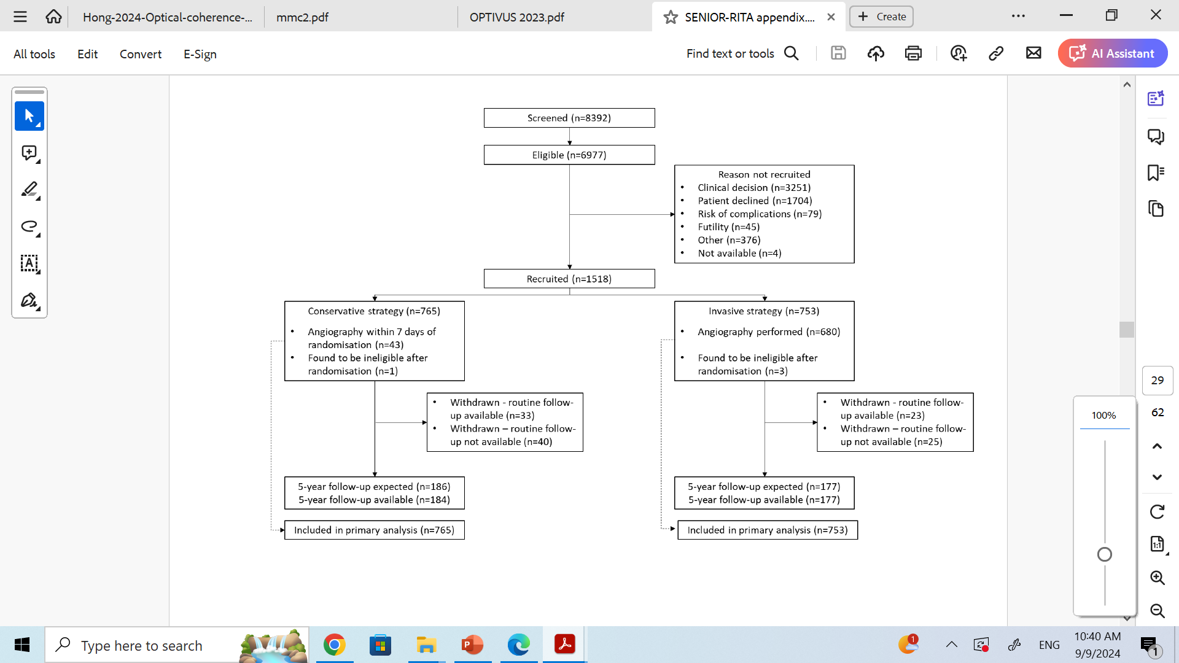

Slide 36
Results
From November 2016 through March 2023, a total of 6977 eligible patients from 48 National Health Service trusts across England and Scotland underwent screening then 1518 were randomized with 5 years follow up
55% received invasive treatment
44% received conservative care
1% received palliative care

Slide 37
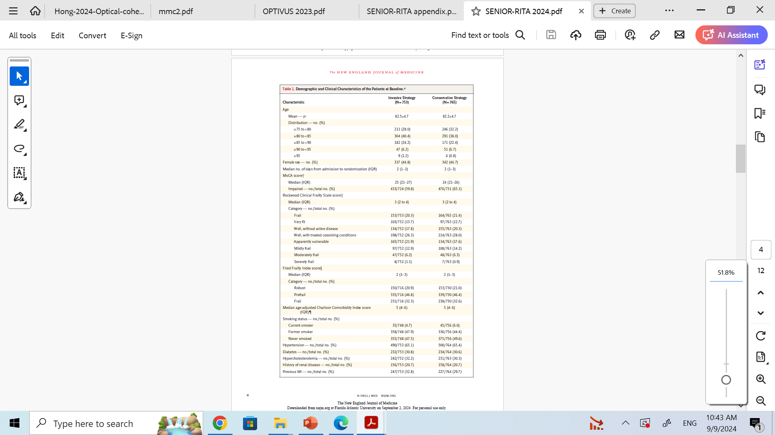

Slide 39
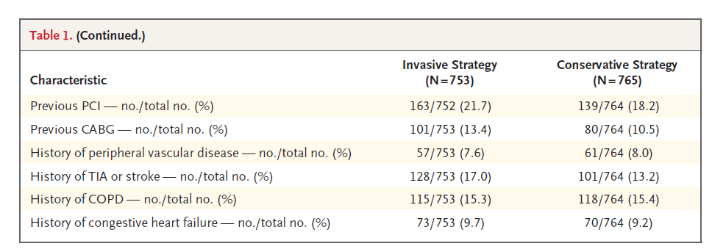

Slide 40
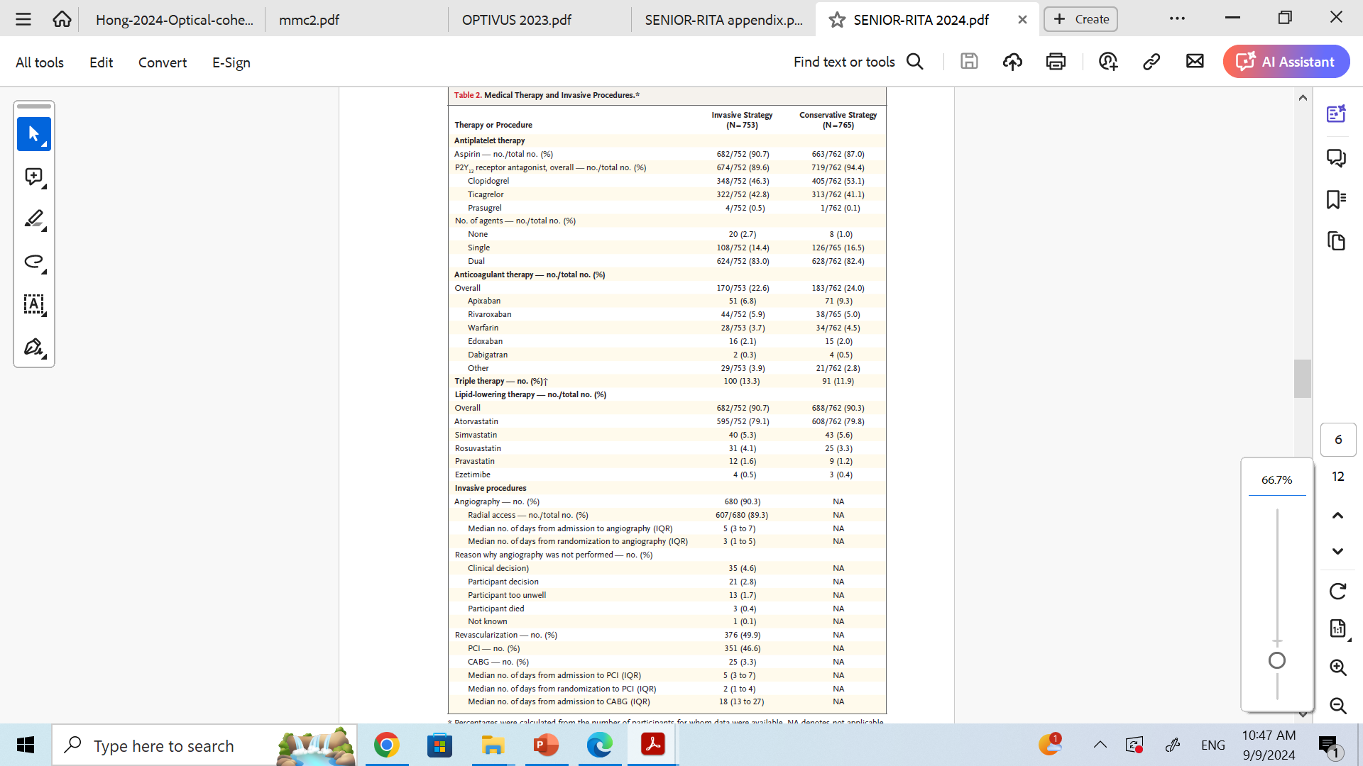

Slide 43
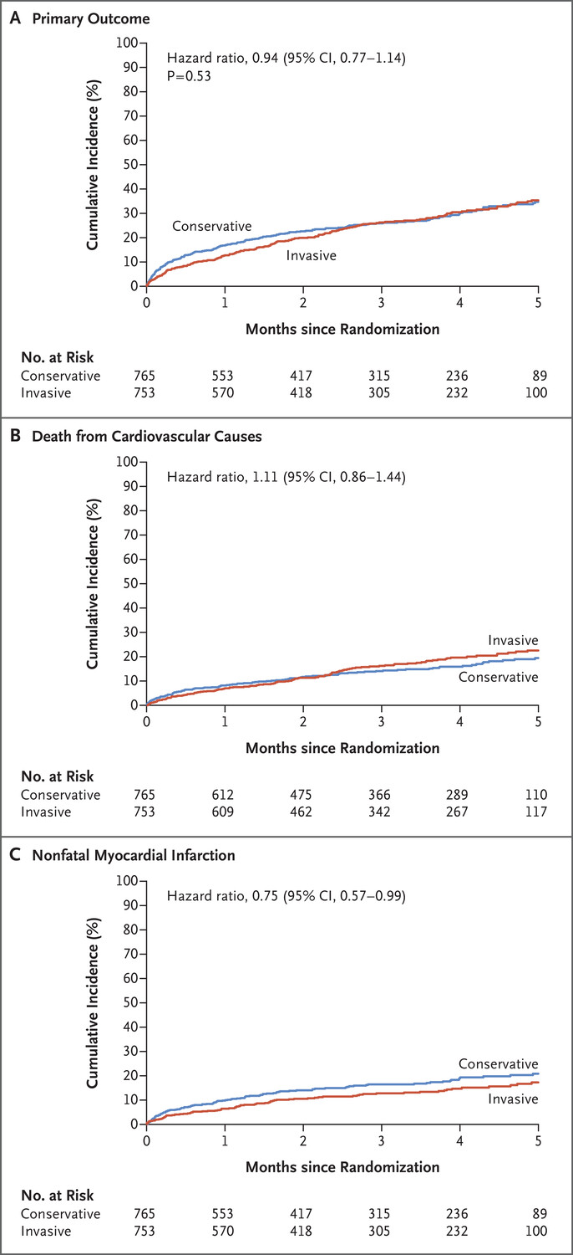
Cardiovascular death or nonfatal myocardial infarction occurred in 193 of the patients (25.6%) in the invasive-strategy group and in 201 of the patients (26.3%) in the conservative-strategy group (hazard ratio, 0.94; 95% confidence interval [CI], 0.77 to 1.14; P=0.53)

Slide 44
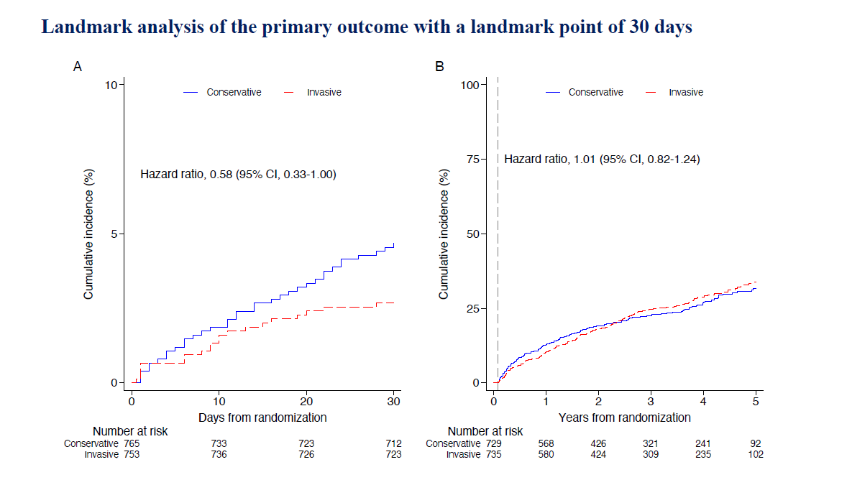

Slide 46
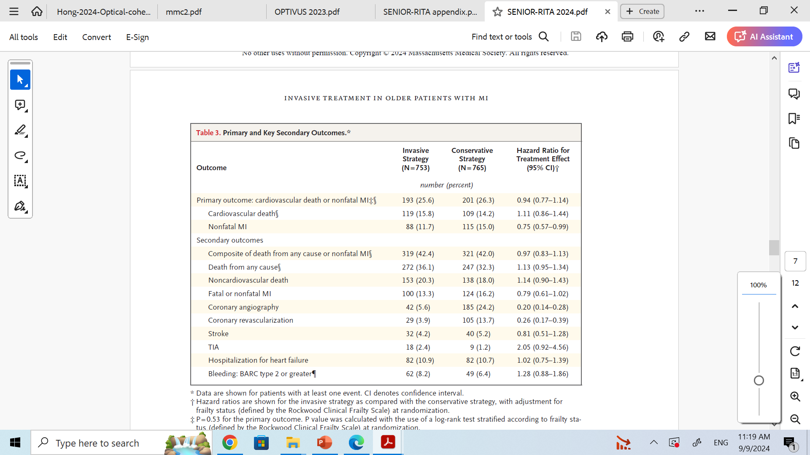

Slide 47
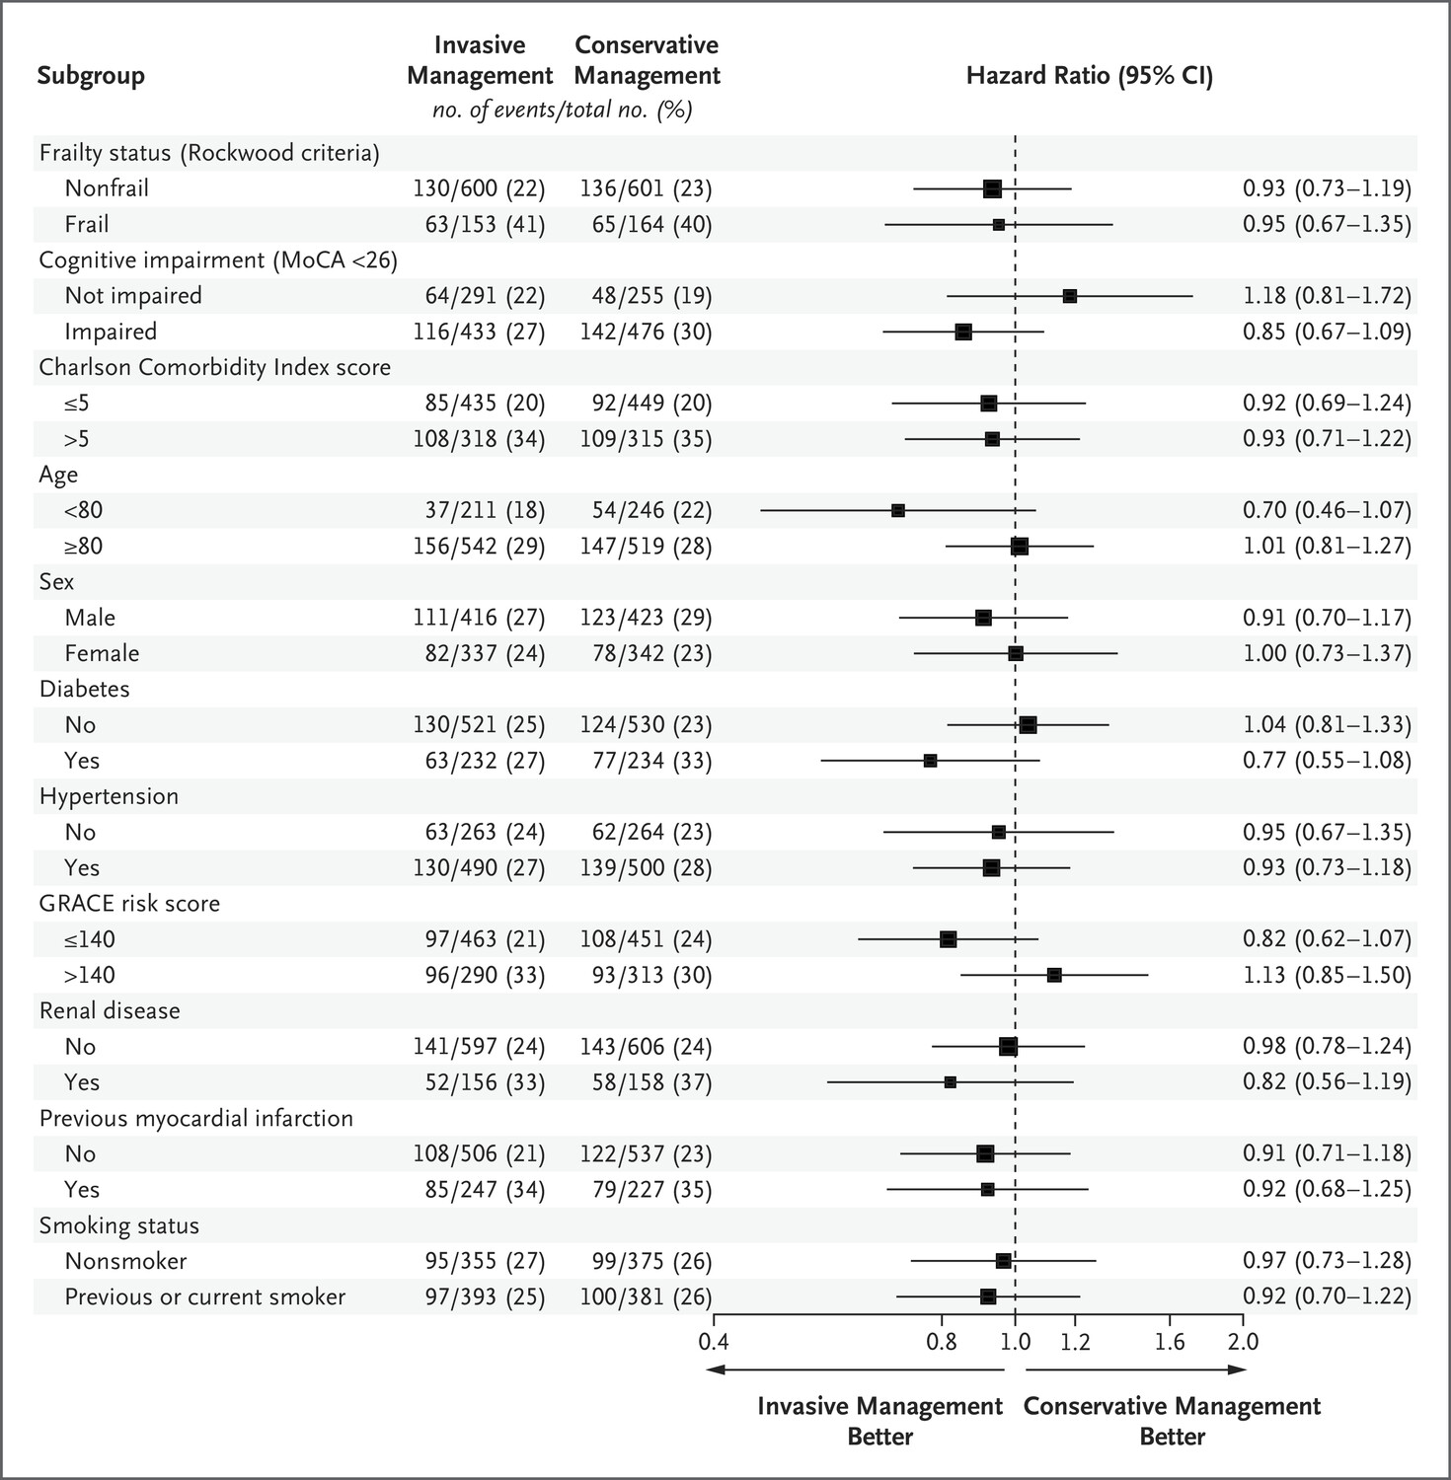

Slide 48
Discussion
Trial showed that among older adults with NSTEMI, the invasive strategy did not result in a significantly lower risk of a primary-outcome event, a composite of cardiovascular death or nonfatal myocardial infarction, than conservative strategy over a median follow-up period of 4.1 years.
Trial included a subgroup of patients who were frail (32.4%) and cognitively impaired (62.5%) and had a high burden of coexisting conditions, features that emphasize the generalizability of our findings to the population of older adults with NSTEMI.

Slide 49
Limitations
Final sample size was 1518, as opposed to the planned 1668, with a lower incidence of primary-outcome events than was anticipated.
The Covid-19 pandemic affected recruitment, especially the recruitment of frail, older patients with a high burden of coexisting conditions, and the decision was made to end recruitment without further extension beyond the funded recruitment period.

Slide 50
One strength of the trial is that the patients who did not undergo randomization had similar clinical and demographic characteristics (mean age, 82 years; 47% women) to patients who had undergone randomization, with 55% assigned to the invasive strategy and 44% to the conservative strategy, thereby strengthening the representativeness of the trial population and the generalizability of our findings

Slide 51
Conclusion
Among older adults with NSTEMI, an invasive strategy did not result in a lower risk of a composite of death or nonfatal infarction than a conservative strategy.

Slide 52
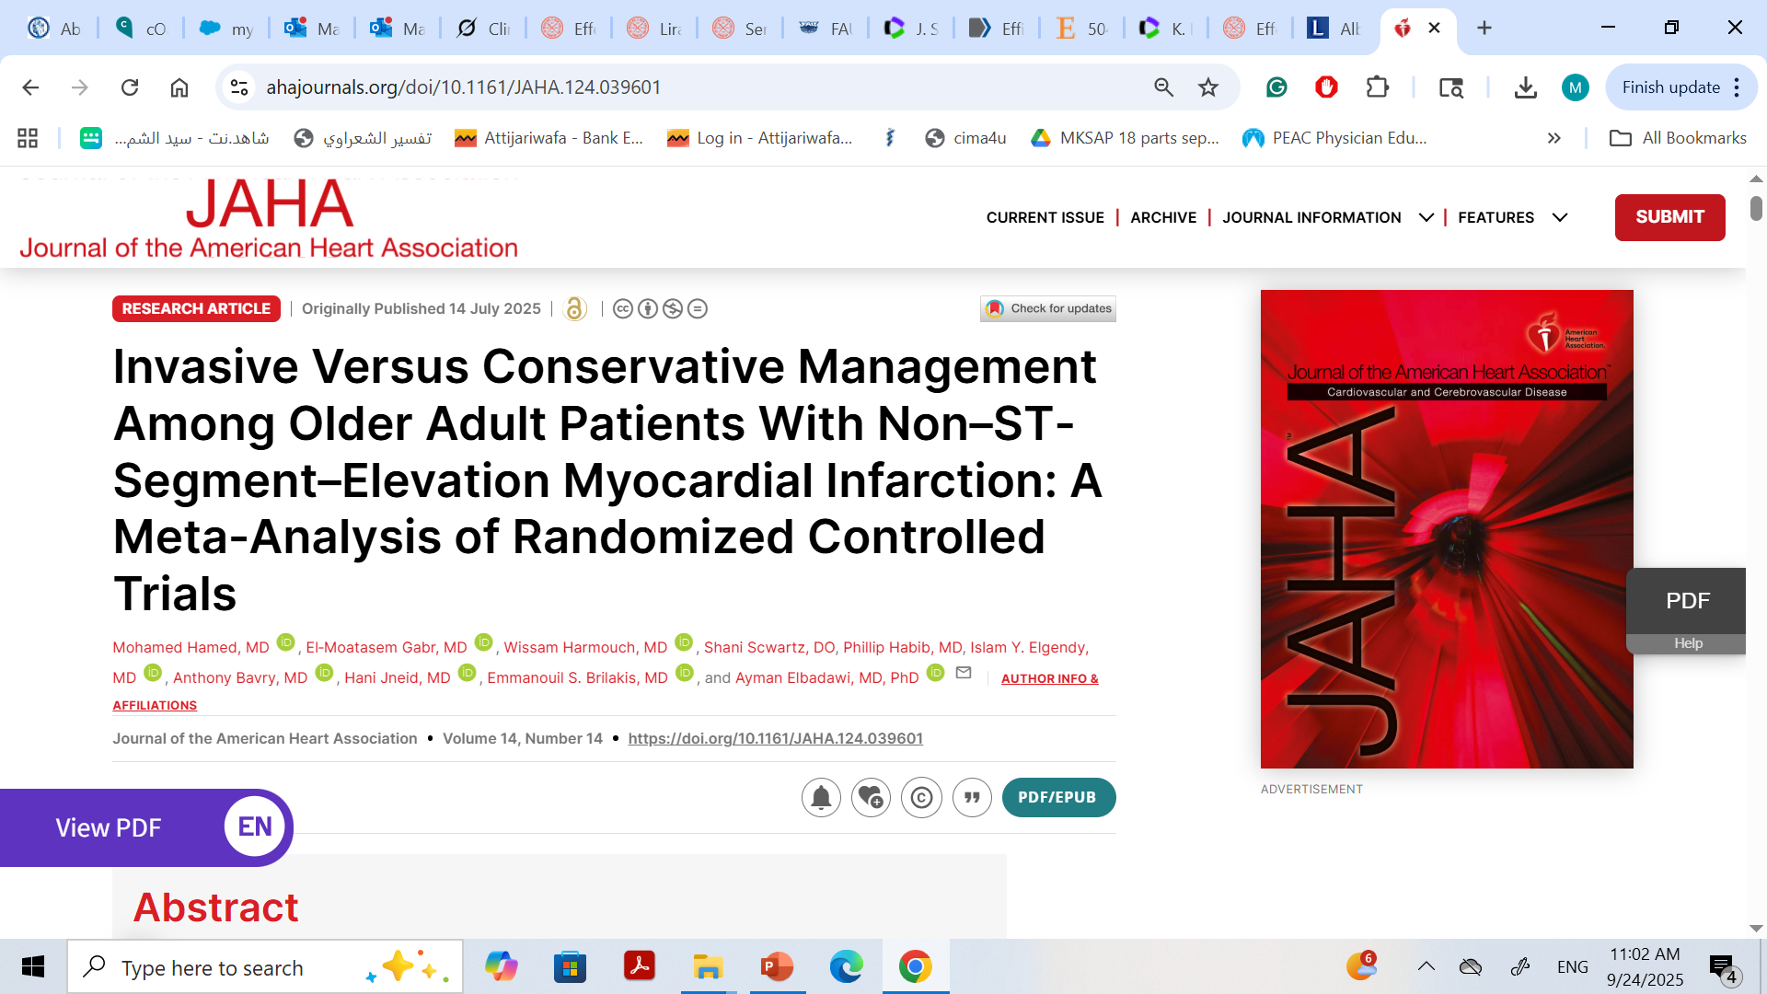

Slide 53
We performed a systematic review and meta‐analysis of all current randomized controlled trials (RCTs) aimed to investigate the efficacy of an invasive versus a conservative medical approach in older adult patients with NSTEMI.

Slide 54
Methods
We performed an electronic search of MEDLINE, Embase, and Cochrane databases through September 10, 2024, for studies comparing invasive versus conservative management in NSTEMI in the older adult population.
We included RCTs that evaluated the outcomes of invasive compared with conservative management in older adult patients with NSTEMI. We included RCTs and patients with age ≥70 years.
We excluded abstracts, retrospective studies, and nonrandomized studies.

Slide 55
Outcomes
The study outcomes included all‐cause mortality, major adverse cardiac events (MACE), recurrent myocardial infarction (MI), unplanned ischemia‐driven revascularization, cardiovascular mortality, stroke/transient ischemic attack, major bleeding, hospitalization for cardiovascular causes, and length of hospital stay.

Slide 56
Assessment of the Quality of the Included Studies
The quality of the included studies was assessed using the Cochrane risk assessment tool. We then classified studies according to their risk of bias: low, high, or unclear

Slide 57
Statistical Analysis
We primarily used a random‐effects model to pool data, applying the Mantel–Haenszel method for dichotomous outcomes and the inverse‐variance method for continuous outcomes
In secondary analyses, data were also pooled using a fixed‐effects model.
We reported outcomes as risk ratios (RRs) for categorical variables
Mean differences (MDs) for continuous variables.
We conducted subgroup analysis according to different age groups and compared studies that exclusively included frail patients with those that not include frail patients.
P values <0.05 were considered significant.

Slide 58
RESULTS
The final analysis included 7 RCTs with 2997 patients: 1489 in the invasive group and 1508 in the conservative group.
The weighted mean follow‐up was 47.1 months, the weighted mean age was 82.6 years, and the proportion of men was 53.2%.
Three studies included patients aged ≥80 years
2 studies included patients aged ≥75 years,
2 studies included patients aged ≥70 years.
Only 2 studies included Frailty Index scores: the MOSCA‐FRAIL used the clinical frailty scale, while the SENIOR‐RITA trial used the Fried Frailty Index, modified Rockwood Clinical Frailty Scale, and Comorbidity Index.

Slide 59
Revascularization were treated primarily via the transradial approach (71%–91%) and predominantly through percutaneous intervention (42.4%–61.3%), compared with coronary artery bypass grafting (1.1%–21.5%).
All of the included studies were multicenter and open‐label studies

Slide 60
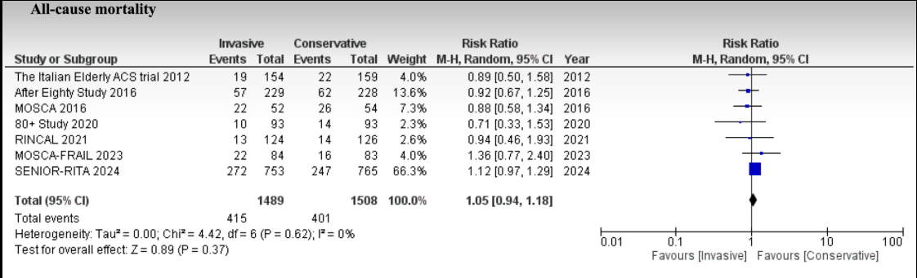
Outcomes
There was no significant difference in all‐cause mortality in the invasive compared with the conservative group (27.9% versus 26.6; RR, 1.05 [95% CI, 0.94–1.18]; P=0.37) with low heterogeneity (I²=0%, τ²=0.00)

Slide 61
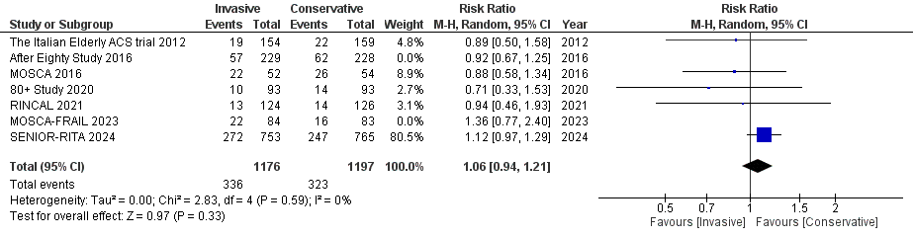
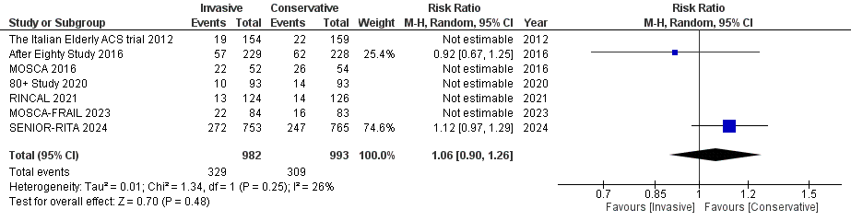
Sensitivity analyses excluding studies with a higher risk of bias (28.6% versus 27%; RR, 1.06 [95% CI, 0.94–1.21], P=0.33; I²=0, τ²=0.00), and studies with at least 3 years of follow‐up (33.5% versus 31.1%; RR, 1.06 [95% CI, 0.90–1.26], P=0.48; I²=26%, τ²=0.01) showed similar
Excluding high risk of bias
3 years of follow‐up

Slide 62
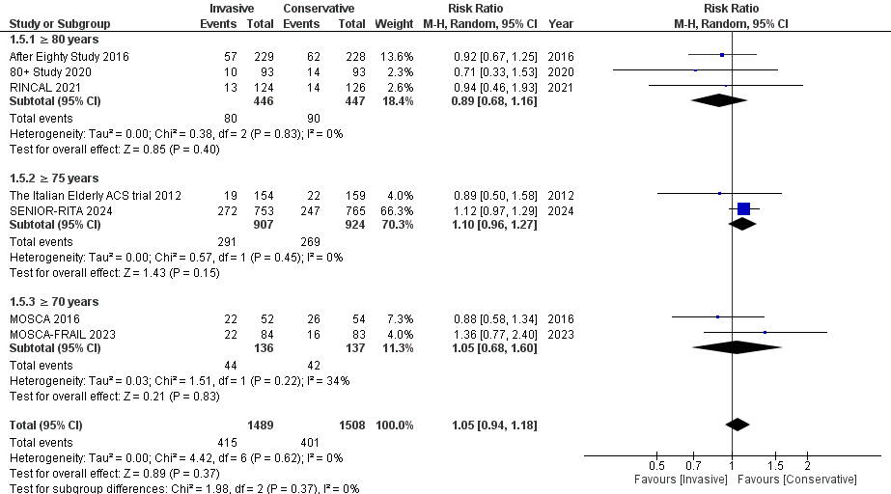
Subgroup analysis showed no subgroup interaction among the age groups ≥70 years, ≥75 years, and ≥80 years (P=0.37 for interaction)

Slide 67
Discussion
In this meta‐analysis of 7 RCTs with almost 3000 older adult patients (mean age 82.6 years), The salient study findings were:
(1) there was no significant difference in all‐cause mortality between invasive and conservative approaches among older adult patients with NSTEMI
(2) compared with a conservative approach, an invasive approach was associated with reduced recurrent MI, ischemia‐driven revascularization and a trend towards fewer MACE
(3) there were no significant differences between both groups in cardiovascular mortality, major bleeding, stroke/transient ischemic attack, hospitalization for cardiovascular causes, or length of hospital stay.

Slide 68
Our analysis demonstrated that an invasive approach among older adult patients with NSTEMI might help in improving quality of life and reducing hospitalizations by avoiding recurrent MI and urgent revascularization without an increase in complications.
Expectedly in this age group, we were not able to demonstrate a survival benefit with invasive versus conservative approaches.
Collectively, among older adult patients with NSTEMI, routine invasive therapy can be considered, but it should be tailored to the patient's clinical presentation, including angina burden, the complexity of their coronary anatomy, and higher‐risk features (such as ventricular arrhythmias or left ventricular systolic dysfunction), and should involve a “collaborative decision‐making process taking into account patients’” functional status and frailty.

Slide 69
Limitations
First, it was a study‐level meta‐analysis without individual patient data. This precluded further granular analyses.
Second, geriatric syndromes were only explicit in the MOSCA‐FRAIL and SENIOR‐RITA trials, so we performed a subgroup analysis that showed possible interaction in outcomes based on frailty status.
Third, there was heterogeneity in the percutaneous coronary intervention technique utilized in each individual trial, as not all patients who underwent coronary angiography received percutaneous coronary intervention.
Last, the definition of MACE varied between the included studies.

Slide 70
Conclusions
Among older adult patients with NSTEMI, an invasive approach did not improve survival compared with a conversative approach. An invasive approach was associated with reduced risk of recurrent MI and urgent revascularization without increased risk for major bleeding. These findings should help with informed decision‐making among older adult patients with NSTEMI.

