Slide 1

MANAGEMENT OF ACID INDIGESTION
J.C. Meeroff, MD, PhD
Gaia, Florida Institute of integrative medicine
Florida, USA
Internal Medicine Lectures Series. Boca Ratón, FL 2025. JCM All rights reserved

Slide 2

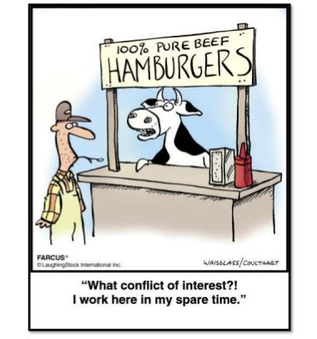
DISCLOSURES/
CONFICTS OF INTEREST
NONE

Slide 3
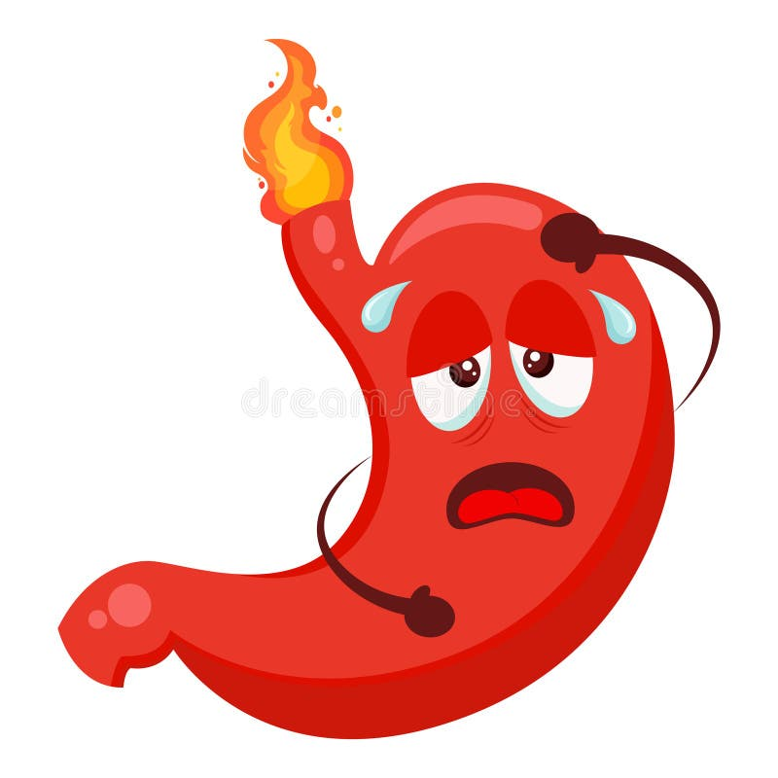
What is acid indigestion?
ACID INDIGESTION (AC IN) is a complex summation of symptoms affecting the upper abdomen including:
Early satiety
Upper abdomen discomfort
Abdominal and/or chest pain
Burning sensation in the retrosternal area
Abdominal distention
Nausea and/or vomiting
Eructation
Flatulence

Slide 4
WHY IS THIS ISSSUE IMPORTANT
In the US, AC IN affects nearly 1/3 of the adult population. Close to 100 million people suffer from AC IN at least once a month and close to 30 million once a day
Statistically, the estimated prevalence of ulcers in patients with AC IN is only 10-20 per cent, while the prevalence of AC IN in the general population is about 60 %
Nevertheless, those numbers may be not representative since we don’t perform studies in every patient with heartburn

Slide 5
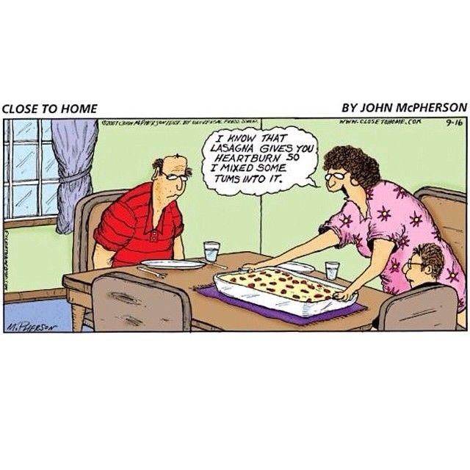
Pathologies associated with acid indigestion
Peptic ulcer disease
Non ulcer dyspepsia
Gastroesophageal reflux
Hiatal hernia
Zenker diverticulosis
Esophageal candidiasis
Presby esophagus
Esophagitis
Esophageal Dyskinesia
Diffuse esophageal spasm
Gastric carcinoma
“El empacho” or undigested food syndrome

Slide 6

The three major etiologies causing acid indigestion
GASTRO - ESOPHAGEAL REFLUX (GER)
PEPTIC ULCER DISEASE (PUD)
NON- ULCER DYSPEPSIA (NUD)

Slide 7
What is Gastro-esophageal Reflux?
It is a syndrome primarily caused by a weakened or improperly functioning lower esophageal sphincter (LES), which normally prevents stomach contents from flowing back into the esophagus. This backflow of stomach acid (and sometimes bile) irritates the esophageal lining, leading to symptoms like burning and coughing.

Slide 8
What is Peptic Ulcer Disease?
A condition in which open ulcers developed in the upper GI tract causing AC IN symptoms.
An ulcer is a benign macroscopic break in the mucosal lining of the stomach, the duodenum or occasionally the lower esophagus. The breach in the mucosa extends through the muscularis mucosae into the submucosa or even deeper.

Slide 9
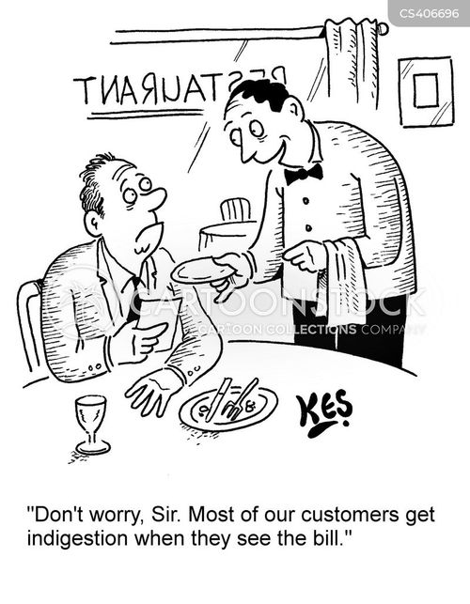
What is Non - Ulcer Dyspepsia?
It is a chronic disorder characterized by an acid indigestion syndrome that occurs without ant identifiable structural and/or biochemical abnormality

Slide 10


FAMOUS PEOPLE WHO SUFFERED PUD
While traveling in Argentina in the 1830s, Charles Darwin acquired two significant GI diseases:
Chagas disease, he was bitten by vinchucas in Mendoza
Peptic ulcer disease, he probably consume contaminated water as Barry Marshall suggested in is blog http://barryjmarshall.blogspot.com/2009/02/darwins-illness-was-helicobacter-pylori.html

Slide 11

PUD in the good old days
PUD was the “bread and butter” of all gastroenterologists
Tobacco smoking and milk for “ulcers” were common features in almost all Hollywood movies of the 1930s,1940s and early 1950s
Every day we performed dozens of gastric juice analysis and the ratio duodenal/gastric ulcers was 4/1
Reliable epidemiologic data from last century is missing since PUD was non reportable
Liz Taylor and Spencer Tracy in “The father of the bride”

Slide 12

WHO GET ULCERS ?
THE POPULAR WISDOM INDICATES THAT CEOs, DOCTORS AND LAWYERS GET MORE ULCERS THAN THE REST OF THE POPULATION
BUT A DANISH EPIDEMIOLOGIC STUDY SUGESTED THAT PEOPLE EMPLOYED IN TRAFFIC & TRANSPORTATION GOT MORE ULCERS THAN CEOs, DOCTORS AND LAWYERS
Alsted,G. (1954) The Social and Public Health Aspect of Peptic Ulcer. Gastroenterology; 26 (2): 268-287
But now we are all driving in the same cockamamie traffic, surrounded by frenasthenic, nomophobic people

Slide 13
CLASIFICATION
According to their pathophysiologic mechanism we distinguish 4 types of ulcers: peptic, trophic, infectious and mixed
Peptic ulcers are the result of hypersecretion of gastric juice.
Trophic ulcers are secondary to deficient mucosal defensive mechanisms
Infectious ulcers are caused by microbial agents such as HP
Mixed Ulcers where there is a combination of 2 or 3 of the other types
Marshall BJ & Warren RM.( 1984) Unidentified curved bacilli in the stomach of patients with gastritis and peptic ulceration. Lancet;16:1311–1315
Meeroff M & Meeroff JC. (1973) Differentiation of trophic gastric ulcers . Hispalis Medica (Sevilla); 30: 601-613
Meeroff JC & Meeroff M (1990). Gastroduodenal ulcer disease. Ed Poligráfica Argentina, Buenos Aires, Argentina
Ciociola, AU. Et al. (1999). Helicobacter pylori infection rates in duodenal ulcer patients in the United States may be lower than previously. Am J Gastroenterol. ;94(7):1834 -1840

Slide 14
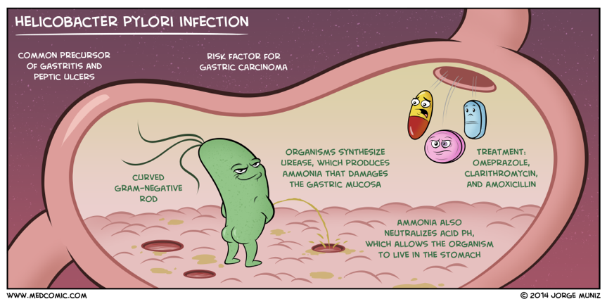
Infectious ulcers (IU)
Stomach invaded by Helicobacter Pylori

Slide 15
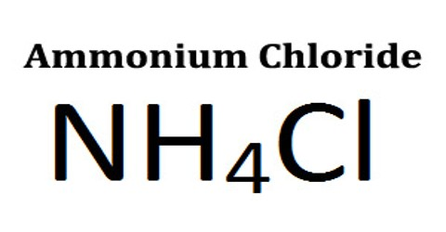
AMONIA PLUS HYDROCHLORIC ACID
NH3+HCl=NH4Cl
Ammonia is a weak base that reacts with hydrochloric acid, forming a compound called ammonium chloride (NH4Cl)
NH4Cl is highly soluble in water and exerts a mild diuretic effect. Solutions of NH4Cl are mildly acidic

Slide 16
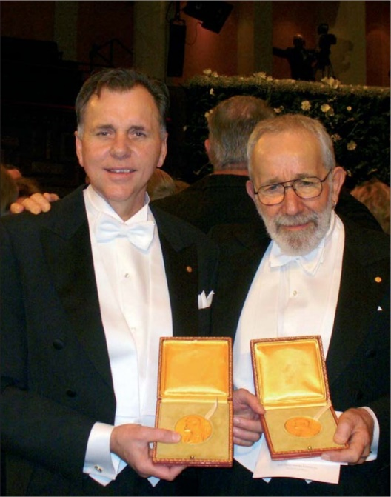
MUCOSAL DAMAGE CAUSED BY HP
The mechanism by which HP acts is complex and probably multifactorial. HP damages the mucosa via exotoxins including urease, responsible for the production of NH3 from the urea secreted in gastric juice and saliva; cytotoxins; proteases; phospholipase A2 and platelet-activating factor
NH3 impairs mitochondrial cellular respiration, cellular energy metabolism and decreases mucosal cell viability, leading to mucosal damage
HP disease evolve in 3 stages:
1. Initial infection
2. Intermediate inflammation
3. Chronic/long term malignancy
Tsujii, M. et al. (1992) Mechanism of gastric mucosal damage induced
by ammonia. Gastroenterology; 102(6) :1881-1888
Szabo S, & Kovacs K. (1990). Causes and mechanisms of cell and
tissue injury in endocrine glands. In: Kovacs K, Asa A, eds. Endocrine
pathology. Boston: Blackwell Scientific Publications; 914–33
2005 Nobel Prize in Medicine Dr. Barry J.
Marshall and Dr. J. Robin Warren

Slide 17
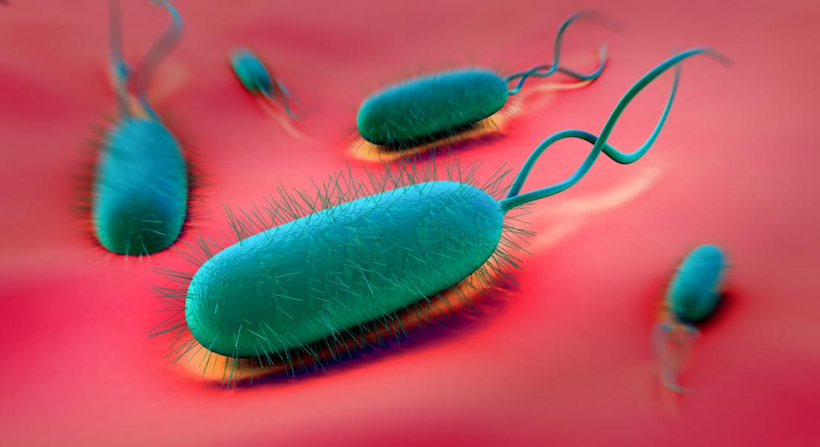
HP epidemiology
The prevalence of H pylori infection varies from as low as 18.9% in Switzerland (95% CI, 13.1−24.7) to 87.7% in Nigeria (95% CI, 83.1−92.2). Based on regional prevalence estimates, there were approximately 4.5 billion individuals with H pylori infection worldwide in 2016
Only 10% or less of all HP infected people develop PUD
H. Pylori is implicated in the genesis of gastric cancer, Hashimoto’s dsx and in metabolic sx
Hooi JKY. Et al. (2017) Global Prevalence of Helicobacter pylori Infection: Systematic Review and Meta-Analysis.
Gastroenterology 153(2); 420-429
Sapolsky, RM (1994). Why zebras don’t get ulcers New York: W.H. Freeman

Slide 18
H. Pylori, why bother?
THE BAD HP infection increases the risk of :
Gastric cancer via the “Pelayo Correa cascade” of atrophic gastritis (50%), metaplasia (25%),
dysplasia (10%), and neoplasia --carcinoma-- (3%)
Metabolic syndrome
THE GOOD HP infection may decrease the incidence of :
Barrett’s esophagus and esophageal cancer
Inflammatory bowel disease
Asthma
Correa, P. and Piazuelo BM. (2011) Helicobacter pylori and gastric adenocarcinoma. GastroenterolHepatol Rev; Jun: 59-64
Moss SF (2016) The clinical Evidence Linking Helicobacter Pilory to Gastric Cancer. Cel Mol Gastro Hepat; 3: 183-191
Refaeli R. et al (2018) Relationships of HP infection and its related gastroduodenal morbidity with metabolic syndrome: a large cross-sectional study. Sci Rep Mar 6;8(1):4088. doi: 10.1038/s41598-018-22198-9

Slide 19
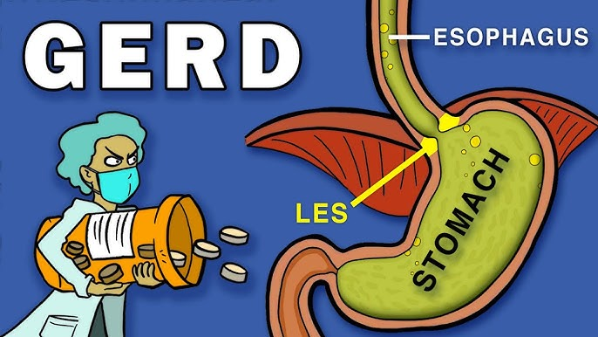
Lower esophageal sphincter
The LES is controlled by a complex mechanism including:
1. Neural control, a mixture of Autonomic nervous system and enteral nervous system
2. Hormonal/Neurochemical control
3. Myogenic control
4. Swallowing reflex

Slide 20
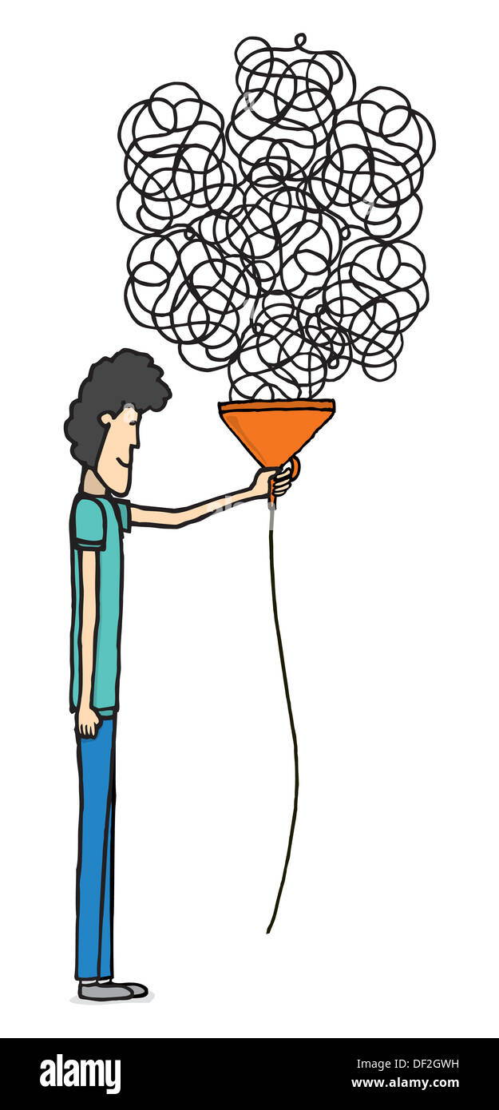
LES made relatively simple
The LES has intrinsic smooth muscle tone, meaning it maintains a baseline contraction even in the absence of neural input. This tone prevents reflux of gastric contents into the esophagus under resting conditions.
Acetylcholine increases tone
Nitric oxide (NO) and vasoactive intestinal peptide (VIP) decease sphincter tone
Gastrin increases sphincter tone
Secretin, cholecystokinin (CCK), glucagon decrease LES tone.
Nicotine decreases basal LES pressure promoting reflux
Take home message: the problem of LES pathophysiology is complex and needs further basic scientific studies

Slide 21
Stress and acid indigestion
DISTRESS, caused by the inability to cope with imposed demands, leads to
INCREASE ADRENERGIC TONE = Release of adrenaline causing decreased mucosal blood flow and decreased production of protective gastric mucus and decreases LES tone
INCREASE VAGAL TONE = Release of acetylcholine leading to hypersecretion of gastric HCl and increase of LES tone
Levenstein et al. (2015). Decrease mucosal defensive mechanisms. Clin Gastroenterol Hepatol; 13(3): 498-500
EUSTRESS, generated when the individual has the ability to cope with imposed demands, leads to
INCREASE RELEASE OF NITRIC OXIDE (NO) affecting the dorsal vagal complex, the dorsal motor nucleus (DMN) and the nucleus tractus solitarius (NTS) therefore decreasing the cholinergic stimulation of gastric acid secretion. But it decreases LES tone
Esplugues JV et al. (1996). Inhibition of gastric acid secretion by stress: A protective reflex mediated by cerebral nitric oxide. Proc Natl Acad Sci ; 93(12): 14839–14844

Slide 22

TREATMENT
SIX GENERAL STRATEGIES TO TREAT ACID INDIGESTION SYNDROMES
Reducing HCl production
Neutralizing secreted HCl
Citoprotecting the mucosa
Eliminating microorganisms
Improving gastric emptying & LES tone
Eradicating distress

Slide 23

1 REDUCING HCl PRODUCTION
Anticholinergics antimuscarinics ( atropine, glycopirolaye,homatropine, Belladona, hiosciamine, Demerol)
H2 receptor blockers or H2 Blockers = ranitidine, cimetidine, famotidine, nizatidine
Proton Pump Inhibitors or PPIs = omeprazole, lanzoprazole, pantoprazole, rabeprazole, dexlansoprazole
NEW! K-competitive Acid blockers or P-CABs
(Vonoprazan, Tegoprazan)
Hormones (somatostin, prostaglandins)
Physical exercise to reduce choline and Ach
Acupuncture/acupressure to balance neuroendocrine tone
Acupressure point P6

Slide 24
H2 BLOCKERS SIDE EFFECTS
Short term: Abdominal pain, Confusion, Hallucinations, Runny nose, Bradycardia, Cough, Gynecomastia, Insomnia
Interactions: H2blockers are inhibitors of cytochrome P450. Consequently, they reduce the metabolism of many drugs which are normally degraded by phase I reactions, leading to potentially toxic plasma concentrations of therapeutic agents such as some oral anticoagulants, beta-blockers, anticonvulsants, benzodiazepines and xanthines
Long term: Impotence; Clostridium dificile infection; osteoporosis; Magnesium deficiency; Kidney failure; Intestinal bacterial overgrowth; Male infertility
Wormsley PJ. (1986). Adverse reactions and interactions with H2-receptor antagonists. Med Tox; 1(3): 192-216

Slide 25

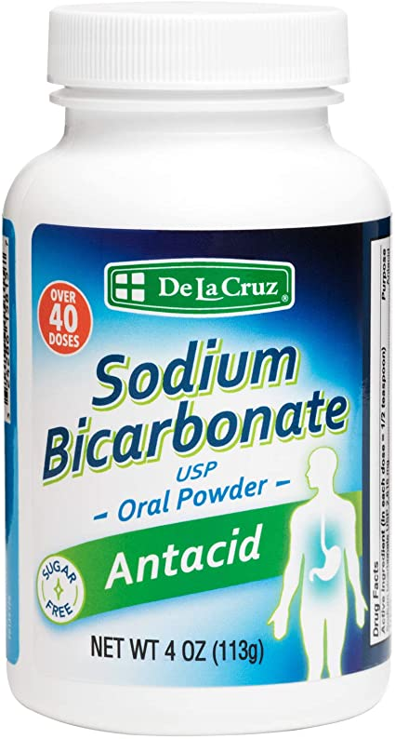
2 NEUTRALIZING HCl
Antacids
Alkalizing foods
Fluids to dilute HCl

Slide 26
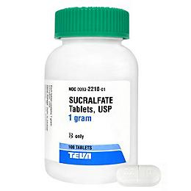
3 cytoprotection
Sucralfate
Misoprostol
Angiotensin inhibitors (Ibersartan)
Coloidal Bismuth
Vitamin C derivatives ( sodium oxyferriscorbone)
Curcumin
Zinc-hialuronidase
Quercitin
Vitamin A
Licorice
IFN

Slide 27

4 antibacterial agents
Amoxicillin
Clarithromycin
Metronidazole
Tetracycline
Doxycycline
Levofloxacin
Probiotics
Clove
Garlic
Oil of oregano
Abshintium
Wormwood
Nitrofurans y nitroimidazoles
Xanthones
HP vaccines

Slide 28

NEW TREATMENTS FOR H. PYLORI
Xanthones
No name yet
Klesiewicz K. et al. (2016). Anti-Helicobacter pylori activity of some newly synthesized derivatives of xanthone. J.Antib 69; 825–834
Nitrofurans
Furoxone (Furazolidone)
New nitroimidazoles
Secnidazole (Solosec)
Interferon-like agents

Slide 29
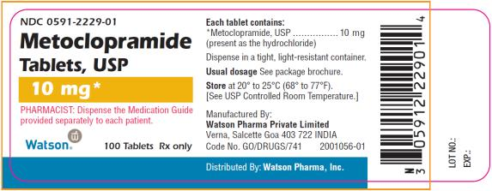
5 prokinetics
Dopamine antagonists
Metoclopramide
Droperidone
Cisapride
Proclorperazine

Slide 30

6 Avoiding distress
A very difficult task since “imposed demands” are mostly external and many times it is very little what we can do to control them
Psychotherapy
Meditation
Mind/body therapies
Reiki
Hypnosis

Slide 31

UNCONVENTIONAL TREATMENTS
Melatonin and tryptophan
“Healthy diet” such as the Mediterranean diet
Unprocessed honey
Elimination of tobacco smoking
Limiting and/or eliminating ETOH beverages
Rest and adequate sleep
Phytophamaceuticals: Turmeric-curcumin
Mastic; Cabbage extract; Avena sativa
Banana diet (Hass)
Lupini diet
Cannabis sativa

Slide 32
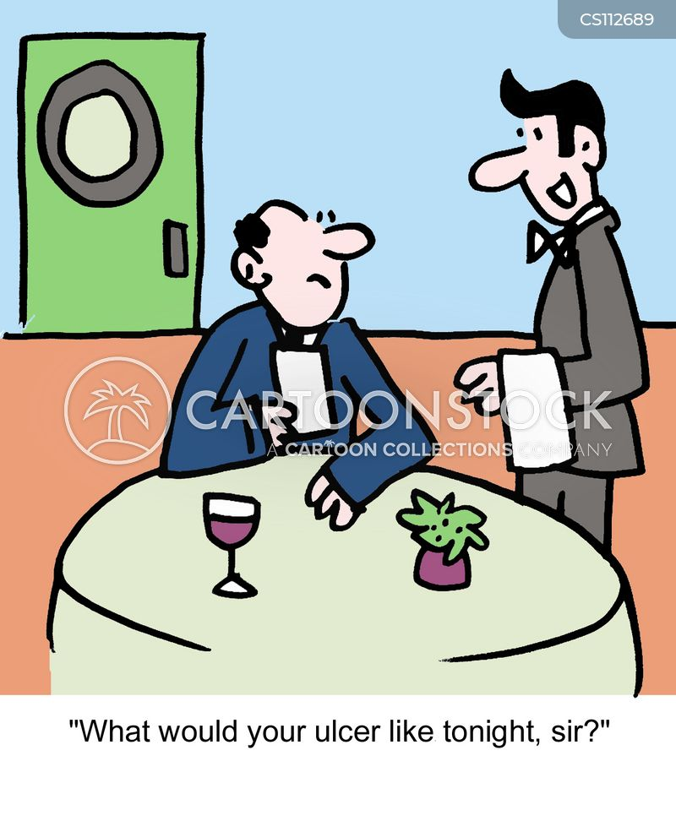
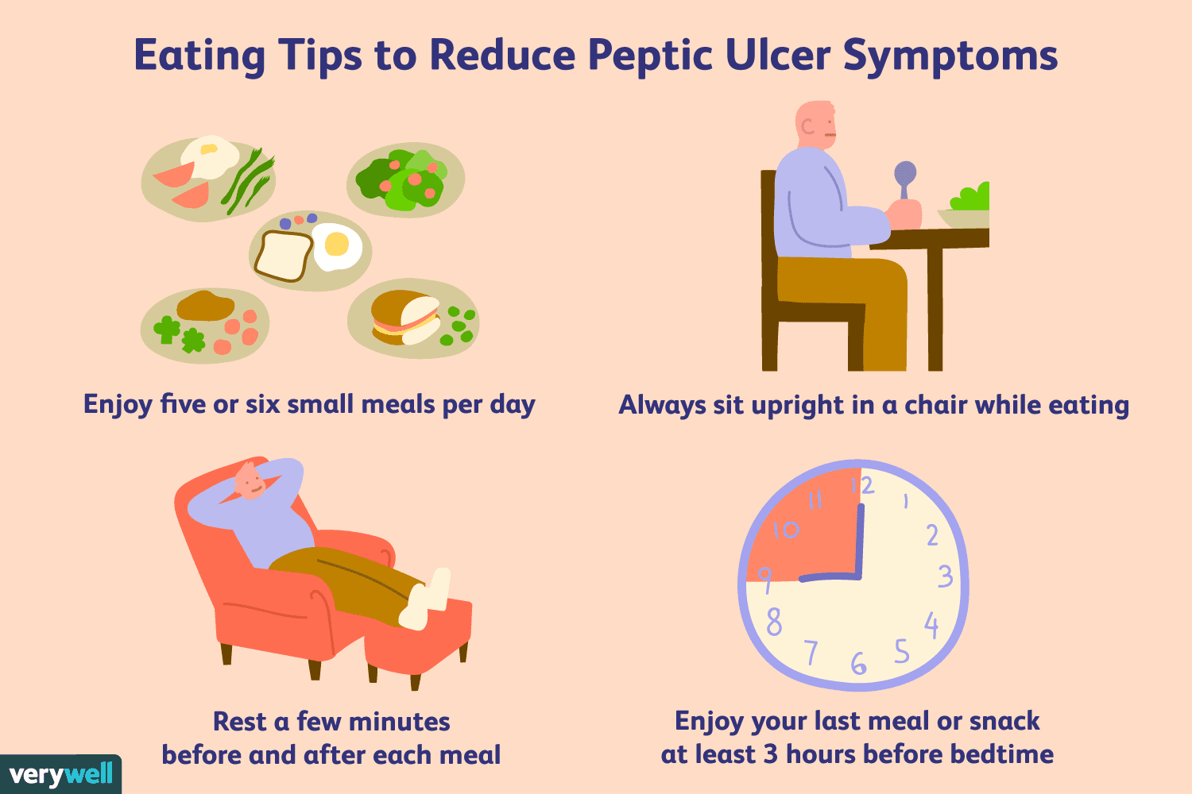
Diet for acid indigestion
It is a myth that diet is irrelevant in the management of AC IN
It is also a myth that dairy products are bad for AC IN
But it is a fact that spicy, acid & HCl stimulant foods make AC IN worse
AC IN patients must eat a balanced diet with plenty of natural fiber
AC IN patients must consume foods according to their tolerance
Small frequent meals are still beneficial to AC IN patients

Slide 33
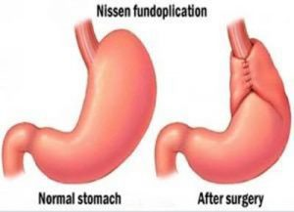
Surgery for acid indigestion
Not the preferred therapeutic choice, but occasionally surgery is necessary and useful, specially when AC IN is associated with large hiatal hernias and/or when endocrine tumors releasing excessive amount of gastrin (gastrinomas) are present

Slide 34


