Slide 1
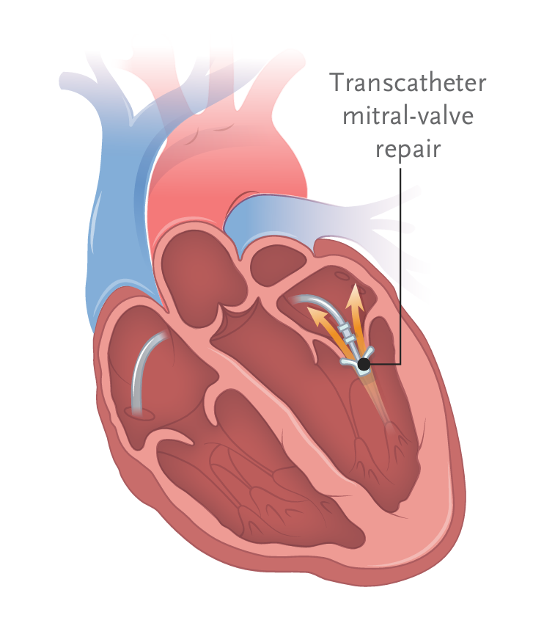
RESHAPE-HF2 Trial:
Transcatheter Valve Repair in Heart Failure with Moderate to Severe Mitral Regurgitation
Joseph Michael-Salami
FAU Cardiology Fellow, PGY-5
Notes:
Introduce the topic briefly (1–2 min). Highlight the trial’s relevance to perioperative management

Slide 2
Disclosures
Neither the planners nor the speakers disclosed relevant financial relationships with ineligible companies.

Slide 3
Last Week:
Highlights from the COAPT (Cardiovascular Outcomes Assessment of the MItraClip) and the and MITRA-FR (Percutaneous Repair With MitraClip Clip Device for Severe Functional/Secondary Mitral Regurgitation) trials.
The Multicenter Mitral Valve Reconstruction for Advanced Insufficiency of Functional or Ischemic Origin (MATTERHORN) trial was Presented.
MATTERHORN was a non-inferiority trial comparing M-TEER (Mitral Transcatheter Edge-to-Edge Repair) to Mitral valve surgery among patients with secondary MR who are at high surgical risk.

Slide 4
This Week:
Review the pathophysiology and current guideline-recommended management of secondary mitral regurgitation
Recap of findings from the COAPT and the MITRA-FR trials.
Presentation of the RESHAPE-HF2 trial.

Slide 5
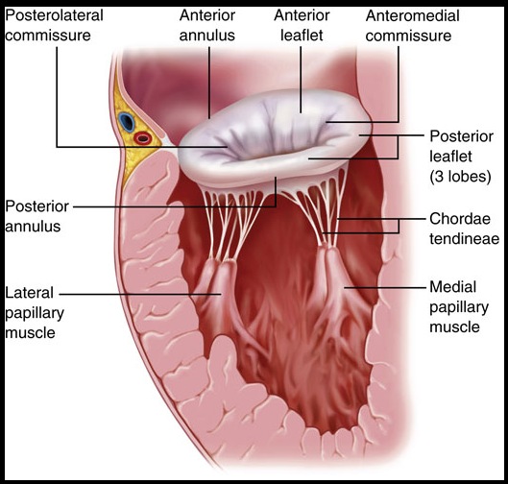
Anatomy of Secondary MR
(From Otto CM. Evaluation and management of chronic mitral regurgitation. N Engl J Med. 2001;345:740-746.

Slide 6
Pathophysiology of Secondary MR
Two main etiologies:
  (1) Annular dilation, (2) Leaflet tethering from a ventricular disease
Secondary MR stemming from LV dilation and systolic dysfunction, often with concomitant mitral annular dilation, is a common consequence of ischemic and nonischemic cardiomyopathies
Results from displacement of the papillary muscles, tethering of the MV leaflets, and alteration of annular mechanics.
Notes:
The two main etiologies of secondary MR are annular dilation or atriogenic MR (Carpentier type I) and leaflet tethering from a ventricular disease (Carpentier IIIA)
Atriogenic MR has gained increasing recognition as the etiology of MR in the setting of normal LV mechanics. Recent studies suggest the underlying mechanism is related to insufficient leaflet growth, LA dilation and annular dilation with altered annular dynamics.
In the setting of LV dysfunction and dilation, secondary MR results from displacement of the papillary muscles, tethering of the MV leaflets, and alteration of annular mechanics

Slide 7
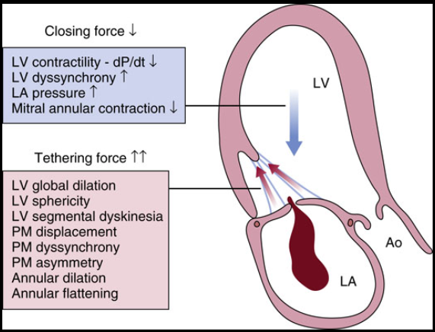
Pathophysiology of Secondary MR
Notes:
A number of mechanisms may contribute to malcoaptation of the MV leaflets in secondary MR
(1) global and/or regional LV dilation/dysfunction that decreases the closing forces of the leaflets,
(2) displacement of the papillary muscles with tethering of the leaflets into the ventricular cavity, which outweighs the closing forces,
(3) dilation and dysfunction of the annulus, and
(4) inadequate leaflet adaptation to ventricular or atrial enlargement

Slide 8
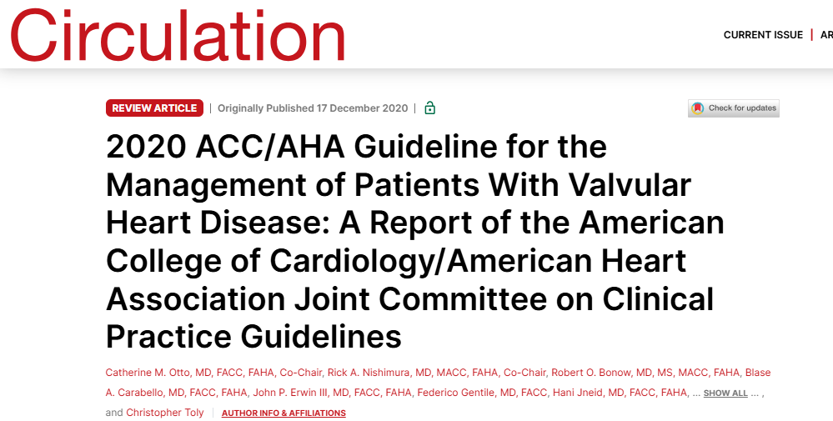
Management of Secondary MR

Slide 9
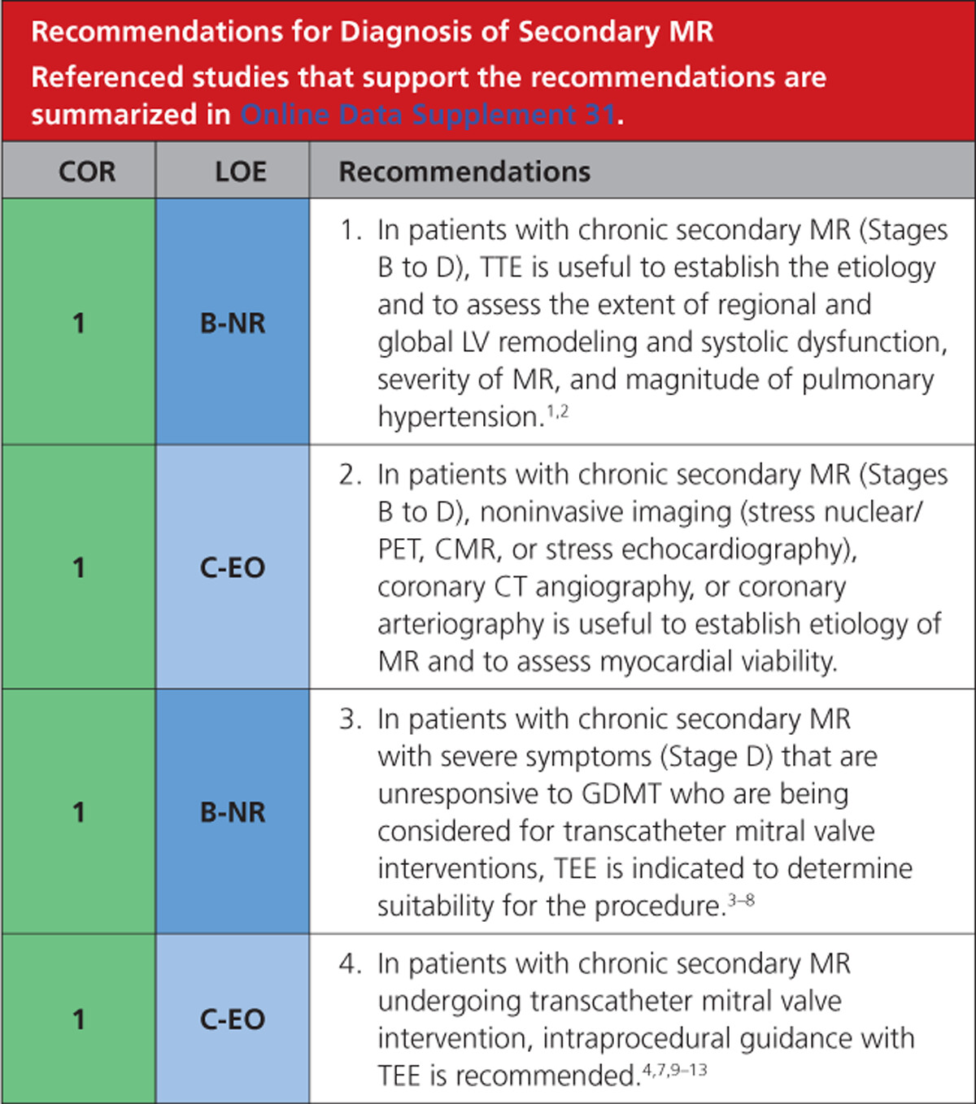
Notes:
TTE, Nuclear stress test, CMR, CTA coronaries all Class I recommendation
TEE for evaluation if unresponsive to GDMT and consideration for M-TEER or intraprocedural guidance

Slide 10
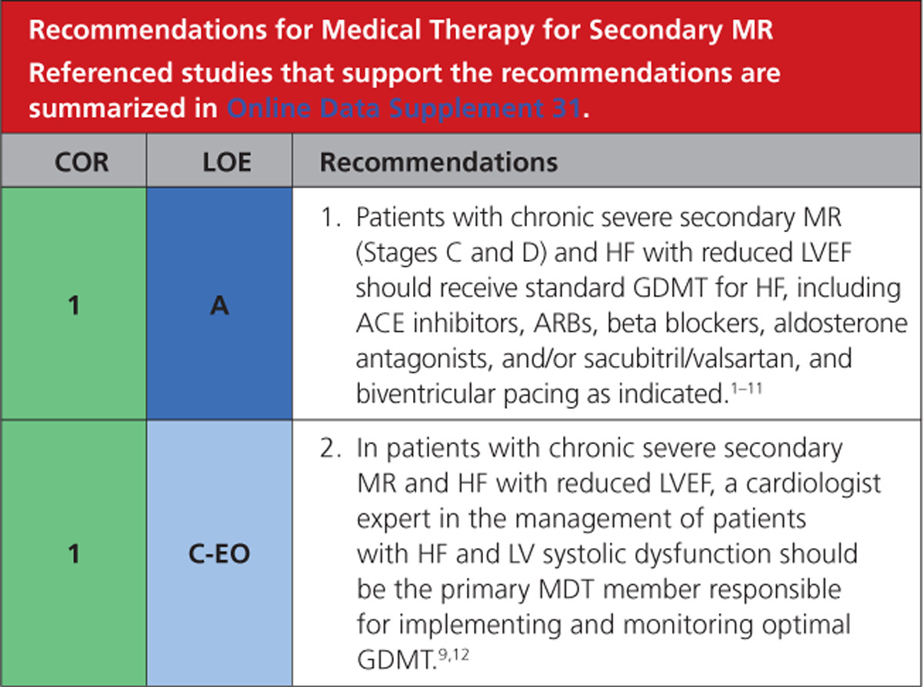
Notes:
Secondary MR with HFrEF: Standard GDMT (ARNi, BB, MRA, SGLT2i)
Get a Cardiologist involved (The guideline also recommends HF specialists involvement)

Slide 11
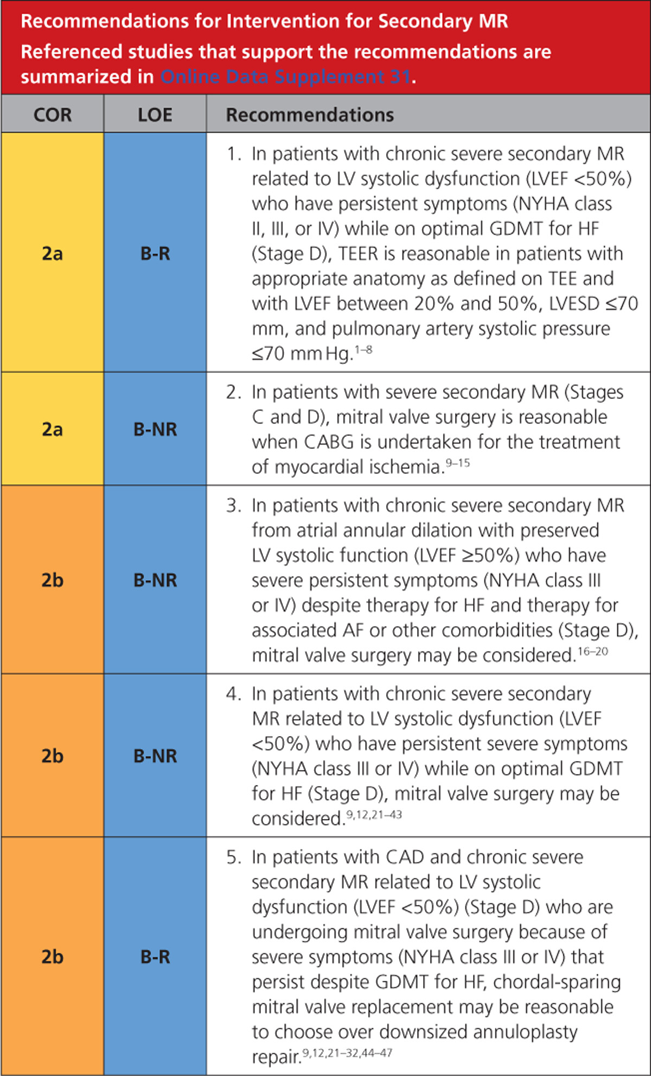
Notes:
Intervention carried Class 2a recommendation, at best

Slide 12
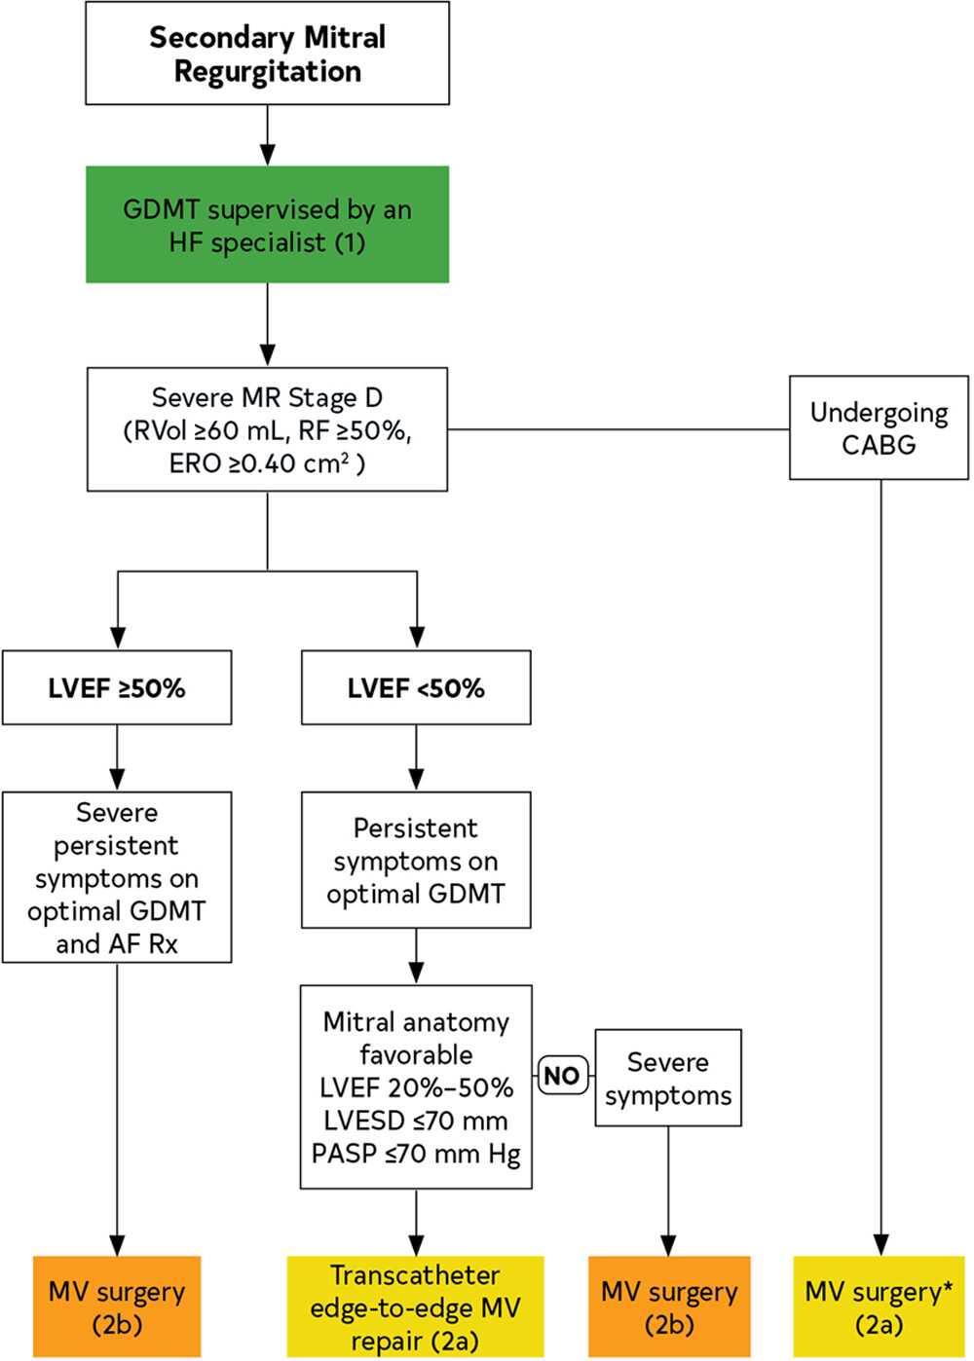
Notes:
Intervention carried Class 2a recommendation, at best

Slide 13
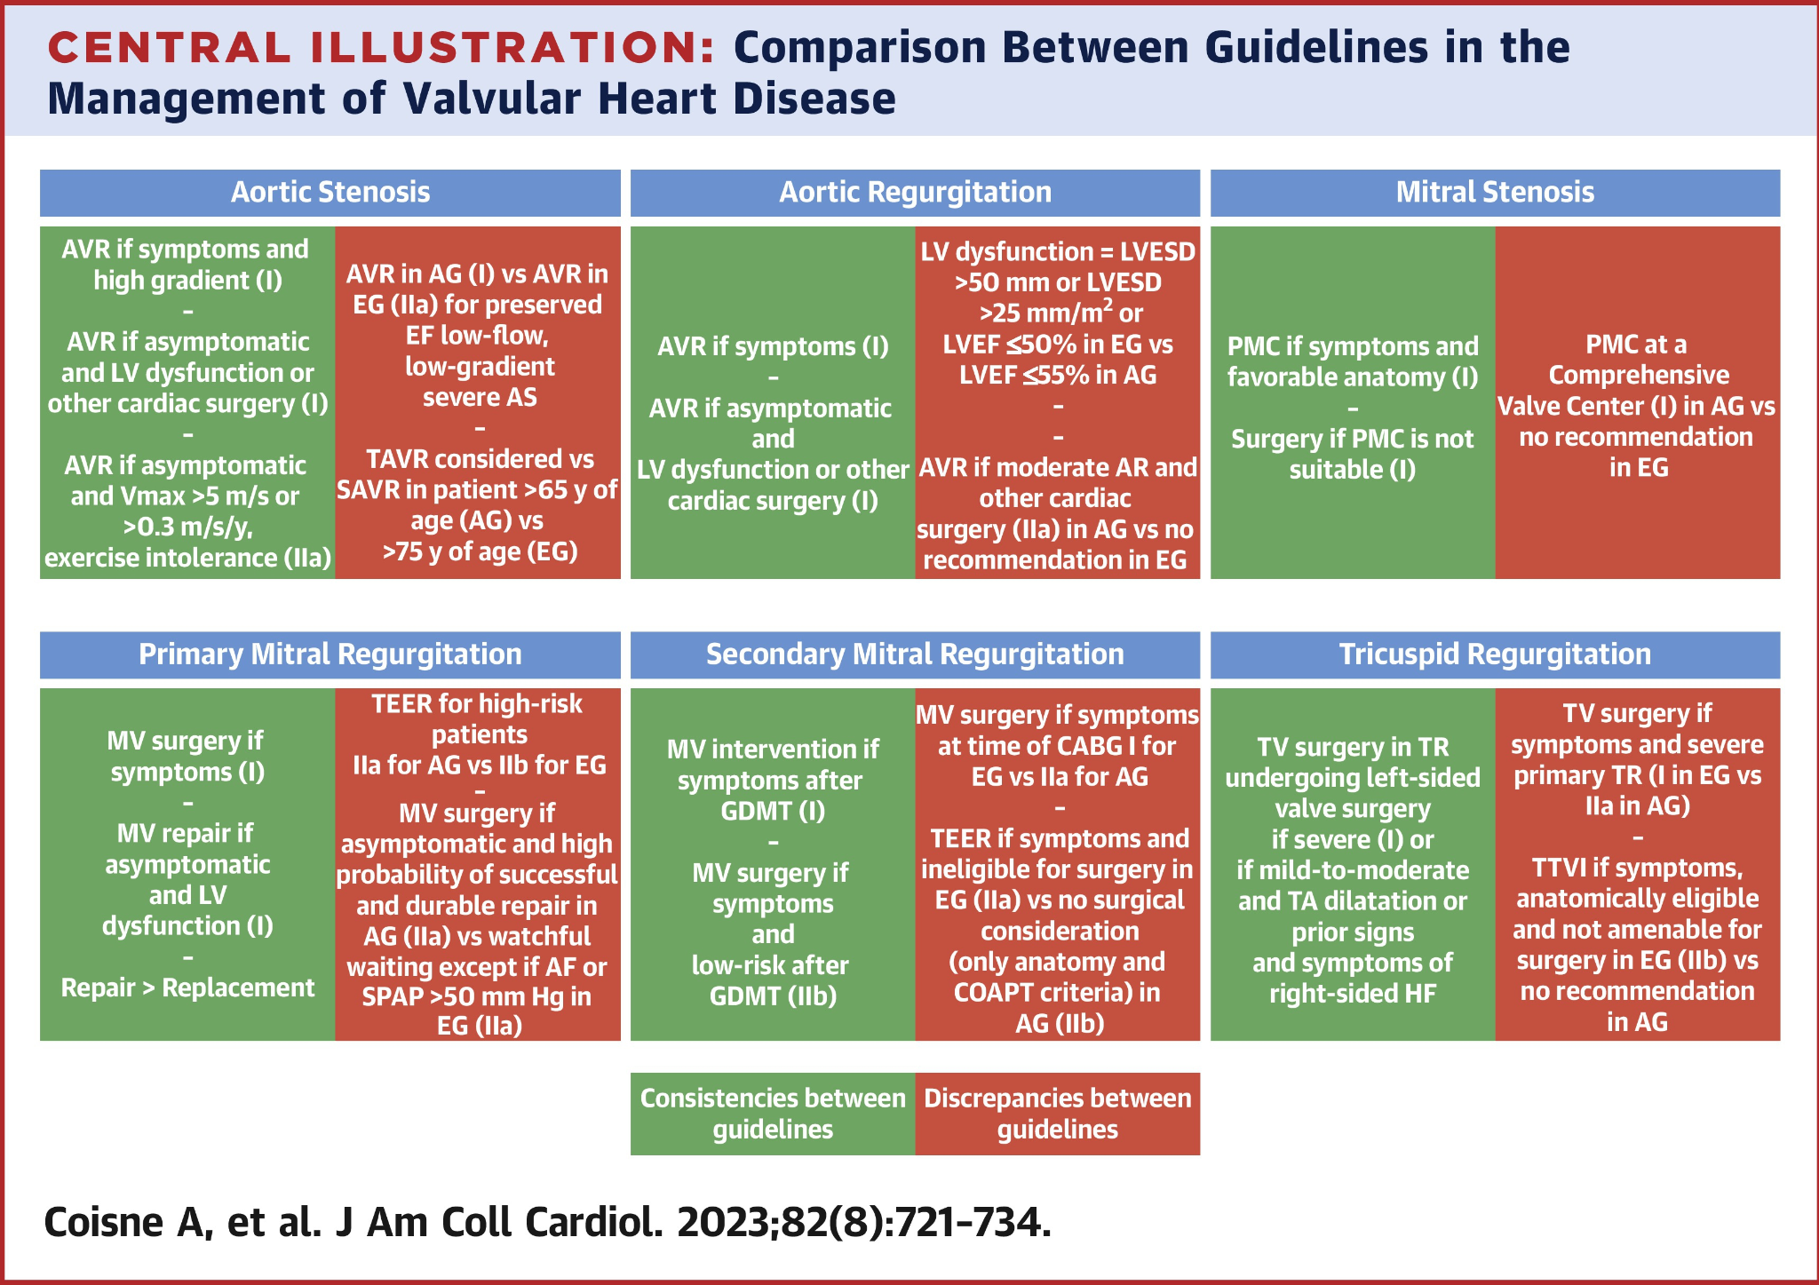
Notes:
Time will fail us if we want to highlight the European Society of Cardiologists (ESC) guidlines

Slide 14
Notes:
Time will fail us if we want to highlight the European Society of Cardiologists (ESC) guidlines

Slide 15
Notes:
Time will fail us if we want to highlight the European Society of Cardiologists (ESC) guidelines. Here is where these major guidelines agree and disagree.

Slide 16
Should we just do as we are told by the guidelines?
Beyond the meds, is there a role for invasive intervention in the management of Secondary MR?
Notes:
We needed more evidence

Slide 17
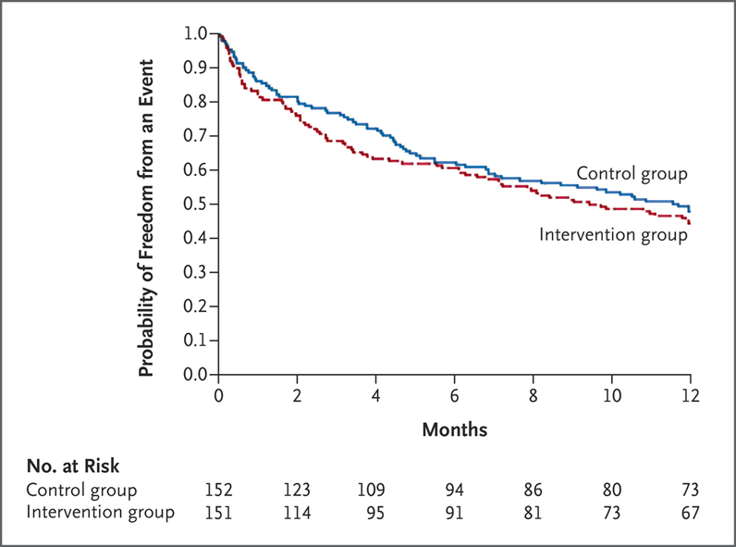
The MITRA-FR Trial
The primary outcome of death or hospitalization for heart failure, occurred in 54.6% of the M-TEER group compared with 51.3% of the medical therapy group (p = 0.53).
Notes:
●Evaluate clinical safety and efficacy of percutaneous MV repair plus medical therapy in patients with HF and secondary MR.
●Multicenter, randomized, open label, controlled phase 3 trial across 37 centers in France from Dec. 2013 to March 2017, randomized 452 patients in 1:1 fashion to percutaneous MV repair + medical therapy vs medical therapy only
●Eligible patients:
○Severe MR with EROA > 20 mm2 and Reg Vol 30 ml/beat (ESC guidelines)
○LVEF 15 40% with NYHA class II-IV
○Not eligible for MV surgery
Primary efficacy outcome was composite of death from any cause or unplanned hospitalization for HF at 12 months after randomization

Slide 18
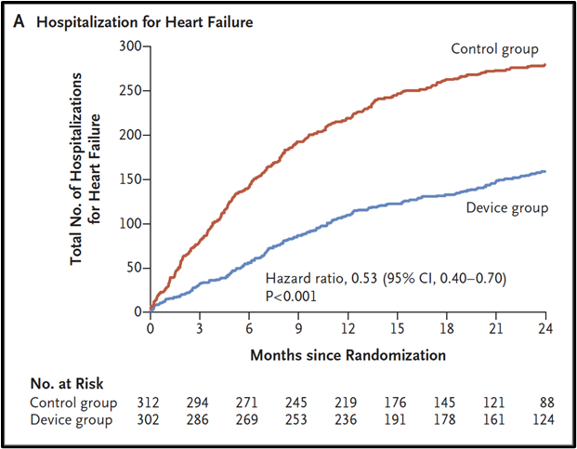
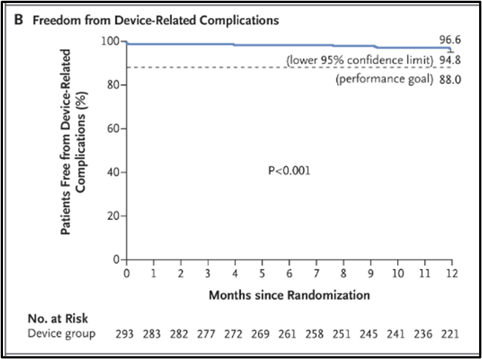
The COAPT Trial
HF hospitalization at 24 months for MitraClip + GDMT vs. GDMT, was 35.8% vs. 67.9%
Notes:
Evaluate the safety and effectiveness of the M-TEER in patients with HF and secondary MR who remained symptomatic despite GDMT.
Study Design: Multicenter, randomized, open-label trial (78 centers, US & Canada, Dec 2012–June 2017)
Participants: 614 patients with HF and secondary MR, randomized 1:1 to MitraClip + GDMT vs. GDMT only
Eligibility:
Ischemic/non-ischemic cardiomyopathy, LVEF 20-50%, moderate-to-severe (3+/4+) MR
Symptomatic (NYHA II, III, IVa) despite optimal GDMT
LVESd <70 mm, STS score for MV replacement >8%
Exclusions: PASP >70 mmHg, inotrope/MCS use, MV area <4 cm²
Assessment: Heart team (advanced HF, IC, CTS) confirmed eligibility, CTS deemed ineligible for MV surgery
Endpoints:
Primary Efficacy: All HF hospitalizations within 24 months
Primary Safety: Freedom from device complications at 12 months

Slide 19
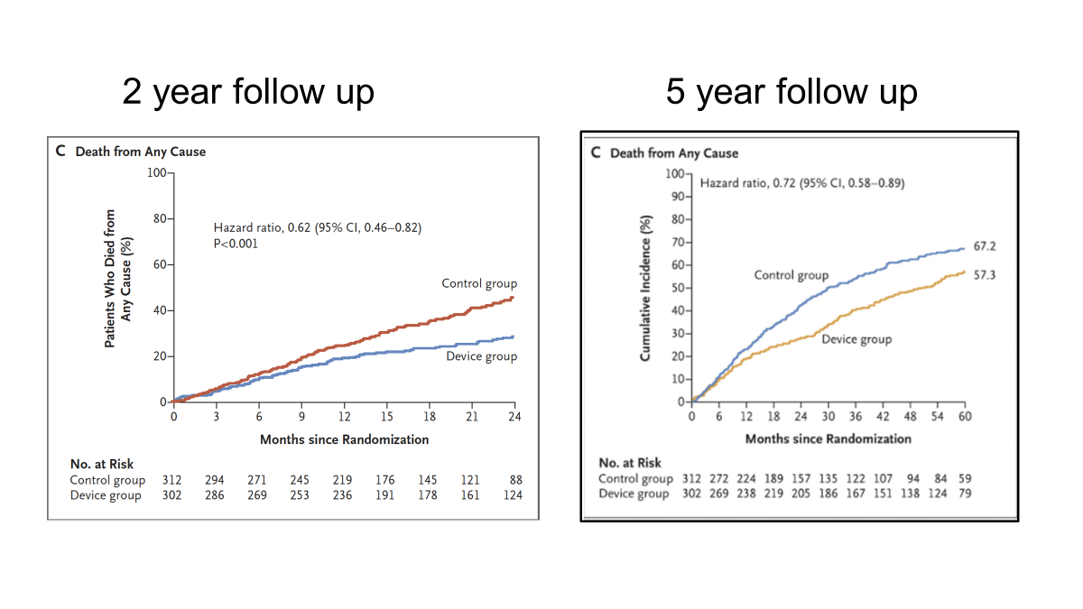
The COAPT Trial

Slide 20
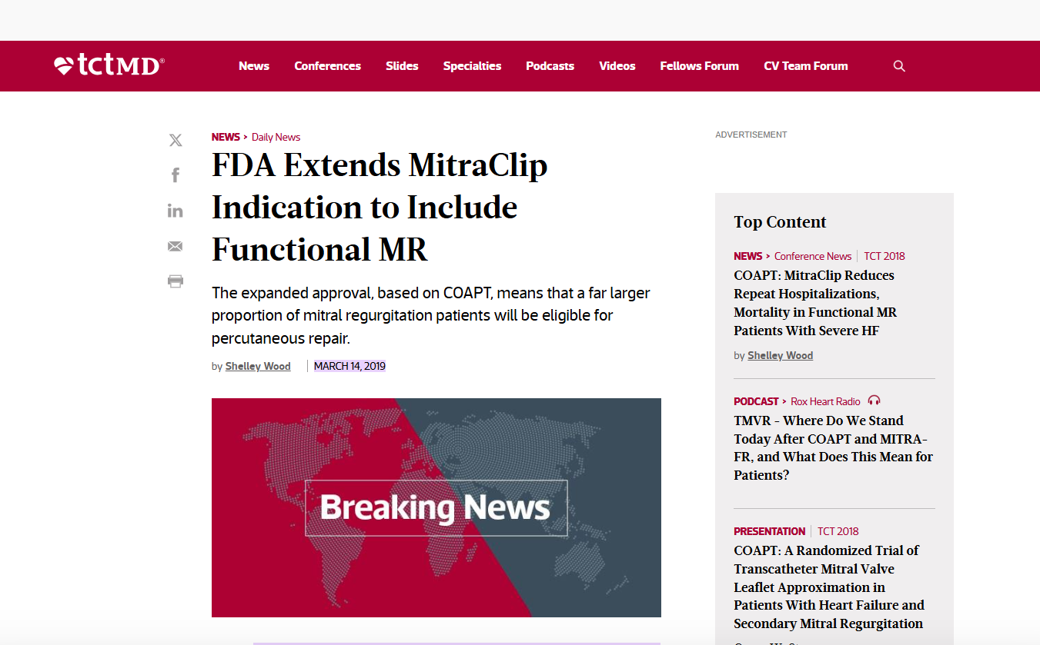
Notes:
Note: The MITRA-FR trial was set in France and funded by the French Ministry of Health and Abbott Vascular, while the COAPT trial was in US and CANADA and funded by Abbott.

Slide 21
Two Landmark trials essentially evaluated the same question but gave different answers.
We need another trial!
Notes:
We needed more evidence

Slide 22
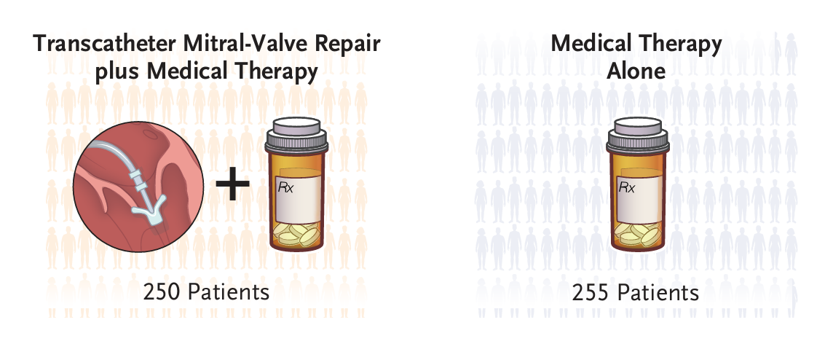
The RESHAPE-HF2 Trial
Objective: Evaluate the safety and efficacy of mitral transcatheter edge-to-edge repair (M-TEER) with MitraClip plus guideline-directed medical therapy (GDMT) vs. GDMT alone in symptomatic HF patients with moderate-to-severe FMR.

Slide 23
Trial Design
Study Type: Prospective, randomized, open-label, multicenter trial.
Location: 30 sites across 9 countries (e.g., Germany, Poland).
Sponsor: University Medical Center Göttingen, Germany; funded by Abbott Laboratories.
Ethics: Registered at ClinicalTrials.gov (NCT02444338).
Randomization: 1:1 to M-TEER + GDMT (device group) vs. GDMT alone (control group).
Sample Size: 505 patients (250 M-TEER, 255 control)
Notes:
Date: March 2015 to April 2024
An investigator-initiated design refers to a clinical trial where the principal investigator or an academic institution, rather than a pharmaceutical company or device manufacturer, conceives, designs, and conducts the study. The investigator takes primary responsibility for the trial’s protocol, funding, and execution.
Key features include independence, flexibility
Advantages: “no commercial interest”, reduced industry bias
Limitations: limited funding, expertise variability, personal/academic biases (career advancement or institutional prestige)

Slide 24
Patient Selection
Inclusion Criteria:
Age between 18 years and 90 years.
Clinically significant functional mitral regurgitation (moderate-to-severe or severe MR), as defined by European Association of Echocardiography within 90 days prior to randomization (EROA ≥ 20 mm² and a regurgitant volume ≥ 30 mL, with a regurgitant fraction of 50% or higher)
On optimal standard of care therapy for heart failure according to current European Society of Cardiology/Heart Failure Association guidelines with no dose changes of heart failure drugs (with the exception of diuretics) during the last 2 weeks immediately prior to randomization.
Symptomatic with documented New York Heart Association (NYHA) Class II, III or IV heart failure, despite optimal standard of care therapy, within 30 days preceding randomization.
Subject agrees to return for all required post-procedure follow-up visits.
Minimum of one documented hospitalization (acute care admission or emergency room visit) for heart failure within 12 months preceding randomization OR values of at least 300 pg/mL for BNP or at least 1000 pg/mL for NT-proBNP after optimal medical and/or device management within 90 days preceding randomization.
Ambulatory patient with symptomatic congestive heart failure (CHF) in NYHA functional class II to IV (despite optimal standard of care therapy as assessed within 30 days preceding randomization) and with LVEF 20% to 50%.
Patient is ambulatory and able to perform a 6MWT with the only limiting factor(s) being due to cardiovascular fitness, unless in NYHA functional class IV.
The subject has been informed of the nature of the study and agrees to the study’s provisions, including the possibility of randomization to the Control group, and has provided written informed consent as approved by the respective clinical site’s Ethics Committee.

Slide 25
Patient Selection
Exclusion Criteria:
Patients for whom mitral-valve surgery was recommended
Degenerative mitral-valve disease (Primary MR)
Any of the following procedures performed within 90 days before enrollment: percutaneous coronary intervention, cardiovascular surgery, or atrial fibrillation ablation.
Need for any cardiovascular surgery.
Renal replacement therapy.
Uncontrolled HTN (>180/105 mmHg)
6MWT > 475m
Notes:
(moderate-to-severe or severe MR), as defined by European Association of Echocardiography within 90 days prior to randomization and confirmed by the Echocardiography Core Laboratory.

Slide 26
Study Procedure
All the patients at each site were evaluated by a heart team consisting of a heart-failure specialist, an interventional cardiologist, an echocardiographer, and a cardiothoracic surgeon.
Both transthoracic and transesophageal echocardiography were required to determine patient eligibility.
Patients were randomly assigned in a 1:1 ratio to undergo transcatheter mitral-valve repair and receive medical therapy (device group) or to receive medical therapy alone (control group).

Slide 27
Study Procedure
Medical therapy was based on GDMT.
Randomization was was stratified according to trial site and cause of heart failure (ischemic or nonischemic).
Patients in the device group were scheduled to undergo M-TEER with the MitraClip device implantation within 14 days after randomization.
Follow-up visits were conducted at discharge (device group only), at 30, 180, and 365 days, and then yearly.
All the patients were followed up by a heart-failure specialist

Slide 28
Trial Outcomes
There were three primary end points:
  Rate of the composite of first or recurrent hospitalization for heart failure or death from cardiovascular causes during 24 months,
  Rate of first or recurrent hospitalization for heart failure during 24 months, and
  Change from baseline to 12 months in the score on the Kansas City Cardiomyopathy Questionnaire–Overall Summary (KCCQ-OS; scores range from 0 to 100, with higher scores indicating better health status).

Slide 29
Trial Outcomes
The Secondary end points included:
  mitral regurgitation of grade 2+ or worse at 12 months
  change from baseline to 12 months in the 6-minute walk distance
  death from any cause during the entire trial period
  the rate of first or recurrent hospitalization for any cause during 24 months
  NYHA functional class I or II heart failure at 12 months.

Slide 30
Statistical Analysis
Performed according to the intention-to-treat principle and included all the patients who had undergone randomization.
Sensitivity analyses were conducted in the form of shared random-effects models that included the event of interest and competing events.
Analyses of continuous outcomes were performed with linear mixed models for repeated measures with gaussian distribution and included all available data with no imputation.
Sensitivity analyses were performed with the use of reference-based multiple imputation.
Notes:
Assuming an annual incidence of death from cardiovascular causes of 12.5%, an annual incidence of death from noncardiovascular causes of 5.5%, and an annual incidence of hospitalization for heart failure of 60 events per 100 patient-years of follow-up in the control group and a follow-up period of 24 months, we originally estimated that a sample of 420 patients would provide the trial with 80% power to reject the null hypothesis of no effect under the assumption of a hazard ratio of 0.75 at a two-sided significance level of 5%
After a blinded sample-size review, we decided to follow the patients for more than 24 months and enroll at least 650 patients to maintain 80% power to reject the null hypothesis at a hazard ratio of 0.7; they reverted to the original plan because of COVID 19 pandemic.
All endpoints that were based on recurrent events were analyzed with Lin–Wei–Yang–Ying (LWYY) models. In these analyses, trial discontinuation was handled as an independent censoring event, and the actual time in the trial was included in the LWYY analyses.

Slide 31
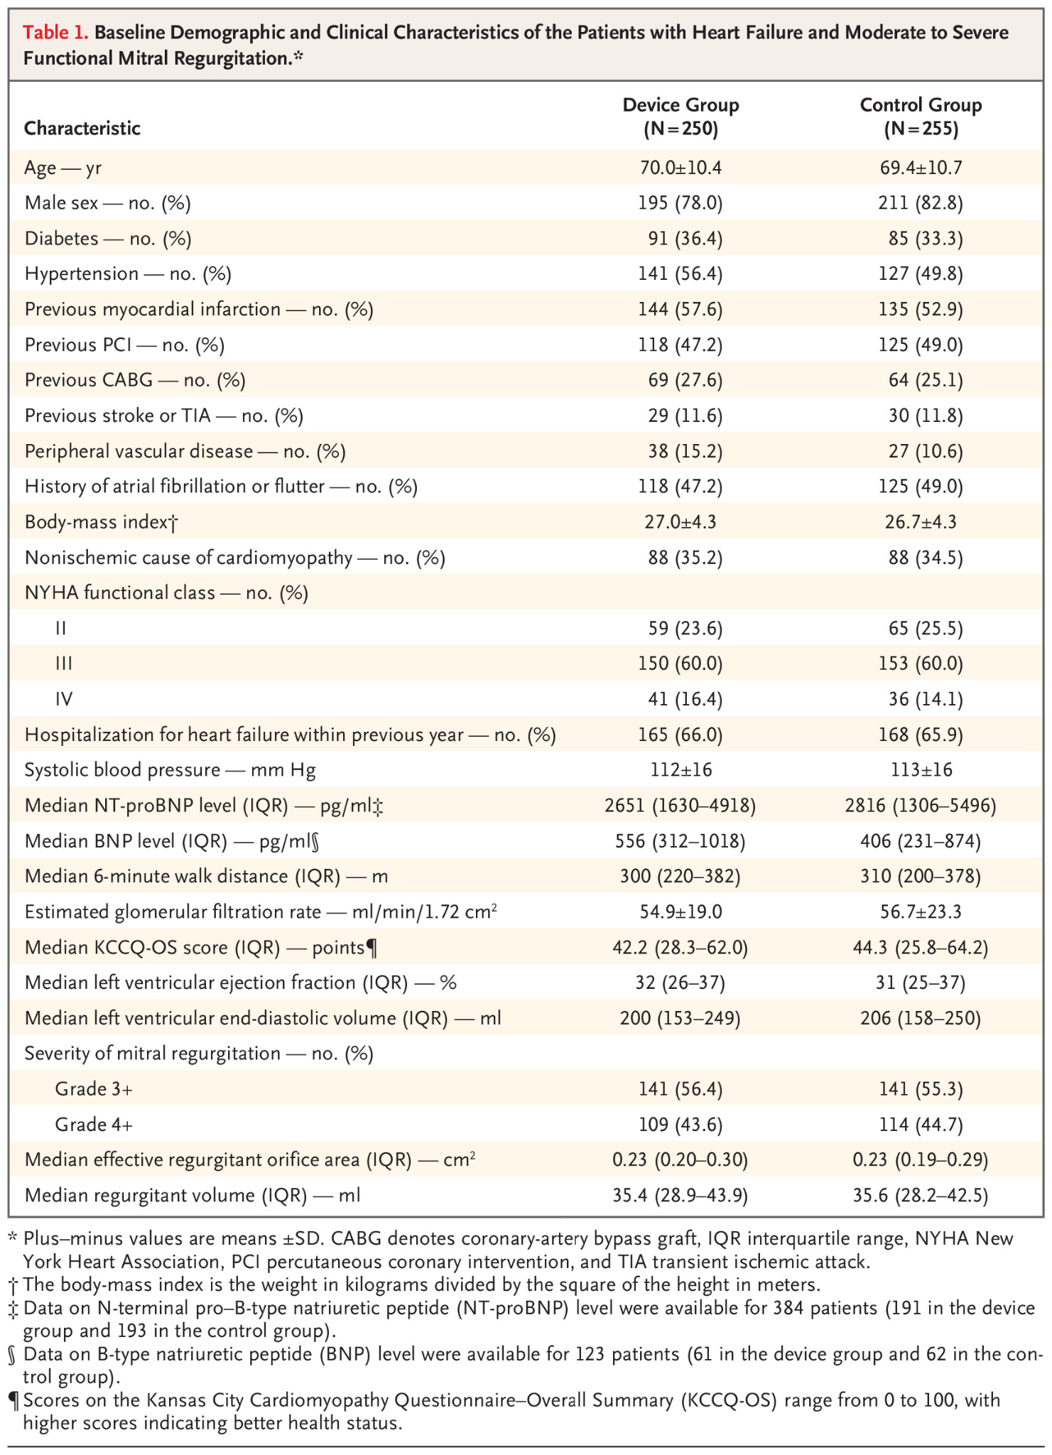
Results

Slide 32
Results

Slide 33
Results
Notes:
Of 250 participants assigned to the device group, 248 (99.2%) had transcatheter mitral-valve repair attempted. The MitraClip device was deployed in 244 patients (98.4%), and echocardiographic data at the end of the procedure were available for 243 patients (97.2%). The severity grade of mitral regurgitation was 1+ or lower in 181 patients (74.5%), 2+ in 43 patients (17.7%), 3+ in 10 patients (4.1%), and 4+ in 9 patients (3.7%). Procedures were performed within 14 days after randomization in 220 patients, within 15 to 30 days in 21 patients, and after 30 days in 7 patients. The median procedure time was 117 minutes (interquartile range, 70 to 150). The median fluoroscopy time was 22 minutes (interquartile range, 12 to 34).

Slide 34
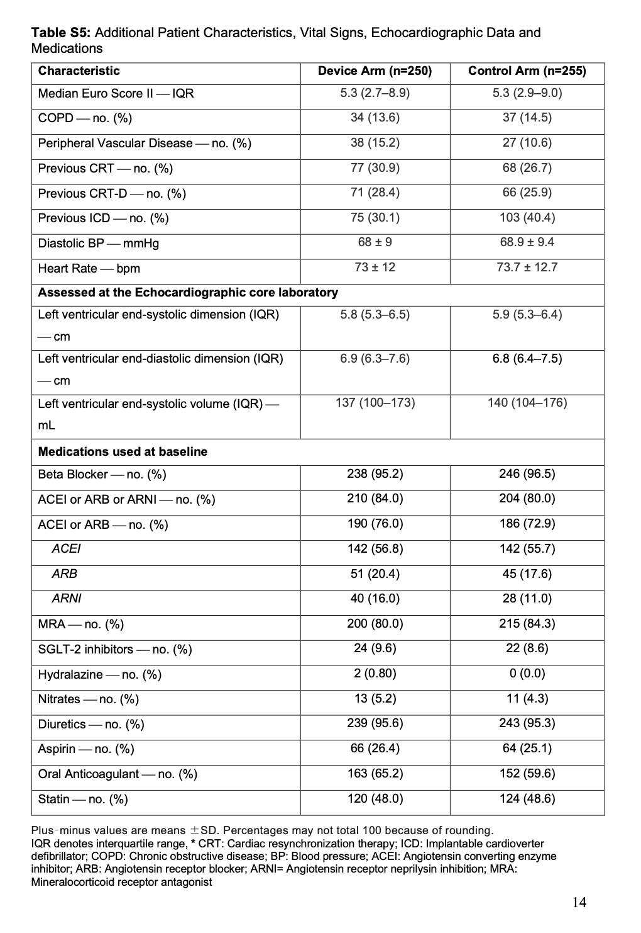
Results

Slide 35
Results

Slide 36
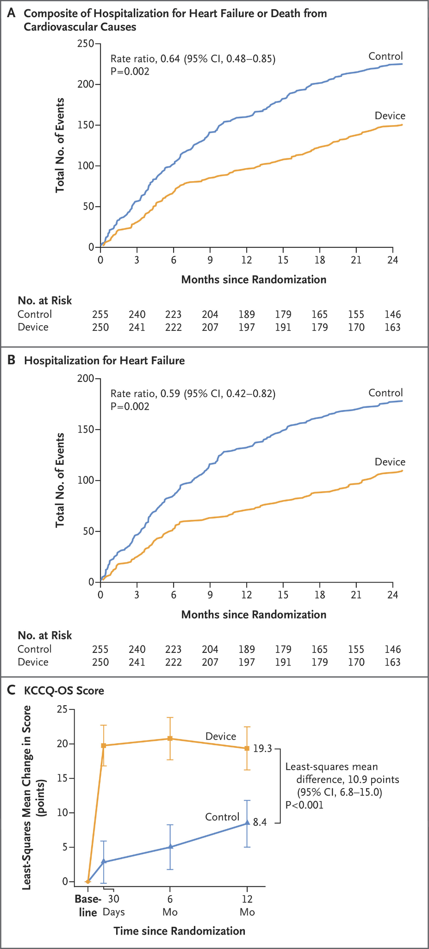
Results

Slide 37
Results

Slide 38
Results

Slide 39
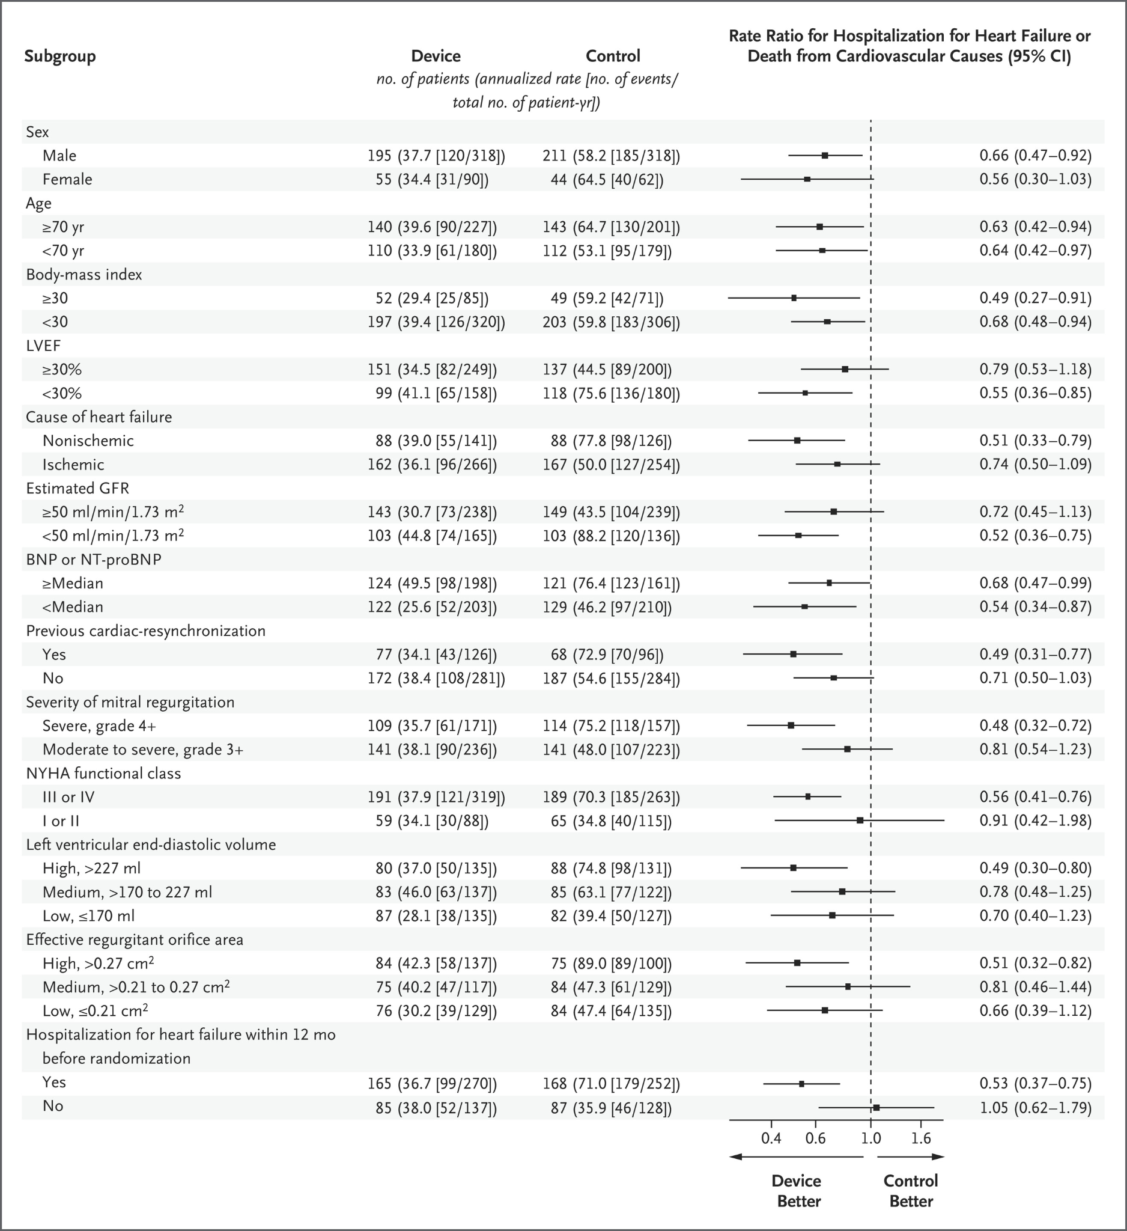
Results
Notes:
LV dyssynchrony reduces closing force

Slide 40
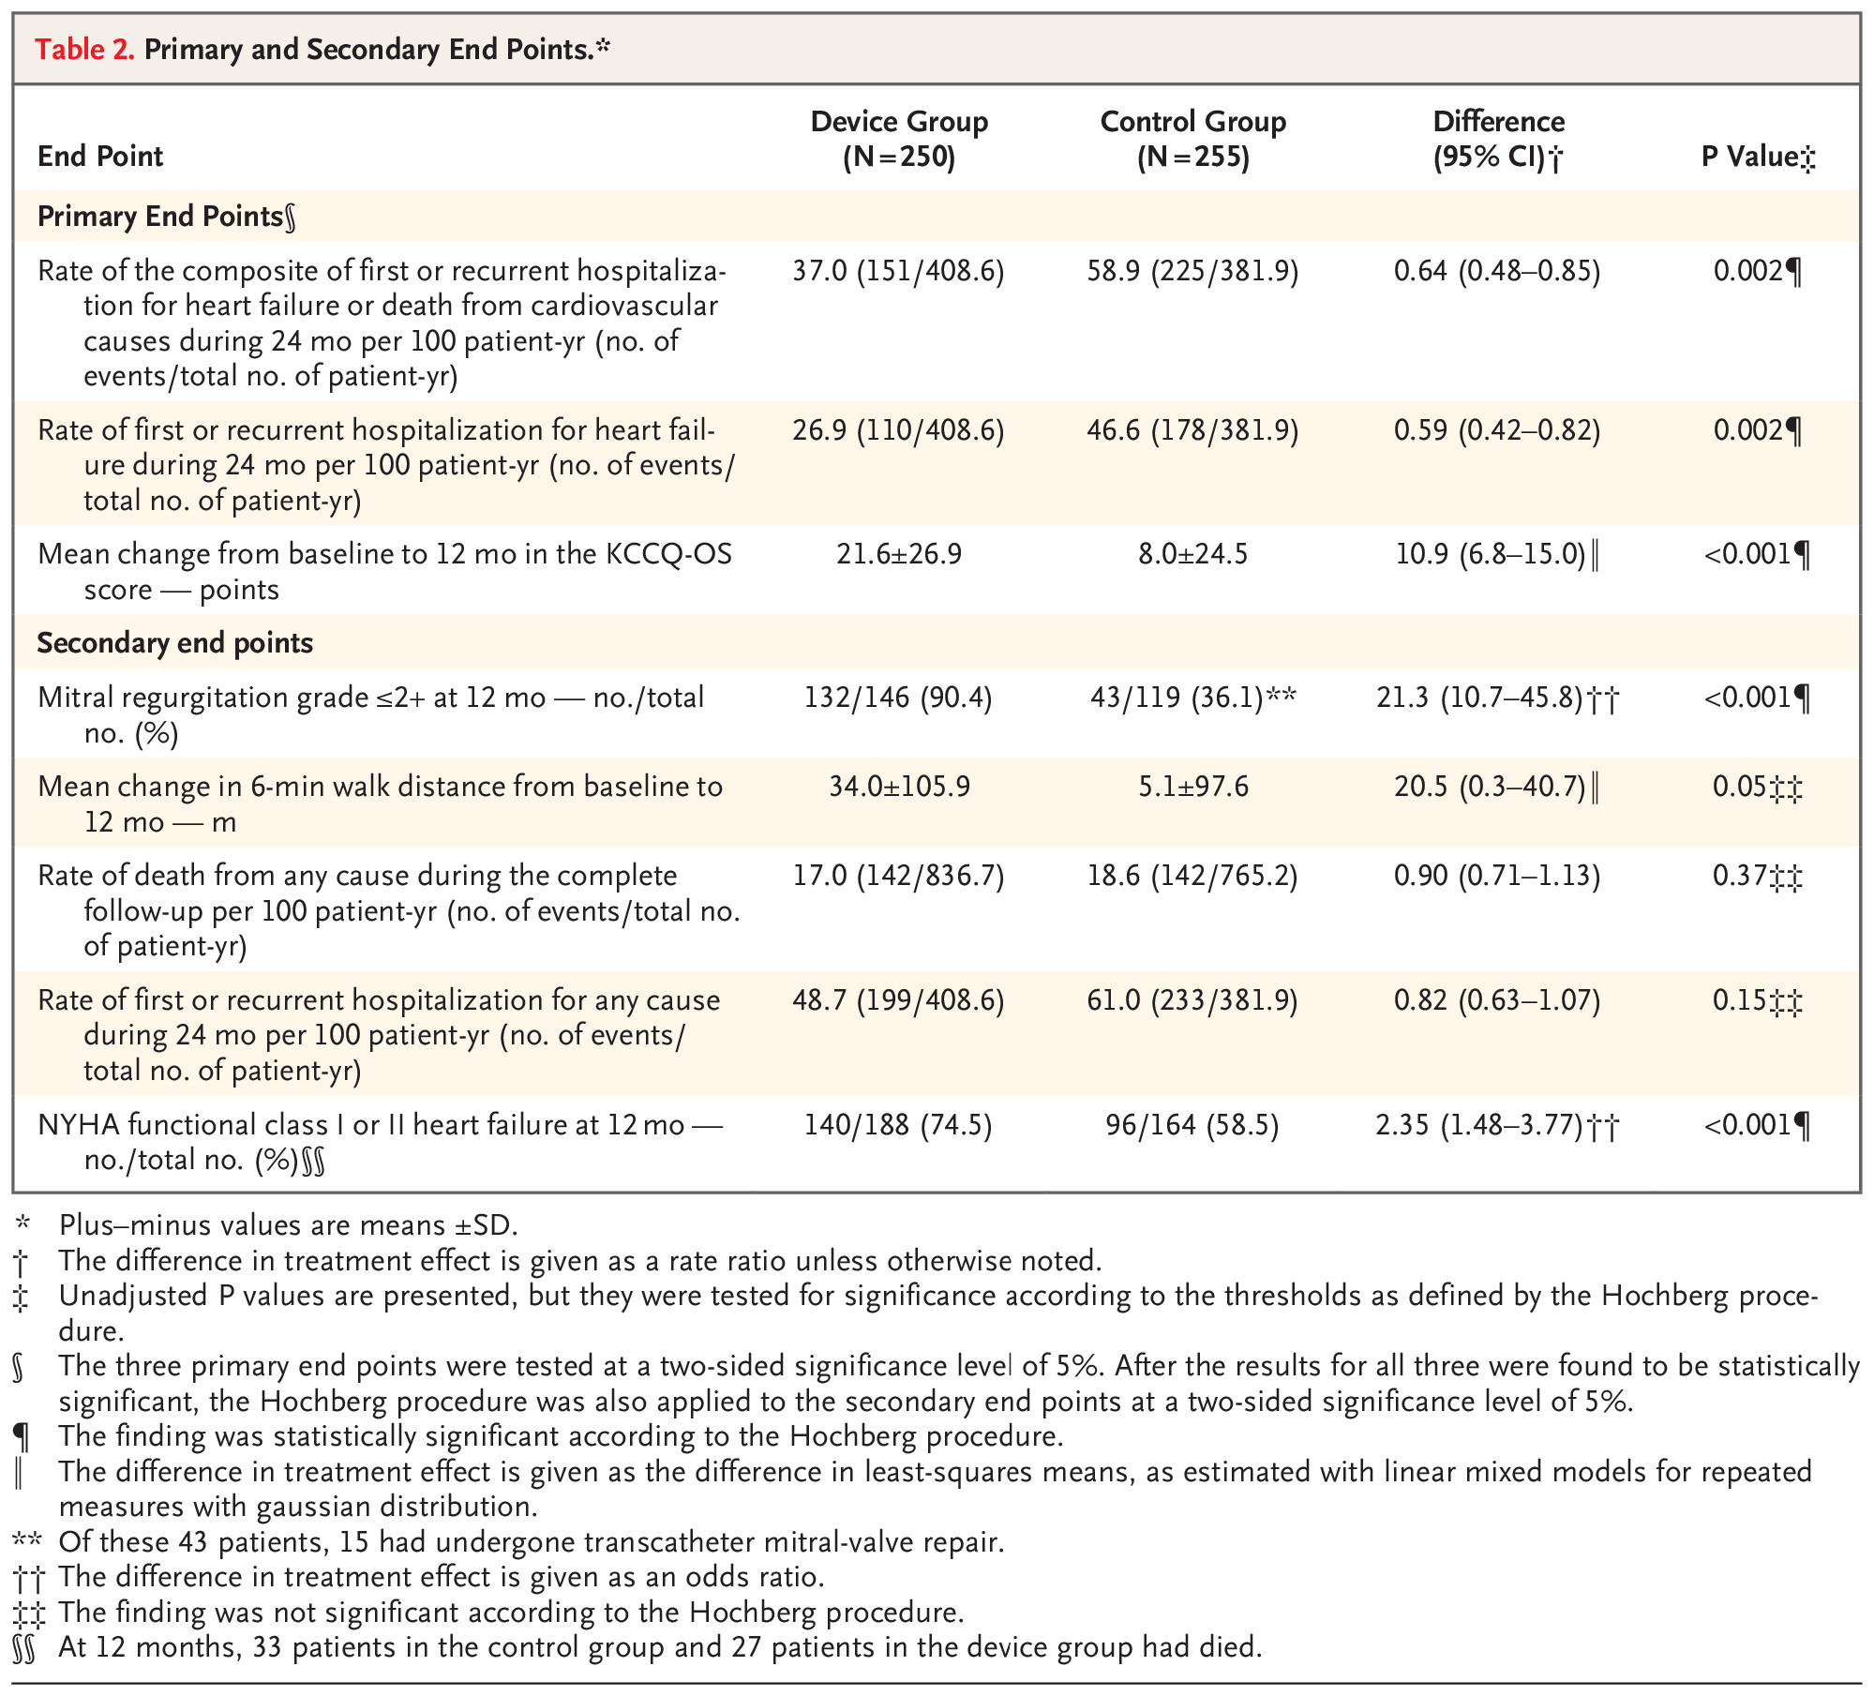
Results

Slide 41
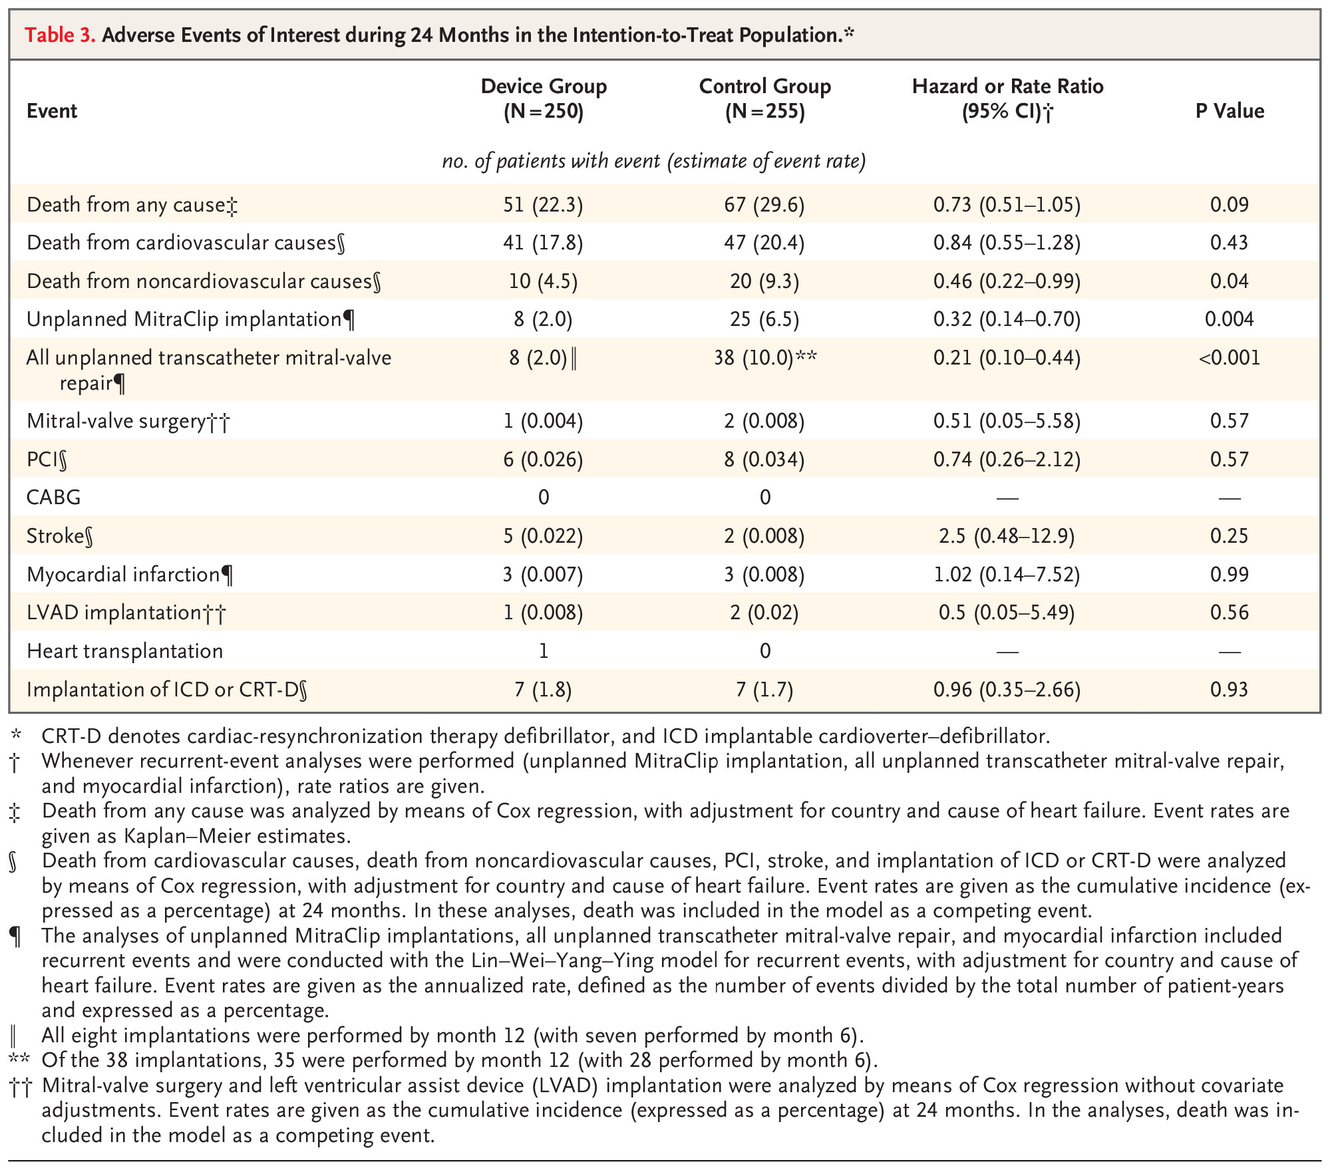
Results
Notes:
Among the patients assigned to the device group, periprocedural adverse events were reported in four (1.6%). These events included two cases of hematoma, one case of pericardial effusion, and one case of right atrial perforation that led to thoracotomy after completion of the device implantation.

Slide 42
Summary of Findings
The RESHAPE-HF2 trial, which involved patients with moderate to severe functional mitral regurgitation who remained symptomatic despite medical therapy, M-TEER led to a lower rate of first or recurrent hospitalization for heart failure or death from cardiovascular causes during 24 months, as well as a lower rate of first or recurrent hospitalization for heart failure during 24 months and a greater increase from baseline to 12 months in the KCCQ-OS score, than medical therapy alone.
Notes:
there were 38 patients who crossed over from medical management only to M-TEER; 28 were performed by month 6, and 35 were performed by month twelve

Slide 43
Summary of Findings
The RESHAPE-HF2 trial, which involved patients with moderate to severe functional mitral regurgitation who remained symptomatic despite medical therapy, M-TEER led to a lower rate of first or recurrent hospitalization for heart failure or death from cardiovascular causes during 24 months, as well as a lower rate of first or recurrent hospitalization for heart failure during 24 months and a greater increase from baseline to 12 months in the KCCQ-OS score, than medical therapy alone.

Slide 44
Summary of Findings
The RESHAPE-HF2 trial, which involved patients with moderate to severe functional mitral regurgitation who remained symptomatic despite medical therapy, M-TEER led to a lower rate of first or recurrent hospitalization for heart failure or death from cardiovascular causes during 24 months, as well as a lower rate of first or recurrent hospitalization for heart failure during 24 months and a greater increase from baseline to 12 months in the KCCQ-OS score, than medical therapy alone.

Slide 45
Summary of Findings
The RESHAPE-HF2 trial, which involved patients with moderate to severe functional mitral regurgitation who remained symptomatic despite medical therapy, M-TEER led to a lower rate of first or recurrent hospitalization for heart failure or death from cardiovascular causes during 24 months, as well as a lower rate of first or recurrent hospitalization for heart failure during 24 months and a greater increase from baseline to 12 months in the KCCQ-OS score, than medical therapy alone.

Slide 46
Study Limitations
Although randomization was performed in a blinded manner, the participants, investigators, and echocardiographers were not unaware of subsequent treatments, which could have created bias, especially for quality-of-life assessments recorded by patients.
Some patients who had been assigned to receive medical therapy alone underwent transcatheter mitral-valve repair, which could have diluted the observed treatment effect.
Finally, the trial was not designed to show differences in mortality.
Notes:
there were 38 patients who crossed over from medical management only to M-TEER; 28 were performed by month 6, and 35 were performed by month twelve

Slide 47
Why the differences between MITRA-FR, COAPT, and RESHAPE-HF2
Notes:
The extent of left ventricular damage and severity of mitral-valve regurgitation have been proposed as important determinants of benefit from transcatheter mitral-valve repair

Slide 48
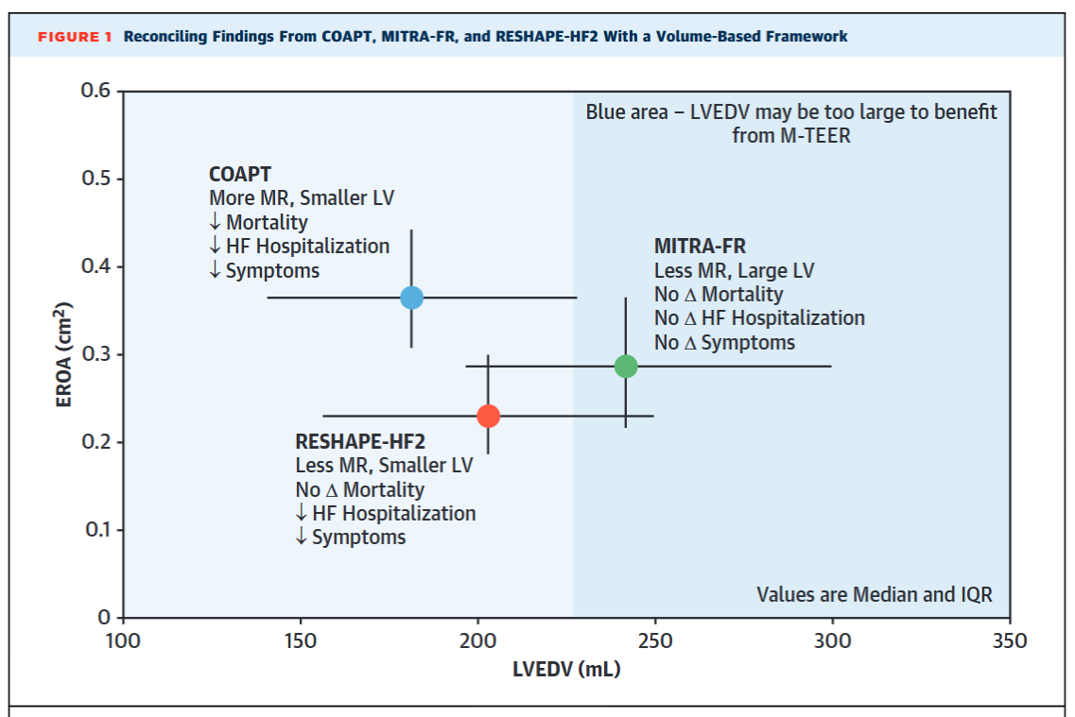
Notes:
Plot of effective regurgitant orifice area (EROA) (y-axis) and left ventricular end-diastolic volume (LVEDV) (x-axis) for the 3 randomized clinical trials of mitral transcatheter edge-to-edge repair + medical therapy vs medical therapy alone.
COAPT, which had greater mitral regurgitation (MR) severity and small LVEDV, had improvements in mortality, heart failure (HF) hospitalization, and patient-reported symptoms.
RESHAPE-HF2 had less MR and similar LVEDV, with no mortality improvement but improved HF hospitalization and symptoms.
MITRA-FR had values of MR severity that were intermediate between COAPT and RESHAPE-HF2, with no measurable benefits in any of the outcome measures.
The blue shaded area represents a potential degree of left ventricular enlargement that is not associated with improved outcomes with mitral transcatheter edge-to-edge repair relative to medical therapy.
COAPT = Cardiovascular Outcomes Assessment of the MitraClip; LV = left ventricle; MITRA-FR = Percutaneous Repair With the MitraClip Device for Severe Functional/Secondary Mitral Regurgitation; RESHAPE-HF2 = A Randomized Study of the MitraClip Device in Heart Failure Patients With Clinically Significant Functional Mitral Regurgitation.

Slide 49
Notes:
We need to continue to examine this subject, it seems. And there are more studies cooking (IRIS, CLASP IID/IIF, AMEND I)

Slide 50
Clinical Implication
M-TEER is beneficial in reducing hospitalization and improving symptoms/QoL among patients with heart failure and secondary MR; it may have a beneficial effect on mortality.
These benefits may be driven largely by the extent of LV remodelling at the the time of M-TEER.
It is critical to emphasize the importance of robust medical therapy to cause LV reverse remodeling and thus reduce the displacement of the mitral valve–supporting structures that leads to FMR.
Notes:
GDMT leads to reduction in severity and improved outcomes for FMR: studies report 28% to 50% reduction in grade of FMR from baseline in patients receiving optimal or maximally tolerated doses of GDMT.9,10
The benefit of GDMT to reduce FMR is likely to be most apparent in patients with meaningful LV enlargement (ie, >220 mL).
A greater proportion of patients in the RESHAPE-HF2 trial received GDMT compared with those in the COAPT and MITRA-FR trials.8 Specifically, 4 of 5 patients in RESHAPE-HF2 were taking mineralocorticoid receptor antagonists, whereas only about one-half of the patients in the COAPT and MITRA-FR trials were similarly treated.
The use of angiotensin receptor-neprilysin inhibitors and beta-blockers was also more prevalent in RESHAPE-HF2, albeit <15%.
The robust utilization of GDMT likely eliminated the enrollment of patients in whom marked LV enlargement would be a contributory factor to significant FMR, likely selecting for patients amenable to achieving the benefits of MR reduction and reverse remodeling after M-TEER.

Slide 51
Than
Thank You

Slide 52
RESHAPE-HF2 Trial:
Transcatheter Valve Repair in Heart Failure with Moderate to Severe Mitral Regurgitation
Joseph Michael-Salami
FAU Cardiology Fellow, PGY-5
Notes:
Introduce the topic briefly (1–2 min). Highlight the trial’s relevance to perioperative management

