Slide 1

Multicenter Mitral Valve Reconstruction for Advanced Insufficiency of Functional or Ischemic Origin (MATTERHORN)
Priya Patel, MD PGY-6

Slide 2
Disclosure Statement
Neither the planners nor the speakers disclosed relevant financial relationships with ineligible companies.

Slide 3
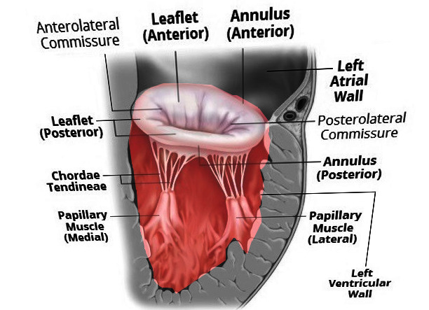
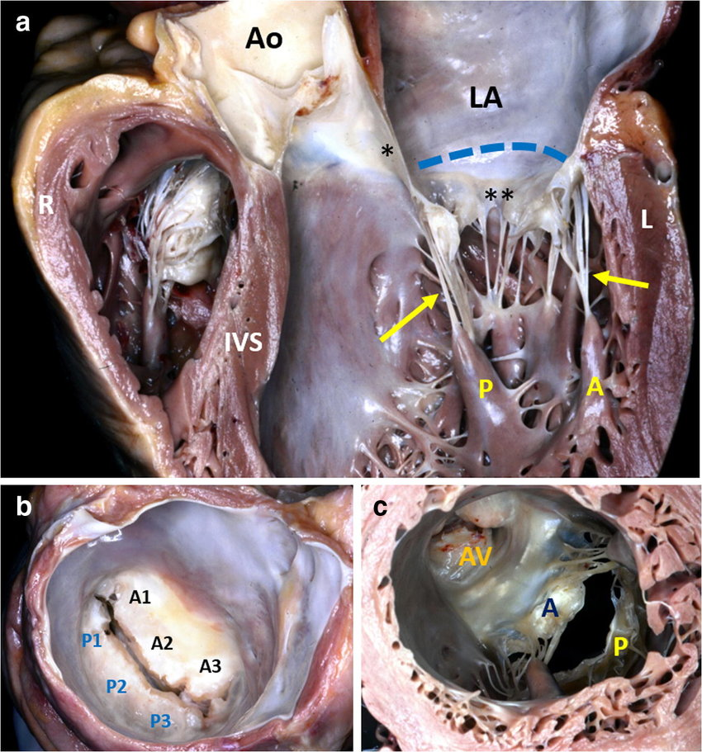
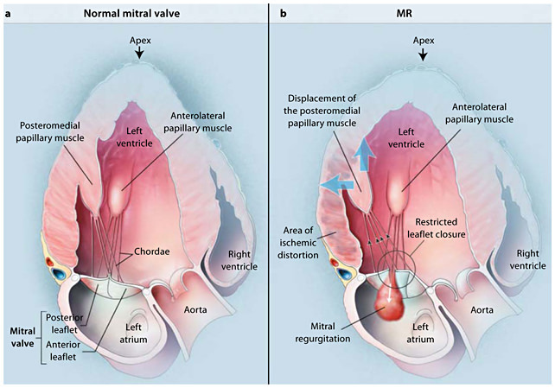
Types of Mitral Regurgitation
Primary: AKA degenerative or organic involving leaflets, chordae, or papillary muscles causing leaflets to close insufficiency during systole
Common causes: papillary muscle ruptures, MVP or leaflet perforation
Secondary: can be due to LV wall motion abnormalities (ischemia) or LV remodeling (dilated ventricle). Structurally the valve is intact.
Notes:
https://www.ncbi.nlm.nih.gov/books/NBK553135/

Slide 4

EVEREST II Trial

Slide 5

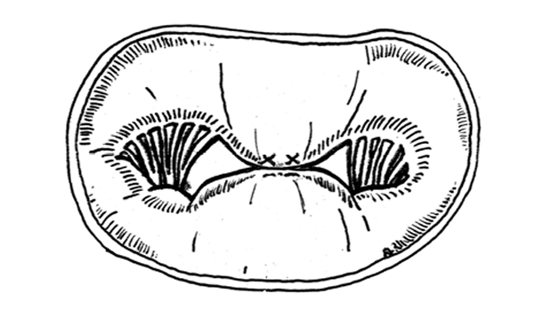
About EVEREST II
Evaluate the efficacy and safety of percutaneous MV repair as compared with conventional surgical repair or replacement in people with severe MR.
Multicenter, randomized, non blinded study from Sept. 2005 to Nov. 2008
Randomized 279 people in 2:1 fashion to percutaneous (n= 184) vs surgical (n=95)
US and Canada
Sponsored by Abbott
Dr. Ottavio Alfieri, MD
Notes:
The edge-to-edge repair has been used as a surgical technique in open chest, arrested heart surgery for the treatment of MR since the early 1990s. The edge-to-edge suture is placed in the middle of the valve, the valve will have a functional double orifice during diastole, hence the alternate name for the procedure: “Double Orifice Repair”, MV can still open on both sides during diastole, known as the Alfieri surgical repair and today we use the MitraClip

Slide 6
Inclusion and Exclusion Criteria
+3/+4 MR using ACC/AHA MR criteria AND
Symptomatic with > 25% LVEF and LVESD ≤ 55mm OR
Asymptomatic with one or more of the following: LVEF 25% to 60%
LVESd 40 to 50 mm
New onset of atrial fibrillation
Pulmonary hypertension defined as (PASP) >50mmHg at rest or >60 mmHg with exercise.
Candidate for MV surgery
Primary regurgitation jet at A2 and P2
EF < 25% and/or LVESd > 55mm
Mitral valve orifice area <4.0 cm2
For flail leaflet:
Width > 15 mm and Gap > 10 mm
Tethering:
Coaptation gap > 11 mm and Length < 2 mm
Severe MAC
Leaflet anatomy:
Calcification in the grasping area of A2 and/or P2
Significant cleft of A2 or P2
One of more anatomic criteria above
Bileaft flail or severe bileaflet prolapse
Lack of both primary and secondary chordal support
Notes:
Adequate reduction of mitral regurgitation to a grade of 2+ or less is assessed with the use of echocardiography.
If the reduction in mitral regurgitation is inadequate with one device, the device may be removed or a second device placed.
Patients with grade 3+ or 4+ mitral regurgitation despite device treatment were referred for elective valve surgery.

Slide 7
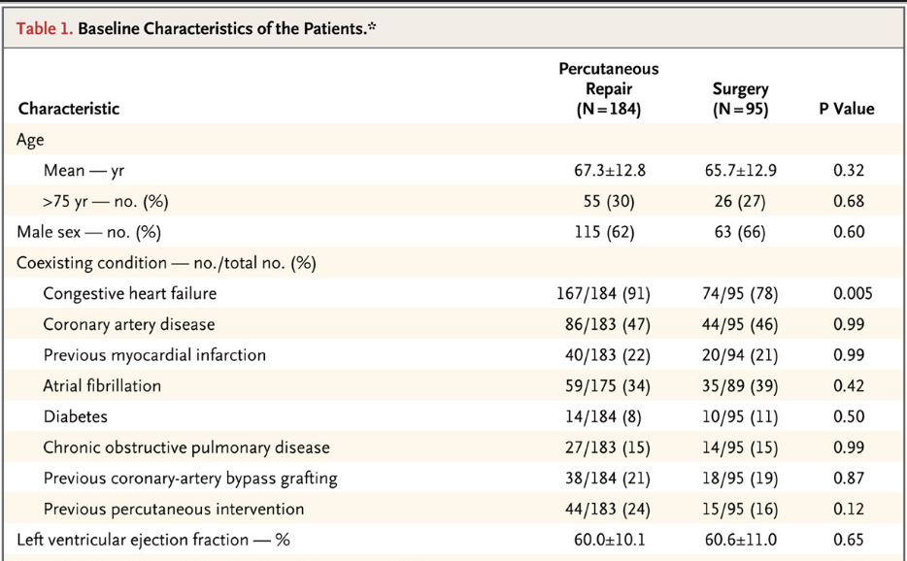

Slide 8
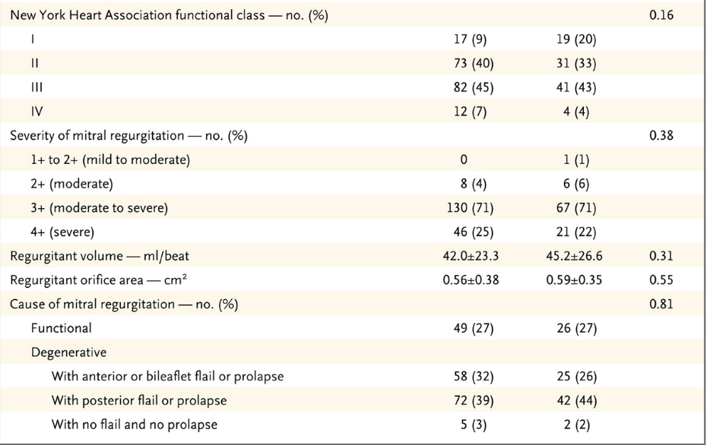

Slide 9
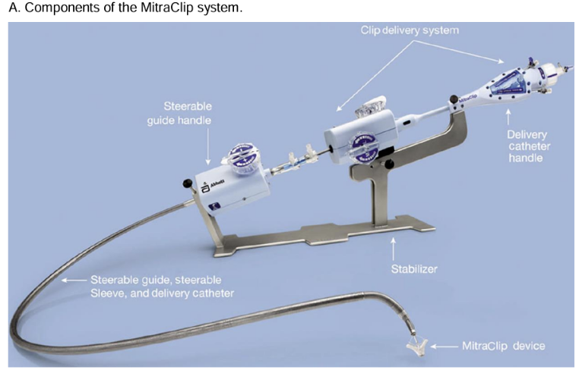
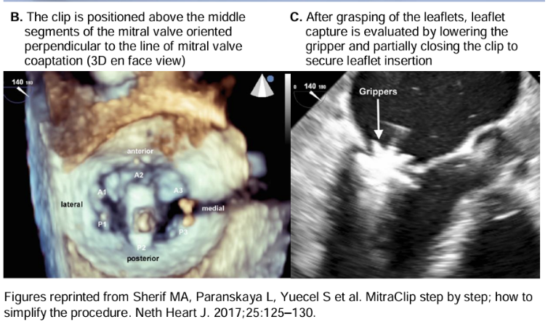
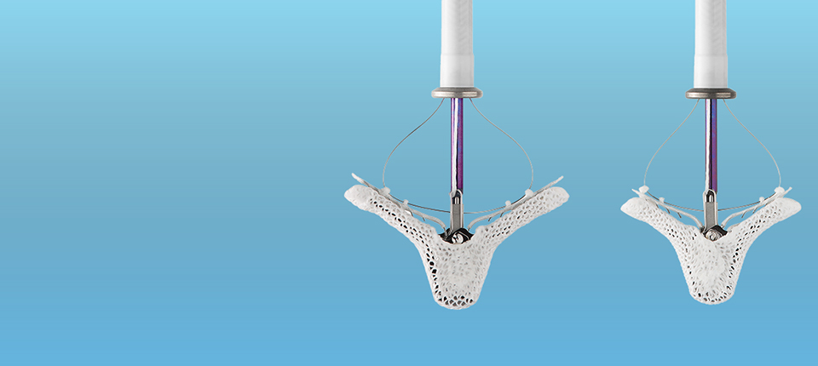
Notes:
The MitraClip device first received FDA approval in 2013 for treating degenerative mitral regurgitation in patients at high risk for open-heart surgery.
An expanded indication for secondary mitral regurgitation in heart failure patients was approved in 2019 based on the COAPT trial.

Slide 10
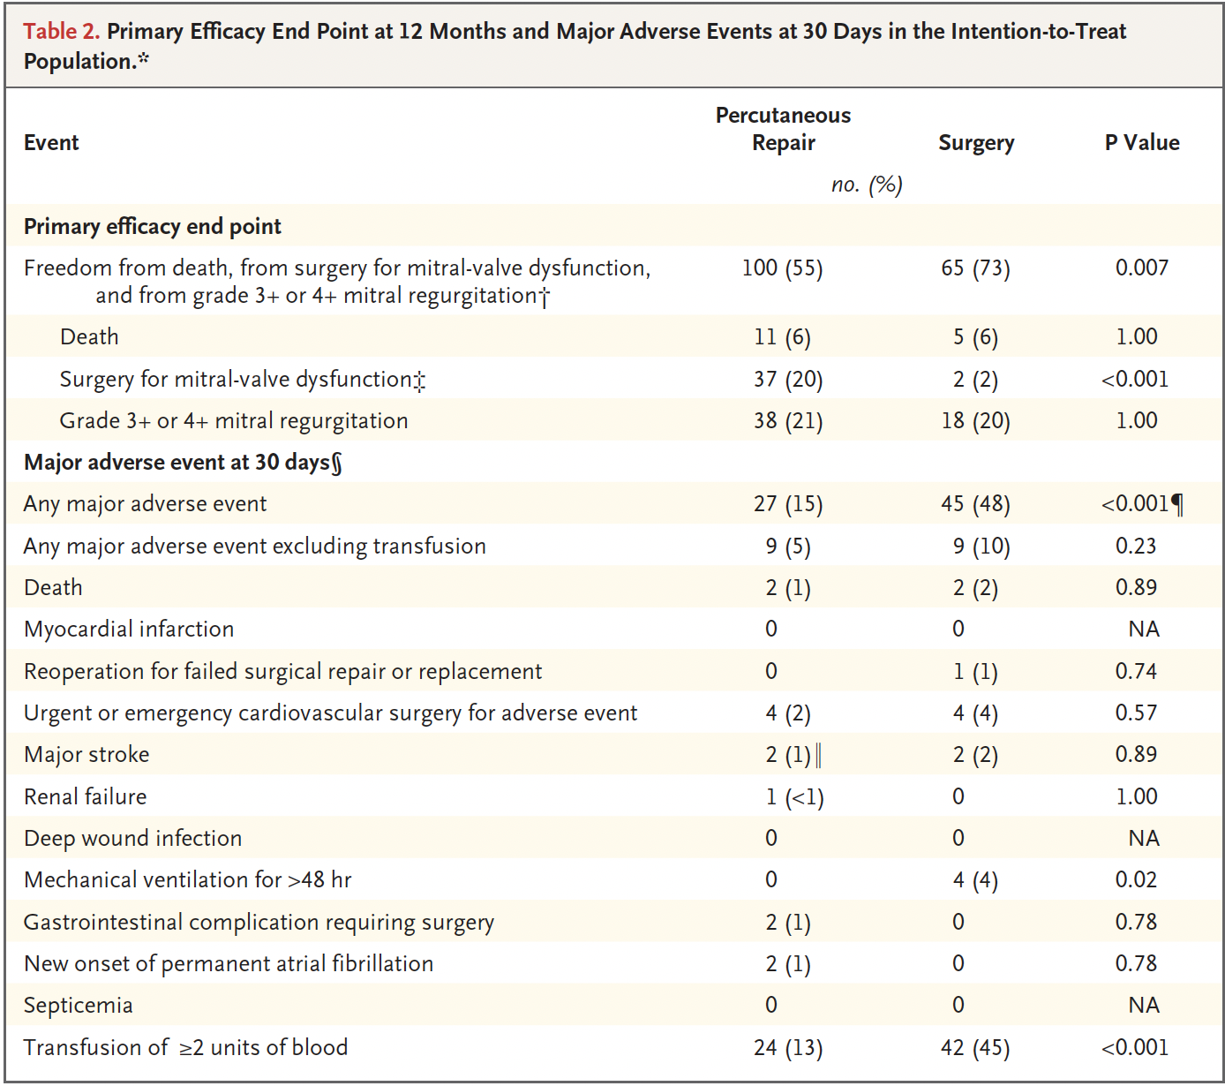
Endpoint/Results
Primary endpoint for efficacy was freedom from death, MV surgery and from grade 3+/4+ MR at 12 months
Primary safety endpoint was rate of major adverse effects at 30
Notes:
M-TEER group - 178 patients who were treated in the percutaneous- repair group, 41 (23%) had grade 3+ or 4+ mitral regurgitation on assessment before hospital discharge and were referred for surgery
Of the 41 -> 28 had surgery ->15 MVr and 13 MVR
Rates of death and grade +3/+4 MR was similar
MV surgery was more common in M-TEER, surgery occurred in 20% in the M-TEER and 2.2% in the surgery group
Surgery group, 80 had < +2 MR before hospital discharge, 11 had MVR and 69 had MVr

Slide 11
Outcome
The primary effectiveness outcome favored surgery at 1 year due to more complete resolution of mitral regurgitation.
However, beyond 1 year, the need for surgery or moderate to severe mitral regurgitation was similar between the groups.
This therapy demonstrated improved safety at 30 days compared with surgery, largely by reducing the need for blood transfusion.
Notes:
https://www.jacc.org/doi/10.1016/j.jacc.2015.10.018
https://www.acc.org/Latest-in-Cardiology/Clinical-Trials/2014/07/06/19/45/EVEREST-II
Transcatheter mitral-leaflet approximation with the MitraClip device (Abbott) was safer than surgical mitral-valve repair but was not as effective in reducing the severity of mitral regurgitation.
However, device-based and surgical mitral-valve repair were associated with similar outcomes in the small subgroup of patients with secondary mitral regurgitation.

Slide 12
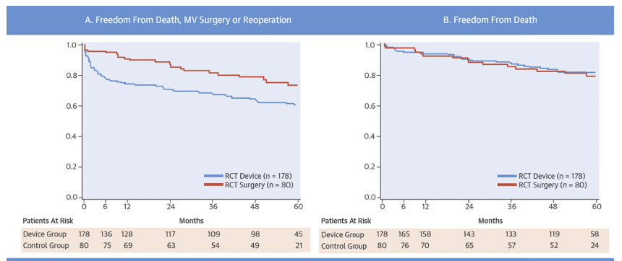
EVEREST II 5 - year follow up
Notes:
At 5 years, freedom from death and surgery for MV dysfunction was 60.6% with the device versus 73.3% in the surgery group (p = 0.03)
Survivors in both groups demonstrated significant reduction in MR from baseline to 12 months (paired p < 0.001 for both groups) and from baseline to 5 years (paired p < 0.001 for both groups), demonstrating the durability of MV repair with both the surgical and the percutaneous approaches.
Primary finding of the EVEREST II 5-year follow-up is the durability of MR reduction with this device.
Despite early imbalance in rates of 3+ or 4+ MR and of subsequent surgery for MV dysfunction, few patients (n = 10 of 43) experienced worsening MR or surgery after 6-month follow-up.
In addition, even when there was more severe residual MR after device placement, there was no difference in long-term survival after percutaneous repair compared with surgery

Slide 13
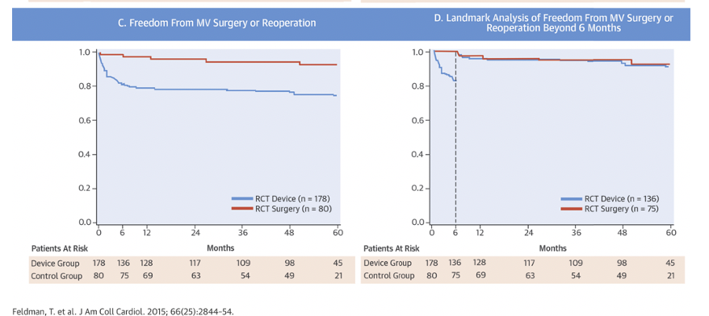
Notes:
An early hazard for surgery for MV dysfunction was observed after percutaneous repair; specifically, 78% of surgeries (33 of 43) occurred by 6-month follow-up.
Beyond 6 months through 5 years, there was no difference in the rate of freedom from surgery for MV dysfunction (77.7% with percutaneous repair vs. 76.2% with surgery; p = 0.77)

Slide 14
COAPT Trial
Evaluate the safety and effectiveness of the M-TEER in patients with HF and secondary MR who remained symptomatic despite GDMT.
Multicenter, randomized, open label trial across 78 centers in the US and Canada from Dec 2012 to June 2017.
Randomized 614 patients in a 1:1 fashion to MitraClip + GDMT vs GDMT only
Eligible patients:
  Ischemic and non- ischemic cardiomyopathy with LVEF 20-50% with moderate to severe (+3/+4) secondary MR confirmed by central echo lab
  Symptomatic - NYHA II, III and IVa (ambulatory) despite optimal GDMT
  LVESd < 70 mm
  STS score for MV replacement > 8%
Exclusion: PASP > 70 mmHg, inotrope or MCS, MV area < 4 cm2 by TTE
Each site had a heart team that assess the patients for eligibility – advanced HF, IC, CTS (ineligible for MV surgery by CTS)
Primary efficacy endpoint was all hospitalization for HF within 24 months for follow up
Primary safety outcome was free from device complications at 12 months
Notes:
https://www.acc.org/Latest-in-Cardiology/Clinical-Trials/2018/09/21/20/12/COAPT

Slide 15
Patients
Cardiomyopathy:
  Ischemic in 60.7% both groups
  Nonischemic 39.2% in both groups
LVEF was 31.3 ± 9.3%
RVSP 44 +/- 13.4 mmHg
LV dimensions
  LVESd 5. 3 cm +/- 0.9 cm
  LVEDd 6.2 cm +/- 0.8 cm
MR grade 3+ in 52.2 % and 4+ in 47.8%
EROA 0.4 cm2
HF hospitalization within past 1 year was 58% (device) vs 56 % (control)
CRT device 38.1% (control) vs 34. 9 % (control)
Mean STS score for risk of death in 30 days was 8.2±5.9%
  Central eligibility committee determined that 69.2% of the patients were at high risk for surgery-related complications or death and 30.8% were not

Slide 16
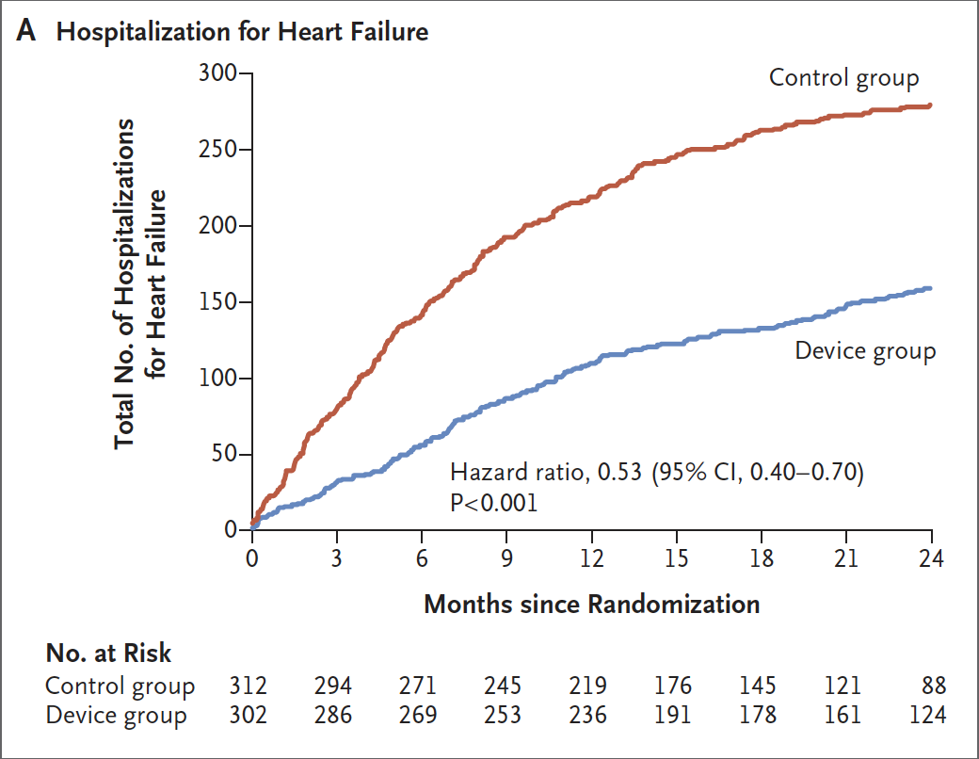
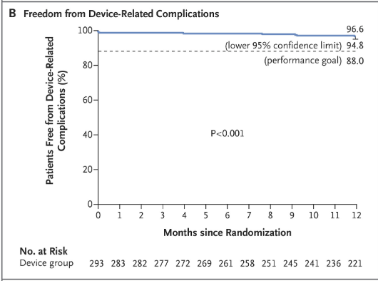
Results
The primary effectiveness endpoint, HF hospitalization at 24 months for MitraClip + GDMT vs. GDMT, was 35.8% vs. 67.9%
The primary safety endpoint, freedom from device-related complications at 12 months, was 96.6% for MitraClip (p < 0.001).
Notes:
A total of 160 hospitalizations for heart failure occurred in 92 patients in the device group, and a total of 283 hospitalizations for heart failure occurred in 151 patients in the control group.
The lower rate of hospitalization for heart failure with device-based treatment emerged within 30 days after treatment.
Hospitalizations: At 2 years, all-cause hospitalization for MitraClip + GDMT vs. GDMT alone: 68.6% vs. 80.7% (p = 0.004)
CV hospitalization: 50.2% vs. 66.8% (p < 0.0001)
HF hospitalization: 34.8% vs. 56.4% (p < 0.0001)
Total all-cause hospitalization: 102.3/100 patient-year (P-Y) vs. 143.3/100 P-Y (p < 0.0001)
Fatal all-cause hospitalizations: 7.8 vs. 14.5/100 P-Y (p = 0.002)
Total CV hospitalizations: 54.9 vs. 88.0/100 P-Y (p < 0.0001)
CV non-HF hospitalization: 20.0% vs. 22.1% (p = 0.50).

Slide 17
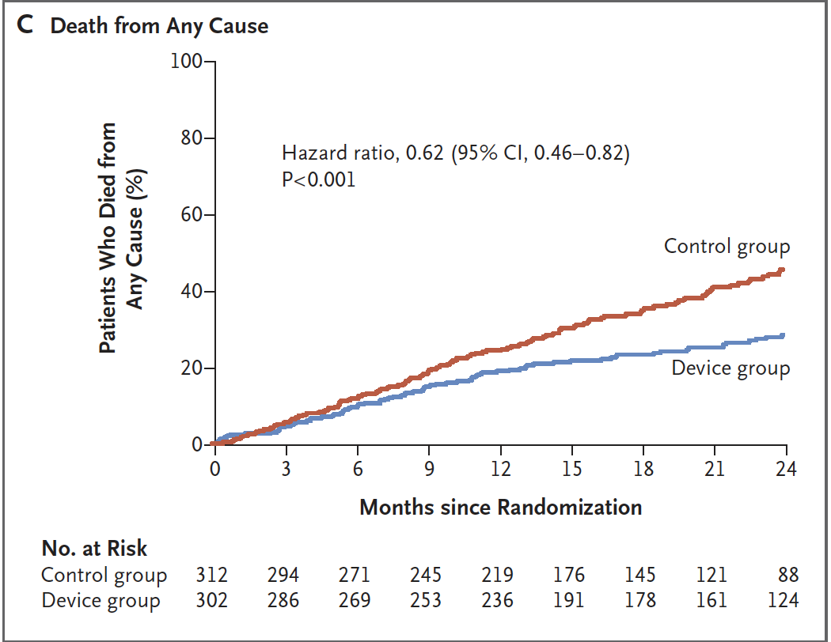
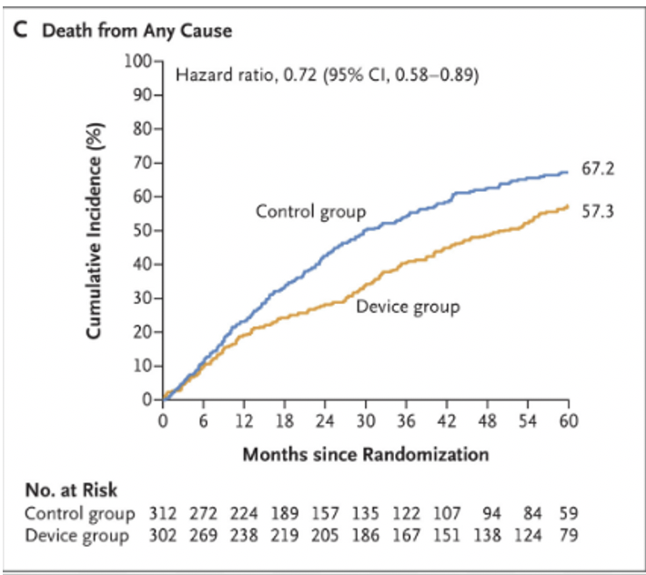
2 year follow up
5 year follow up
Notes:
The lower mortality predominantly emerged more than 1 year after treatment, a delayed response consistent with long-term benefits from a durable decrease in the severity of left ventricular volume overload.

Slide 18
Outcomes
M-TEER resulted in a lower rate of hospitalization for heart failure, lower mortality, and better quality of life and functional capacity within 24 months of follow-up than medical therapy alone
Rate of freedom from device-related complications with M-TEER exceeded a prespecified objective performance goal.
Transcatheter mitral-leaflet approximation led to a decrease in the severity of secondary MR
Lower rate of hospitalization for heart failure with device-based treatment emerged within 30 days after treatment.
The lower mortality predominantly emerged more than 1 year after treatment, a delayed response consistent with long-term benefits from a durable decrease in the severity of left ventricular volume overload.

Slide 19
MITRA FR Trial
Evaluate clinical safety and efficacy of percutaneous MV repair plus medical therapy in patients with HF and secondary MR.
Multicenter, randomized, open label, controlled phase 3 trial across 37 centers in France from Dec. 2013 to March 2017, randomized 452 patients in 1:1 fashion to percutaneous MV repair + medical therapy vs medical therapy only
Eligible patients:
  Severe MR with EROA > 20 mm2 and RegVol 30 ml/beat (ESC guidelines)
  LVEF 15 - 40% with NYHA class II-IV
  Not eligible for MV surgery
Primary efficacy outcome was composite of death from any cause or unplanned hospitalization for HF at 12 months after randomization
Notes:
https://www.nejm.org/doi/full/10.1056/NEJMoa1805374

Slide 20
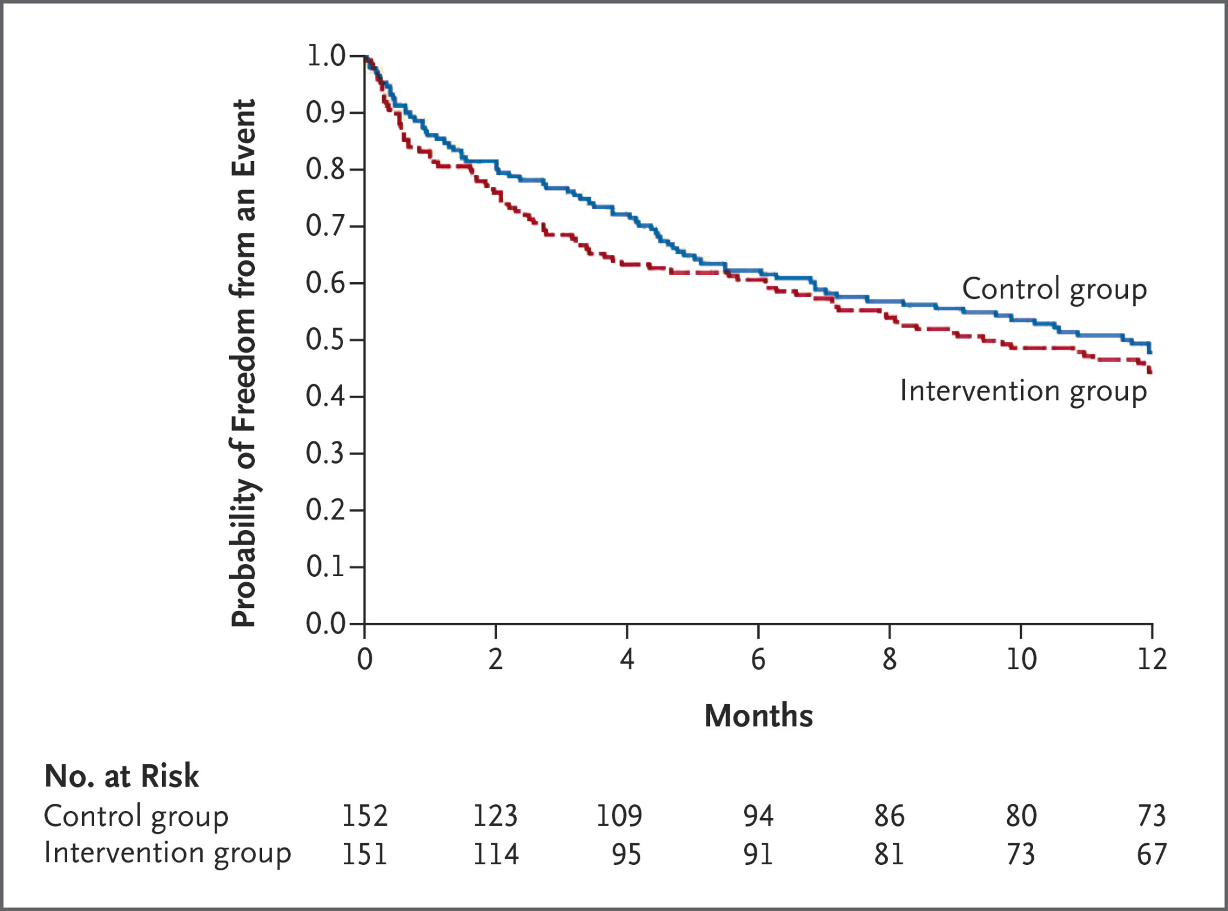
Results
The primary outcome of death or hospitalization for heart failure, occurred in 54.6% of the percutaneous mitral valve repair group compared with 51.3% of the medical therapy group (p = 0.53).
Notes:
Among patients with severe secondary mitral regurgitation, percutaneous mitral regurgitation repair (MitraClip) was not beneficial.
The MitraClip device was not associated with a reduction in the composite (or individual components) of death or hospitalization for heart failure.
The MitraClip device was effective since 92% of patients experienced a reduction in mitral regurgitation of at least 2 grades; however, follow-up echocardiographic data were incompletely reported.
The lack of benefit was likely due to the poor prognosis of the severe underlying cardiomyopathy.
This trial contrasts with the COAPT trial, which documented benefit from MitraClip therapy for secondary mitral regurgitation.
One reason postulated for this difference is that patients in COAPT had more mitral regurgitation per unit of ventricular volume (i.e., disproportionate mitral regurgitation).
In COAPT, the mean EROA was 41 mm² and the mean LVEDV was 194 cc versus MITRA-FR, where the mean EROA was 31 mm² and the mean LVEDV was 272 cc.

Slide 21
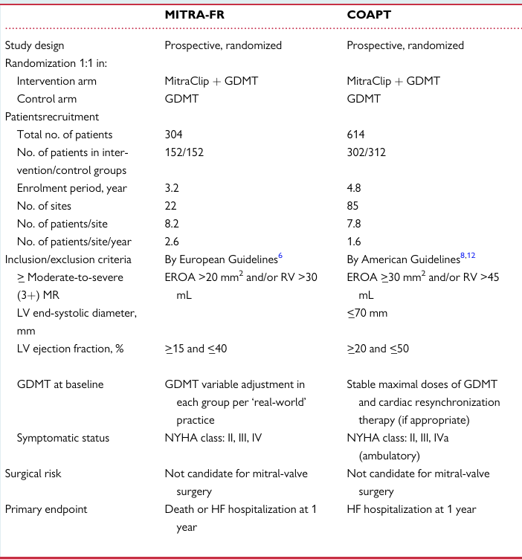
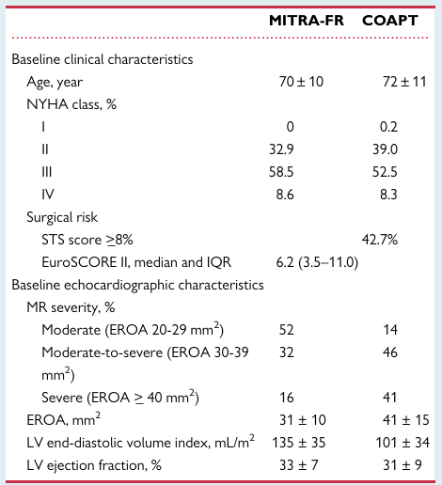

Slide 22
COAPT vs MITRA -FR
Sample size was 2 x larger than in COAPT vs MITRA FR
LV disease:
  LV volumes in COAPT 101 +/- 34 vs MITRA FR 133 +/- 35
  LV dimensions: COAPT LVESd < 70 mm, no mention in MITRA FR
  LVEF: 20-50% in COAPT vs 15-40% in MITRA FR
MR severity: EROA 31 mm +/- 10mm in MITRA FR vs EROA 41 mm +/- 15 mm in COAPT
GDMT
Notes:
MITRA-FR, the underlying cardiomyopathy (myocardial or LV disease) was likely the predominant cause of the heart failure and thus the main determinant of the poor clinical outcome. And in this context, the MR was probably more bystander than the actual cause of the HF.
On the other hand, in COAPT, HF was in large related to he MR (more severe) while LV disease (smaller size and higher LVEF) was less advanced. In COAPT, MR was important contributor to the HF and clinical outcomes whereas in Mitra FR, LV dysfunction was probably the main determinant of clinical outcomes.

Slide 23
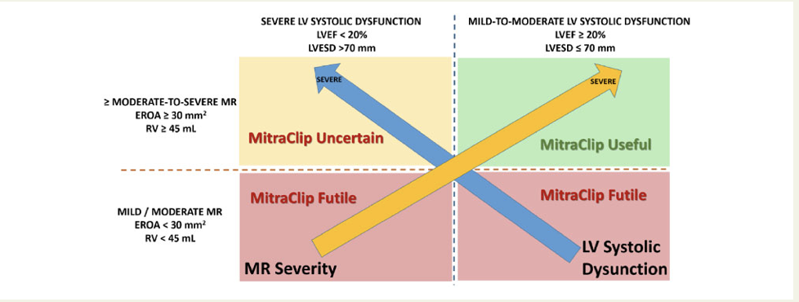

Slide 24
RESHAPE HF2
Will be discussed next week by Dr. Michael - Salami.

Slide 25
About MATTERHORN
Determine whether transcatheter edge-to-edge (TEER) therapy is noninferior to mitral-valve surgery in patients with secondary mitral regurgitation who are at high surgical risk.
Multicenter, prospective, randomized controlled, non-inferiority trial across 15 centers in Germany from February 2015 to December 2022
Steering committee and independent data and safety monitoring committee that included cardiac surgeons, interventional cardiologists, statisticians who provided oversight in trial progress, patient safety and data quality
Funded by Abbott

Slide 26
Inclusion Criteria
Secondary mitral regurgitation + 2 of the following:
  EROA of at least 20 mm2
  Biplane vena contracta > 8 mm
  Reg Vol at least 30 mL
  Regurgitant fraction of at least 50%
  OR at least 2 hospitalizations for acute HF during the 12 month period before enrollment
NYHA class II – IV despite optimal GDMT (including CRT therapy > 1 month)
LVEF > 20%
Eligible for TEER and surgery
High surgical risk determined by local Heart Team
Consent

Slide 27
Exclusion Criteria
Echocardiographic evaluation not available or not suitable for analysis at baseline
Severe TR according to current guidelines
Coronary revascularization or CRT-device within 1 month before the procedure
Other severe valve disorders requiring intervention according to current guidelines
Patient not suitable for MV surgery/ percutaneous MV reconstruction as judged by Heart Team
Key information from patients (e.g. NYHA, MR grade) not available
Pregnant or breastfeeding women
Participation in another clinical trial
Known allergy or intolerance against the studied device
Subject in dependent relationship to investigator or Abbott
Disease with a life expectancy < 12 months
Persons held in an institution by legal or official order

Slide 28
Randomization
Randomized in 1:1 ratio either to TEER (intervention group) or mitral valve repair/replacement group (surgery group)
Transcatheter procedures used the MitraClip
MV surgery – access and technique including surgical ablation, TV surgery were left to the surgeons discretion

Slide 29
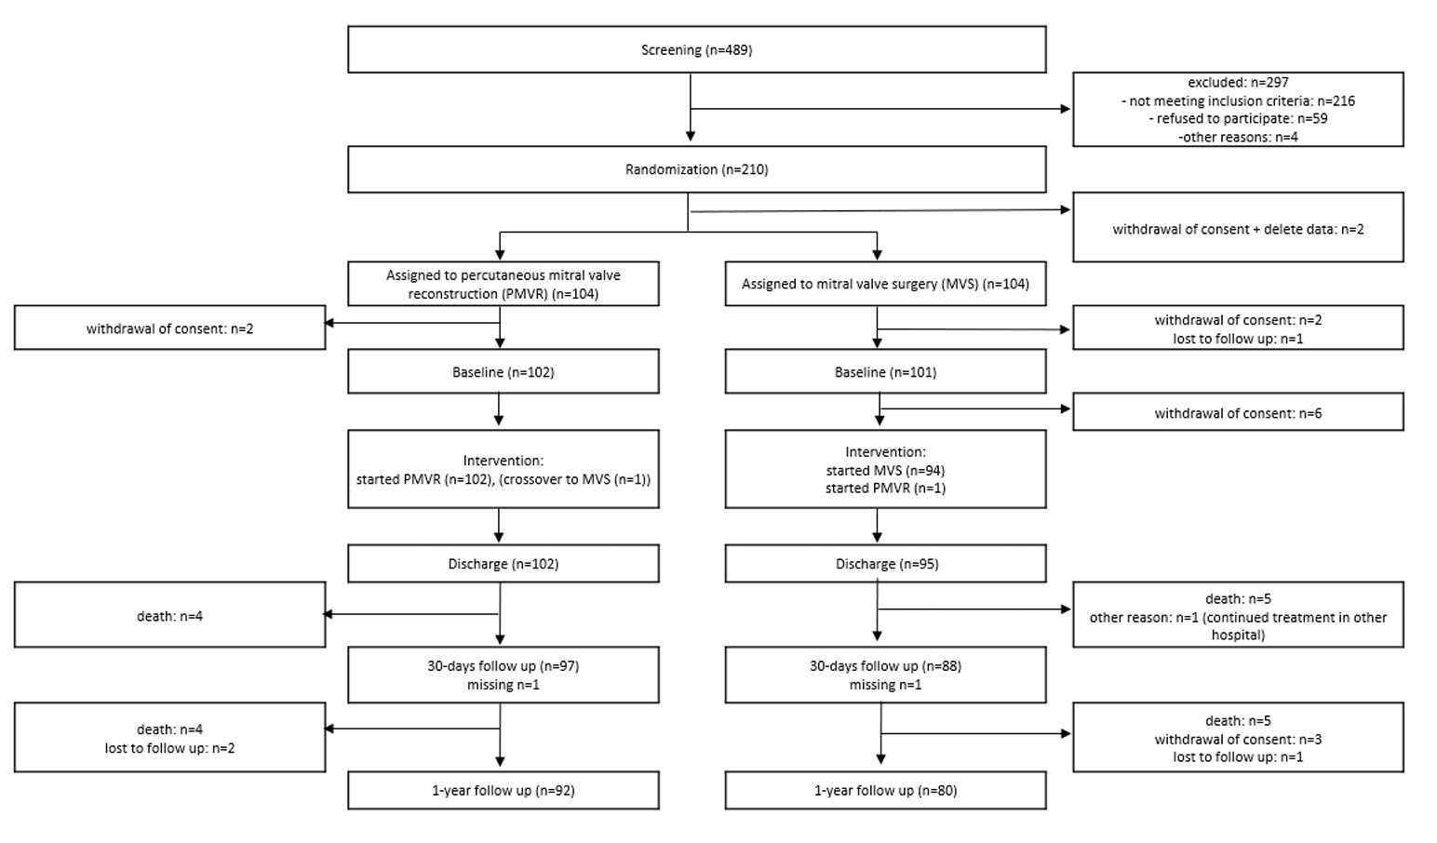

Slide 30
Periprocedural
Evaluation at baseline, hospital discharge, 1 month and 12 months
TEE done before procedure
TTE before procedure, before discharge and 12 months
Echo images reviewed at a core lab

Slide 31
Endpoints
Primary efficacy endpoint was composite of death from any cause, hospitalization for heart failure, mitral-valve reintervention, implantation of an assist device in the left ventricle, or stroke within 1 year after the procedure.
Secondary endpoints:
  Recurrence of grade 3 or 4 mitral regurgitation based on the following criteria as judged by the core lab:
    EROA
    Vena contracta (mean of 2CV and 3CV)
    3D vena contracta area
    Regurgitant volume (RV)
    Regurgitant fraction (RF)
    Pulmonary vein flow

Slide 32
Statistics
For the primary efficacy endpoint, they assumed an average incidence of 35%.
Needed a total of 210 patients would provide the trial with 80% power, accounting for a 5% dropout rate and stratification according to trial site.
The upper boundary of the 90% confidence interval of the estimated mean between-group difference had to be below 17.5 percentage points to meet the criterion for noninferiority.

Slide 33
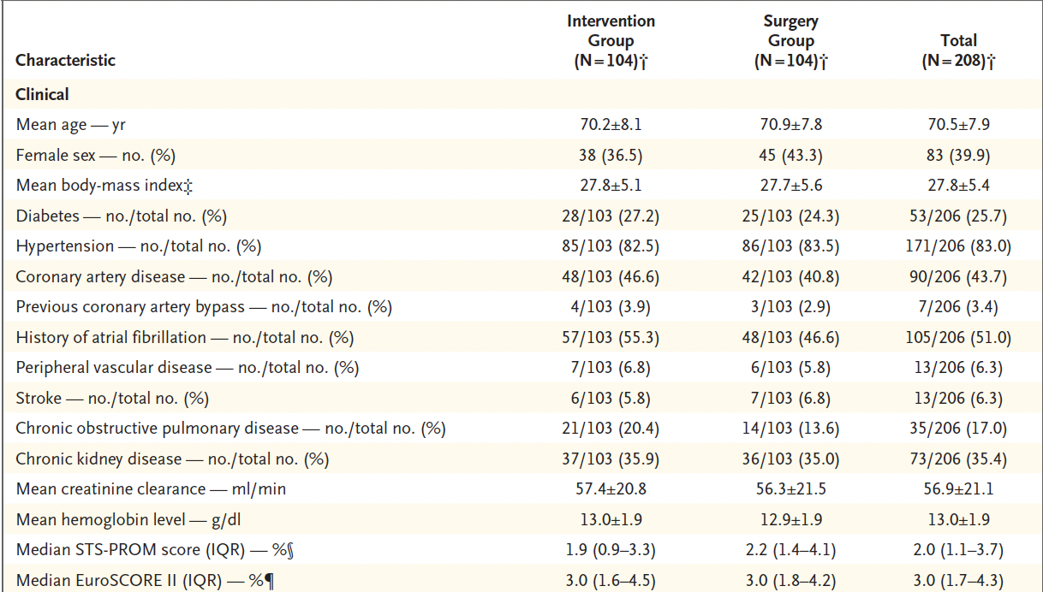

Slide 34
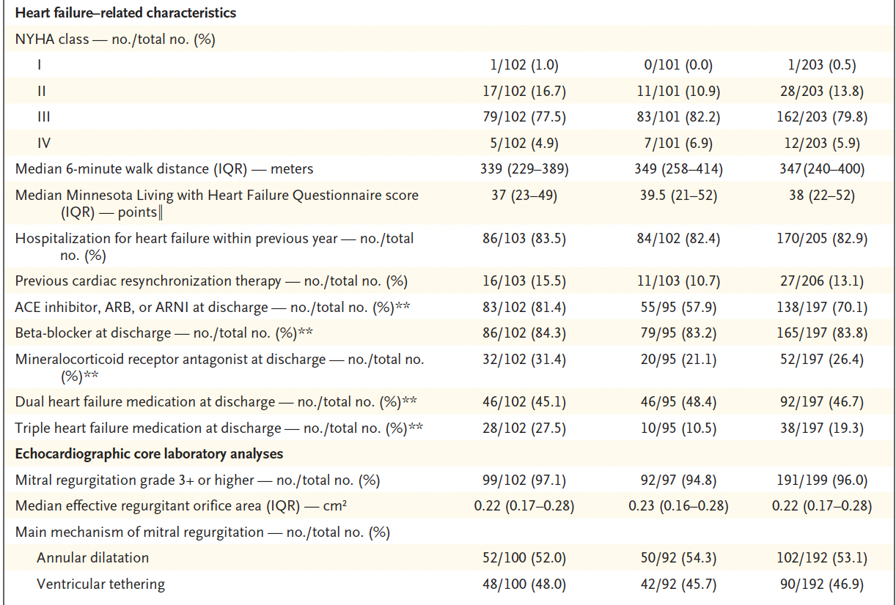

Slide 35
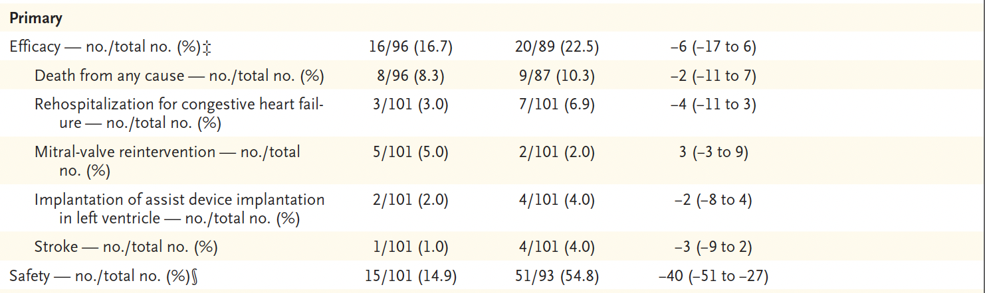
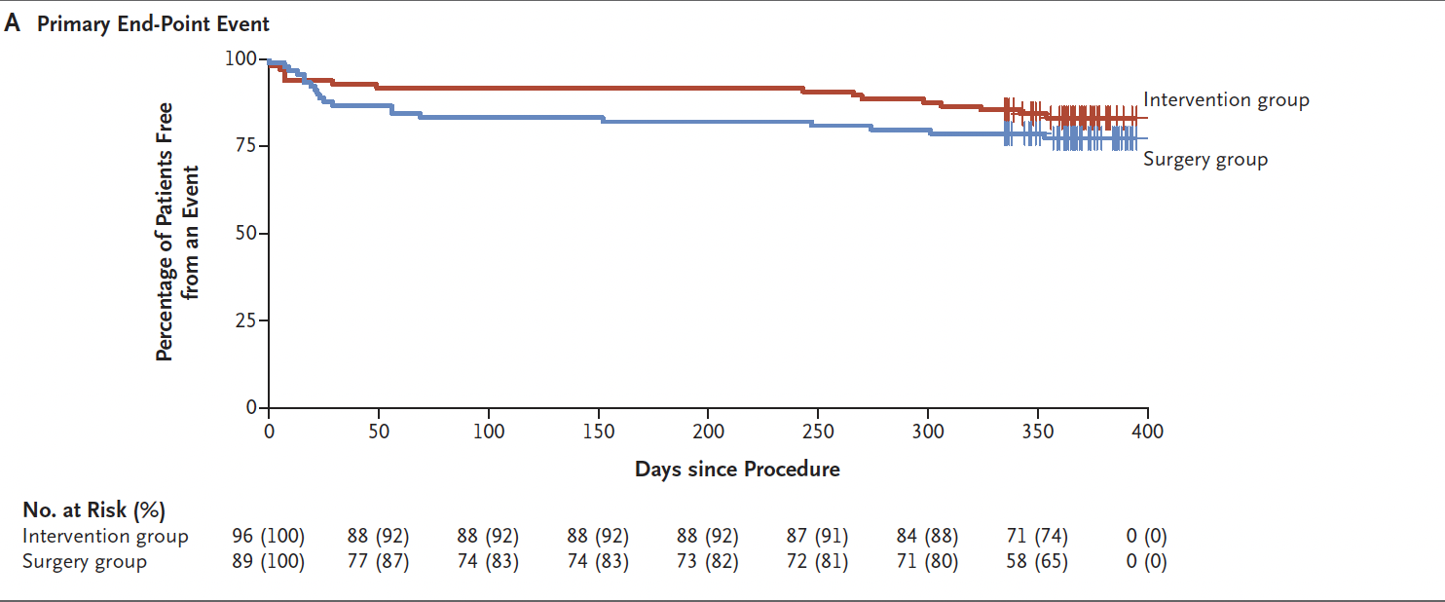
Notes:
Within 1 year after the procedure, 16 patients (16.7%) in the intervention group and 20 patients (22.5%) in the surgery group had a
primary efficacy end-point event (estimated mean difference, −6 percentage points; 95% confidence interval [CI], −17 to 6; P<0.001 for noninferiority) (Table 2 and Fig. S4).
Panel A: shows the cumulative percentage of patients who were free from a primary end-point event among patients with secondary mitral regurgitation who underwent transcatheter edge-to-edge repair (intervention group) and among patients who underwent surgery (surgery group).

Slide 36
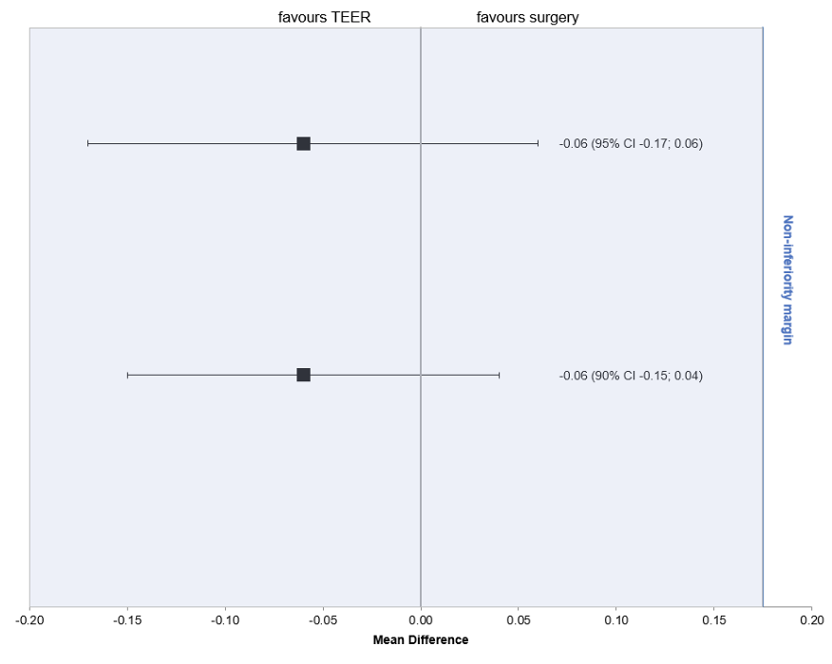
Notes:
The mean difference of the estimated proportions was -0.06 with an 95% confidence interval of -0.17 to 0.06. This confidence interval is below 0.175, thereby meeting non-inferiority. The study protocol defined that the upper boundary of the 90% confidence interval of the mean difference of the estimated proportions had to be below the non-inferiority margin to fulfil non-inferiority.

Slide 37
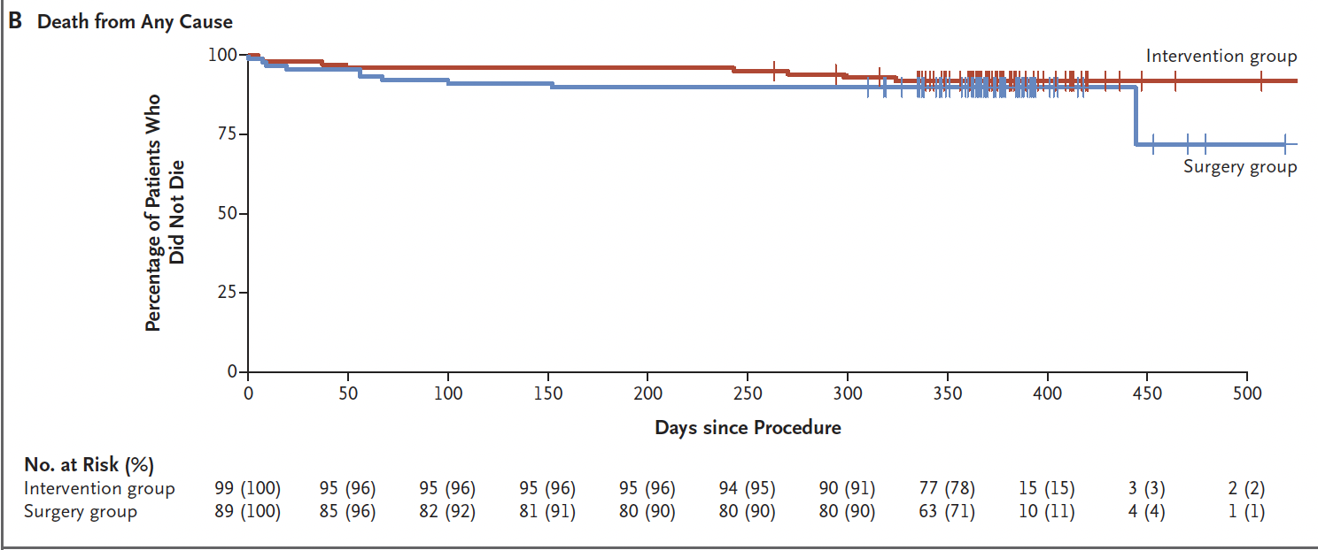
Notes:
Panel B shows the freedom from death from any cause in the two groups.

Slide 38
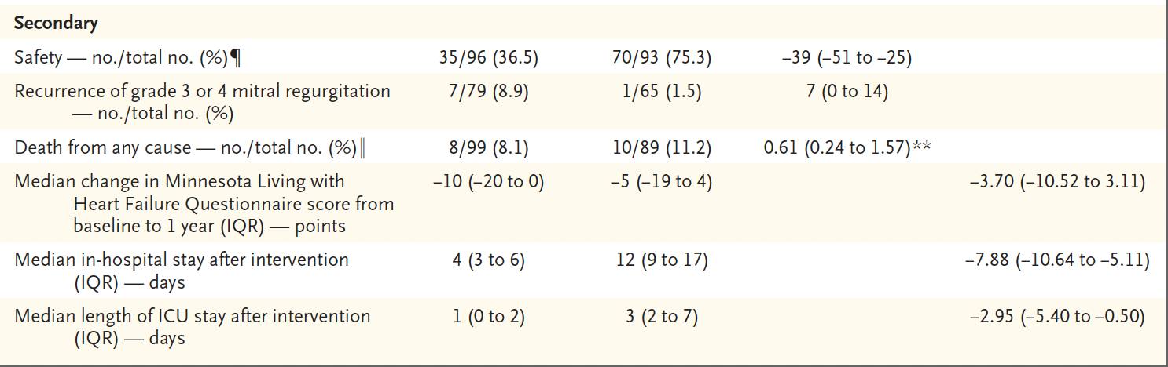
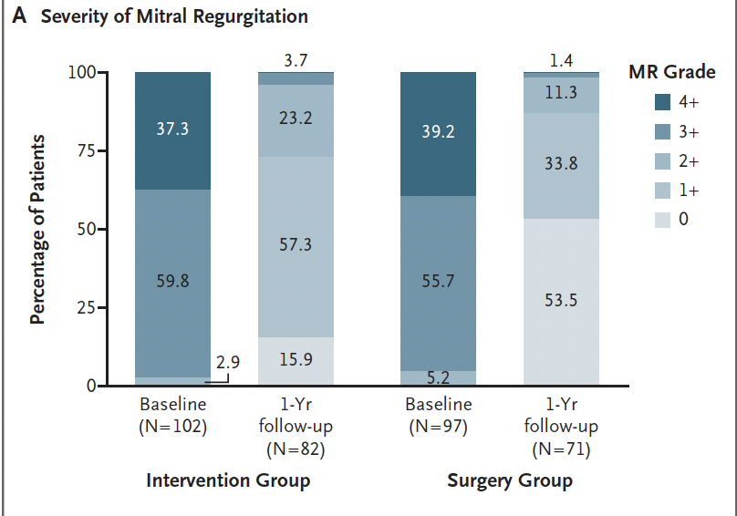
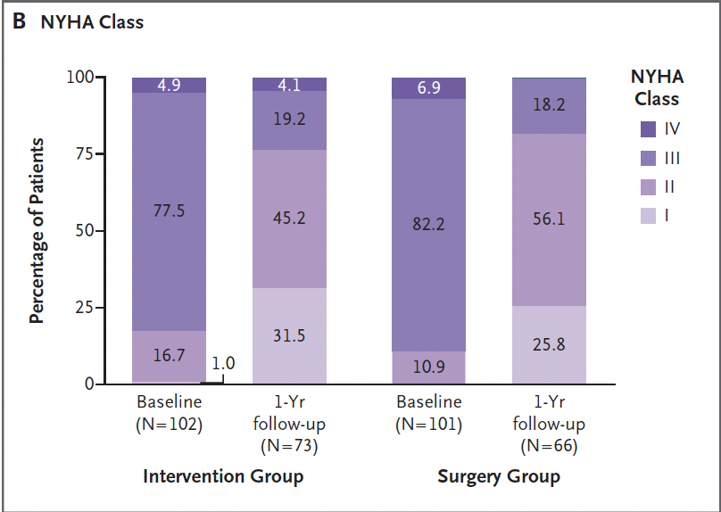

Slide 39
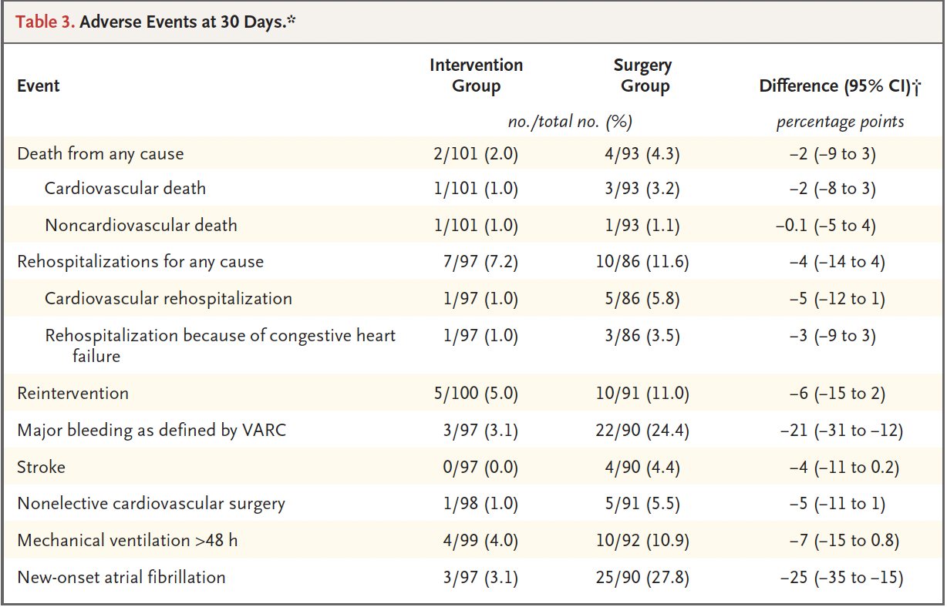

Slide 40
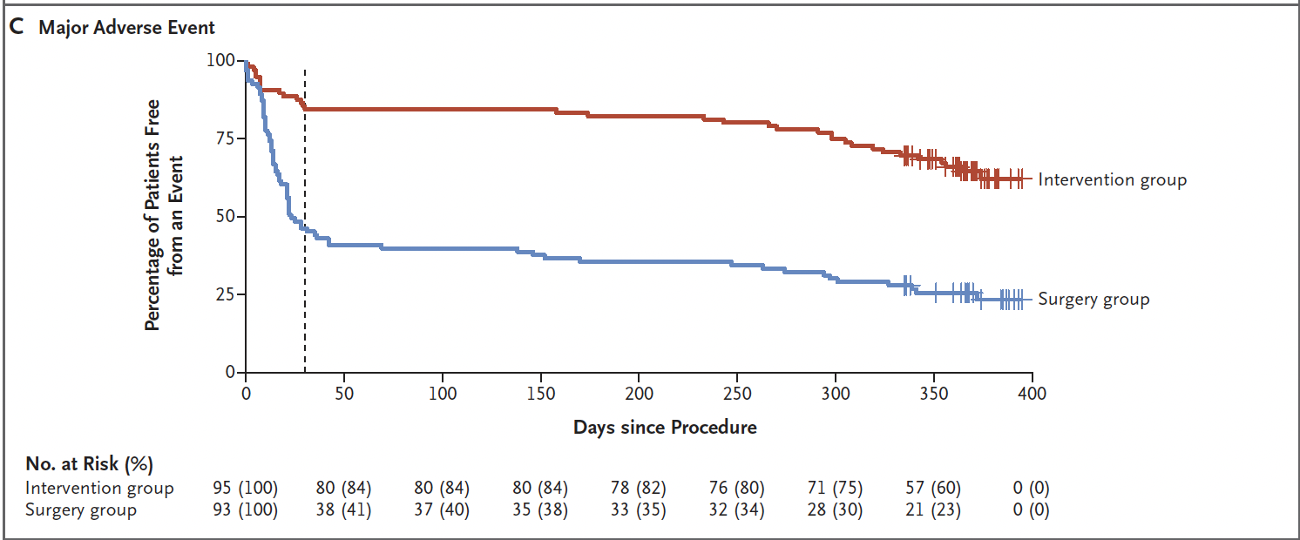
Notes:
Panel C shows the percentage of patients in the two groups who did not have a primary safety end-point event at 30 days after the procedure (dashed line) and over the entire trial period.

Slide 41
Takeaways
Among people with HF and secondary MR who were suitable candidates for isolated mitral-valve surgery according to current practice, TEER was noninferior to surgery with respect to a primary efficacy endpoint (composite of death, hospitalization for heart failure, reintervention, implantation of an assist device, or stroke at 1 year after the procedure).
Intervention group had a 60% lower relative risk of a primary safety end-point event than the surgery
group at 30 days, and this decreased risk was sustained throughout the first year of follow-up.
Both procedures were efficacious when compared at 1 year, there was total of 98.6% of patients in the surgery group had mitral regurgitation of grade 2+ or lower at 1 year of follow-up

Slide 42
Limitations
Enrolled patient population was relatively low risk
The participating centers were selected on the basis of their level of experience with both TEER procedures and mitral-valve surgeries, and results may not be generalizable to all centers.
Masking of the group assignments from patients and investigators was not possible.
Recruitment took 7 years and small population
Medical treatment for systolic heart failure were not administered as vigorously, about less than half of the trial population had LVEF < 40%
Wide non-inferiority margin
Short follow up period of 1 year

Slide 43
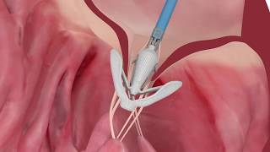
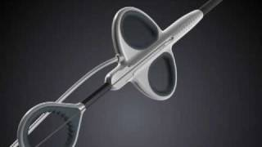
MV Repair Trials
CLASP IID/IIF: Edwards PASCAL Transcatheter Valve Repair System in patients with degenerative mitral regurgitation (DMR) who have been determined to be at prohibitive risk for mitral valve surgery by the Heart Team, and in patients with functional mitral regurgitation (FMR) on guideline directed medical therapy (GDMT).
RECHORD Trial: Assess the safety and effectiveness of the NeoChord DS1000 System for the treatment of patients with moderate or severe degenerative mitral regurgitation.

Slide 44
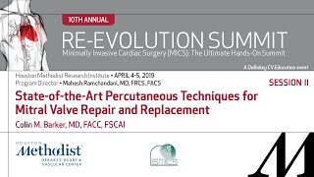
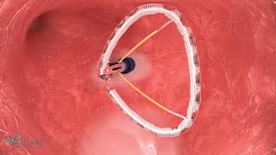
IRIS trial is underway outside of the US to assess the IRIS system in approximately 50 patients, focusing on acute safety (primary endpoint: adverse events) and 30-day efficacy (secondary endpoint).
AMEND I study is a multicenter study assessing the safety and efficacy of the AMEND system in reducing mitral regurgitation.

Slide 45
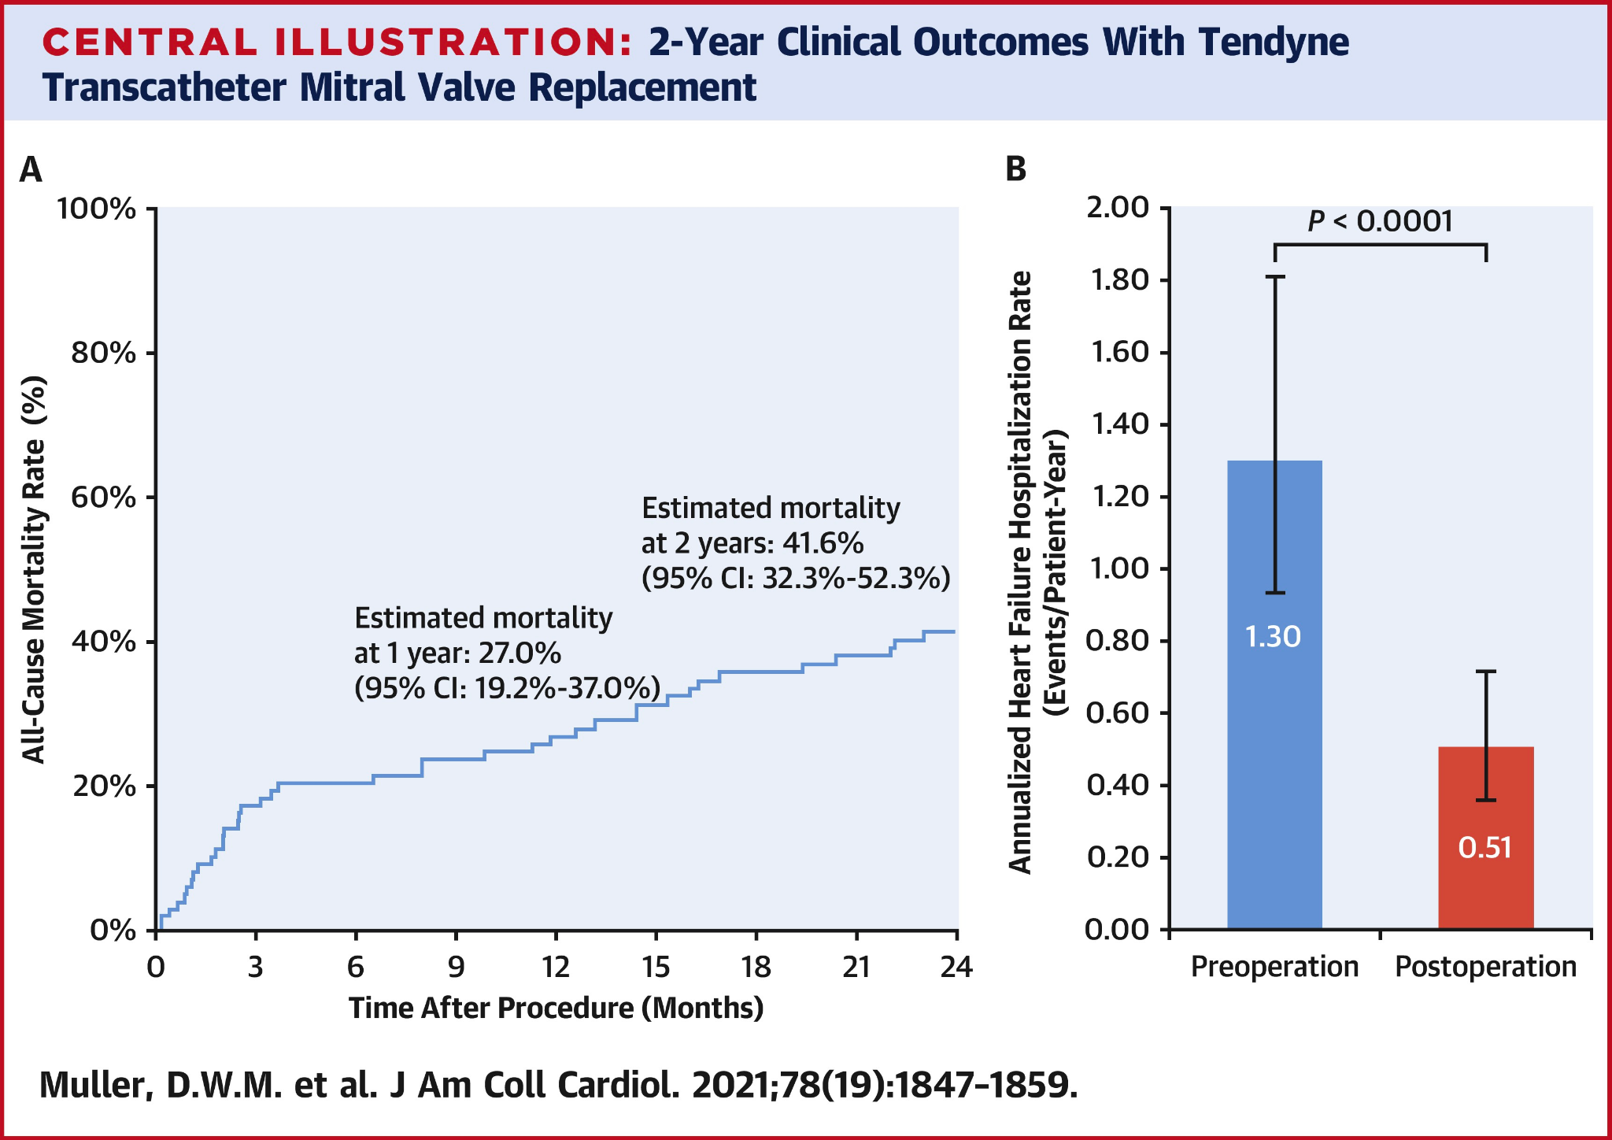
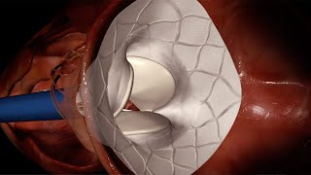
SUMMIT Tendyne Trial: Safety and effectiveness through 2-year follow-up of TMVR in high-surgical-risk patients with severe MR.
Notes:
FDA approved May 27, 2025

Slide 46


