Slide 1

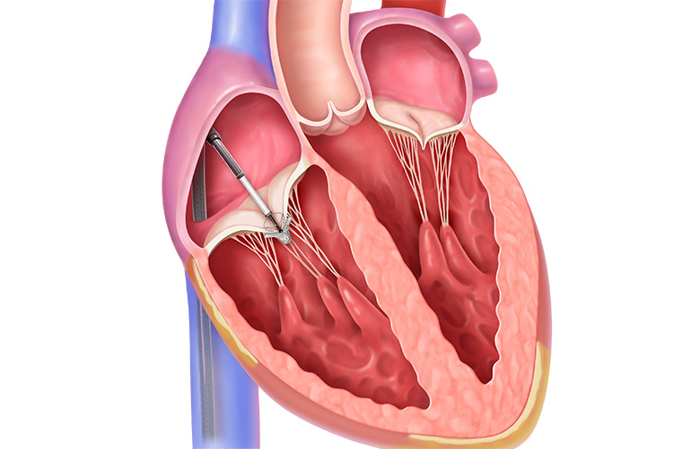
Tri. Fr
Mohamed Hamed
CVD Fellowship
PGY-6

Slide 2
Disclosures
Neither the planners nor the speakers disclosed relevant financial relationships with ineligible companies.

Slide 3
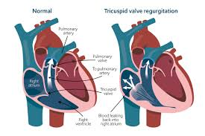
Tricuspid Regurgitation
Tricuspid regurgitation is the backflow of blood from the right ventricle into the right atrium
Often secondary (annular dilation or malcoaptation of leaflets)
Leading to Right sided heart failure, decreased cardiac output and systemic symptoms

Slide 4
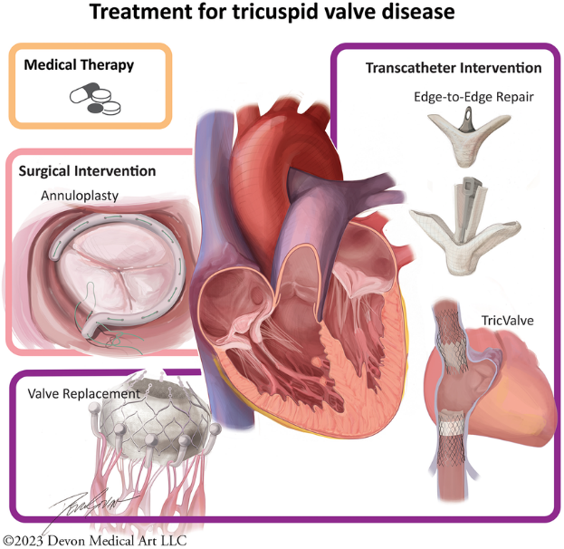
What interventions
1. Surgical Interventions
Tricuspid Valve Repair: Annuloplasty (ring implantation)
Tricuspid Valve Replacement: Mechanical or bioprosthetic valve.
2. Transcatheter Interventions
A. Transcatheter Edge-to-Edge Repair (TEER): Devices like TriClip and Pascal.
B. Annuloplasty Devices: Cardioband, Trialign, Millipede systems.
C. Valve Replacement (Transcatheter)
Orthotopic: Replacement within the native tricuspid valve. Devices: Evoque, LuX-Valve
Heterotopic: Caval valve implantation (CAVI) in vena cava (SVC/IVC).

Slide 5
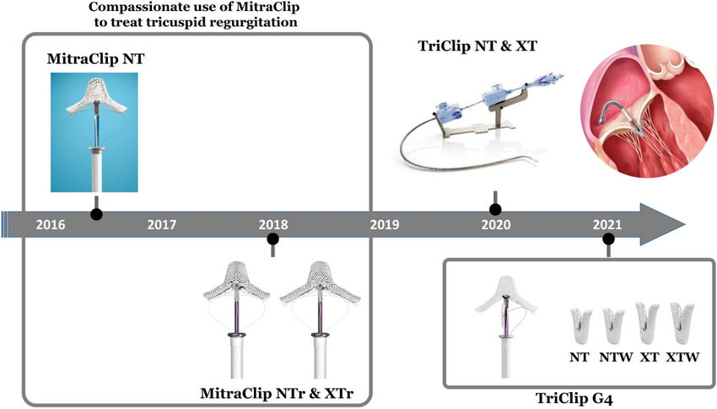
Notes:
Compassionate treatment of tricuspid regurgitation started in 2016 with the MitraClip NT. Subsequently, MitraClip NTr and XTr were used. MitraClip XTr features 3-mm longer arms compared to NTr. In 2020, the TriClip Transcatheter Tricuspid Valve Repair System, which is based on modifications of the MitraClip System, was introduced for clinical use with two devices (NT and XT) that were joined in 2021 by two new generation devices, NTW and XTW. The new generation features wider arms and independent leaflet grasping.

Slide 6
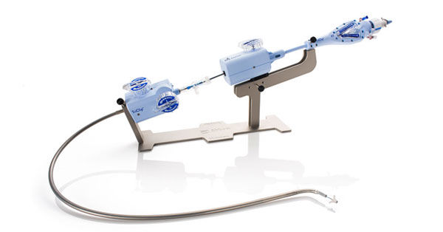
TRILUMINATE Pivotal Trial (NEJM March 2023)
First RCT comparing TriClip T-TEER plus optimal medical therapy (OMT) to OMT alone
patients with severe TR at high surgical risk (using the TriClip system (Abbott Structural)
1 year follow up study

Slide 7
Included 350 patients
severe symptomatic TR
(New York Heart Association [NYHA] functional class II, III, or IVa)
Pulmonary artery systolic pressure of less than 70 mm Hg
Receiving stable (≥30 days) guideline-directed medical therapy for heart failure
No other cardiovascular conditions in need of interventional or surgical correction
intermediate or greater surgical risk
International RCT at 65 centers in the United States, Canada, and Europe

Slide 8
Key Findings:
  Significant TR reduction: reduced tricuspid regurgitation to moderate or less severe in 87% of patients
  Quality-of-life improvement: 19–20-point increase in Kansas City Cardiomyopathy Questionnaire (KCCQ) score; 83% of patients in NYHA class I/II at 1 year.
  Safety: 98.3% freedom from major adverse events (MAEs) at 30 days.
  No significant mortality benefit compared to OMT
  Contribution: Established T-TEER as effective for TR reduction and symptom improvement, with a strong safety profile, even in complex anatomies.

Slide 9
bRIGHT Study:
Real-world, prospective, post-approval registry of 511 patients across 26 European sites using the TriClip system, including those with endocardial leads and significant comorbidities (88% massive/torrential TR, 80% NYHA III/IV).
Key Findings:
  High procedural success: 99% device implantation rate, 71% achieved moderate or less TR at 30 days.
  Clinical improvements: Significant KCCQ score gains and NYHA class improvement at 1 year; no MAEs in some cohorts.
  Effective in patients with endocardial leads, with similar TR reduction.
Contribution: Demonstrated T-TEER’s real-world effectiveness and safety in a diverse, high-risk population

Slide 10
EuroTR Cohort
Observational study evaluating T-TEER outcomes in a European cohort with severe TR.
Key Findings:
  Residual TR grade ≤2 associated with reduced heart failure hospitalizations and better survival.
  Predictors of success included lower baseline serum creatinine and higher right ventricular tricuspid annular plane systolic excursion (RV TAPSE).
  Low rates of complications like single leaflet device attachment (SLDA, ~12.5%).

Slide 11
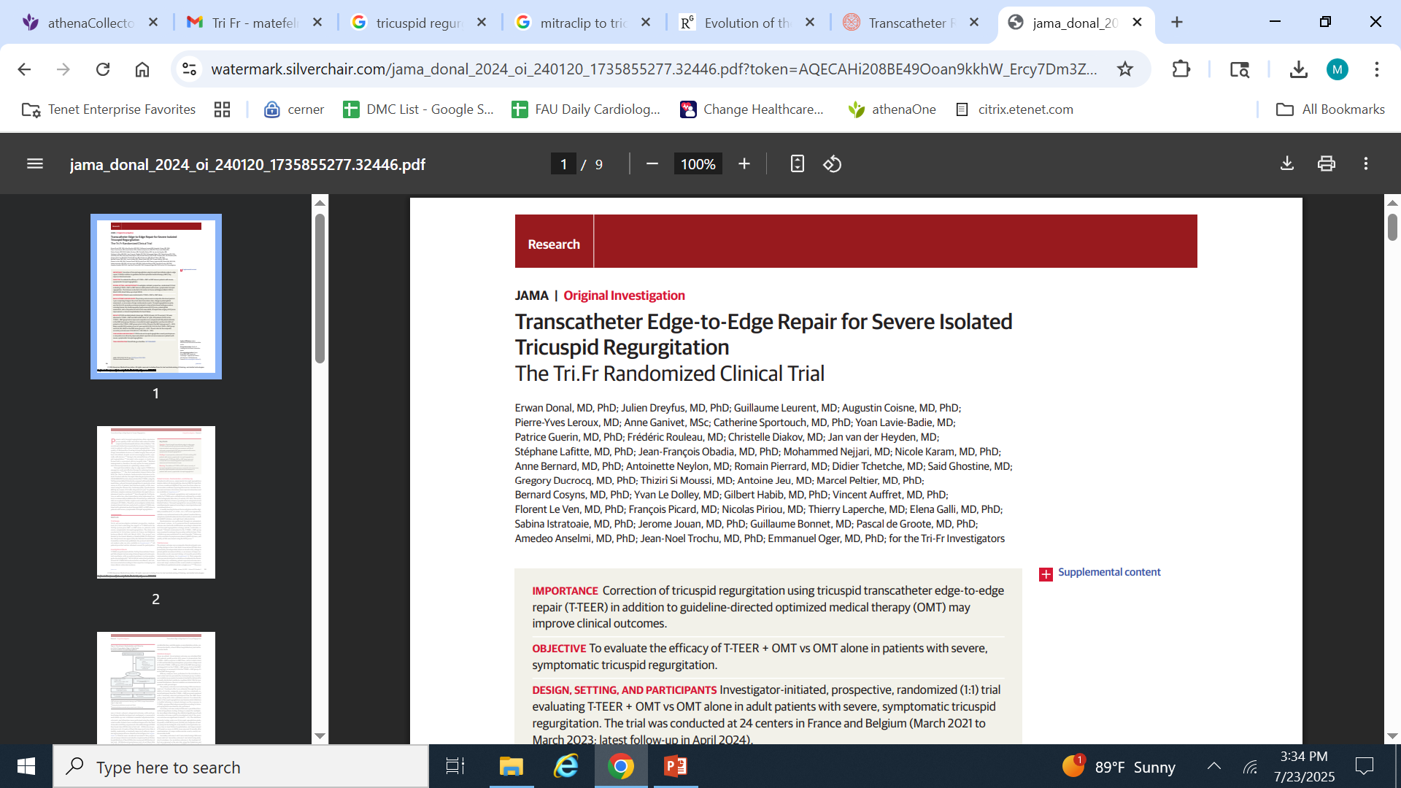
JAMA
Published Online: November 27, 2024

Slide 12
Rationale
Patients with tricuspid regurgitation often experience poorer quality of life associated with reduced cardiac output and clinical manifestations of heart failure.
Medical management is, therefore, the only option for many patients and is focused primarily on optimizing volume status

Slide 13
Trial Design
Investigator-initiated
Prospective
Randomized (1:1) trial evaluating the impact of T-TEER with the TriClip system plus OMT vs OMT alone
Patients with severe, symptomatic tricuspid regurgitation.
24 tertiary centers in France and Belgium between March 2021 and March 2023.
Funded by the French Ministry of Health

Slide 14
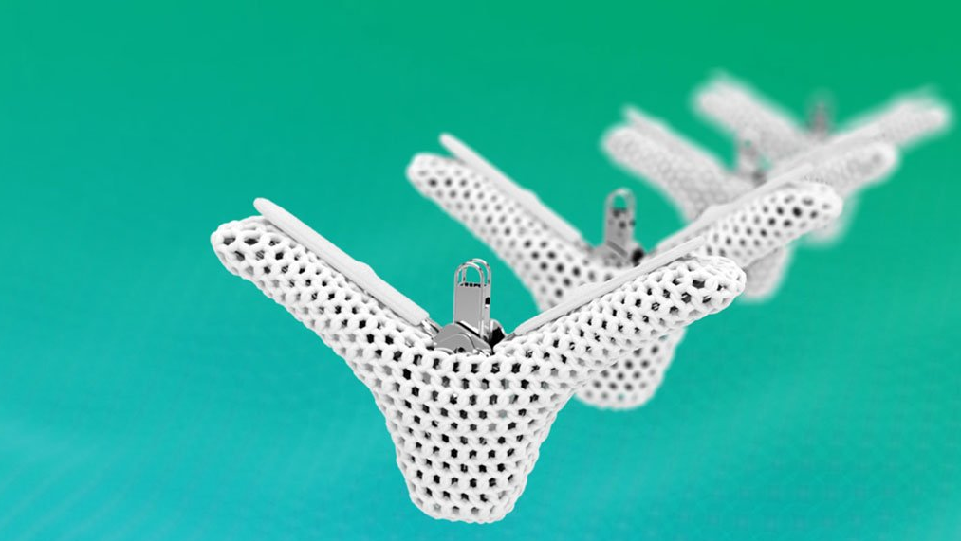
Investigational Device
T-TEER was performed with the TriClip Transcatheter Tricuspid Valve Repair System using a femoral approach under general anesthesia, with procedural guidance via transesophageal echocardiography.⁹

Slide 15
Randomization
Severe, symptomatic tricuspid regurgitation despite stable (≥30 days) guideline-directed OMT for heart failure
Severity of tricuspid regurgitation and anatomical suitability for T-TEER were evaluated and confirmed by a central echocardiography laboratory (CoreLab)
Randomization was performed through an automated, web-based system.
A 1:1 permuted block randomization scheme
Patients randomized to the T-TEER + OMT group were required to undergo the procedure within 14 days.
Clinical follow-up was conducted at 1, 6, and 12 months. Follow-up visits consisted of symptom assessment, 6MWT distance, and quality-of-life assessment using the KCCQ score.

Slide 16
Inclusion Criteria
Age ≥ 18 years
Symptomatic secondary (at least) severe TR (Carpentier Type IIIB (restrictive) and / or I (tricuspid annulus dilation)) stable for at least 30 days
NYHA functional class II to IV without cirrhosis and/or ascites
Signs of heart failure in the previous 12-months
Stable optimized medical and/or interventional treatment
Ineligible for corrective action on the valve by surgical approach after a specialized multidisciplinary consultation ("heart team")
Signature of an informed consent

Slide 17
Central core-laboratory analysis
TR characterized before Implantation by at least one of the following criteria:
• Regurgitation volume > 45 mL / beat
• Surface of the regurgitant orifice > 40 mm²
• Vena contracta > 7mm
• Gap between leaflets ≤ 10 mm (at the presumed location of the clip)

Slide 18
Exclusion Criteria
Recent Mitraclip or other percutaneous approach on the mitral valve in the past 3-month
Any prior tricuspid valve procedure that would interfere with placement of the Triclip device
Tricuspid valve leaflet anatomy which may preclude clip implantation
Myocardial infarction or coronary bypass surgery in the past 3-month
Left ventricular ejection fraction ≤35%
Cardiac Resynchronization therapy for less than 3-month
TR that is clearly related to the right ventricular lead positioning
Cardioversion for less than 6 weeks
Life expectancy <1 year
Other scheduled cardiac surgery

Slide 19
Coronary angioplasty in the preceding month
Current infection requiring prescription of antibiotics
End-stage renal failure (dialysis patient)
Severe hepatic insufficiency
Stroke in the previous 3-month
Uncontrolled pre- capillary pulmonary hypertension
Contraindication, allergy or hypersensibility to dual anti-platelet and anticoagulant therapy
Ongoing infection requiring antibiotic therapy
Evidence of intra vascular or intra cardiac thrombus

Slide 20
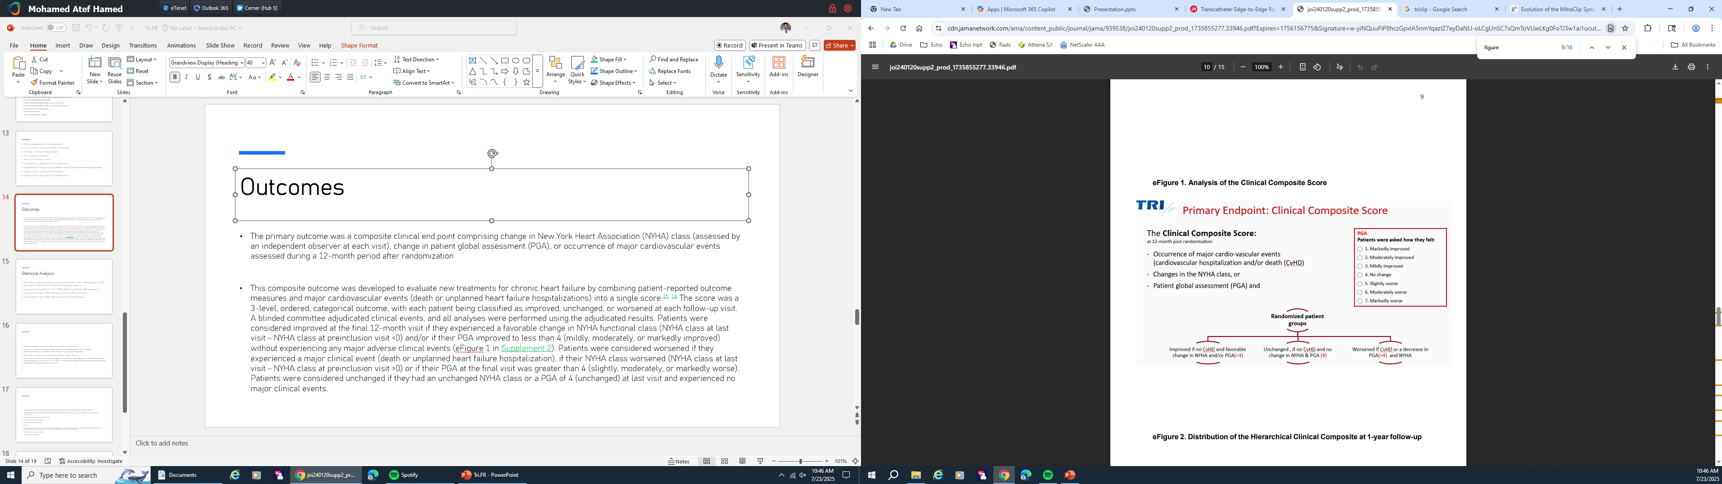
Outcomes
The primary outcome was a composite clinical end point comprising change in 1 -New York Heart Association (NYHA) class (assessed by an independent observer at each visit), 2- change in patient global assessment (PGA), or 3- occurrence of major cardiovascular events assessed during a 12-month period after randomization

Slide 21
Patients were considered improved if they experienced a favorable change in NYHA functional class (NYHA class at last visit – NYHA class at preinclusion visit <0) and/or if their PGA improved to less than 4 (mildly, moderately, or markedly improved) without experiencing any major adverse clinical events
Patients were considered worsened if they experienced a major clinical event (death or unplanned heart failure hospitalization), if their NYHA class worsened (NYHA class at last visit – NYHA class at preinclusion visit >0) or if their PGA at the final visit was greater than 4 (slightly, moderately, or markedly worse).
Patients were considered unchanged if they had an unchanged NYHA class or a PGA of 4 (unchanged) at last visit and experienced no major clinical events.

Slide 22
Secondary Outcomes
Tricuspid regurgitation grade
Quality of life assessed with the KCCQ score
PGA
A hierarchical composite outcome including all-cause death or tricuspid valve surgery, time to heart failure hospitalization, and improvement of 15 points or greater in KCCQ score
Major cardiovascular events (myocardial infarction, unstable angina, revascularization, stroke, cardiovascular death, or heart failure hospitalization)
Cardiovascular death.

Slide 23
Statistical Analysis
300 patients would provide 90% power to demonstrate that T-TEER + OMT is superior to OMT alone, with a 1-sided α level of .025 and the following assumptions: ​
proportions of improved (0.15 in the T-TEER + OMT group; 0.05 in the OMT-alone group)​
unchanged (0.5 in the T-TEER + OMT group; 0.45 in the OMT-alone group)​
worsened (0.35 in the T-TEER + OMT group; 0.5 in the OMT-alone group).​

Slide 24
Efficacy analyses were performed in the intention-to-treat cohort ​
Continuous variables are presented as means (standard deviations) (for normally distributed variables) or medians (25th-75th) for nonnormal distributions. ​
The primary outcome was tested using a Wilcoxon linear-rank test. ​
To evaluate the effect of tricuspid regurgitation mechanism (atrial dilatation vs leaflet tethering vs mixed etiology) on the response to T-TEER, a prespecified subgroup analysis according to tricuspid regurgitation mechanism was performed.​​

Slide 25
Secondary outcome analysis followed a predefined hierarchical hypothesis-testing strategy to adjust for multiplicity. ​
The statistical significance of each secondary outcome could be investigated only if the previous outcome was significant (2-tailed P < .05). ​
The statistical-hierarchy testing order was ​
(1) tricuspid regurgitation grade​
(2) quality-of-life KCCQ score​
(3) PGA​
(4) composite secondary end point including all-cause death or tricuspid valve surgery, time to heart failure hospitalization, and improvement of 15 points or more in KCCQ score assessed 12 months after randomization​
(5) major cardiovascular events​
(6) cardiovascular death.​

Slide 26
Secondary outcomes 1 and 3 were tested using a Wilcoxon linear rank test. ​
Secondary outcome 2 was tested using analysis of covariance. ​
Secondary outcome 4, the treatment effect was expressed as the win ratio using the Finkelstein and Schoenfeld unmatched pair approach.​
Secondary outcomes 5 and 6 were tested using the log-rank test. ​
All analyses were performed using SAS version 9.4 (SAS Institute). ​
All P values were 2-tailed unless explicitly stated.​

Slide 27
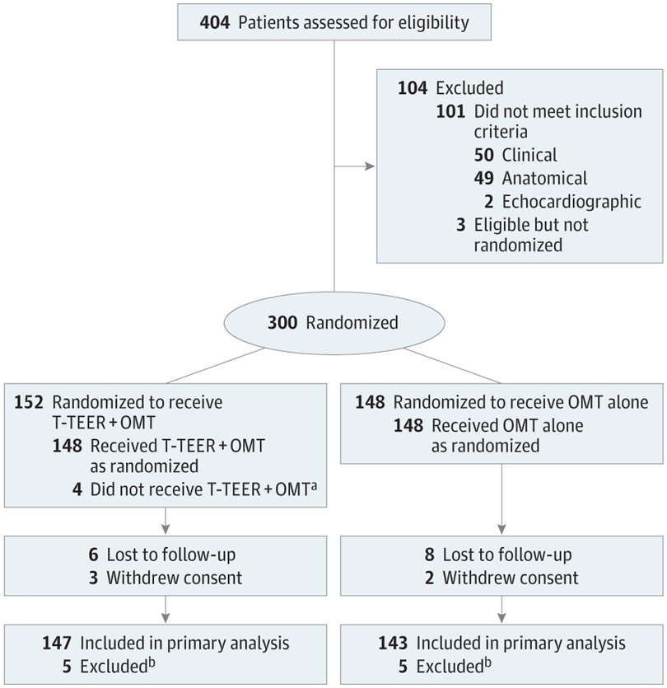

Slide 28
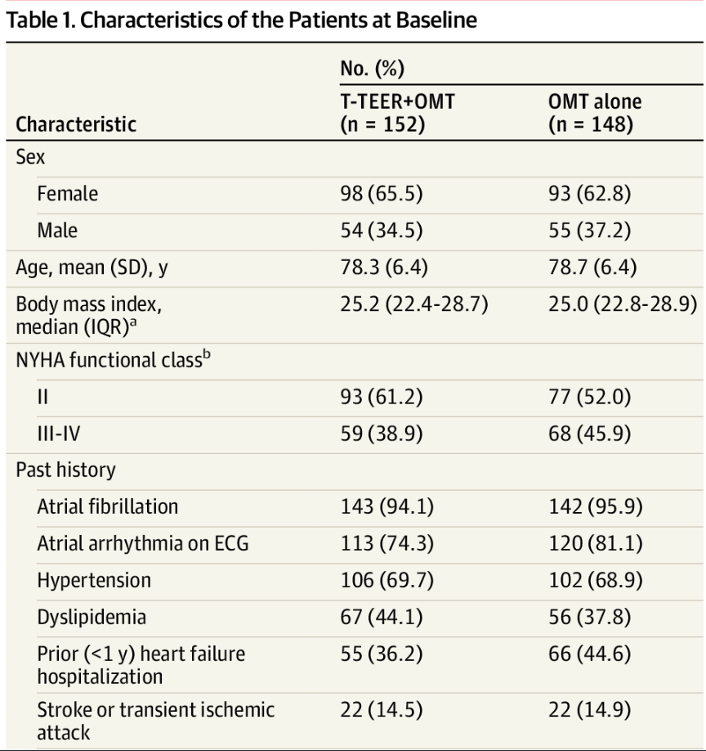
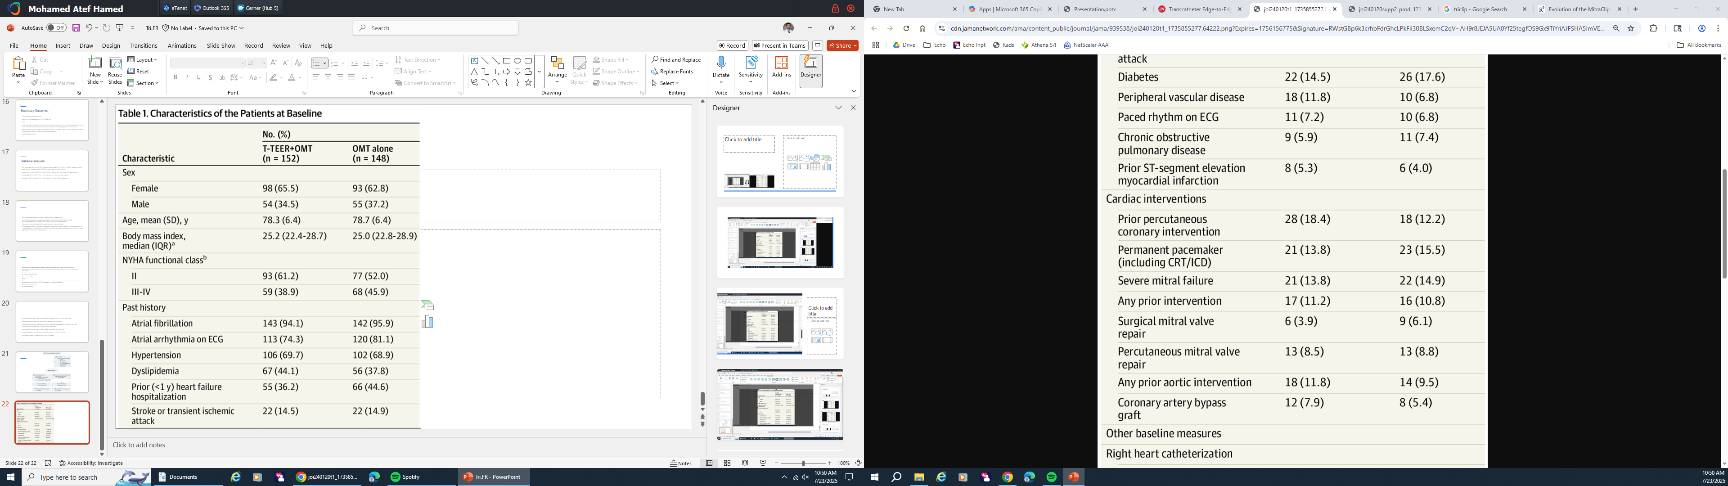

Slide 29
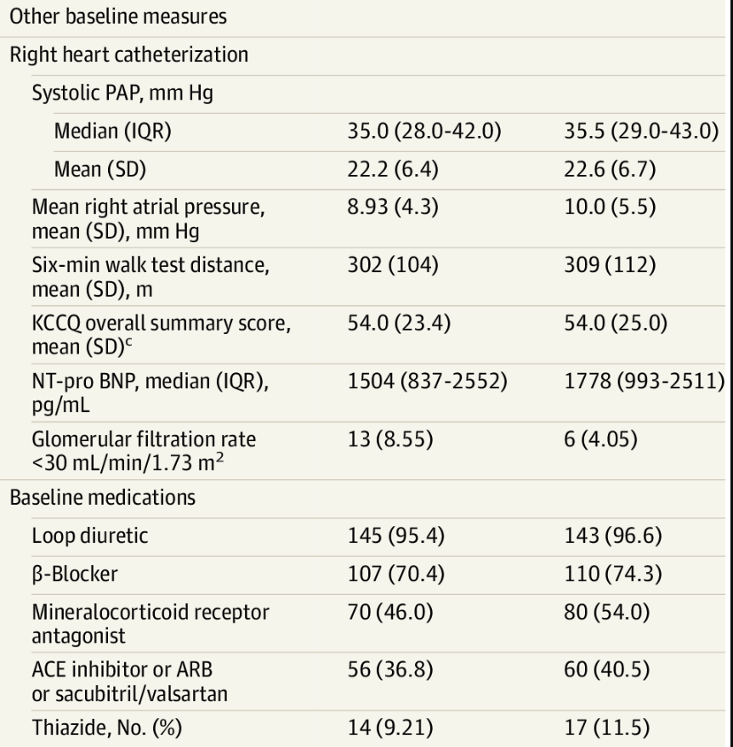
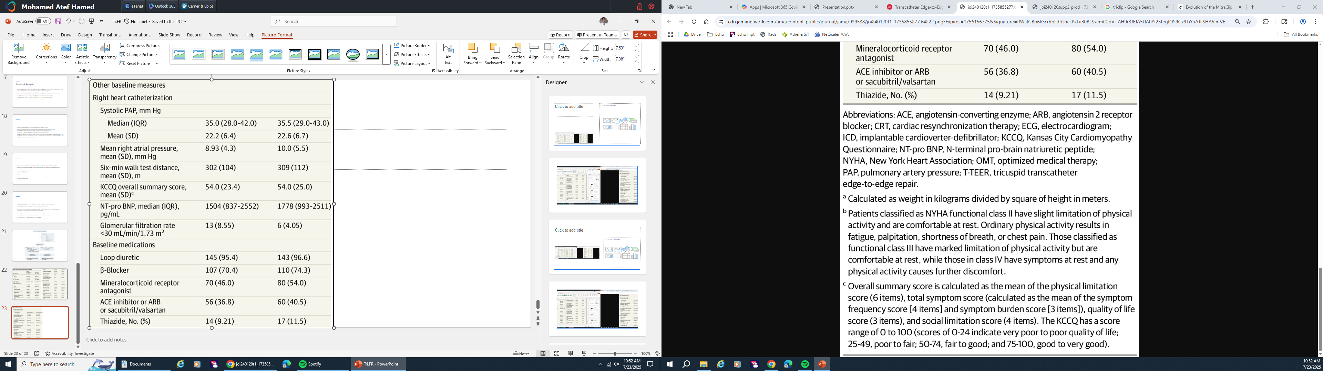

Slide 30
Procedural Outcomes
Four patients allocated to T-TEER + OMT did not receive the device:
3 withdrew before the inclusion visit and 1 had a stroke just before the intervention.
Among the 148 patients who underwent T-TEER, the device was successfully implanted in 144 patients (97.3%); 123 (83.1%) had 2 or more clips deployed
Median time from device insertion to removal was 75 min (25th-75th, 55-100).
Median length of stay in the hospital was 3 days (25th-75th, 2-6).
One patient (0.67%) died within 30 days of the procedure.

Slide 31
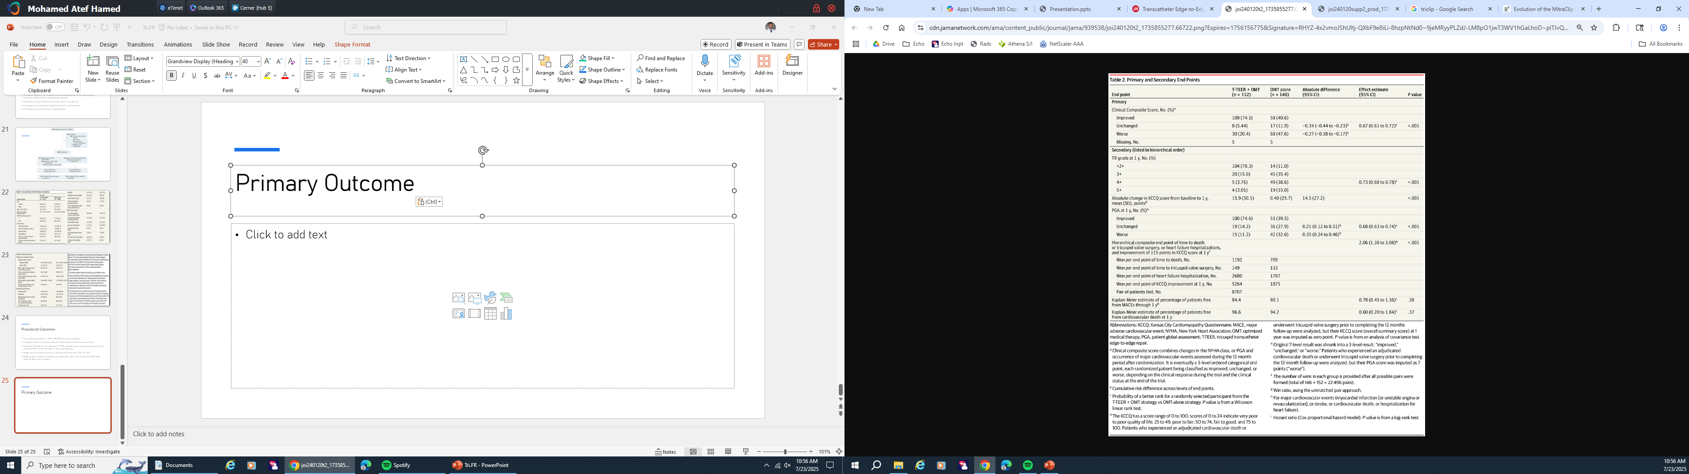

Slide 32
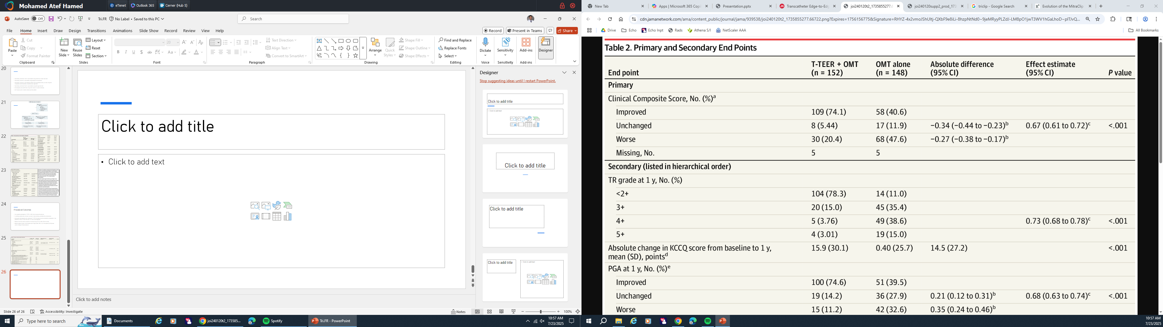
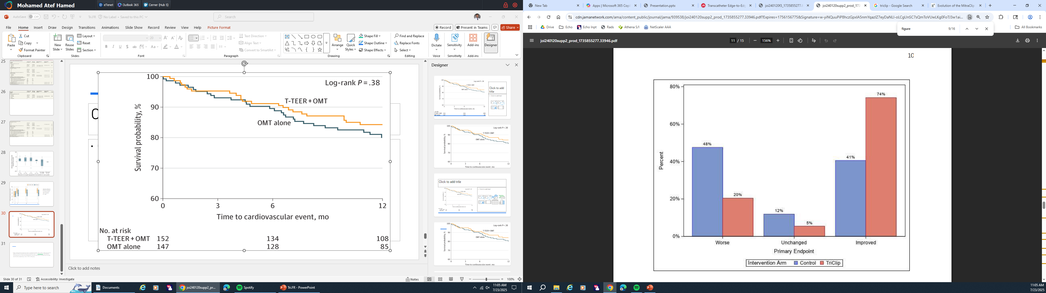

Slide 33
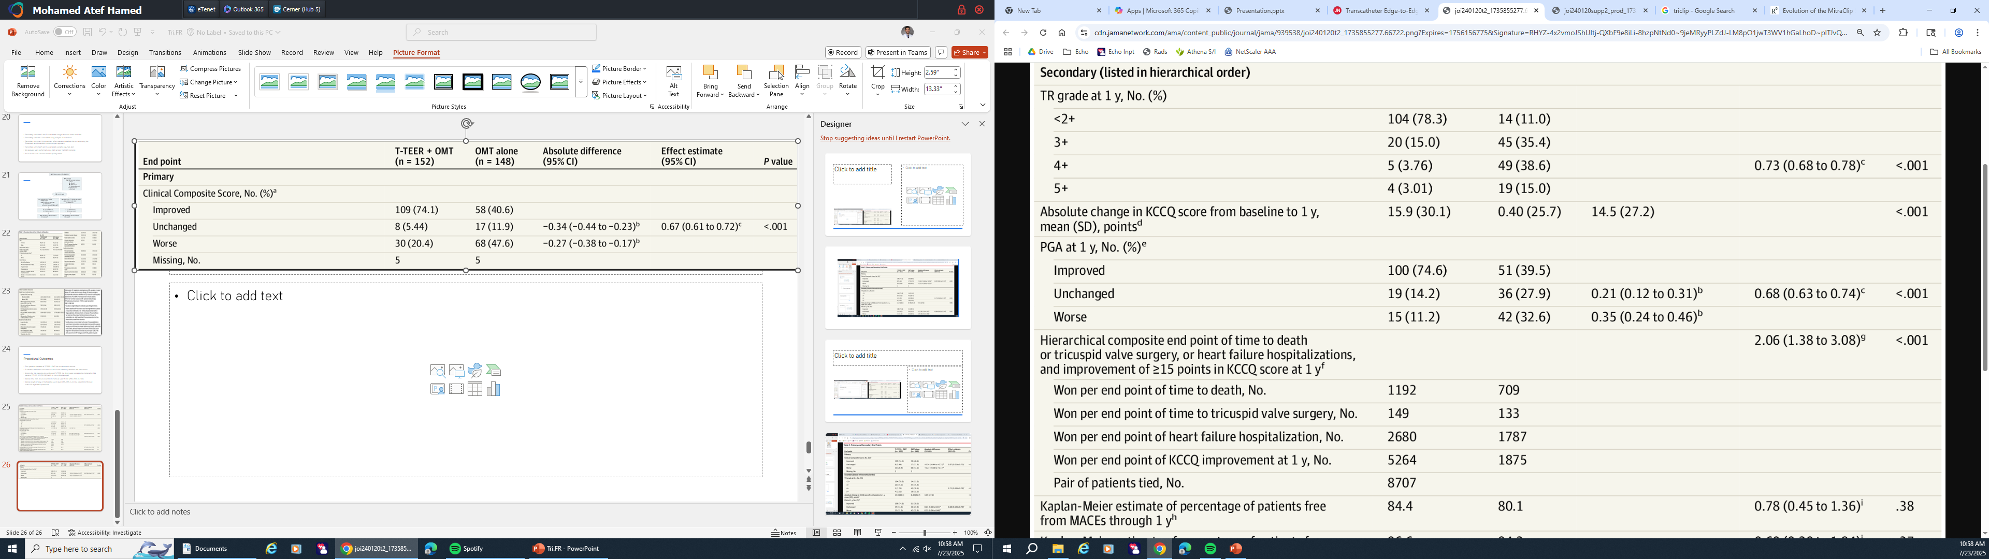
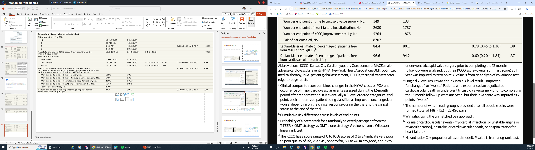

Slide 34
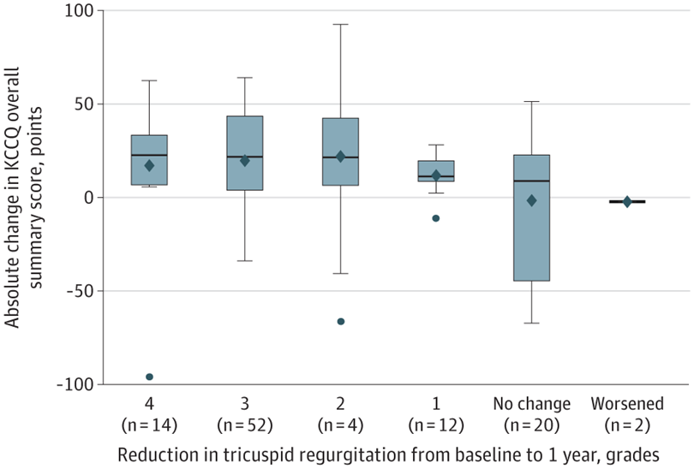

Slide 35
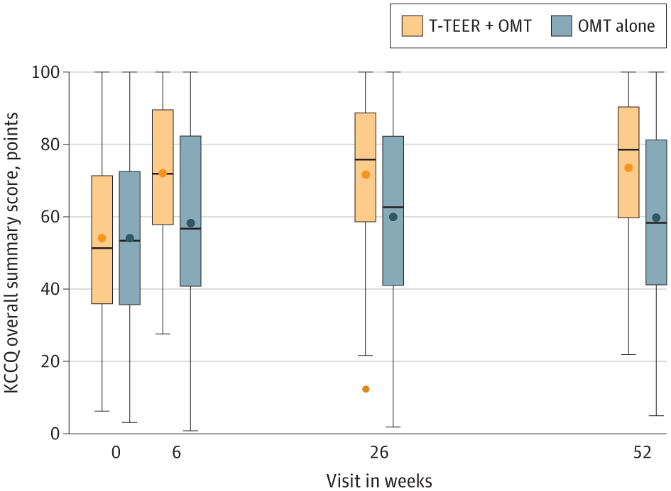
Absolute difference between the groups at 1 year was 14.5 (SD, 27.2) points (P < .001)

Slide 36
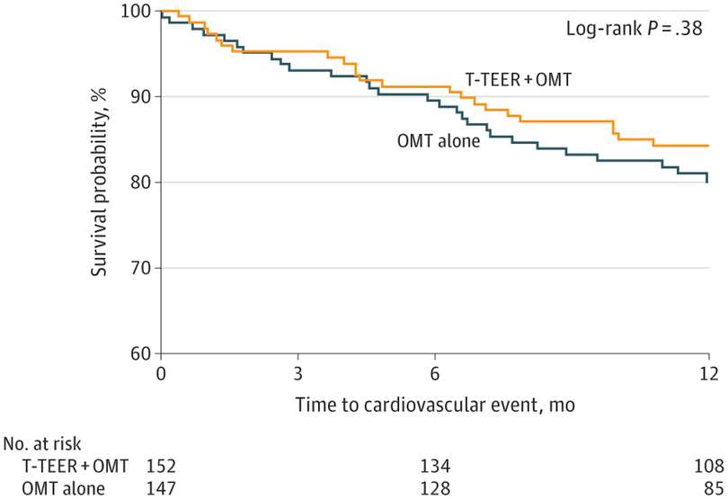

Slide 37
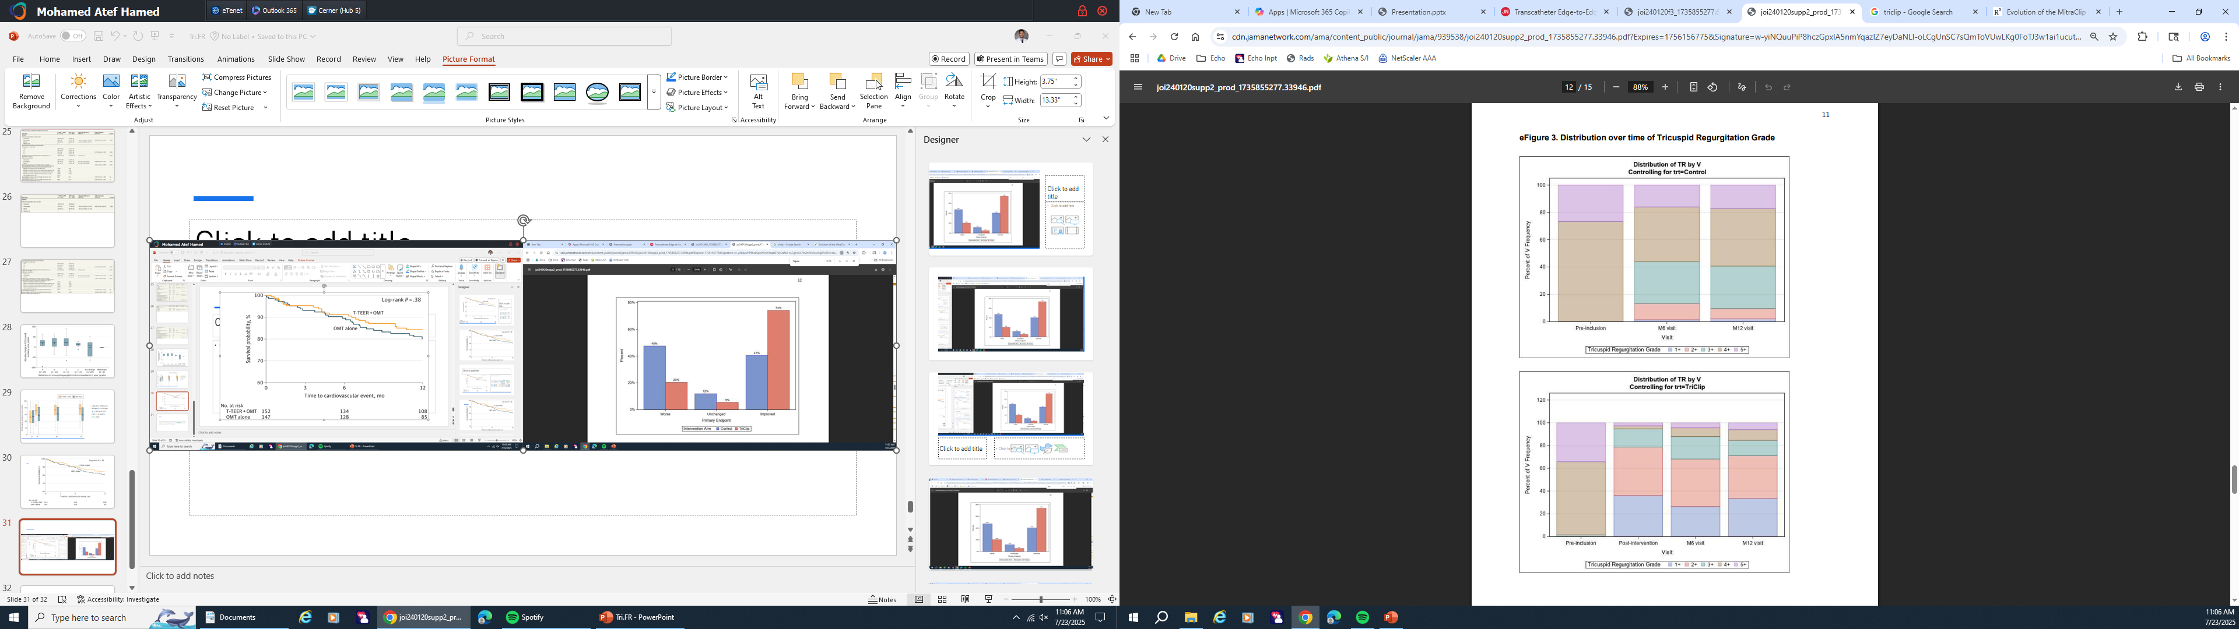

Slide 38
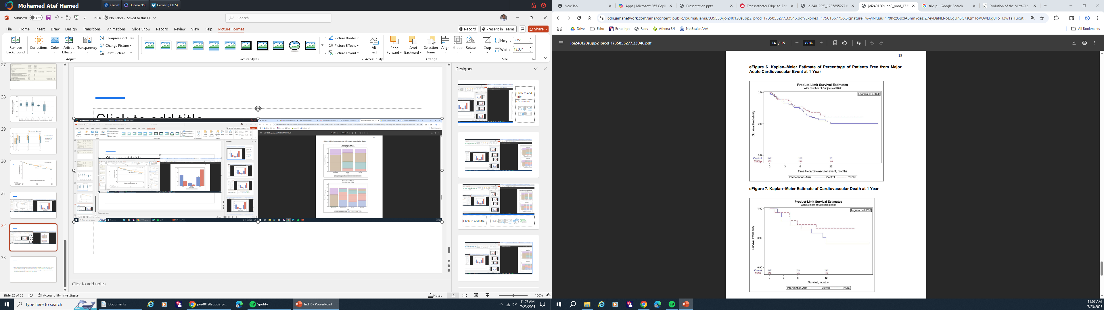

Slide 39
Notes:
In comparison with these studies, fewer patients had advanced heart failure symptoms (42.3% with NYHA class III or IV in Tri.Fr vs 60% to 80% in other studies).^{6,7,11}

Slide 40
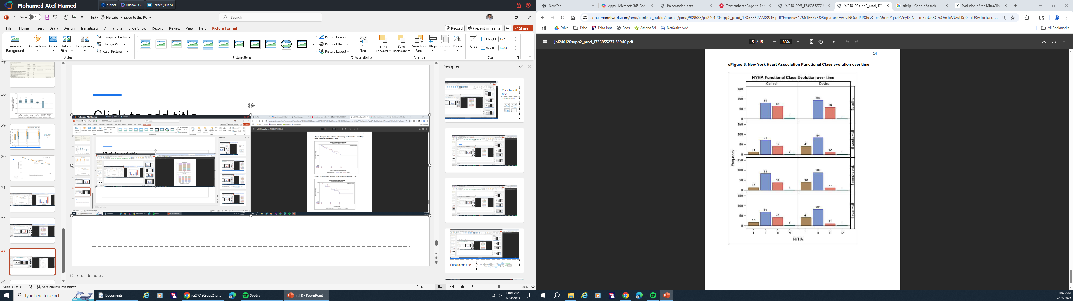

Slide 41
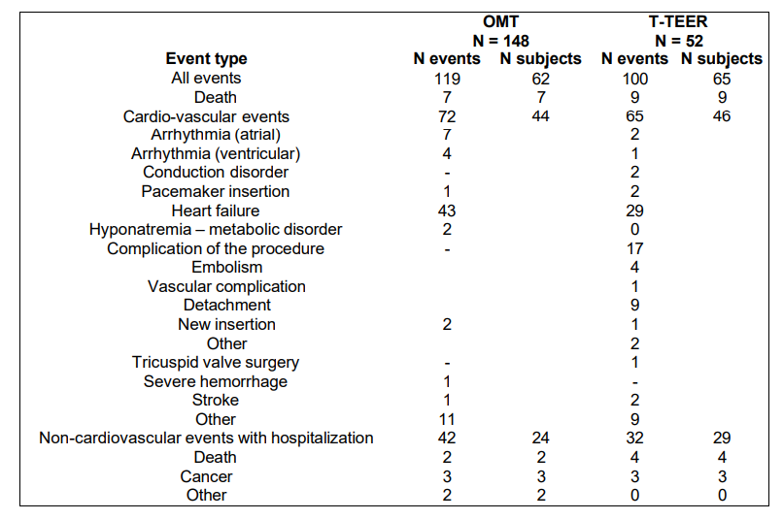
T-TEER procedure displayed a good safety profile, with 8 (5.2%) single-leaflet device attachments and a 30-day major adverse event rate of 0.7%.

Slide 42
In Summary
The randomized Tri.Fr trial demonstrates that T-TEER + OMT reduces tricuspid regurgitation severity and improves clinical outcomes, driven by improved NYHA class and PGA in patients with severe, symptomatic tricuspid regurgitation.
The clinical composite outcome improved in 74.1% of the T-TEER + OMT group vs 40.6% of the OMT-alone group
Improvement in quality of life was sustained at 1 year and was consistent between parameters (NYHA class, PGA, and KCCQ score)
The safety of the procedure was confirmed, with a very low rate of intrahospital adverse events (8.0%)

Slide 43
Comparing to previous studies
Baseline KCCQ score was higher than BRIGHT registry or the prospective TRISCEND I single-group study (tricuspid valve replacement) and closer to that described in the TRILUMINATE Pivotal trial
Fewer patients in Tri Fr had advanced heart failure symptoms (42.3% with NYHA class III or IV in Tri.Fr vs 60% to 80% in other studies).

Slide 44
One-year cardiovascular death and hospitalization rates were lower than in previous registries.
While one-year mortality in the TRILUMINATE was 8.6% vs. 3.4% in the Tri. Fr
In contrast to TRILUMINATE, the numerically lower clinical event rates observed in the T-TEER + OMT group
A clear link between quality-of-life improvement and tricuspid regurgitation reduction was confirmed.
Considering the same predefined outcome as in the TRILUMINATE trial (win ratio, 1.48 compared with medical treatment [95% CI, 1.06-2.13]; P = .02 in TRILUMINATE vs 2.06 [95% CI, 1.38-3.08]; P < .001 in Tri.Fr

Slide 45
Limitations
An investigator-initiated study supported by a limited grant.
Population was selected based on clinical characteristics and an anatomy deemed suitable for T-TEER, which may limit the generalizability of the findings.
An open-label study without a sham control, which may impair the interpretability of changes in patient-reported outcome measures
Only the TriClip was used is this study

Slide 46
Conclusions
T-TEER + OMT reduces tricuspid regurgitation severity and improves the composite clinical outcome comprising NYHA class, PGA, and major cardiovascular events at 12 months, driven by improved patient-reported outcome measures (NYHA class and PGA) in patients with severe, symptomatic tricuspid regurgitation.

Slide 47
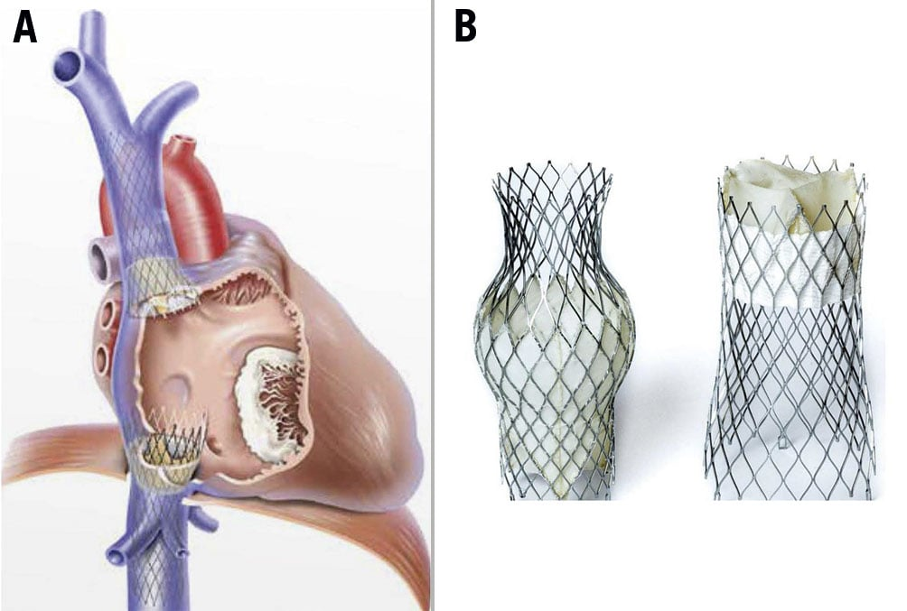

TriCValve
Mechanism: It involves implanting two valves in the superior and inferior vena cava (not the tricuspid valve itself), preventing the backward flow of blood into the veins reducing symptoms of right sided HF
Transfemoral
TRICAV‑I (Interventional Pivotal Trial)
A prospective multicenter
Started: July 2024
Coming to Delray
Notes:
Sites currently enrolling include locations such as San Diego (Scripps) and Phoenix (St. Joseph’s) Reddit+9UCSF Clinical Trials+9Reddit+9.
Tampa General Hospital and USF Health performed the first early‑feasibility case in Florida in April 2025, a part of TRICAV‑I

Slide 48
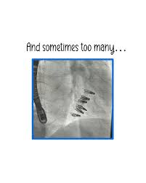
Thank you

