Slide 1

STOP-or-Not Trial:
Continuation vs. Discontinuation of RASIs Before Major Noncardiac Surgery
Joseph Michael-Salami
FAU Cardiology Fellow, PGY-5
Notes:
Introduce the topic briefly (1–2 min). Highlight the trial’s relevance to perioperative management

Slide 2
Disclosure Statement
Neither the planners nor the speakers disclosed relevant financial relationships with ineligible companies.
Notes:
Peri-operative management of B-Blockers has been clarified with large multicenter studies
While it was first though that stopping B-Blockers before surgery would be associated with less hemodynamic instability, large studies found that a strategy with B-Blockers continuation was associated with better peri-operative outcome

Slide 3
Background
Worldwide, more than 200 million major surgical procedures are performed annually
Many of these patients have comorbidities including hypertension, diabetes, and heart failure, all of which have been widely recognized as a risk factor for cardiovascular events and post-operative complications
Treatment of these comorbidities very often includes a Renin-Angiotensin System (RAS) inhibitor (Angiotensin-Converting Enzyme Inhibitors (ACE-Is) or Angiotensin Receptor Blockers (ARBs)
To stop or not to stop medication used to maintain hemodynamic and homeostatic stability in patients with systemic disease is a fundamental anesthetic question.
However, data on management of RAS inhibitors remain scanty and a matter of debate.
Notes:
Peri-operative management of B-Blockers has been clarified with large multicenter studies
While it was first though that stopping B-Blockers before surgery would be associated with less hemodynamic instability, large studies found that a strategy with B-Blockers continuation was associated with better peri-operative outcome

Slide 4
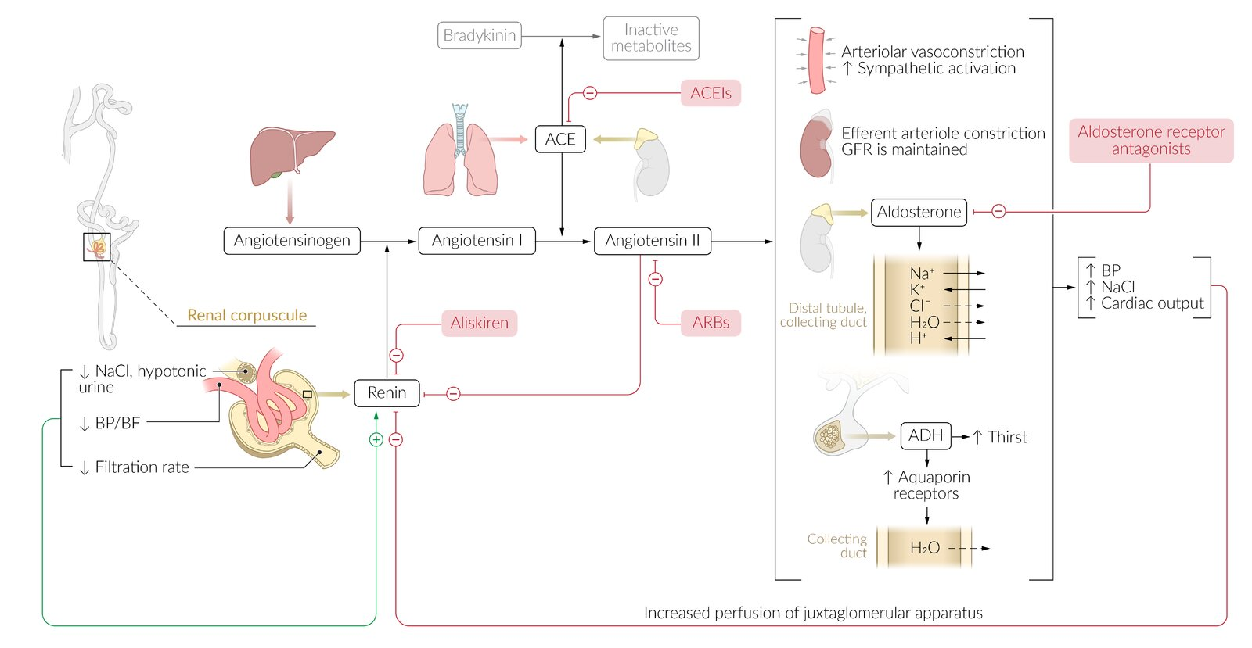

Slide 6
Background
Clinical Dilemma:
Continuation risks intraoperative hypotension, linked to complications (e.g., cardiovascular events, acute kidney injury).
Discontinuation may cause postoperative hypertension, heart failure, or arrhythmias.
Guideline Gaps:
2014 ESC/ESA: Consider withholding RASIs for hypertension to avoid hypotension.
2014 ACC/AHA: Continuation reasonable; 2023 ESC: Limited data, mixed recommendations.
2022 ESC guidelines underscored the the lack of data, but noted withholding RASIs in patients with hypertension could be considered to prevent intraop hypotension.
Notes:
Peri-operative management of B-Blockers has been clarified with large multicenter studies
While it was first though that stopping B-Blockers before surgery would be associated with less hemodynamic instability, large studies found that a strategy with B-Blockers continuation was associated with better peri-operative outcome

Slide 7
Trial Objective & Hypothesis
Objective:
Compare the effect of continuing vs. discontinuing RASIs before major noncardiac surgery on postoperative complications and mortality.
Hypothesis:
Continuation of RASIs does not increase major postoperative complications compared to discontinuation.
Relevance:
Provides evidence to standardize perioperative RASI management.

Slide 8

Study Design
Multicenter, open-label, randomized clinical trial.
Location: 40 French hospitals.
Sponsor: Investigator-initiated, no industry funding.
Ethics: Approved by Île de France 2 IRB (No. 2017-202114-301).
Blinding: Clinical events committee blinded to group assignment; patients and anesthesiologists unblinded due to practical constraints.
Notes:
Disadvantages of open label design
Bias in Assessment: Participants and researchers may have expectations about the treatment's effectiveness, leading to biased reporting of outcomes (e.g., placebo effect or observer bias).
Lack of Blinding: Without blinding, subjective outcomes (e.g., pain, quality of life) are more susceptible to distortion, as participants may alter responses based on their knowledge of the treatment.
Placebo Effect: Participants aware of receiving the active treatment may report improved symptoms due to psychological expectations rather than the drug's efficacy.
Researcher Bias: Investigators may unintentionally influence results through differential treatment, data collection, or interpretation based on knowledge of group assignments.
Reduced Objectivity: Open-label trials are less robust for establishing causality compared to double-blind studies, as the lack of blinding undermines the ability to control for confounding factors.
Limited Generalizability: Regulatory agencies and clinicians may view open-label results as less reliable, potentially limiting the trial’s impact on clinical practice or drug approval.
Participant Behavior Changes: Knowledge of treatment allocation may affect participant behavior (e.g., adherence, lifestyle changes), skewing results.

Slide 9
Patient Selection
Inclusion Criteria
Age ≥18 years.
Scheduled for elective major noncardiac surgery (e.g., abdominal, orthopedic, vascular).
Chronic RASI therapy (ACEIs or ARBs) for ≥3 months.
Women of childbearing age agree to use adequate contraception during testing period
SIgned informed consent

Slide 10
Patient Selection
Exclusion Criteria
Emergency surgery (surgical treatment needed within 24 hours)
Hyperkalemia (>5.5mmol/L)
Severe renal failure (eGFR <15 mL/min/1.73 m²)
Death is imminent and inevitable or life expectancy of <1 month
Pre-operative shock (need for vasoactive medications prior to surgery)
Contraindications to RASI continuation
Inability to obtain informed consent
Notes:
After enrollment, patients were randomized at a 1:1 ratio to continue or discontinue RASI therapy (Figure 1), with stratification by hospital site and by heart failure status (New York Heart Association stage <II or ≥II).

Slide 11
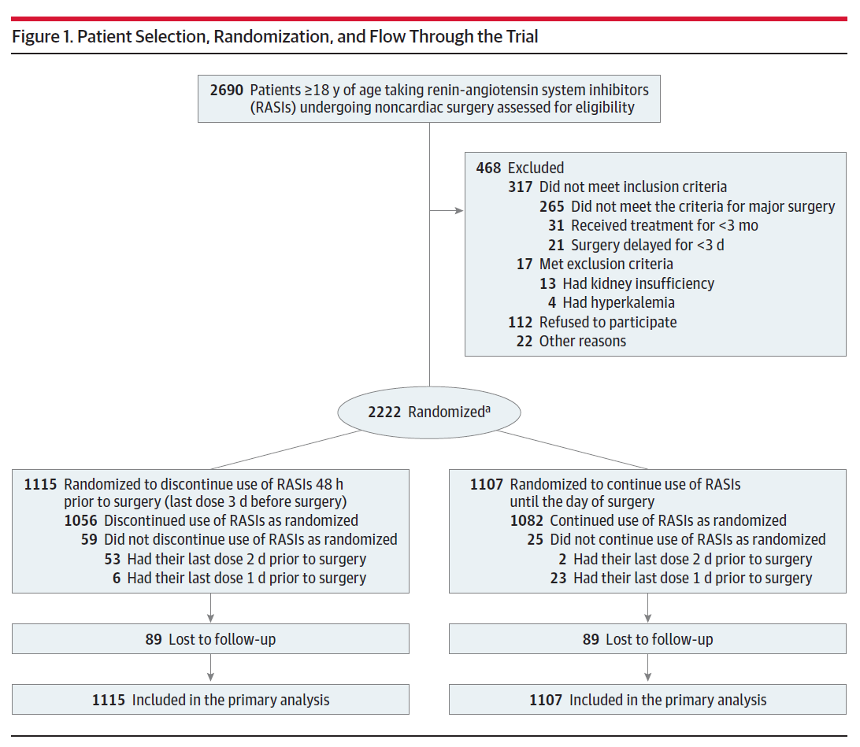

Slide 18
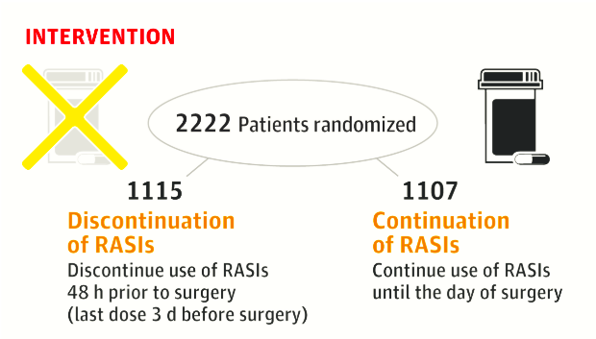
Intervention Arms
Notes:
A prescription indicating the strategy (continue or discontinue use of RASI) was generated automatically, printed, and then handed and explained to the patient. Every patient received a phone call from a clinical research assistant 3 days before surgery to ensure a good understanding of the instructions and also received a leaflet to record daily intake of RASI pills.⁷ In each study group, patients were to resume RASI therapy as soon as possible after surgery when the oral route was deemed feasible, and in the absence of hypotension or worsening kidney function.
Follow up was 28 days post-surgery

Slide 19
Primary and Secondary Outcomes
Primary Outcome:
Composite of all-cause mortality and major postoperative complications within 28 days.
Secondary Outcomes:
Intraoperative hypotension (mean arterial pressure <60 mm Hg or requiring vasopressors).
All-cause mortality,
Acute kidney injury
End organ failure
Hospital stay.
Notes:
Major postoperative complications, which included
(1) postoperative major cardiovascular events (acute myocardial infarction, arterial or venous thrombosis, stroke, acute pulmonary edema, cardiogenic shock, acute severe hypertension, de novo cardiac arrhythmia requiring therapeutic intervention)
(2) sepsis or septic shock (defined according to the Sepsis-3 definition⁸ )
(3) respiratory complications (determined by the need for reintubation or noninvasive ventilation for respiratory failure)
(4) unplanned intensive care unit (ICU) admission or readmission
(5) acute kidney injury (based on the serum creatinine item of the Kidney Disease Improving Global Outcome criteria⁹ )
(6) hyperkalemia (serum potassium level >5.5 mmol/L requiring therapeutic intervention¹⁰ )
(7) need for surgical reintervention within 28 days after surgery

Slide 20
Methodology
Randomization:
1:1 allocation, stratified by surgery type and center.
Data Collection:
Baseline: Age, comorbidities, RASI type/dose, surgical risk.
Intraoperative: Blood pressure, fluid management, vasopressor use.
Postoperative: Complications, labs, SOFA scores, hospital stay.
Notes:
Patients were followed up from hospital admission until postoperative day 28. Investigators and research staff members responsible for the primary outcome assessment were unaware of group assignments.
A double-blinded trial was not feasible due to the large number of RASIs available on the market, making the generation of placebos infeasible. A clinical events committee (blinded to group assignment) reviewed all adverse events to determine if the study outcome had been reached

Slide 21
Methodology
Statistical Analysis:
Intention-to-treat for primary analysis, and comparing the composite outcome measures at 28 days by study group using the χ² test.
Logistic regression for primary outcome.
Kaplan-Meier for time-to-event outcomes.
Per-protocol and as-treated analyses for sensitivity.
P < .05 was considered statistically significant
Notes:
Based on an estimated incidence of 25% for the primary outcome,⁸ enrolling 2222 patients would allow 80% power to detect a relative decrease of 20% in complications in the RASI continuation group (corresponding to an absolute reduction of 5% for incidence of the primary outcome) using the χ² test, and considering that the 2 interim analyses led to a final test at a nominal α level of .0465 according to the O’Brien-Fleming method.

Slide 22
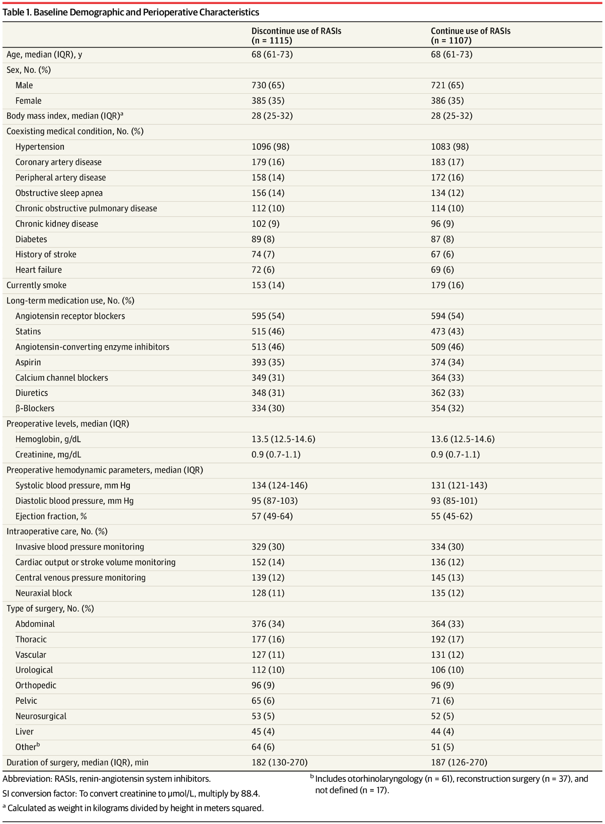
Results

Slide 23
Results

Slide 24
Results

Slide 25
Results

Slide 26
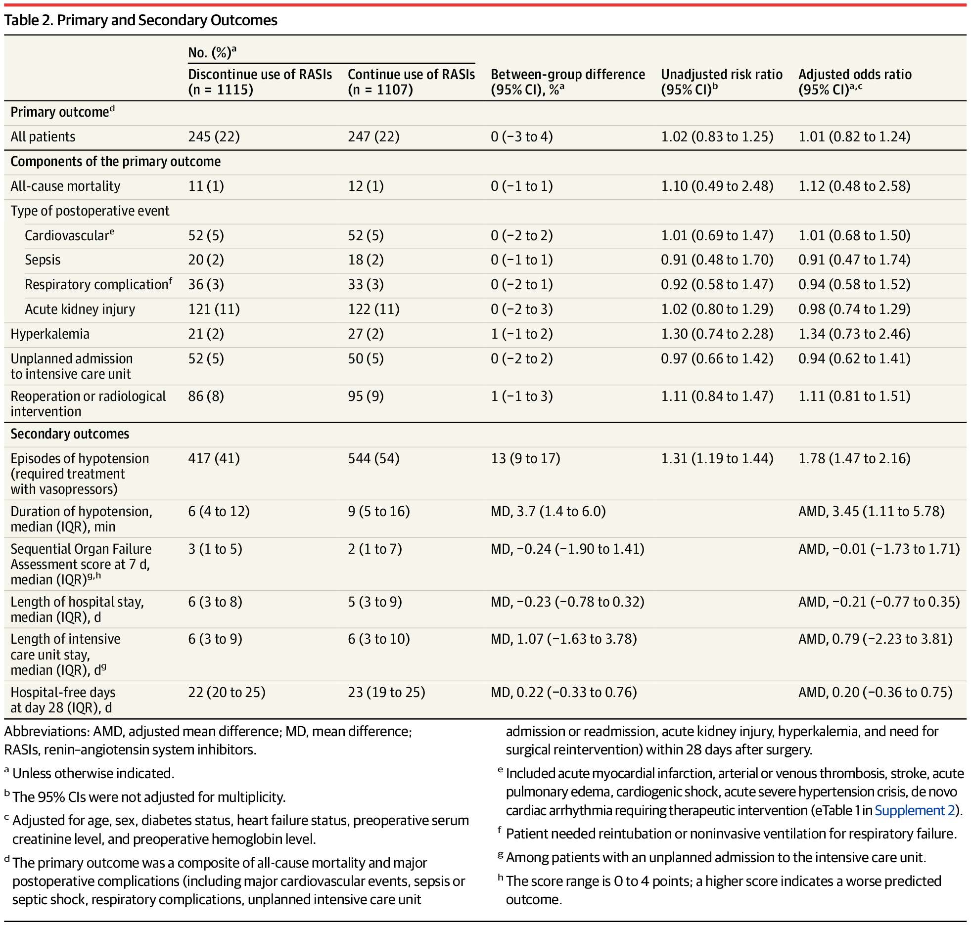
Results

Slide 27
Results

Slide 28
Results
Notes:
The median duration of hypotension with a mean arterial pressure below 60 mm Hg was 6 minutes (IQR, 4-12 minutes) in the RASI discontinuation group and 9 minutes (IQR, 5-16 minutes) in the RASI continuation group (Table 2 and eFigure 3 and eTable 1 in Supplement 2). The mean difference in duration of mean arterial pressure below 60 mm Hg was 3.7 minutes (95% CI, 1.4-6.0 minutes).

Slide 29
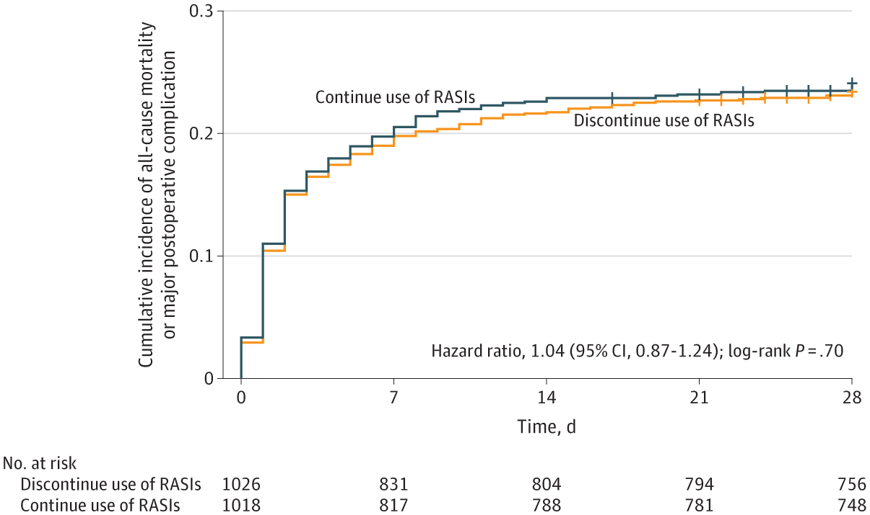
Results
Cumulative Incidence of the Primary Outcome by Treatment Group
Notes:
The primary outcome was a composite of all-cause mortality and major postoperative complications within 28 days after surgery. The hash marks indicate censoring.

Slide 30
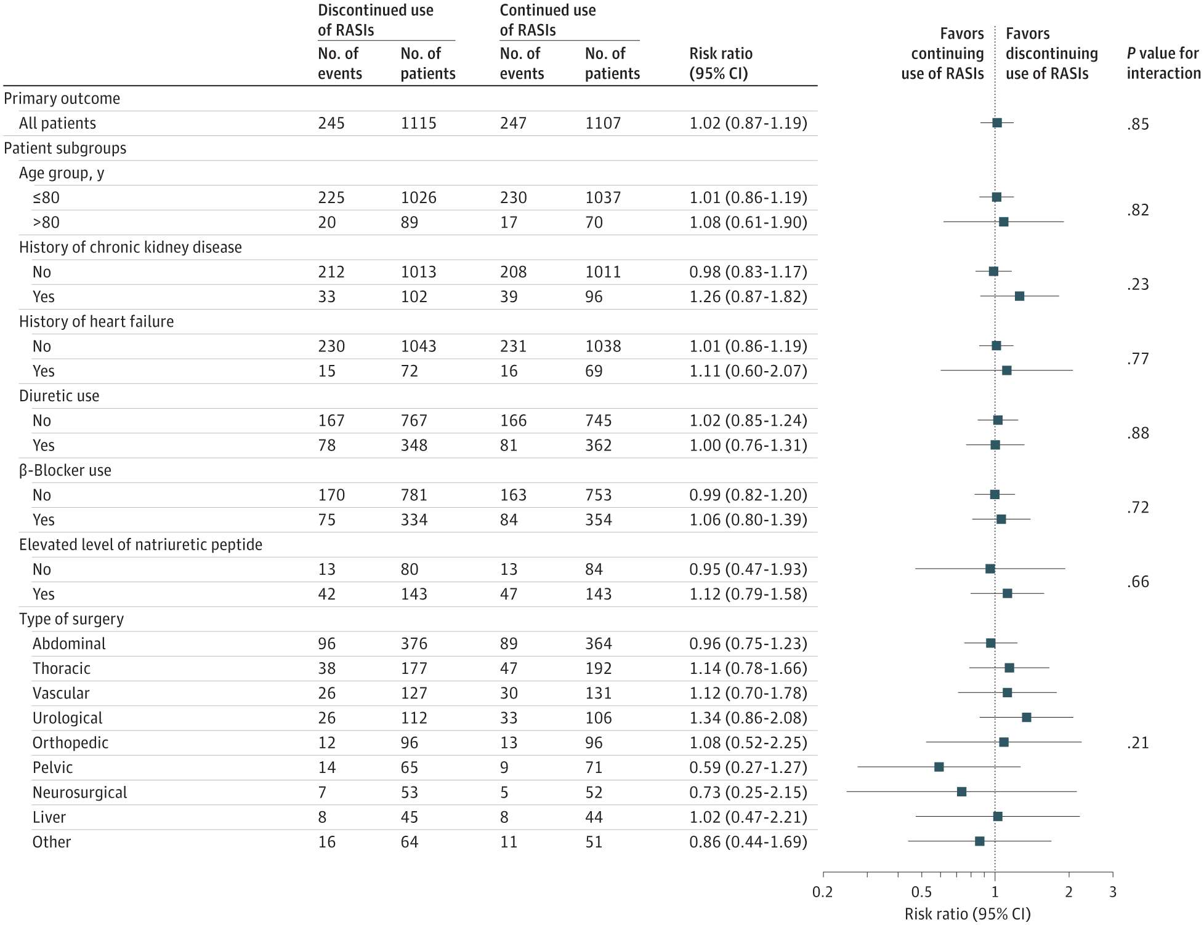
Results
Primary Outcome for All Patients and by Individual Patient Subgroup

Slide 31
Results
Per-Protocol and As-Treated Analyses
The results for all-cause mortality and major postoperative complications were mostly the same in the per-protocol analysis (risk ratio, 1.01 [95% CI, 0.86-1.18]) and in the as-treated analysis (risk ratio, 1.00 [95% CI, 0.85-1.17]).
Sensitivity Analysis
According to the sensitivity analysis, 27% of the patients in the RASI discontinuation group with an actual surgery duration of longer than 2 hours had a complication within 28 days vs 28% in the RASI continuation group. The risk of developing a postoperative complication was not affected by the type of RASI (ACEIs or ARBs) or the type of preoperative epidural analgesia.

Slide 32
Comparison to Prior Studies
Observational Studies: Mixed results; hypotension linked to complications but biased.
Other RCTs:
INPRESS: Intraoperative norepinephrine to maintain SBP within 10% of patient’s resting baseline vs. treatment of hypotension (SBP <80 mm Hg or <40% of baseline) with norepinephrine, as per standard care, during and for 4 hours post-surgery.
POISE-3 Trial: No difference in outcomes between hypotension avoidance vs hypertension avoidance strategy (7.7% on RASIs).
Advantage of STOP or NOT:
First dedicated RCT on RASI continuation.
Notes:
The INPRESS (Intraoperative Norepinephrine to Control Arterial Pressure) trial was a multicenter, randomized, parallel-group clinical trial conducted in nine French hospitals from December 4, 2012, to August 28, 2016,
The PeriOperative ISchemic Evaluation-3 (POISE-3) trial was a large, international, multicenter, randomized controlled trial designed to evaluate two interventions in patients undergoing noncardiac surgery: the use of tranexamic acid (TXA) versus placebo to reduce bleeding and a hypotension-avoidance strategy versus a hypertension-avoidance strategy to manage perioperative blood pressure.
Hypotension-Avoidance Strategy: Targeted intraoperative mean arterial pressure (MAP) ≥80 mm Hg, withheld ACEIs/ARBs on the day of surgery and for 2 days post-surgery, and used other antihypertensives stepwise if systolic blood pressure (SBP) ≥130 mm Hg (n=3,742).
Hypertension-Avoidance Strategy: Targeted intraoperative MAP ≥60 mm Hg, continued all antihypertensives perioperatively (n=3,748).

Slide 33
Strengths
Large Sample: 2,222 patients across 40 centers.
Randomized Design: Minimizes bias.
Comprehensive Outcomes: Captures relevant events.
Blinded Adjudication: Ensures objective assessment.

Slide 34
Limitations
Open-Label Design: Potential bias in intraoperative management.
Generalizability: Limited to French settings.
Underpowered for Subgroups: Few heart failure patients.
Pragmatic Nature: Heterogeneous surgeries.

Slide 35
Clinical implication
Key Finding:
Both continuation and discontinuation of RASIs are safe.
Continuation:
Suitable for most, especially with heart failure, but monitor hypotension.
Discontinuation:
Preferred for high-risk surgeries.
Should this impact Guidelines (ESC/ACC)?

Slide 36
Clinical implication
Key Finding:
Both continuation and discontinuation of RASIs are safe.
Continuation:
Suitable for most, especially with heart failure, but monitor hypotension.
Discontinuation:
Preferred for high-risk surgeries.
Should this impact Guidelines (ESC/ACC)?

Slide 37
Than
Thank You

Slide 38
STOP-or-Not Trial:
Continuation vs. Discontinuation of RASIs Before Major Noncardiac Surgery
Joseph Michael-Salami
FAU Cardiology Fellow, PGY-5

