Slide 1
ABYSS
Abhishek Kumar, MD
PGY-5 FAU Cardiology

Slide 2
Disclosure: Neither the planners nor the speakers disclosed relevant financial relationships with ineligible companies.

Slide 3
Beta Receptors
3 clinically relevant G-protein coupled receptors: ß1, ß2, ß3
ß1 located in heart, kidneys (JGA), brain
ß2 located in the heart, lungs, kidneys, skeletal muscle, brain, pancreas
ß3 located in the adipose tissue (brown & white), urinary bladder, gallbladder

Slide 4
Beta Blockers
Epinephrine (E) & norepinephrine (NE) bind to B1 receptors and increase cardiac automaticity as well as conduction velocity
E & NE increase the efflux of Ca from the sarcoplasmic reticulum via cAMP leading to enhanced contractility
Cardioselective: atenolol, bisoprolol, metoprolol, esmolol
Non-selective: carvedilol, labetalol, nadolol, propranolol, nebivolol, bucindolol

Slide 5
Beta Blockers in MI
Lengthens ventricular effective refractory period
Suppresses triggered activity and automaticity
Attenuates electrophysiological heterogeneity (modulates conduction in the peri-infarct zone)
Reduces sympathetic nervous system overactivity
Reverse remodeling in patients with EF < 40%

Slide 6
Historical Rationale for Beta-Blockers Post-MI
Derived from pre-reperfusion era trials: BHAT (1982), ISIS-1 (1986)
Showed reduction in arrhythmias and reinfarction
Benefits seen in high-risk patients with ST-elevation, anterior MI, or reduced EF
Became standard in post-MI management
Notes:
BHAT Trial, randomized, double-blinded, placebo-controlled trial that randomized propranolol vs placebo to patients who had at least 1 MI for 3 years. 7.2% vs 9.8% intervention vs placebo group.
ISIS-1 IV atenolol (5–10 mg) → followed by oral atenolol 100 mg daily × 7 days -> early IV + oral atenolol modestly reduced early mortality in acute MI, with low cost and acceptable safety

Slide 7
COMMIT-CCS Trial (2005)
45,852 acute MI patients randomized to early IV metoprolol vs placebo
Mean Follow Up: Hospital discharge (or through four weeks if still hospitalized)
Patients were randomized to treatment with metoprolol (three intravenous injections of 5 mg each followed by oral 200 mg/day for up to four weeks; n=22,929) or placebo (n=22,923).
Fewer patients on BB had reinfarction (464 [2.0%] metoprolol vs 568 [2.5%] placebo; OR 0.82, 0.72–0.92; p=0.001) or VF (581 [2.5%] vs 698 [3.0%]; OR 0.83, 0.75–0.93; p=0.001), but more of the treated patients went into cardiogenic shock (1141 [5.0%] vs 885 [3.9%]; OR 1.30, 1.19–1·41; p0.00001).

Slide 8
CAPITAL-RCT Trial (2017)
Multi-center, open-label, RCT STEMI patients with successful primary PCI within 24 hours from the onset and with left ventricular ejection fraction (LVEF) ≥40%
Exclusion: Shock, HR < 60 bpm, SBP < 100 mmHg
Randomly assigned in a 1-to-1 fashion either to the carvedilol group or to the no beta-blocker group within 7 days after primary PCI
Outcome: Long-term carvedilol therapy added on the contemporary evidence-based medications did not seem beneficial in selected STEMI patients treated with primary PCI

Slide 9
REDUCE-AMI Trial (2023)
Multicenter, randomized, open-label, registry-based trial (Sweden)
Population: 5,020 patients with acute MI, LVEF ≥ 50%, no heart failure
Intervention: Metoprolol or the alternative bisoprolol, and treating physician were encouraged to titrate up to 100 mg PO QD or 5 mg PO daily respectively.
Control: Tapered off beta blocker over 2 - 4 weeks.
Follow-up: Median ~3.5 years
Outcome: No significant difference in composite of all-cause death, reinfarction, or hospitalization for HF

Slide 10
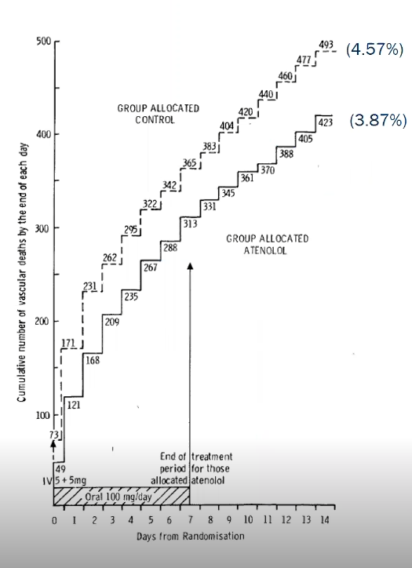
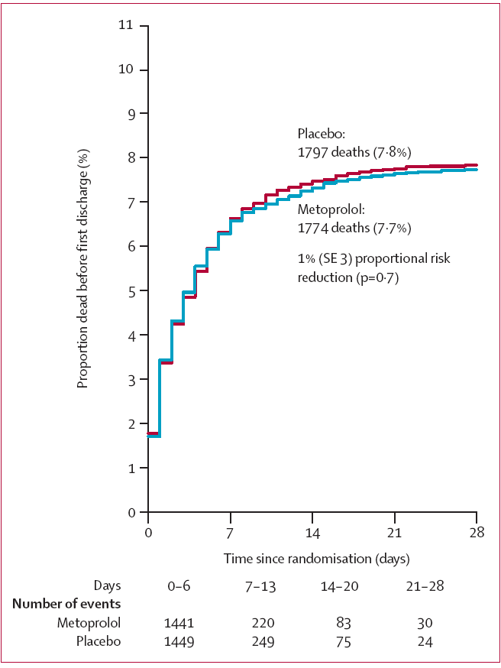
ISIS-1
COMMIT

Slide 11
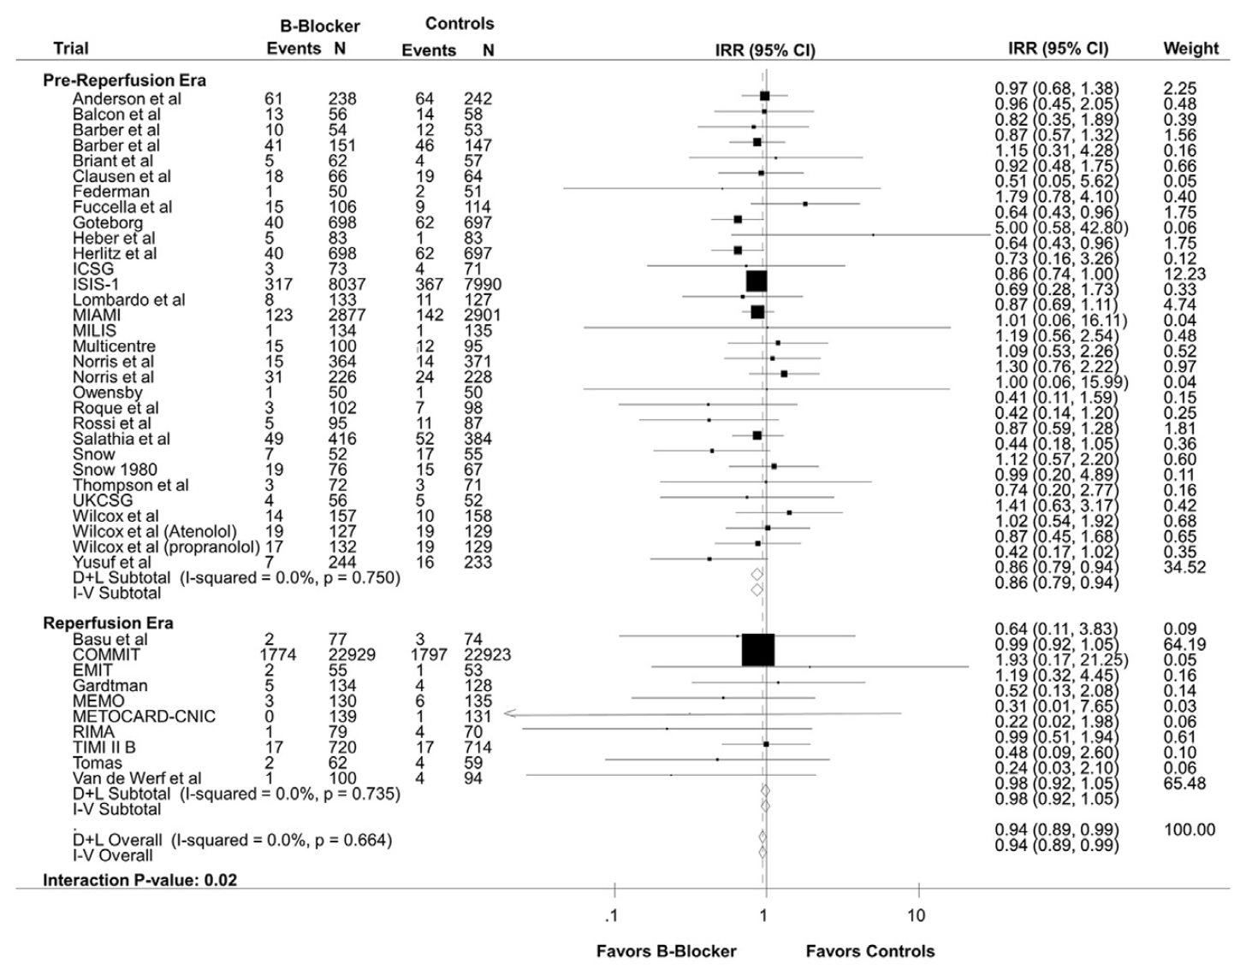

Slide 13
Transition to Modern Era
Most patients now receive early reperfusion, statins, ACEi/ARB, antiplatelets
Many have preserved EF and minimal residual ischemia
Question: Do beta-blockers still provide long-term benefit?

Slide 14
2025 ACC/AHA ACS Guidelines

Slide 15
2025 ACC/AHA ACS Guidelines
“Overall, the weight of the evidence suggests that a low dose of oral beta blocker should be initiated in patients without contraindication early after diagnosis of ACS (<24 hours) with slow dose escalation as blood pressure and heart rate permit.”
“The optimal duration of beta-blocker use remains unclear in patients with preserved LVEF. Although a randomized trial did not confirm long-term benefit from continued use of a beta blocker after hospital discharge in lower risk patients with preserved LV function who had undergone coronary revascularization, additional studies are ongoing in this space.”

Slide 16
2025 ACC/AHA ACS Guidelines
“In hemodynamically stable patients with STEMI who do not have acute HF, intravenous beta blockers can be administered prior to reperfusion if there are ongoing symptoms or a clinical indication for administration”
“The weight of the evidence does not support the routine use of intravenous beta blockers prior to PPCI because of inconsistent results as to whether it has any favorable effect on infarct size or clinical outcomes.”

Slide 17
European Guideline Summary
ESC 2023: BB use for >1 year in EF >40% is Class IIa (may be considered), Ia indefinitely in reduced EF
Need for modern RCTs evaluating BB utility in lower-risk patients

Slide 18
Background ABYSS
Early coronary reperfusion therapy has decreased HF & death after MI, questioning the benefits of beta blockers with preserved EF and no other indication for beta-blocker therapy
Large nationwide registries have often suggest an absence of long-term beta blocker benefit, though the data has been inconsistent
RCT data has been lacking to evaluate the late discontinuation in the absence of chronic heart failure or LV dysfunction

Slide 19
Hypothesis
Beta blocker interruption would be clinically safe and the patient’s quality of life would improve
Stopping beta-blockers would be considered “just as safe” as continuing them if the rate of the primary outcome (death, MI, stroke, or hospitalization) was no more than 3% higher in the group that stopped them.

Slide 20
Study Design
Design: Multicenter, randomized, open-label, non-blinded, noninferiority trial in France.
Population: Adults with history of MI, LVEF ≥ 40%, event-free for ≥6 months.
Randomization:
Interruption group: Discontinued beta-blockers.
Continuation group: Continued beta-blockers long-term.
Follow-up duration: Median 3.5 years.

Slide 21
Study Design
Total patients enrolled: 3,698 (1,852 intervention, 1,846 control)
Mean age: ~61 years; ~83% male
Beta-blockers included bisoprolol, metoprolol, carvedilol

Slide 22
Inclusion Criteria
Male or female 18 years of age
Current treatment with BB whatever the drug or the dose used.
Prior acute MI 6 months or more before randomization defined either by: an episode of STEMI and/or the presence of Q wave (Type I MI), an episode of NSTEMI with preferably at least one of the followings: documented hypokinetic or akinetic segment on echo or any other imaging technique, segmental hypoperfusion Thallium or any other imaging technique, segmental aspect of necrosis on MRI
An episode of silent MI discovered on ECG or Cardiac Imaging.

Slide 23
Exclusion Criteria
Uncontrolled arterial hypertension according to investigator decision
Prior episode of heart failure in the past two years of follow-up and/or low left ventricular ejection fraction <40% requiring the use of BB
New ACS (in the past 6 months) including UA/NSTEMI and STEMI
Persistent angina or ischemia (>10% viable myocardium) requiring the use of BB
Prior episode of ventricular or supraventricular arrhythmia in the past year of follow-up requiring the use of BB
Treatment with other investigational agents or devices (randomization) within the previous 30 days, or previous enrollment in this trial
Pregnant women or breastfeeding women
Patient under legal protection (protection of the court, or in curatorship or guardianship)

Slide 24
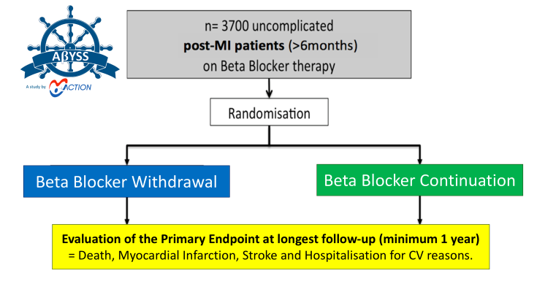

Slide 25
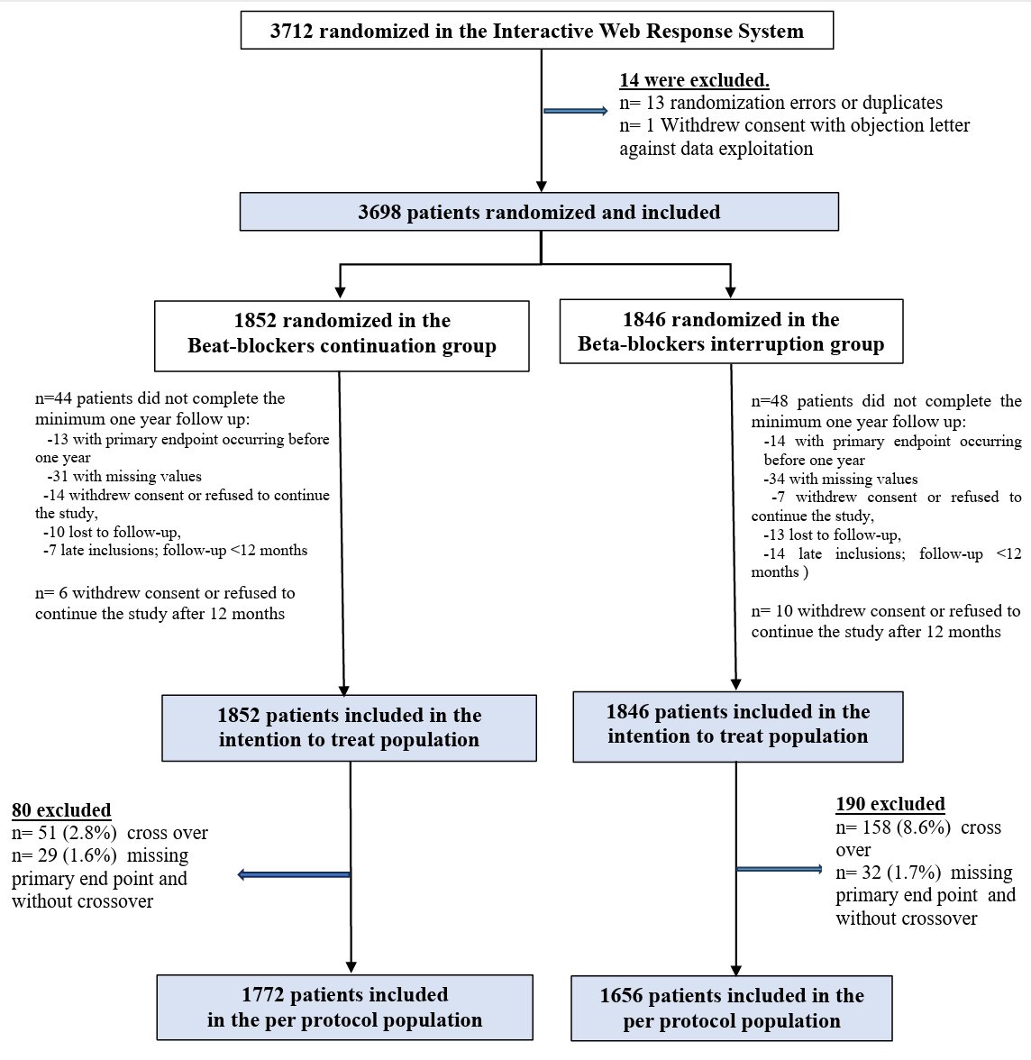

Slide 26
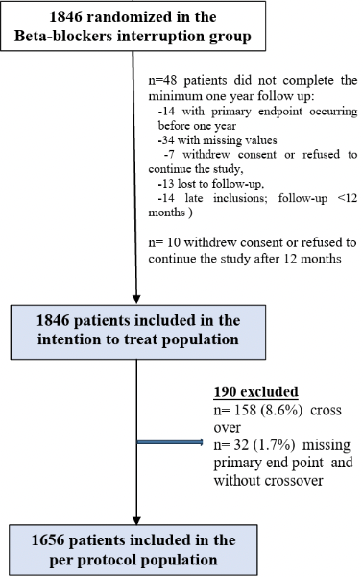

Slide 27
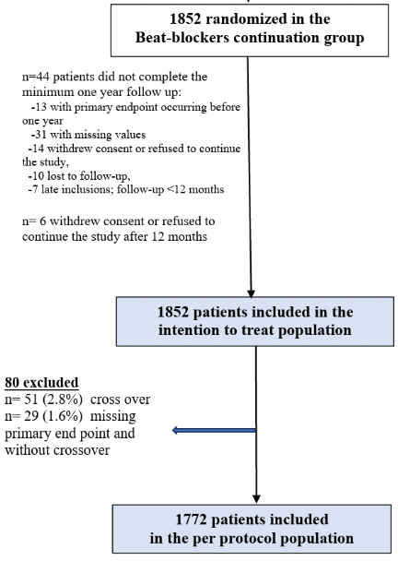

Slide 28
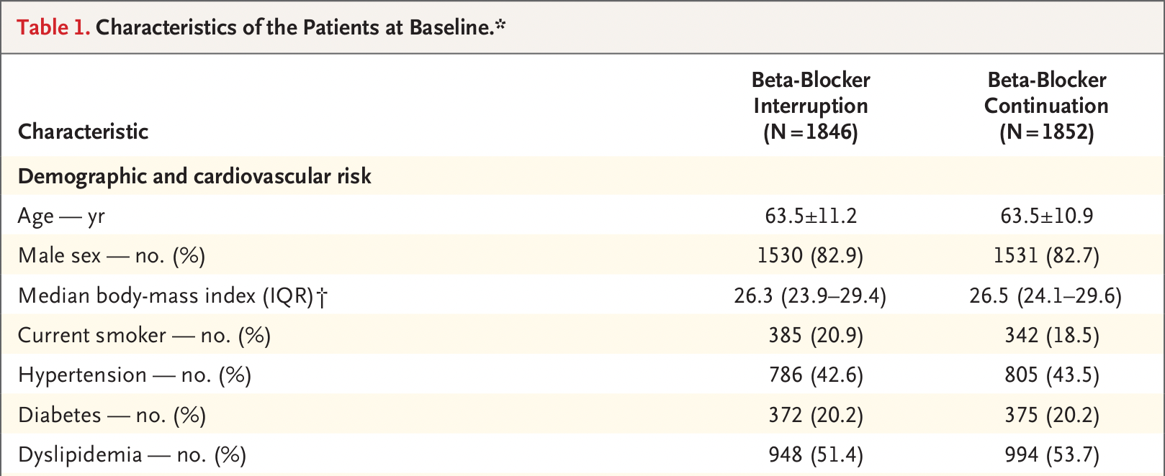

Slide 29
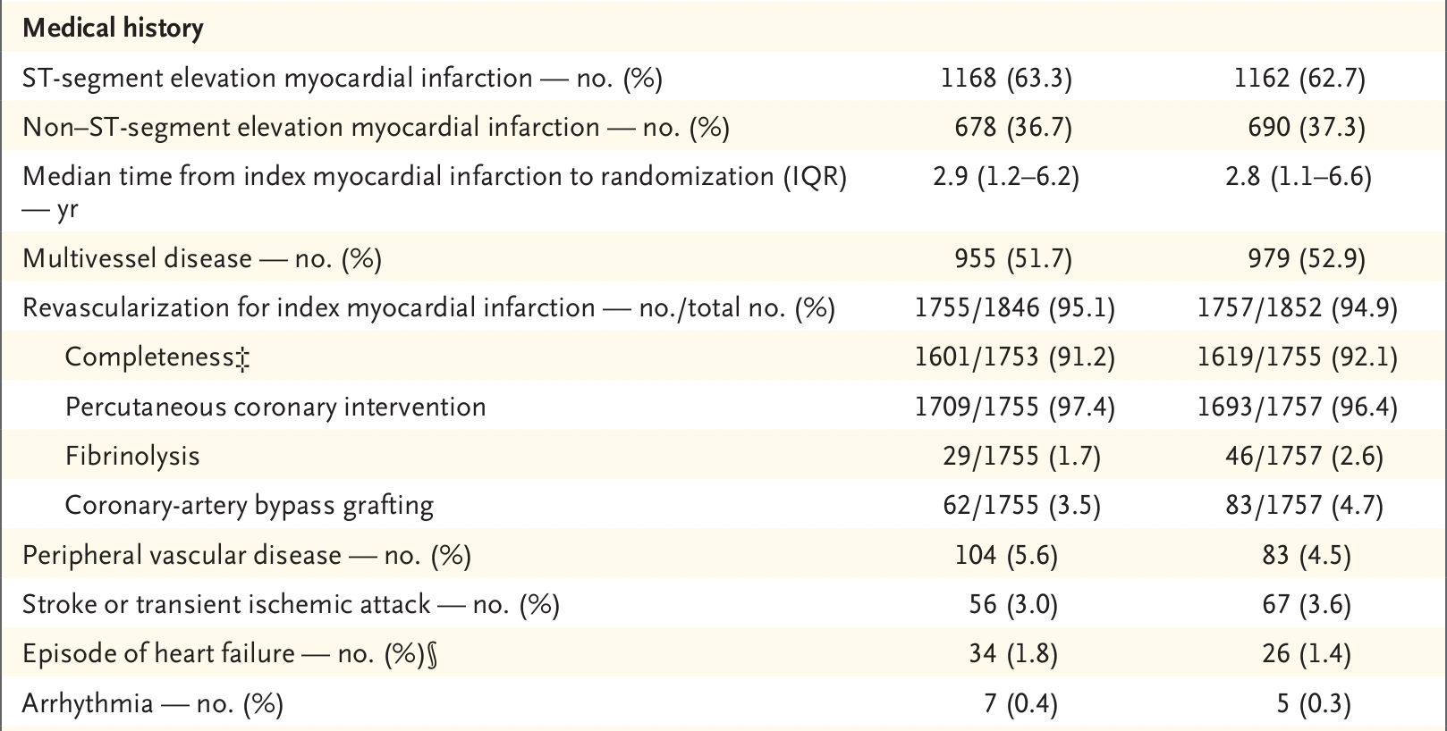

Slide 31
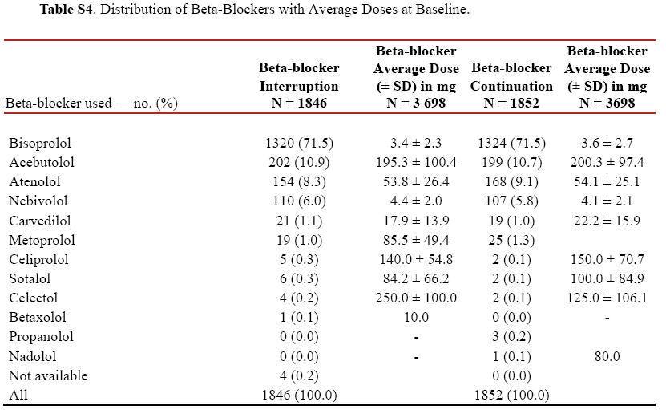

Slide 32
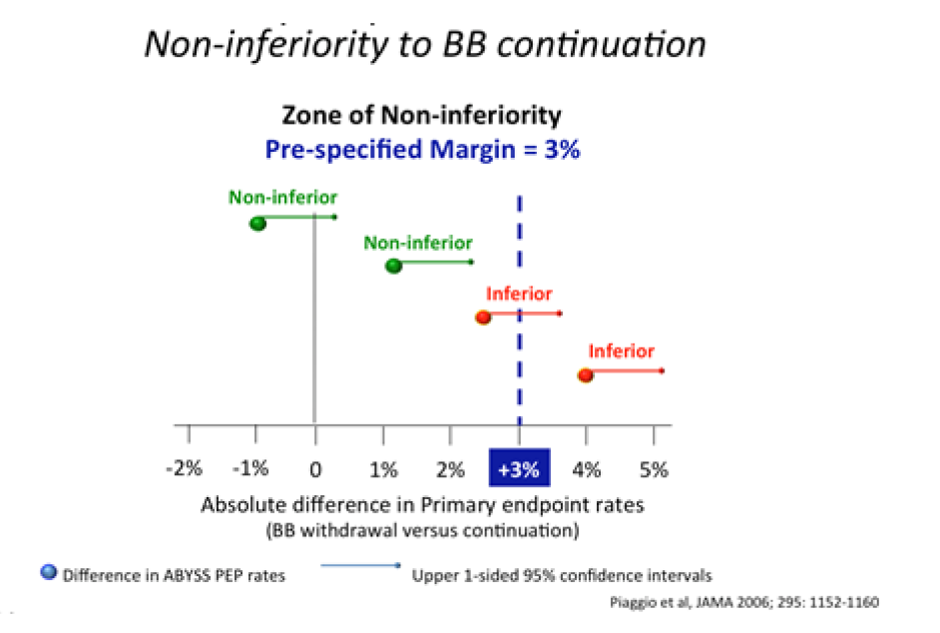
Statistical Analysis
The non-inferiority will be considered demonstrated if the upper value of the 95% two-sided confidence interval of the difference Pi–Pp is inferior to the non-inferiority margin equal to 3%.
Notes:
If the difference in event rates between the interruption group and the continuation group is:
+2.2%, with a 95% confidence interval of +0.4% to +2.9%, → This would be considered non-inferior (because the upper limit is below 3%). But if the upper limit is above 3%, then we cannot say stopping beta-blockers is just as safe.

Slide 33
Statistical Analysis
Noninferiority margin were established based on the following expected event rates:

Slide 35
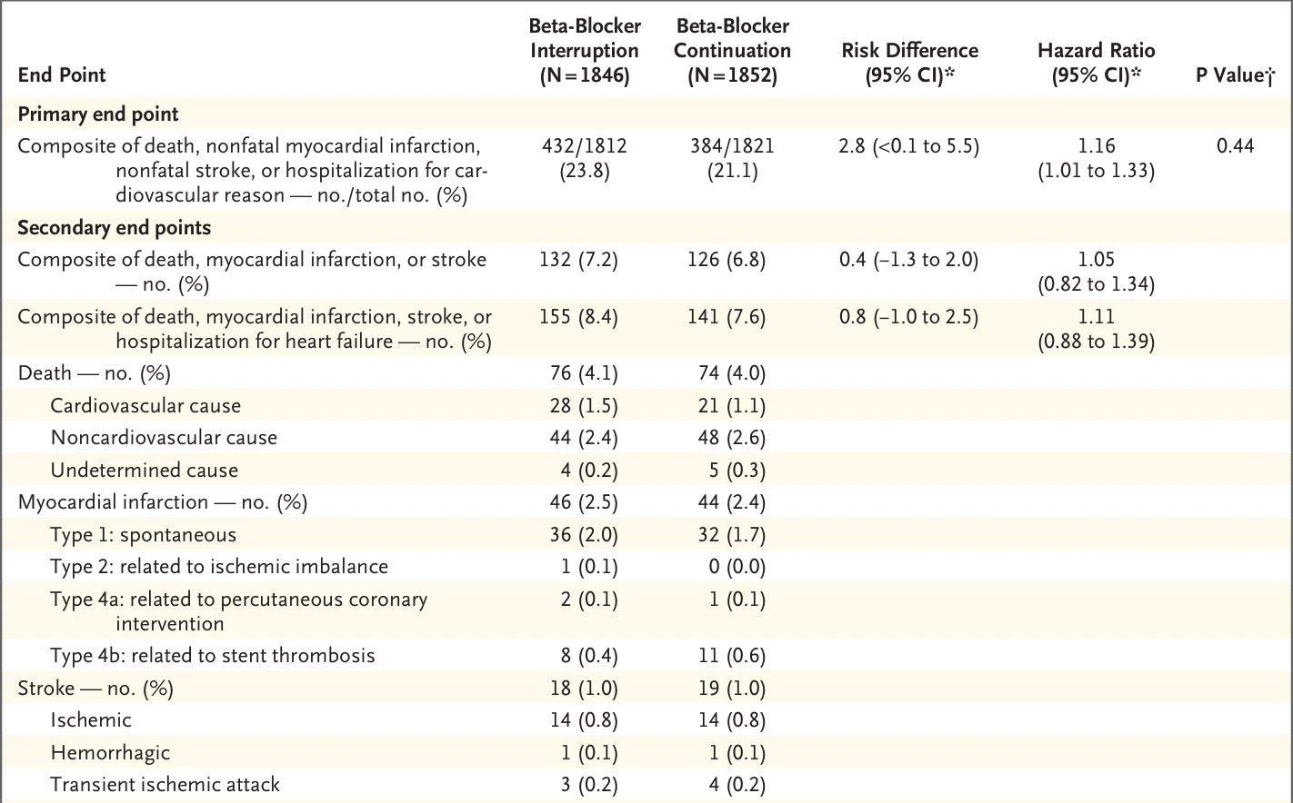

Slide 36
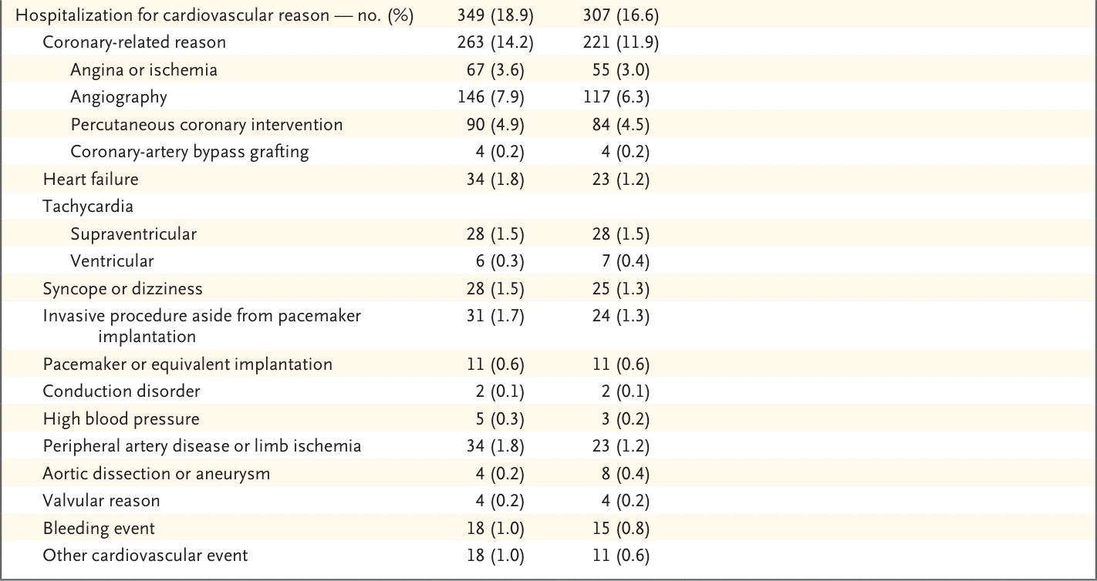

Slide 37
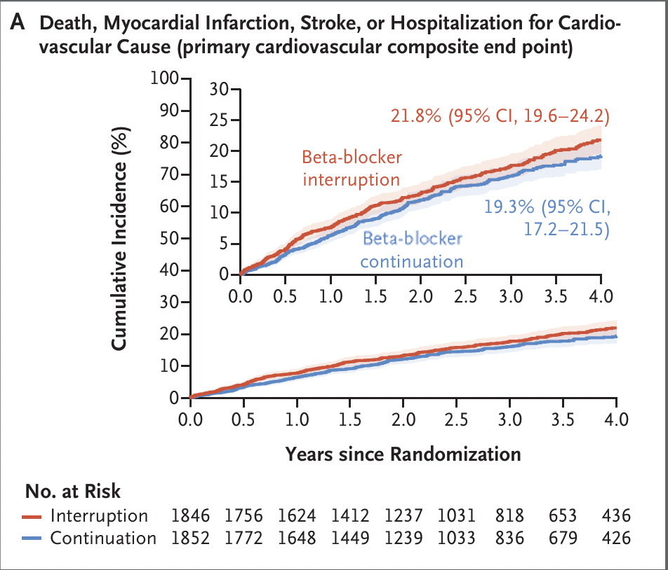

Slide 38
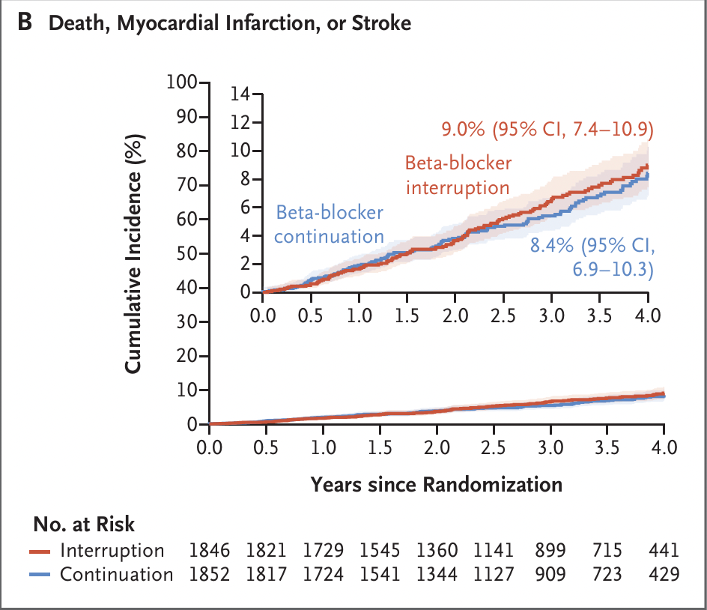

Slide 39
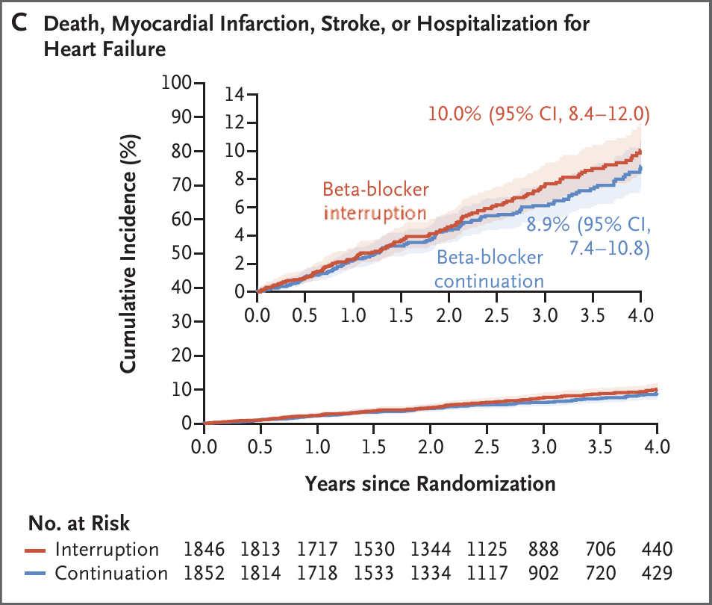

Slide 40
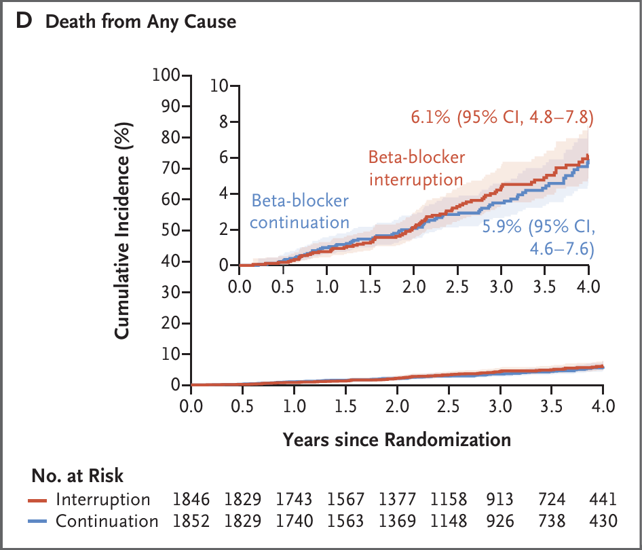

Slide 41
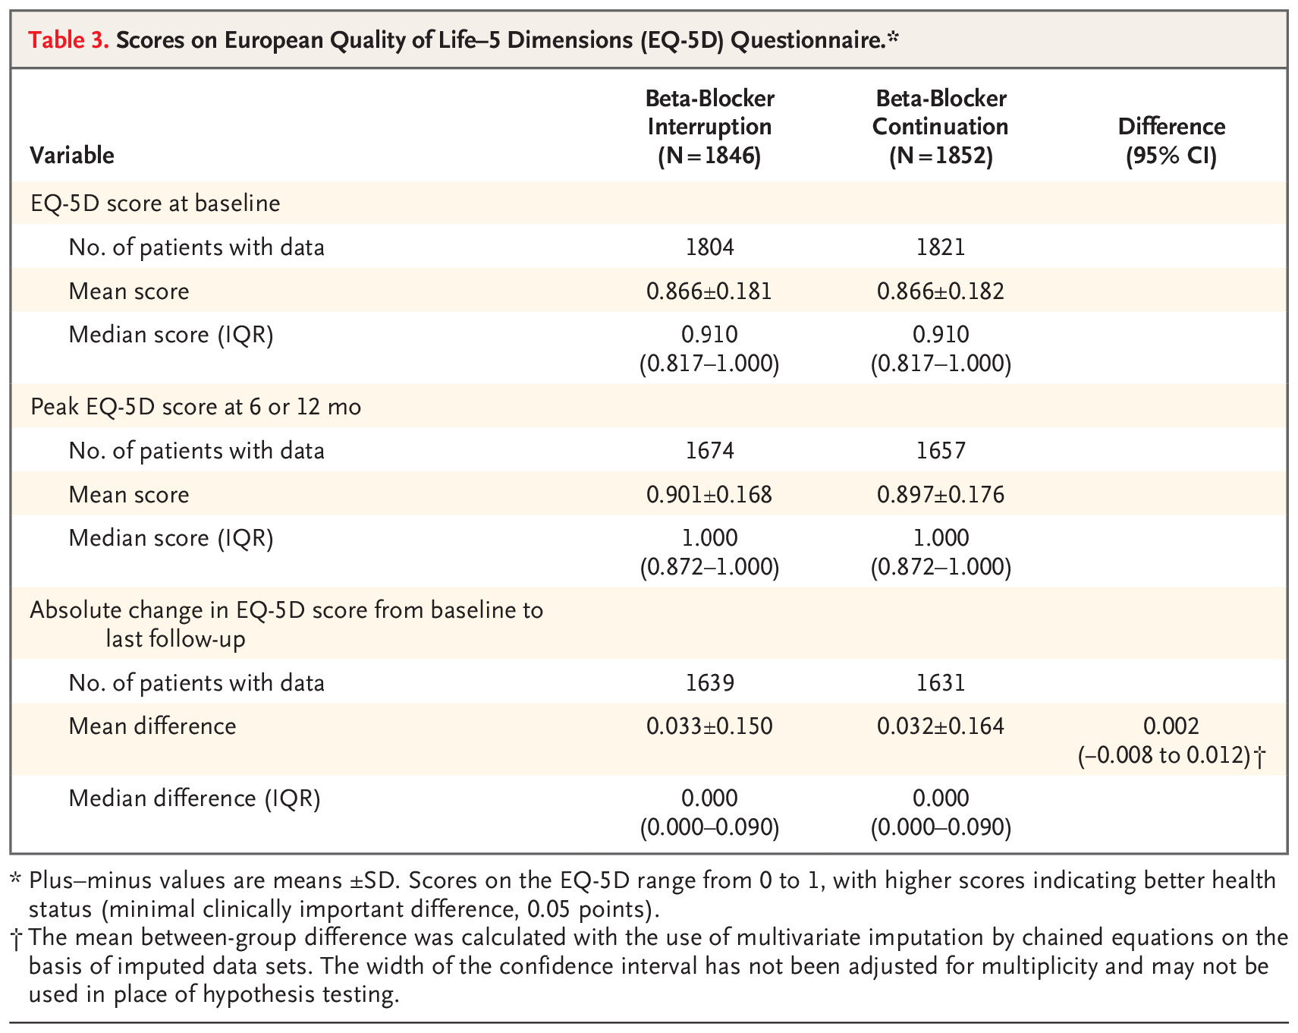

Slide 42
Discussion
Interruption of beta-blocker therapy did not result in an improvement in patient-reported quality of life.
Beta-blocker interruption was associated with a numerical increase in the risk of recurrent angina and other coronary-related conditions leading to hospitalization and coronary procedures
Results did not show the noninferiority of interruption, as compared with continuation, with respect to cardiovascular events.
There was no apparent difference between the groups regarding quality of life, despite the current belief among many physicians and patients that this class of drugs has a poor side-effect profile

Slide 43
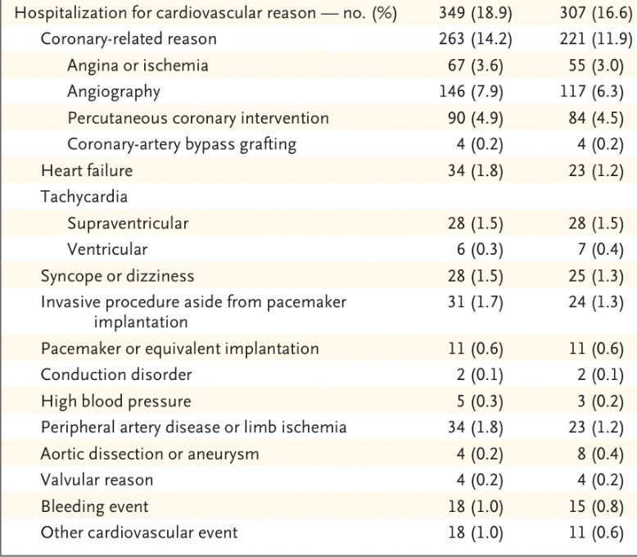

Slide 44
Limitations
Lack of blinding could have influenced several outcomes, including QoL evaluation
Anticipated under-treatment of patients with MI, but heart rates of patients seemed to suggest otherwise
Trial was conducted in a single country, limiting generalizability to other healthcare systems

Slide 45
Conclusion
Interruption of long-term beta-blocker treatment in patients with a history of myocardial infarction was not shown to be noninferior to a strategy of beta-blocker continuation with respect to a composite outcome of death, nonfatal myocardial infarction, nonfatal stroke, or hospitalization for cardiovascular reasons, nor did it seem to improve the patients’ quality of life.

